Slide 1



Business Intelligence
Deep neural networks
Teaching materials ​
for exercises
BAS4SC
Business Analytics Skills
for the Future-proof Supply Chains
Project number – 2022-1-PL01-KA220-HED-000088856

Slide 2
Agenda
What is machine learning?
Foundations and theoretical assumptions of ML
Case Study: Digit Classification with MNIST
How to solve it: Packages to Use
Procedure to Follow

Slide 3
What is machine learning?
Machine learning is a subset of artificial intelligence (AI) that involves the development of algorithms and statistical models that enable computers to perform tasks without being explicitly programmed for those tasks. The primary goal of machine learning is to enable computers to learn from data and improve their performance over time without human intervention.
ML arises from this question: could a computer go beyond "what we know how to order it to perform" and learn on its own how to perform a specified task? Could a computer surprise us? Rather than programmers crafting data-processing rules by hand, could a computer automatically learn these rules by looking at data?

Slide 4
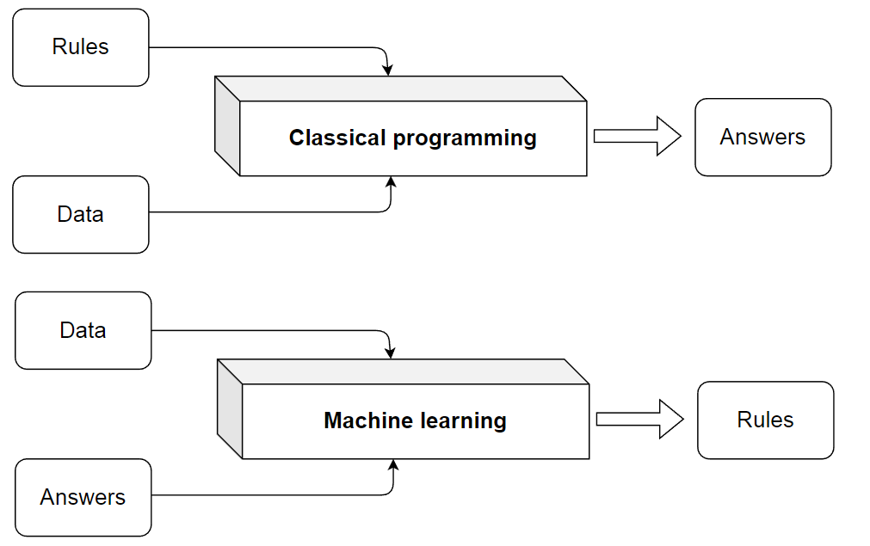
What is machine learning?
Figure. The classical programing vs. machine learning system training
Source: Chollet (2021)

Slide 5
Foundations and theoretical assumptions of ML
Machine learning's integration into business intelligence (BI) has transformed decision-making.
ML rooted in mathematics, especially statistics.
Ongoing debate: Is ML its field or part of statistics?
ML algorithms often operate beyond traditional mathematical boundaries.
ML vital in BI for data preprocessing, mining, and applying insights.
ML enhances decision-making in organizations.
Integration of ML into BI workflows for actionable insights.
Bridging mathematics and practice in ML for effective BI.
Strategies for optimizing ML algorithms for real-world BI applications.
Importance of using ML outputs in decision-making.

Slide 6
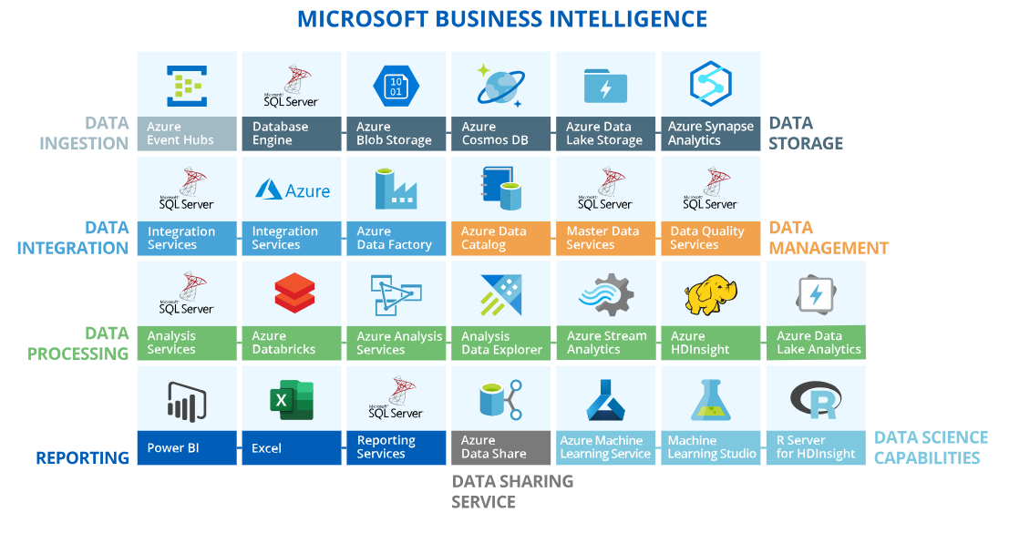
Business intelligence and ML in SCs
Figure. Microsoft business intelligence architecture.
Source: Authors, addpted from https://www.scnsoft.com/services/business-intelligence/microsoft

Slide 7
Business intelligence and ML in SCs
Business intelligence (BI) in SCs involves drawing conclusions about observed processes based on data modeling.
Incorporation of Mathematics: BI relies heavily on statistics but also utilizes operations research, linear algebra, fuzzy logic, numerical optimization, metaheuristics, etc.
Emerging Technologies: New disruptive technologies such as machine learning, artificial intelligence, digital twins, smartization, living labs, etc., are gaining importance in data analysis and conclusions delivery.
Lack of Strict Procedures: BI and ML workflows lack strict organization but rely on successful guidelines from practice and literature.
Diverse Procedures: BI procedures vary based on the software used. For instance, Microsoft's Business Intelligence package offers tools for data ingestion, storage, integration, management, processing, reporting, sharing, and data science.
Tools Offered: Microsoft's BI package provides tools for different tasks, including data ingestion, storage, integration, management, processing, reporting, sharing, and data science.

Slide 8
Case Study: Digit Classification with MNIST
In this case study, we focus on the problem of digit classification using the MNIST dataset, a commonly used benchmark in machine learning, particularly in fields like logistics where automatic postal code recognition is crucial for efficient deliveries.
What is MNIST?
The MNIST (Modified National Institute of Standards and Technology) dataset consists of 70,000 images of handwritten digits, each labeled with its corresponding digit (0-9). The dataset is split into 60,000 training images and 10,000 test images. Each image is 28x28 pixels, representing a small, grayscale, and centered handwritten digit. The goal is to train a model that can recognize these digits and correctly classify them.

Slide 9
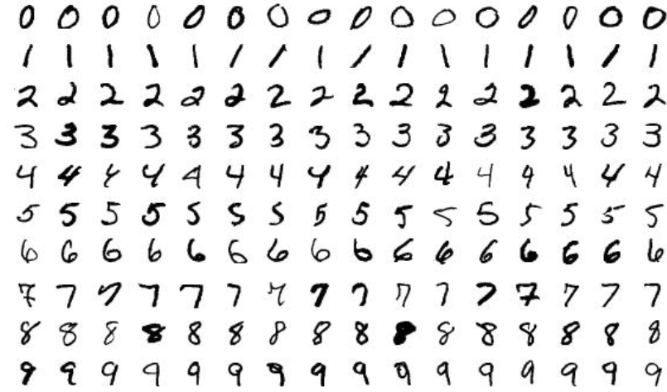
Case Study: Digit Classification with MNIST

Slide 10
How to solve it: Packages to Use
To solve this problem, we will use the following key packages in R:
• keras: A high-level neural networks API that runs on top of TensorFlow. It provides simple and easy-to-use methods for building deep learning models.
• tensorflow: The underlying backend for Keras, providing powerful tools for model training and computation.
• reticulate: A package that allows for easy integration between R and Python, necessary for utilizing TensorFlow efficiently.
These packages allow us to efficiently implement deep learning models such as feedforward neural networks (DNNs) and convolutional neural networks (CNNs) for digit classification.

Slide 11
Procedure to Follow
To solve the MNIST classification problem, the general procedure is as follows:
Load and Preprocess the Data:
  Load the MNIST dataset using the dataset_mnist() function from Keras.
  Reshape the images into vectors (784-dimensional) since the model expects a flat input.
  Normalize the pixel values to a range between 0 and 1 for better performance.
  One-hot encode the labels to match the network's output format.
Define the Model:
  Build a deep neural network using Keras' keras_model_sequential() function.
  Add dense layers with ReLU activation for hidden layers and a softmax activation for the output layer, which is suitable for multi-class classification.

Slide 12
Procedure to Follow
Compile the Model:
  Use the categorical_crossentropy loss function, which is standard for multi-class classification problems.
  Choose an optimizer (e.g., RMSprop) to update model weights during training.
Train the Model:
  Train the model using the training dataset, typically using 80% of the data for training and 20% for validation.
  Track performance metrics such as accuracy to evaluate how well the model is learning.

Slide 13
Procedure to Follow
Evaluate the Model:
  After training, evaluate the model's performance on the test set to determine how well it generalizes to new, unseen data.
Visualize and Interpret Results:
  Visualize the training and validation loss and accuracy over epochs.
  Use the trained model to make predictions on new images and analyze the results.

Slide 14
Summary
The MNIST problem, offers valuable insights into training deep learning models for image classification.
The process involves key tasks such as data preprocessing, model building, training, evaluation, and interpretation, which are crucial skills for anyone working with machine learning in logistics or other real-world applications.

Slide 15
Authors:
Dario Šebalj
Dejan Mirčetić
Michał Adamczak
Final version: June 2025

Slide 16
Thank you for your attention

