Slide 1



Business Intelligence
Tableau Desktop
Calculations and maps
Teaching materials for exercises
BAS4SC
Business Analytics Skills
for the Future-proof Supply Chains
Project number – 2022-1-PL01-KA220-HED-000088856

Slide 2
Agenda
Creating and Editing Calculated Fields
String Functions
Table Calculations
Date Calculations
Maps

Slide 3
Totals and Aggregation
When using a text table, Tableau provides the ability to add row grand totals, subtotals, and column grand totals.
Totals can be added to the view using the Analysis menu on the navigation bar and the Analysis pane.
Totals, by default, use disaggregated data from the underlying data source. If you are using an aggregation besides SUM, this can cause confusion.
In order for totals to work, there must be:
At least one header
Aggregated measure

Slide 4
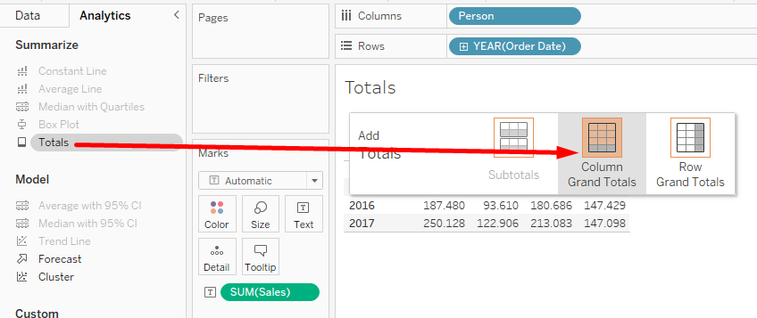
Totals and Aggregation
On the left side, in the Analytics tab, select Totals and drag to the visualization, to the Column Grand Totals field to get the sum of the values ​​in the columns.
Source: Authors

Slide 5
Calculated Fields
Calculated fields allow you to create new data from data that already exist.
Calculated fields are great to use when the underlying data does not contain all the values needed for analysis.
When creating a calculated field, you are essentially creating a new data column from a field you control on the data pane.
Calculated fields can be created in two ways. The first is by double-clicking in an existing field on the Rows, Columns, Marks, or Measure Values shelf to open it as an ad-hoc calculation
The second method is using the calculation field editor. This editor is accessed using the Analysis menu or by using the right click method on the Data pane.

Slide 6
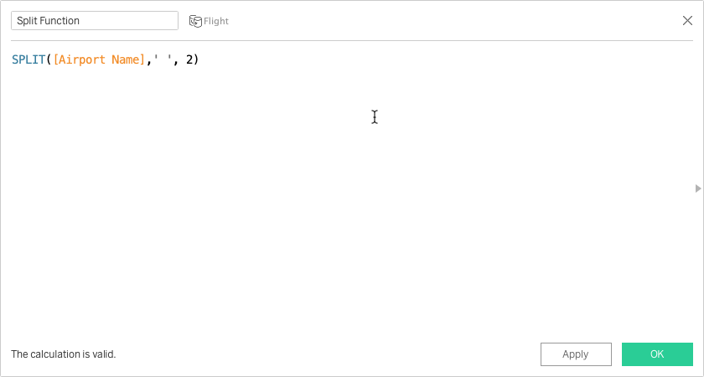
String Functions
One feature of calculated fields is the ability to manipulate string data using specific functions.
Tableau uses a set of built-in functions that are detailed on the Tableau website.
String functions are built using the same method of creating a calculated field from the Analysis menu or Data pane.
Source: Authors

Slide 7
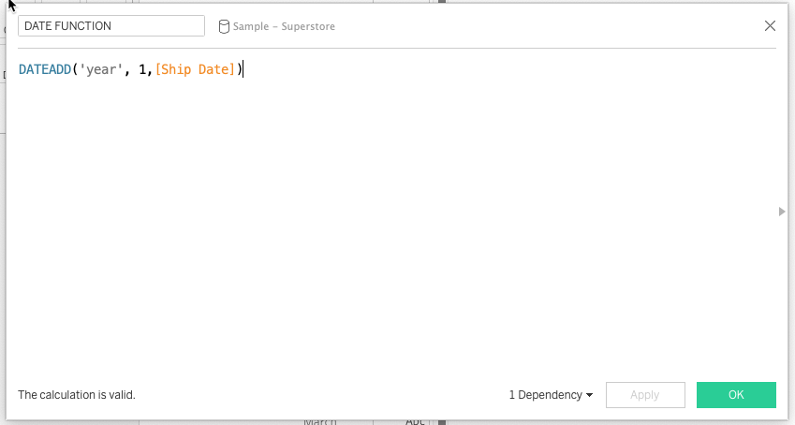
Date Calculations
Dates are common in many data sources.
Tableau automatically recognizes dates and applies a specific set of functionality.
Using the calculated field method, Tableau provides the ability to manipulate the dates in the data source.
Popular date functions include:
DATEADD
DATEDIFF
DATETRUNC
DATEPART
Source: Authors

Slide 8
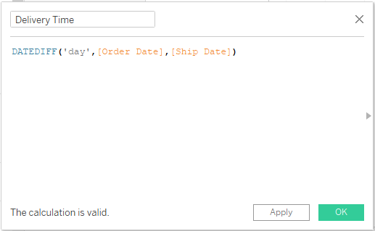
Date Calculations - example
Tableau contains a function that can calculate the time between two dates (eg between the delivery date and the order date).
DATEDIFF('day',[Order Date],[Ship Date])
The 1st parameter is the "date part" which indicates at which date level the difference is calculated (day, month, year...)
The 2nd parameter is "start date" which represents the starting date
The 3rd parameter is "end date", which represents the final date
Source: Authors

Slide 9
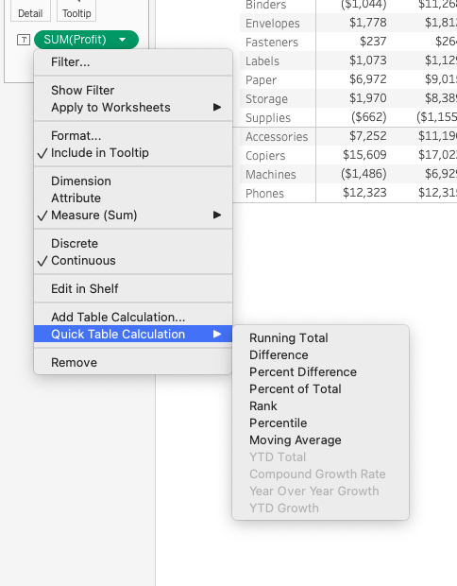
Quick Table Calculations
Quick table calculations allow you to quickly apply calculations to your view using common calculation types.
Quick table calculations can be applied using the right-click method on a measure that has been added to the view.
Common quick table calculations include:
Running total
Difference
Percent difference
Rank
Source: Authors

Slide 10
Why Tableau Maps?
There are times that you have a spatial question that needs to be answered. Using a map, you can help answer this question by looking at trends or patterns in your data.
As you are working with maps, it is important to point out that they should only be used to answer spatial questions.
While maps have their place, there are often other charts that answer the question easier.
As you think about these questions, it is important to to point out what a spatial question is. Examples include:
Where do storms move over time?
Which region has the most farmers markets?

Slide 11
Proportional symbol maps
Symbol maps are dot density maps where the sizes of the dots vary according to a measure.
This map type can show one or two quantitative values per location.
Data should include large variations in the data to properly show proportions.
Issues can occur where there is a large cluster of data; measures can overlap with each other.

Slide 12
Choropleth maps
From the Greek words for “area/region” and “multitude.”
A thematic map in which areas are shaded or patterned in proportion to the measure being displayed.
Choropleth maps are best for showing ratio or aggregated data for polygons.
These polygons can be counties, regions, states, or any area or region that can be geocoded in Tableau.

Slide 13
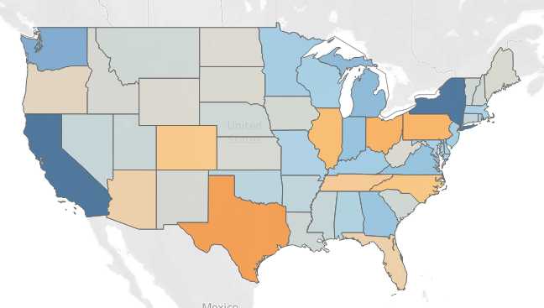
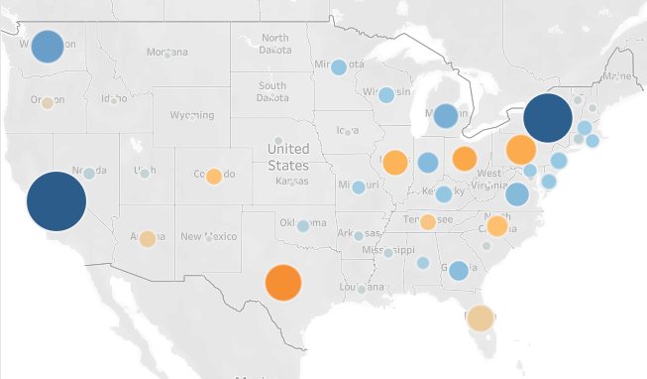
Choropleth vs. Proportional maps
Source: Authors

Slide 14
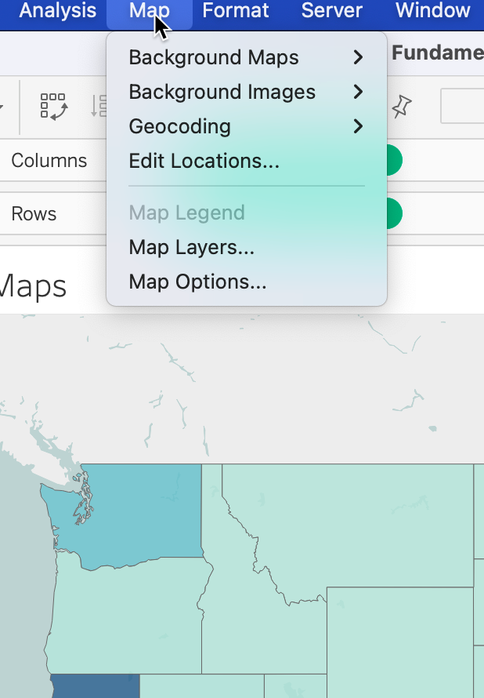
Map options
Specific formatting options are available when working with maps. These options are available using the Map option on the navigation menu.
This menu provides the option to control:
Background theme
Background images
Map layers
Map options
Source: Authors

Slide 15
Authors:
Dario Šebalj
Dejan Mirčetić
Michał Adamczak
Final version: June 2025

Slide 16
Thank you for your attention

