Slide 1



Business Intelligence
Tableau Desktop
Tableau Terminology
Teaching materials for exercises
BAS4SC
Business Analytics Skills
for the Future-proof Supply Chains
Project number – 2022-1-PL01-KA220-HED-000088856

Slide 2
Agenda
The Tableau Platform
Application Terminology
Elements of a Visualization
Workbook Types
Setting Up and Managing Your Data

Slide 3
Exploring the Tableau Platform
Tableau Desktop starts with connecting to a data source.
Tableau Desktop provides many data options to connect to through the Connect Pane.
Search for Data - Connection to an external Tableau Server
To a File - Connection to local files including PDF, CSV, TXT and Microsoft Excel
To a Server - Connection to popular database servers including Redshift, Oracle,DB2, SQL Server
Saved Data Sources - Connection to packaged Tableau data sources

Slide 4
Tableau File Types
Several different file types are used within Tableau
Workbooks (.twb) - Hold one or more worksheets or dashboards. These do not include the data.
Bookmarks (.tbm) - Contain a single worksheet and are easy to share your work.
Packaged Workbooks (.twbx) - Contain the workbook along with any other supporting data or images.
Extract (.hyper or .tde) - Local copy of a subset or entire data that you can use to share with others.
Data Source (.tds) - Shortcut for quickly connecting to the data. These files do not contain the actual data but rather the information to connect.
Packaged Data Source (.tdsx) - Contains the data source file as well as any local file data.

Slide 5
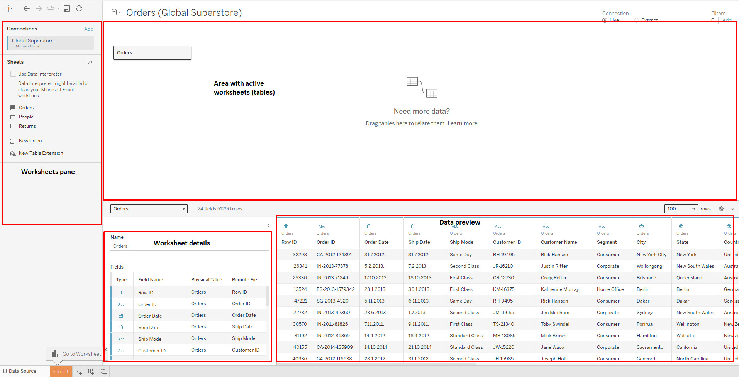
Exploring the Tableau Platform
Source: Authors

Slide 6
Tableau Terminology
Cards and Shelves - Area surrounding the view. Data is placed here to created the structure of your visualization.
Shelve examples in Tableau include:
Rows
Columns
Filters
Card Examples in Tableau include:
Marks
Legends
Pages
Tooltip

Slide 7
Tableau Terminology
Toolbar and Navigation menu - This area is used to access command and analysis.
View - The canvas where the visualization is displayed. This area is surrounded by the cards and shelves.
Marks - The data displayed on the view. These can be displayed in many different visualization types.
Sidebar - Location of the data pane and analytics pane.

Slide 8
Tableau Terminology
Data pane - Display of data source connections and available data fields.
Analytics pane - Quick access to analytics available for your view.
Data Source - Provides access to data source fields to be used in the workbook.
Status Bar - Located at the bottom of the Tableau workspace. Displays descriptions of menu items as well as information about the current view.

Slide 9
Elements of a Visualization
Dimensions, Measures, and Marks are combined to create different charts to visualize data.
Dimensions are qualitative values such as names and dates.
Measures are numeric, quantitative values you can measure.
Marks are the data points displayed on the view using:
Color
Size
Shape
Tooltip

Slide 10
Connecting to a Datasource
Tableau Desktop starts with connecting to a data source.
Tableau Desktop provides many data options to connect to through the Connect Pane.
Search for Data - Connection to an external Tableau Server
To a File - Connection to local files including PDF, CSV, TXT and Microsoft Excel
To a Server - Connection to popular database servers including Redshift, Oracle,DB2, SQL Server
Saved Data Sources - Connection to packaged Tableau data sources

Slide 11
Data Types
Tableau supports 7 different data types. These data types can be changed on using the Data Grid and/or Data Pane. Data types have to be part of the original data source to be changed.
Supported types include:
Text
Date values
Numerical values
Boolean values
Geographic roles
Cluster group

Slide 12
Data Connections
Tableau supports two different data connections Live and Extract.
Live connections connect Tableau directly to the data source. Any changes in the data source will be directly reflected in the Tableau view. Your connection relies on the speed of your database.
Live connections are great when you need just-in-time (near real-time) data and/or you want to leverage your database performance/investments.

Slide 13
Data Connections
Extracts create saved subsets of data that can be used to improve performance and allow you to take advantage of specific Tableau functionality.
Advantages of extracts include:
Supporting large data sets
Improved performance
Additional functionality
Offline access to data
Can be refreshed on a scheduled/periodic basis
Incremental Refresh to limit the amount of data refreshed

Slide 14
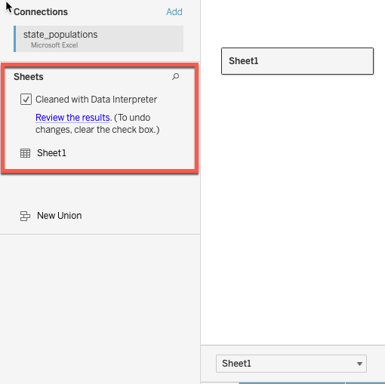
Cleaning your data
Data Interpreter can detect items used for visual appeal and exclude them from your data set. This includes titles, notes, footers, and empty cells.
Data Interpreter can be enabled by checking the data interpreter check box on the connect pane.
Changes will appear on the data grid.
Source: Authors

Slide 15
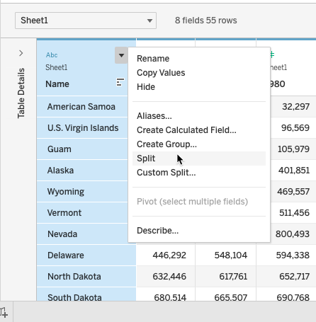
Formatting your data
Split allows you to take fields with multiple pieces of information and split them into separate values.
By default, Tableau will split based on a common separator (comma, space between).
You can control the type of separator using the custom split option.
Source: Authors

Slide 16
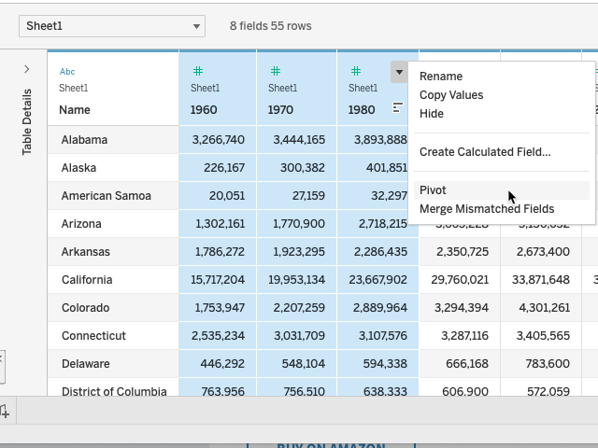
Formatting your data
Pivot - Allows you to swap your data from a column format to a rows format and vice versa.
In general, Tableau prefers that your data be taller than wide.
Data can be pivoted using the column drop down menu on the data grid.
Source: Authors

Slide 17
Authors:
Dario Šebalj
Dejan Mirčetić
Michał Adamczak
Final version: June 2025

Slide 18
Thank you for your attention

