Slide 1

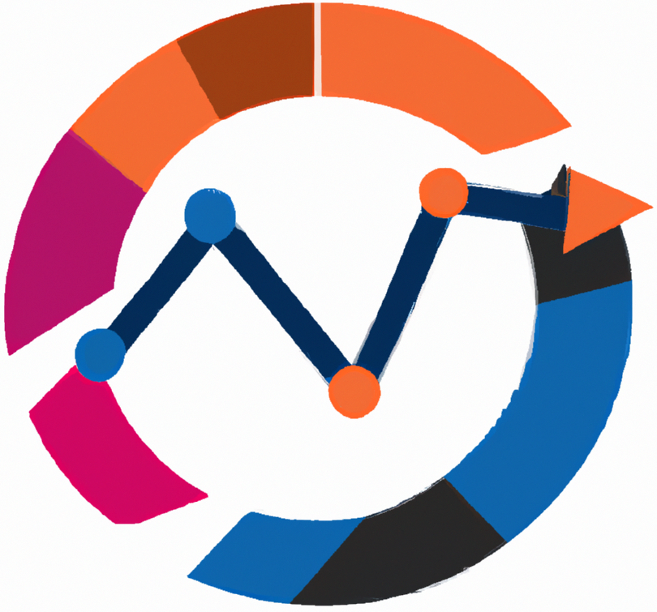

Business Intelligence
Tableau Desktop
Foundations of Chart Visualization
Teaching materials for exercises
BAS4SC
Business Analytics Skills
for the Future-proof Supply Chains
Project number – 2022-1-PL01-KA220-HED-000088856

Slide 2
Agenda
Dimension and Measures
Discrete and Continuous Fields
Editing Data Properties
Axis and Labels
Measure Values and Measure Names
Building Common Charts

Slide 3
Elements of a Visualization
Dimensions, Measures, and Marks are combined to create different charts to visualize data.
Dimensions are qualitative values such as names and dates.
Measures are numeric, quantitative values you can measure.
Marks are the data points displayed on the view using:
Color
Size
Shape
Tooltip

Slide 4
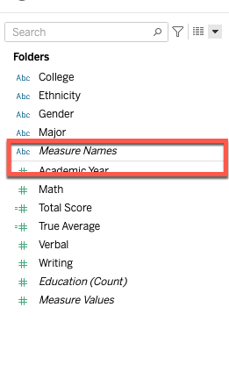
Dimension and Measures
Data fields are created from columns in the data source. Fields dragged to a column or row shelf are represented as marks on the view.
Data fields can be categorized into two types: Dimensions and Measures.
Dimensions are fields used to categorize, segment, and reveal details in your data.
Measures are fields that can be aggregated.
Tableau separates these fields in the data pane using a single horizontal line.
Source: authors

Slide 5
Dimension and Measures
Dimension and Measures can be represented in two different ways: Continuous and Discrete.
Continuous fields represent a continuous path without an interruption. They create X-axis when placed on Columns and Y-axis when placed on Rows Shelf
Discrete fields are individually separate and distinct. They create headers for rows and columns when placed on Rows or Columns Shelf.
Important note: Continuous fields are represented as green and discrete fields are blue.

Slide 6
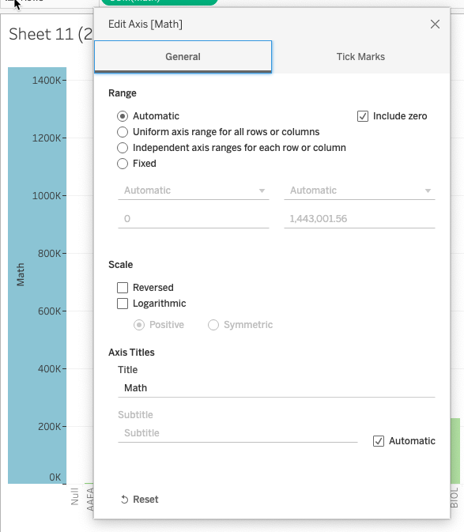
Chart Axis
If your chart includes a continuous field in the rows or columns shelf, an axis is added to the view. The axis will display data points within a range of values.
The axis can appear horizontal or vertical depending on the location of your measure.
Horizontal axis - Measure on the rows shelf
Vertical axis - Measure on the columns shelf
Double clicking the axis provides options to edit the configuration of the axis.
Right click on the axis to adjust the view and format.
Source: authors

Slide 7
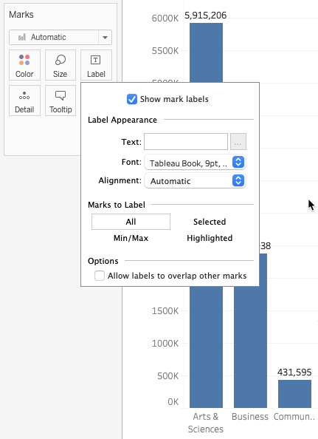
Chart Labels
As you create visualization, labels can be added to the marks on the chart.
You can add labels by clicking on the marks label and checking on the “Show mark labels” checkbox on the labels dialog box.
Using this dialog box, you can change the format of the labels.
Alternatively, you can create labels by dragging a dimension or measure to the labels mark card.
Individual labels can be added to a mark by right clicking the mark on the view.
Source: authors

Slide 8
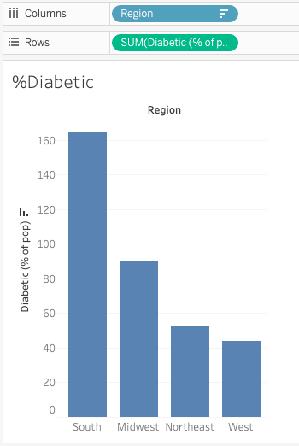
Bar Charts
Bar charts compare data across categories.
A vertical bar chart is created by placing a dimension on the Column shelf and a measure on the Rows shelf.
A horizontal bar chart is created by placing a dimension on the Rows shelf and a measure on the Columns shelf.
Use additional measures or dimensions to further explain your data by adding color (stacked bar) or size to your marks.
Source: authors

Slide 9
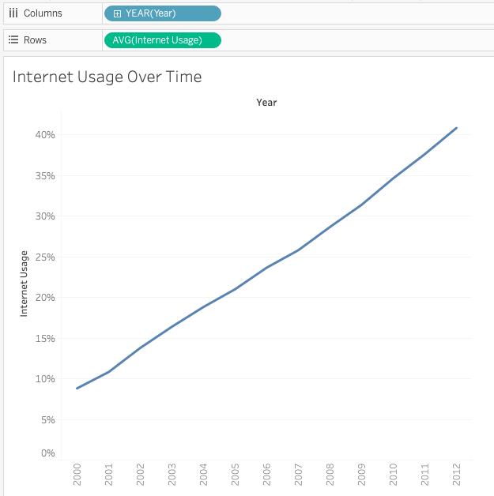
Line Charts
Line charts connect individual data points in a view.
They provide a simple way to visualize a sequence of values and are useful when you want to see trends over time or to forecast future values.
While not required, line charts are commonly used when a date dimension is involved.
Fields added to the columns shelf will be the X-axis and Fields added the rows shelf will be the Y-axis.
Source: authors

Slide 10
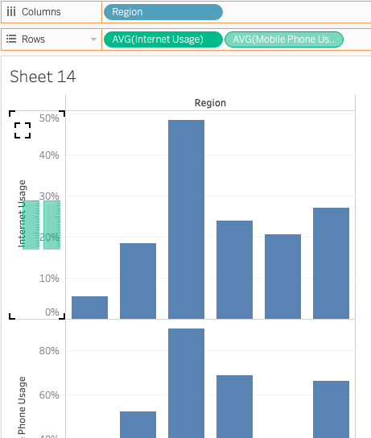
Combined Axis
Combined Axis (Blended Axis) share an axis so that all marks are shown in a single pane.
Blending axes is most appropriate when comparing measures that have a similar scale and units.
Dragging one measure to another measure’s axis will create a combined axis. You will see this indicated by two green bars above the measure Y-axis.
Measures can be dragged to an axis from the data pane or the shelf card.
Source: authors

Slide 11
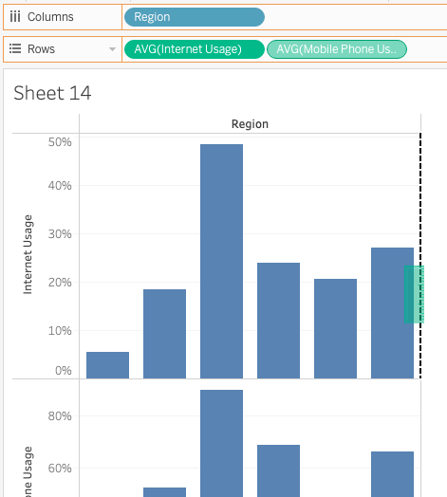
Dual Axis
Dual Axis compare multiple measures using dual axes which are two independent axes that are layered on top of each other.
Dual axes are useful for analyzing two measures with different scales.
Dragging a measure to the right or top of a view will create a dual axis. This is indicated by a black dotted line and one single green bar.
Dual axis can display two different marks types on the same view.
Source: authors

Slide 12
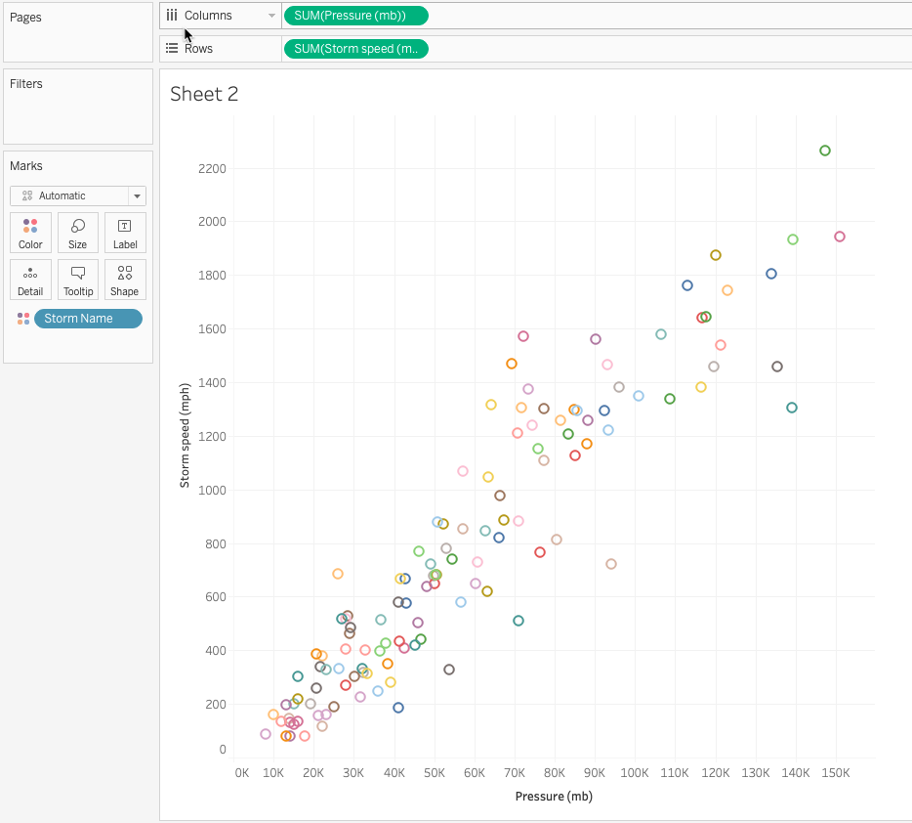
Scatter Plots
Scatter plots are used to visualize relationships between numerical variables and show patterns across data sets.
Create a scatter plot by placing at least one measure on the Columns shelf and at least one measure on the Rows shelf.
Dragging a secondary category (dimension) to the Colors, Size, Label, Detail, or Shape mark will create a multi-mark plot.
Source: authors

Slide 13
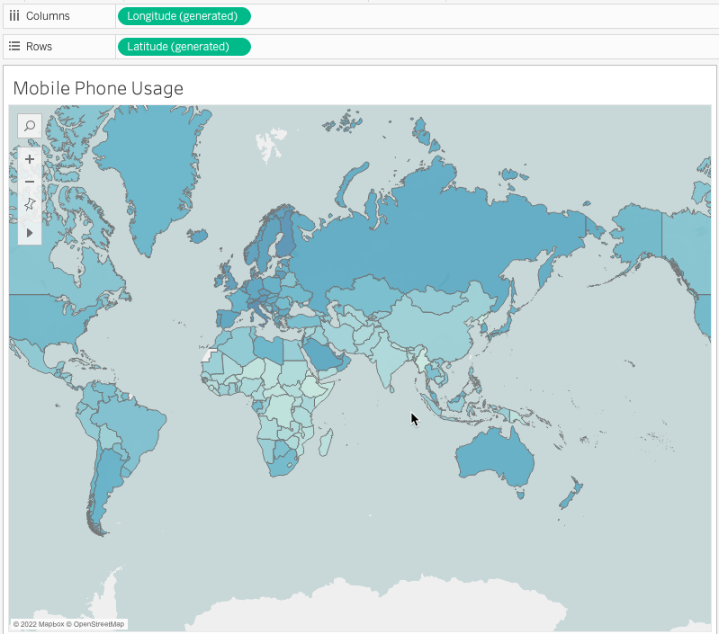
Maps
Maps allow you to develop a geographical analysis on your data.
Maps require location data to work correctly.
Common map data types include:
Longitude and Latitude
City, State, and Country
Airport
Areacode (US)
Adding additional dimensions and measures to the marks card will further explain the level of detail.
Source: authors

Slide 14
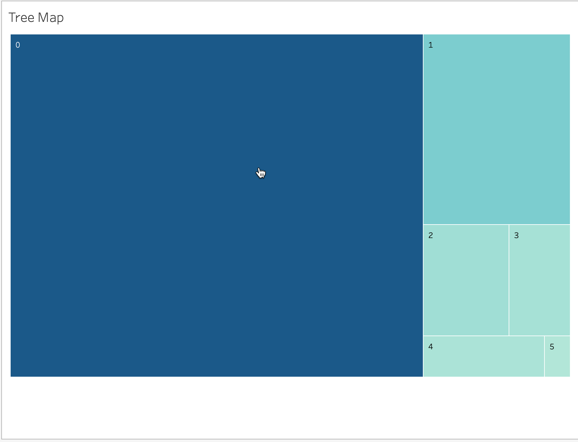
Parts of a Whole
Pie charts and tree maps are great options when you want to show a percentage of a whole.
Pie charts should be used when you want to show relationships between fields as they relate to the whole. They should be used when the amount of dimensions is limited (less than 5).
Tree maps, similar to pie charts, are a great way to show relationships between fields that have over 5 dimensions.
Source: authors

Slide 15
Authors:
Dario Šebalj
Dejan Mirčetić
Michał Adamczak
Final version: June 2025

Slide 16
Thank you for your attention

