Slide 1

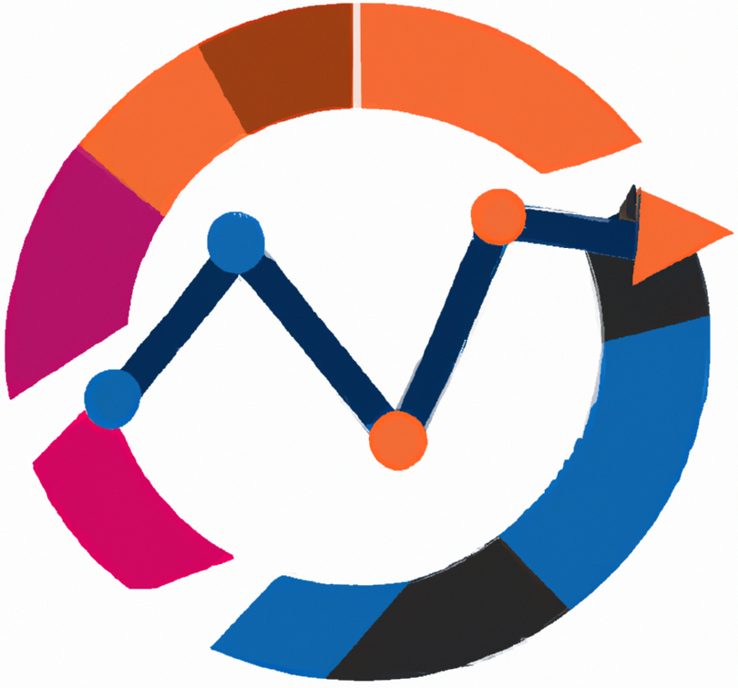
AI Tools
Usage of AI Tools in Statistical Methods for Analysisng Logistics Data
Lectures
BAS4SC
Business Analytics Skills
for the Future-proof Supply Chains
Project number – 2022-1-PL01-KA220-HED-000088856

Slide 2
Agenda
AI Tools on general
ChatGPT
DataRobot
Tableau with TabPy
H2O.ai

Slide 3
AI Tools on general
In the early beginnings (1950s to 1980s), the AI foundation started with algorithms designed to perform logical reasoning and problem-solving. However, due to the limited computing power of technology at the time, these initial AIs lacked real-world applications.
The initial AI was improved through integrating machine learning (the 1990s to 2000s), which allowed computers to learn from existing data, marking a shift from more rule-based AI to more data-driven approaches. Through this approach, many prominent algorithms were developed, including decision trees, support vector machines and early neural networks.
Following the machine learning algorithms, deep learning and automatic machine learning advances have made AI more accessible (2010s to present). By improving the automatization, current AI can automate model selection and training, which, in turn, allows for democratizing AI use.

Slide 4
AI Tools on general
AI tools are being integrated into business and logistics for several benefits, such as streamlining operations, enhancing forecasting, and enabling real-time decision-making. In logistics, AI supports route optimization, optimizing inventory management, preparing demand forecasting, and helping with other critical segments needed for improving supply chain efficiency.
Predictive analytics can also help businesses manage stock levels and respond proactively to existing demand fluctuations. Logistics companies use AI to optimize their delivery routes, which reduces fuel consumption, improves profits, and enhances customer service.
While integrating AI in logistics and businesses can help improve operational efficiency and reduce costs, it also has many challenges related to data privacy, algorithmic transparency, and the adaptability of legacy systems across the entire supply chain.

Slide 5
ChatGPT
ChatGPT was developed by OpenAI and launched in 2018. It was initially based on the GPT-2 model and later iterations on GPT-3 and GPT-4. OpenAI aimed to create an AI capable of understanding and generating human-like text, bridging the gap between machines and human language processing.
OpenAI, a research lab focused on ensuring that artificial general intelligence benefits humanity, designed ChatGPT to democratize access to AI and enable tasks that previously required specialized knowledge.
Developed to assist with various text-based tasks, from answering questions to generating code snippets, images, and documents, making it a versatile tool for learners, professionals and researchers alike.
OpenAI (2024). ChatGPT. Available at: https://openai.com/research/
Ray, P. P. (2023). ChatGPT: A comprehensive review on background, applications, key challenges, bias, ethics, limitations and future scope. Internet of Things and Cyber-Physical Systems, 3, 121-154. https://doi.org/10.1016/j.iotcps.2023.04.003

Slide 6
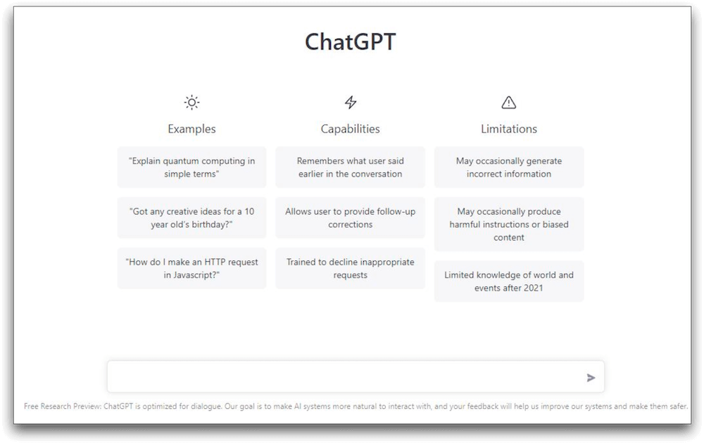
ChatGPT main page

Slide 7
ChatGPT
ChatGPT is powered by a Generative Pre-Trained Transformer (GPT in short) architecture, which utilizes deep learning and a transformer neural network model to generate coherent responses.
It utilizes a neural network structure, which is used as an attention mechanism that weighs the relevance of different words in a sequence (user query) and is adept at maintaining a context over long conversations.
It was trained to integrate diverse datasets, primarily from internet text sources, which allows the tool to respond to a wide range of topics it learned.
The model has undergone several evolutions (upgrades), with each version incorporating larger and newer datasets and improved architectures, which, in turn, enhance its accuracy and coherence in answers.
Banik, D., Pati, N. & Sharma, A. Systematic exploration and in-depth analysis of ChatGPT architectures progression. Artif Intell Rev 57, 257 (2024). https://doi.org/10.1007/s10462-024-10832-0

Slide 8
ChatGPT
It is one of the most widely used AI tools due to its availability, simplicity, and ease of use. In educational settings, it is widely used for concept explanation, guidelines on software, writing, code generation, and problem-solving. For students and professionals in fields like statistics, programming, and business analytics, it can help with problem-solving.
In an industrial or business context, it is used to automate customer service, provide personalized recommendations, assist with office work, and resolve other internal queries.
It is also used as a virtual tutor, providing learners with a guided conversation based on users' queries, offering insights, helping with practice exercises and supporting research.
While the tool becomes more reliable with each upgrade, mistakes are still possible. Users are advised to test and validate their responses before using them in important research (code generation, information backgrounds).

Slide 9
ChatGPT - Example
An e-learning company wanted to create automated support for students using SPSS.
Students frequently requested help with SPSS syntax and statistical interpretation, but manual support by the employees was time-consuming and costly.
By integrating the ChatGPT model into the e-learning platform, the company provided real-time support. Students could converse with the bot in real-time, ask questions, provide information and snippets of their codes, ask questions about the results of statistical tests, and gain quick responses.
By reducing the number of less complex inquiries from students, the employees had more time to focus on the more complex challenges they faced. This, in turn, reduced response times, provided students with the opportunity to learn independently, and improved user satisfaction.

Slide 10
DataRobot
DataRobot was founded in 2012 by Jeremy Achin and Thomas DeGodoy, both former data scientists who saw the need to automate machine learning processes to make predictive modelling accessible to non-experts.
The initial goal of the AI tool and its creators was to simplify the machine learning workflow, which, in turn, could enable businesses to build and deploy more complex and reliable models without the need to have extensive coding knowledge beforehand.
With each iteration of the software, DataRobot became a popular AutoML platform for data science teams, businesses, and industries (e.g., Retail, finance, and healthcare), providing them with a reliable tool to help with their organisation.
DataRobot (2024). About DataRobot platform. Available at: https://www.datarobot.com/platform/
Chaturvedi, V., Raja Mohammed, K.B.N. (2024). Dynamic Inventory Management Using AI: A Case on Datarobot. In: K, H., Rodriguez, R.V., Rege, M., Piuri, V., Xu, G., Ong, KL. (eds) Artificial Intelligence and Knowledge Processing. AIKP 2023. Communications in Computer and Information Science, vol 2127. Springer, Cham. https://doi.org/10.1007/978-3-031-68617-7_1

Slide 11
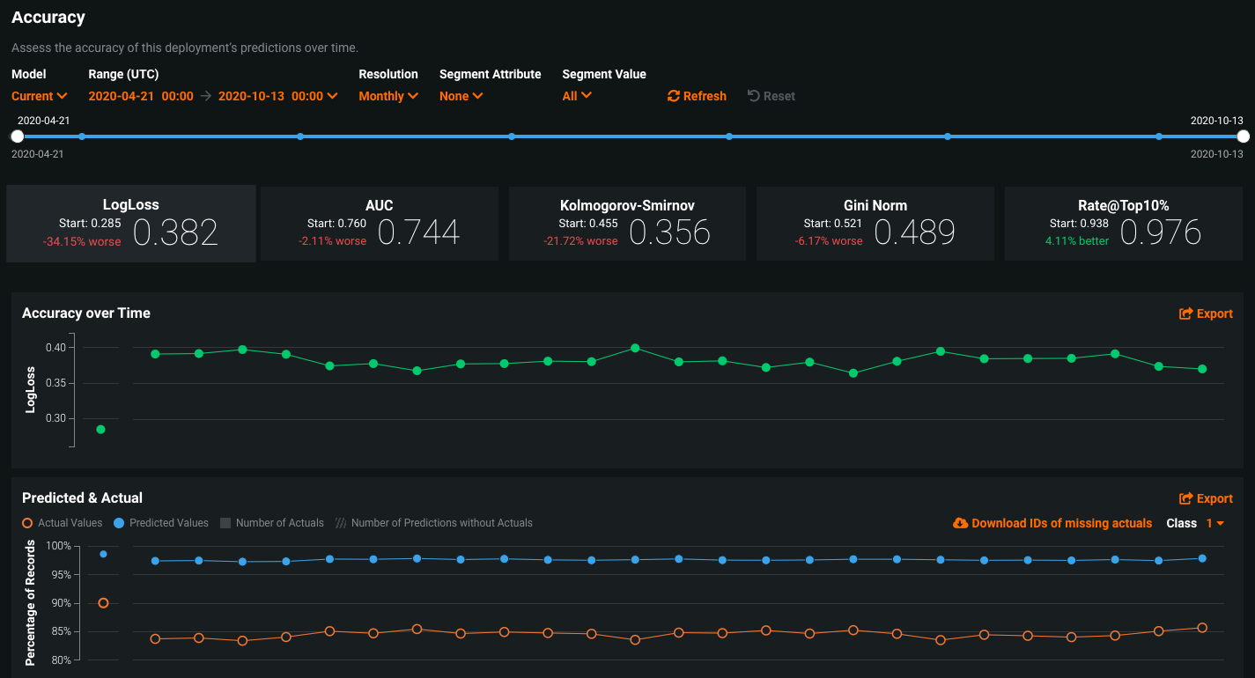
DataRobot platform

Slide 12
DataRobot
DataRobot utilizes a range of machine learning algorithms, including decision trees, logistic regression, gradient boosting machines, and neural networks, to identify the best predictive models based on existing inputs.
The tool works on a platform basis, first identifying and then creating relevant features automatically. This allows potential users to skip manual feature engineering, for which extensive background knowledge would be needed.
The tool also utilizes ensemble learning, combining multiple models to increase predictive accuracy, reliability, and suitability for high-stakes forecasting tasks.
The identified models are also based on pre-set performance metrics, providing users with comprehensive background information in selecting the most optimal option for their problem.
DataRobot (2024). About DataRobot platform. Available at: https://www.datarobot.com/platform/

Slide 13
DataRobot
DataRobot is most commonly used to help with demand forecasting, churn prediction (analyzing and forecasting customer behaviour), and risk assessment analyses in sectors with high unpredictability (e.g., the Finance and retail sectors).
DataRobot provides a guided workflow for new potential users, providing instructions on data upload, model training, evaluation, and model deployment, which simplifies the users' interaction with the tool.
DataRobot is a hands-on learning tool for students in data science programs. It allows them to experiment and explore various algorithms, understand their use and implications, and interpret the results they gain.

Slide 14
DataRobot - Example
A retail company was slowly expanding its repertoire of products and needed to optimize stock levels for its more high-demand products.
Due to overstocking and improper overview of their stocks, they noticed a spike in costs and waste, while understocking resulted in missed sales and loss of profit.
The company used the DataRobots AutoML features, which, based on the company's gathered data, created a demand forecasting model that predicted product demand for each of its product items.
By using the model, the company managed to reduce waste, optimize inventory levels, increase profit, and improve customer satisfaction by keeping available stocks for sales.

Slide 15
Tableau with TabPy
Tableau was developed by Co-founders Chris Stolte, Pat Hanrahan, and Christian Chabot, who were responsible for developing and patenting foundational technology VizQL. This technology enabled the possibility of simplifying data visualization through drag-and-drop actions, and later, TabPy, which also allows Python-based analytics, was integrated.
The tool's main purpose is to provide a friendly interface for building visualizations of datasets while also adding Python's analytical power, enabling complex data analysis.
Tableau is widely adopted in business and academy spheres due to its ability to handle large datasets and simplistic visualization processes. It also enables analysis that provides results for data-driven decision-making.
Tableau (2024). AI in Tableau. Available at: https://www.tableau.com/products/artificial-intelligence
Batt, S., Grealis, T., Harmon, O., & Tomolonis, P. (2020). Learning Tableau: A data visualization tool. The Journal of Economic Education, 51(3–4), 317–328. https://doi.org/10.1080/00220485.2020.1804503

Slide 16
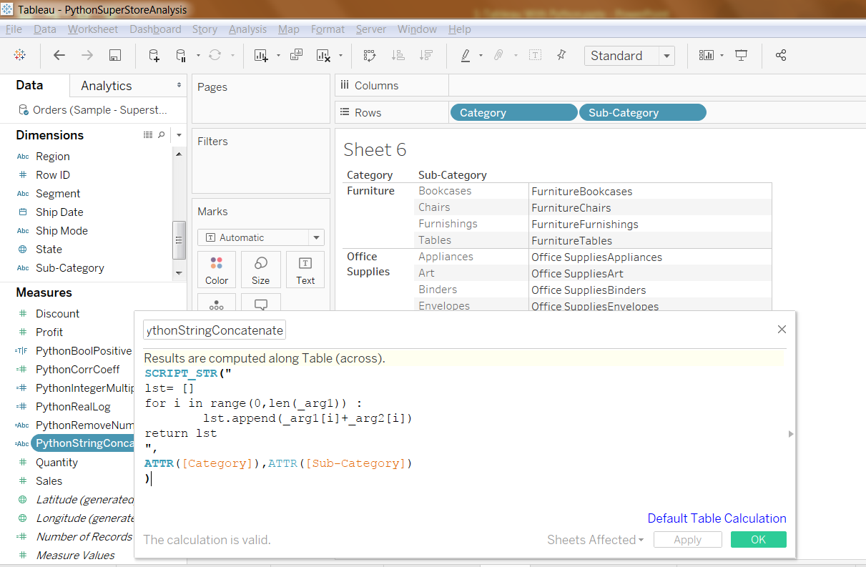
Tableau with TabPy

Slide 17
Tableau with TabPy
TabPy allows users to run Python scripts in Tableau, enabling customized calculations and implementing more advanced analytics models and analysis.
The platform also enables visualization (e.g., Time series and heat maps), which can be further enhanced by integrating Python-based predictions directly into the existing visualizations.
Additionally, it allows using and integration of various data sources, which, in turn, provide more dynamic, complex, and multi-sourced analytics that can be further adjusted by user parameters, enabling users greater dynamics and flexibility.
Tableau (version. 9.1). (2016). Journal of the Medical Library Association : JMLA, 104(2), 182–183. https://doi.org/10.3163/1536-5050.104.2.022

Slide 18
Tableau with TabPy
Tableau, with integrating TabPy, is most beneficial in developing, testing, and validating time series analysis, feature engineering (the process of selecting, manipulating, and transforming raw data into features that can be used in supervised learning), and more advanced/complex statistical modelling.
Users are provided with guidelines and tutorials that help with the learning flow, which consists of importing data into the tool, visualization processes, and Python functionality to add predictive elements to the selected data.
It is frequently used in industry, in sectors, logistics, and finances, where it can help with both data visualization and analysis.

Slide 19
Tableau with TabPy - Example
A logistics company faced fluctuating delivery times due to unpredictable traffic patterns in the region where they were operated.
Due to inconsistent deliveries and several delayed deliveries, the company faces significant customer dissatisfaction.
To avoid potential customer loss, the company used gathered data to develop a visualization of traffic trends in their operating regions to predict potential delays and allow dynamic route adjustments for their delivery trucks.
Through such an approach, the company reduced delivery times, improved punctuality of deliveries, and improved customer experiences and satisfaction.

Slide 20
H2O.ai
H2O.ai was founded in 2011 by Sry Ambati with the mission to democratize AI tools (enable a wider user base of AI technologies), which would make machine learning accessible and scalable not only for businesses but also educational institutions and individuals alike.
It was initially developed as an open-source platform but quickly transformed into an open-source and freely available platform called H2O-3 (traditional machine learning models) and into a commercial software suite called H2O Driverless AI due to ease of use and robust AutoML capabilities suited for business sectors.
The main goal of H2O.ai company and its tool was to remove existing barriers in machine learning by providing both tools that automate data science workflows and by enabling the use of such tools also to a wider userbase with limited experience, knowledge and capabilities to build and deploy predictive models.
It is currently used in the finance, healthcare, retail, and academia sectors because it provides significant support through applications requiring scalable machine-learning solutions and high-speed performance.
H2O (2024). Democratize AI. Available at: https://h2o.ai/company/democratize-ai/
Chen, Y., Liu, X., Gao, L., Zhu, M., Shia, B. C., Chen, M., Ye, L., & Qin, L. (2023). Using the H2O Automatic Machine Learning Algorithms to Identify Predictors of Web-Based Medical Record Nonuse Among Patients in a Data-Rich Environment: Mixed Methods Study. JMIR medical informatics, 11, e41576. https://doi.org/10.2196/41576

Slide 21
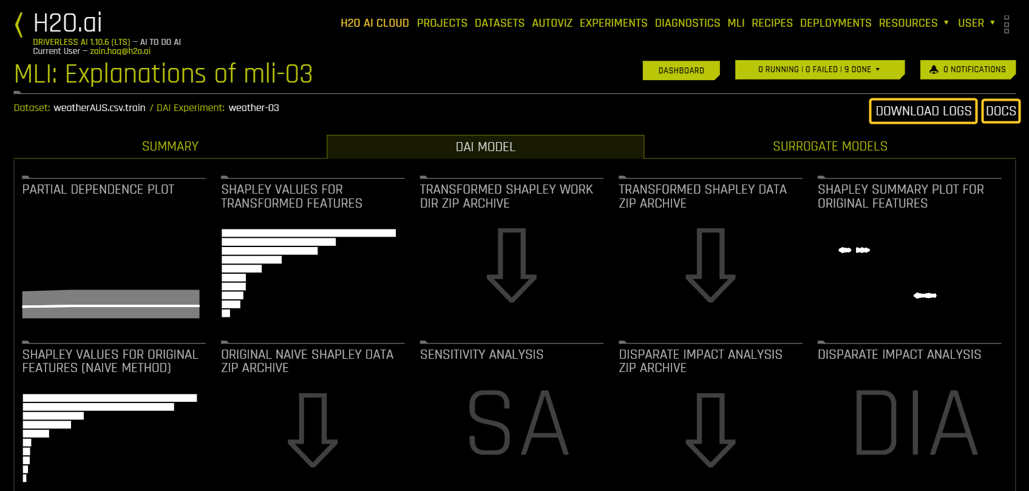
H2O.ai Platform

Slide 22
H2O.ai
H2O.ai utilizes several machine learning models, not excluding Generalized Linear Models (GLM) (a flexible generalization of ordinary linear regression), Gradient Boosting Machines (GBM) (machine learning technique for boosting in a functional space) and deep learning neural networks. In addition, the capability to support ensemble models that combine the outputs of multiple algorithms provides greater comprehensive analysis and accuracy of results.
The neural network frameworks work on principles similar to ChatGPT by learning through selected large datasets, which are useful for complex pattern recognition tasks. Combined with the neural network and data processing capabilities, the platform enables the handling of big data by parallel processing and in-memory computing, enabling scale-up to encompass datasets in enterprise applications.
One of its main advantages is the AutoML engine, which provides an automatic process for selecting, tunning and training existing models. By incorporating hyperparameter optimization (selecting optimal hyperparameters/parameters that would be optimal for a learning algorithm), model performance is maximized through adjusting factors (e.g., learning rate and regularization).
Hall, P., Gill, N., Kurka, M., & Phan, W. (2019). Machine learning interpretability with H2O Driverless AI (A. Bartz, Ed.). H2O.ai, Inc. http://docs.h2o.ai

Slide 23
H2O.ai
The primary application of the tool is aimed at predictive analytics, risk assessment analysis and personalization of models in industries (e.g. Retail).
From an educational or academic viewpoint, the platform is used for teaching machine learning concepts due to its visual, user-friendly interface and variety of available algorithms. Students and learners alike can experiment with algorithms without needing to code.
From a user standpoint, the platform provides a simple guideline on how to upload datasets, configure target variables, and initiate AutoML, which can automatically generate and evaluate a series of models. It also provides a base for best-performing models and ranks them in lists, allowing users to select the most suitable one for their own problems or needs.

Slide 24
H2O.ai - Example
A financial institution needed to streamline its credit scoring process to make quicker and more accurate lending decisions to their bank commitments.
The challenge the financial institution is facing is that their traditional credit scoring methods are slow and incapable of accurately assessing the new factors in financial sectors. This is leading to both credit risk and lost revenue due to potential missed opportunities.
Using the H2O.ai features, the financial institution employees trained a predictive model on past customer data, which helped them identify key factors associated with creditworthiness. The model also helped automate the scoring process, ranking potential commitments and applications by risk level.
Through improved credit assessment accuracy and efficiency, the institution reduced default rates and improved/increased its lending opportunities. Thus, the institution could make decisions faster, enhance customer satisfaction, and optimize its lending operations.

Slide 25
ChatGPT Exercise
A company by the name MerchY has collected data for their deliveries.
In the accompanying Excel File, they have included data regarding Cargo Type, Transport Type, Time needed for delivery, Costs, Payment, Penalty for late delivery and distance of delivery
The company wants to analyse the gathered data with the help of SPSS
While the person responsible for the analysis knows the long way to conduct analysis, he also knows that SPSS allows the usage of Scripts or Syntax in the software
To open a new Syntax go to File -> New -> Syntax, which will open a new window where you can inpute the code for analysis
However the person responsible for the analysis is not familiar with writting such codes, which is why he used ChatGPT

Slide 26
ChatGPT Exercise
Lets say we want to conduct a One Way Anova, where we want to measure if Transport type affects time needed for delivery and costs associated with the transport.
If we ask the ChatGPT, he will prepare us a syntax as the one bellow :
ONEWAY Time_Needed BY Transport_Type
/STATISTICS = DESCRIPTIVES HOMOGENEITY
/POSTHOC = TUKEY
/MISSING ANALYSIS.
ONEWAY Costs BY Transport_Type
/STATISTICS = DESCRIPTIVES HOMOGENEITY
/POSTHOC = TUKEY
/MISSING ANALYSIS.

Slide 27
ChatGPT Exercise
What is now needed to do, is to prepare all the Variables naming in line with the variable we want to analyse in the SPSS. Furthermore, due to Type of transport being categorical, we can add additional command line in our script which will automatically change the variables:
* Assign value labels for Transport_Type (categorical variable).
VALUE LABELS Transport_Type
1 "Truck"
2 "Train"
3 "Van"
4 "Car"
If we have this code snippet included before the real command, the SPSS will automatically consider the categorical valuables as numerical. After we have the data opened in a window in the SPSS, we can click on Run the script with our Syntax and the SPSS will calculate and prepare the results in a new window.

Slide 28
ChatGPT Exercise
If you want, try asking the ChatGPT for different types of analysis we have conducted in our Exercises.
It is important to state which variables you have, which method you want to use and to provide the ChatGPT with what you want to achieve.
Do be careful, as sometimes the code that you gain might not work. In this case check for the Error that SPSS provides and provide it to ChatGPT for finding a possible solution.
Include the gained solution in the Syntax and run again the script.
This approach makes it easier to conduct analysis, as you can change only a few words in the syntax, instead of clicking and opening through the conventional approach.

Slide 29
Summary
There is multiple AI tools that can be used to help with automatization processes and modeling in logistics and business sectors related to statistics.
Majority of existing AI tools aim to be ease to use, have user friendly interfaces and provide comprehensive analysis and results to people with limited or no background knowledge on coding and modeling.
However the AI tools should not be considered entirelly autonomous, since they still rely on learning approaches and existing knowledge, which were provided by creators in the tools initial coding processes.
AI tools differ on their learning curve, capabilities and what they provide to the user, based on their needs.

Slide 30
References
Mikolov, T., Chen, K., Corrado, G., & Dean, J. (2013). Distributed representations of words and phrases and their compositionality. In Advances in Neural Information Processing Systems, 26, 3111–3119.
Goodfellow, I., Bengio, Y., & Courville, A. (2016). Deep Learning. MIT Press. This text comprehensively covers the development of neural networks and their transformative impact on AI tools.
Schmidhuber, J. (2015). Deep learning in neural networks: An overview. Neural Networks, 61, 85–117.
Wang, G., Gunasekaran, A., Ngai, E.W.T., & Papadopoulos, T. (2016). Big data analytics in logistics and supply chain management: Certain investigations for research and applications. International Journal of Production Economics, 176, 98–110.
Dutta, D., & Bose, I. (2015). Managing a big data project: The case of Ramco Cements Limited. International Journal of Production Economics, 165, 293–306. Discusses the challenges of integrating AI and big data into logistics systems.
Zhong, R.Y., Xu, C., Chen, C., & Huang, G.Q. (2017). Big data analytics for physical internet-based intelligent manufacturing shop floors. International Journal of Production Research, 55(9), 2610–2621.
OpenAI (2024). ChatGPT. Available at: https://openai.com/research/
Ray, P. P. (2023). ChatGPT: A comprehensive review on background, applications, key challenges, bias, ethics, limitations and future scope. Internet of Things and Cyber-Physical Systems, 3, 121-154. https://doi.org/10.1016/j.iotcps.2023.04.003
Hall, P., Gill, N., Kurka, M., & Phan, W. (2019). Machine learning interpretability with H2O Driverless AI (A. Bartz, Ed.). H2O.ai, Inc. http://docs.h2o.ai
H2O (2024). Democratize AI. Available at: https://h2o.ai/company/democratize-ai/
Chen, Y., Liu, X., Gao, L., Zhu, M., Shia, B. C., Chen, M., Ye, L., & Qin, L. (2023). Using the H2O Automatic Machine Learning Algorithms to Identify Predictors of Web-Based Medical Record Nonuse Among Patients in a Data-Rich Environment: Mixed Methods Study. JMIR medical informatics, 11, e41576. https://doi.org/10.2196/41576
Tableau (version. 9.1). (2016). Journal of the Medical Library Association : JMLA, 104(2), 182–183. https://doi.org/10.3163/1536-5050.104.2.022
Tableau (2024). AI in Tableau. Available at: https://www.tableau.com/products/artificial-intelligence
Batt, S., Grealis, T., Harmon, O., & Tomolonis, P. (2020). Learning Tableau: A data visualization tool. The Journal of Economic Education, 51(3–4), 317–328. https://doi.org/10.1080/00220485.2020.1804503
DataRobot (2024). About DataRobot platform. Available at: https://www.datarobot.com/platform/
Chaturvedi, V., Raja Mohammed, K.B.N. (2024). Dynamic Inventory Management Using AI: A Case on Datarobot. In: K, H., Rodriguez, R.V., Rege, M., Piuri, V., Xu, G., Ong, KL. (eds) Artificial Intelligence and Knowledge Processing. AIKP 2023. Communications in Computer and Information Science, vol 2127. Springer, Cham. https://doi.org/10.1007/978-3-031-68617-7_1
OpenAI (2024). ChatGPT. Available at: https://openai.com/research/
Ray, P. P. (2023). ChatGPT: A comprehensive review on background, applications, key challenges, bias, ethics, limitations and future scope. Internet of Things and Cyber-Physical Systems, 3, 121-154. https://doi.org/10.1016/j.iotcps.2023.04.003
Banik, D., Pati, N. & Sharma, A. Systematic exploration and in-depth analysis of ChatGPT architectures progression. Artif Intell Rev 57, 257 (2024). https://doi.org/10.1007/s10462-024-10832-

Slide 31
Authors:
Sanja Bojić, Kristijan Brglez , Maja Fošner, Roman Gumzej, Rebeka Kovačič Lukman, Benjamin Marcen, Marinko Maslarić, Boško Matović, Dejan Mirčetić
Final version: June 2025

Slide 32
Thank you for your attention

