Slide 1


AI demo
LEVERAGING AI IN FOOD SUPPLY CHAIN
Lecture
BAS4SC
Business Analytics Skills
for the Future-proof Supply Chains
Project number – 2022-1-PL01-KA220-HED-000088856

Slide 2
Pillars:
AIMS
Investigate whether current demand patterns are merely temporary fluctuations or indicative of a new reality.
Special emphasis on testing the capabilities and performance of artificial intelligence (AI) algorithms in SC contexts.
CONSTRAINTS
Noisy and volatile post Covid data.
Changing market conditions (inflation, oil & gas prices, new Covid forms, etc).
CURRENT ACTIVITIES
Checking the data (duplicates & false entries)
Investigating demand patterns pre and post-Covid.
Testing different forecasting models.
Setting the stage for optimization of all logistic processes.
CURRENT RESULTS
Various AI models examined, we selected feed-forward neural networks (NN) as a key representative. Paper includes analysis of the NN against state-of-the-art forecasting models, specifically Facebook’s Prophet model and the autoregressive integrated moving average model.

Slide 3
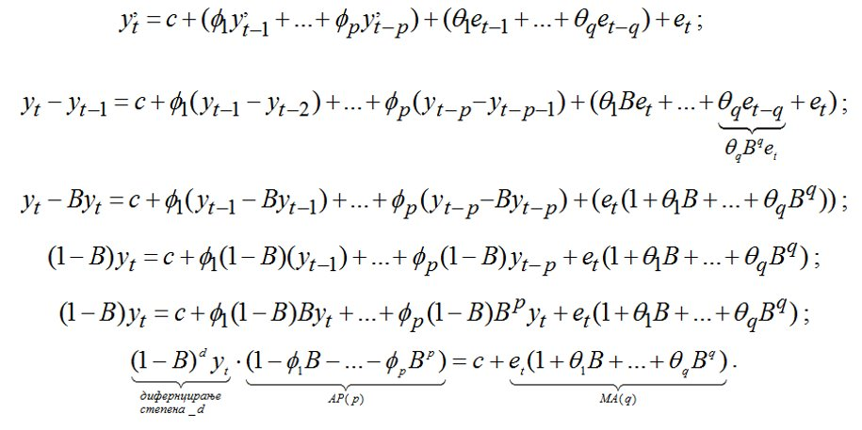
Methodology:

Slide 4
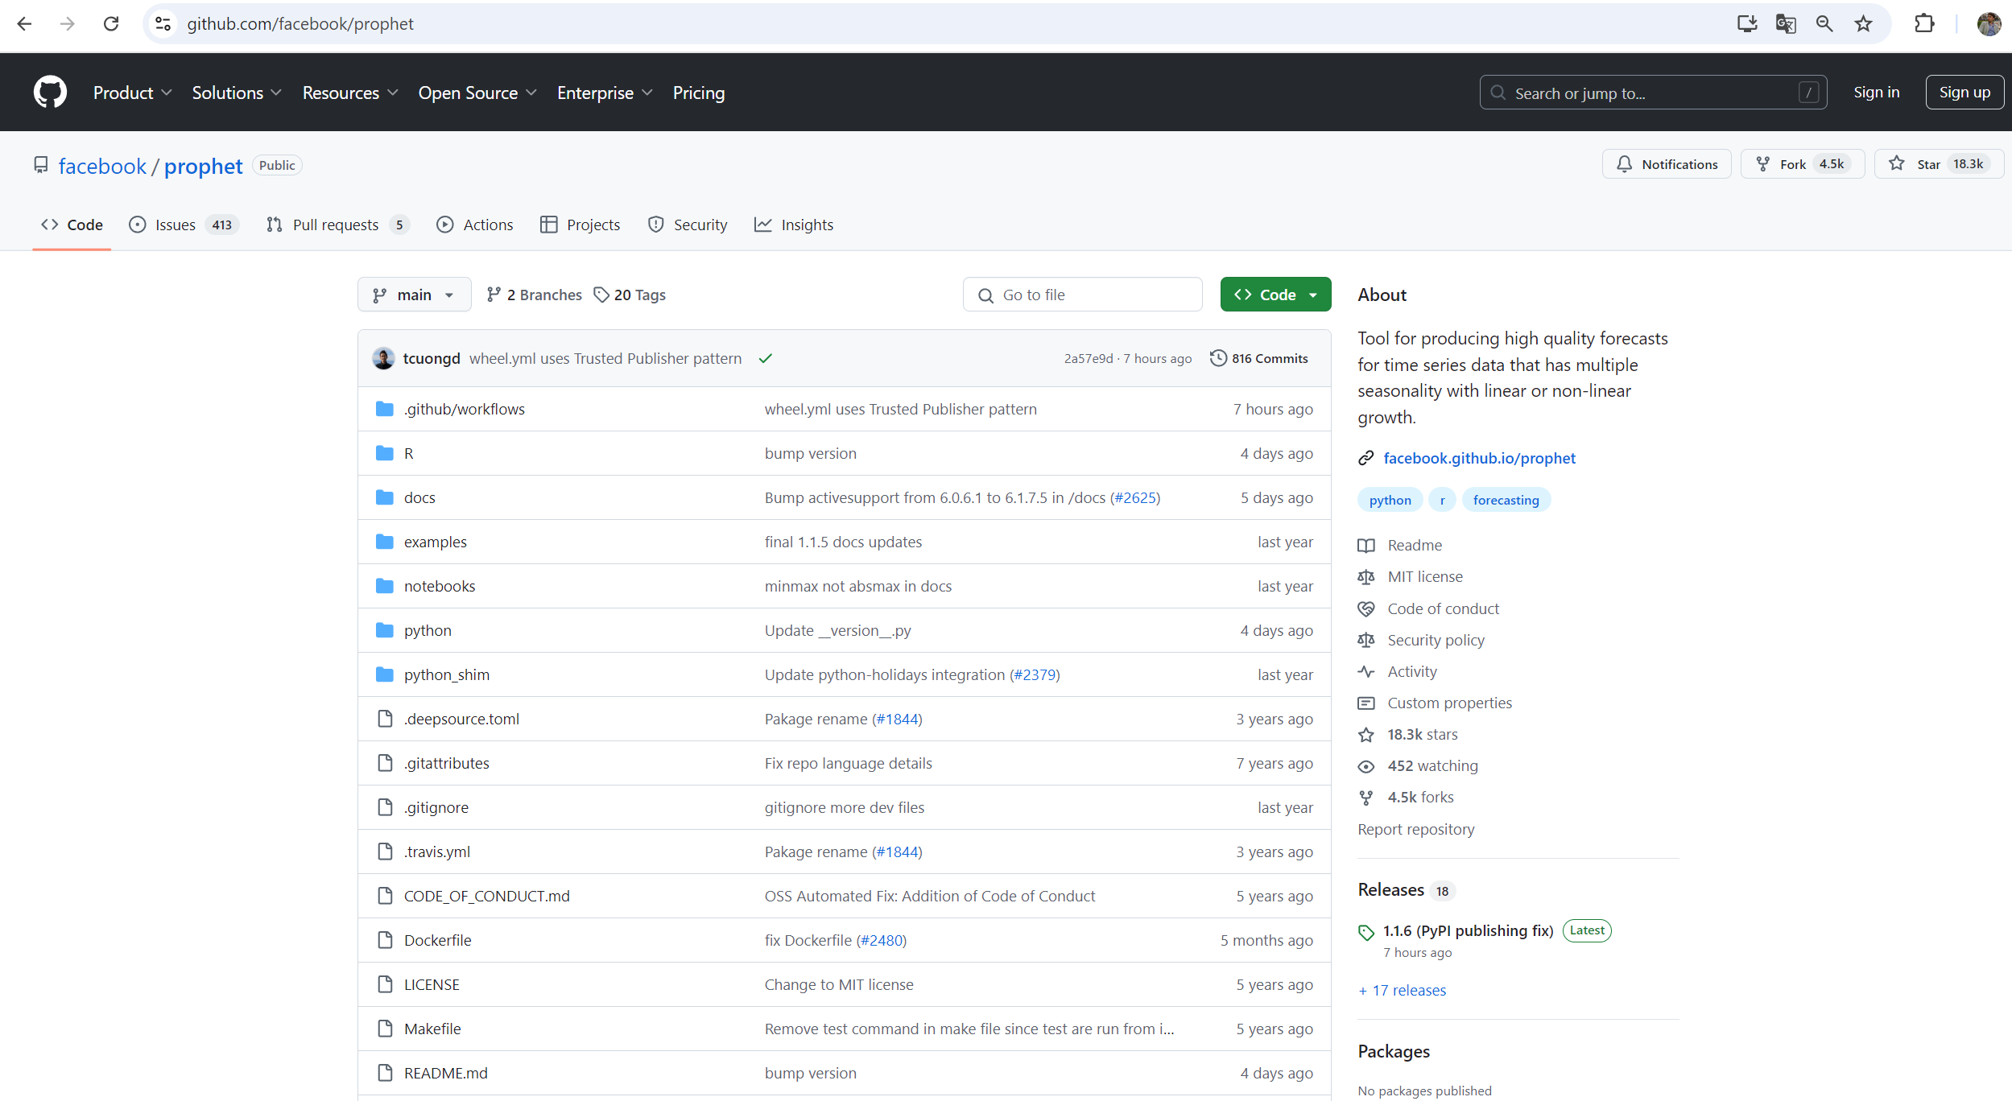
Facebook’s Prophet in action
Under development phase, current open code in GitHub:

Slide 5

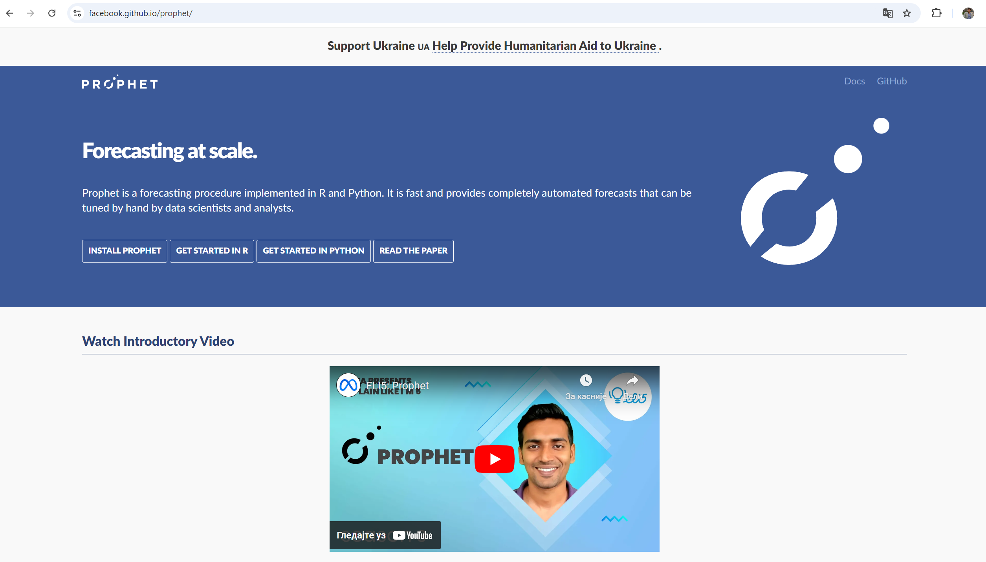
Facebook’s Prophet in action
Prophet can be considered a nonlinear regression model of the form:
where g(t) describes a piecewise-linear trend (or “growth term”), s(t) describes the various seasonal patterns, h(t) captures the holiday effects, and εt is a white noise error term. The Prophet is used in many applications across Facebook for producing reliable forecasts for planning and goal setting. Facebook found it to perform better than any other approach in the majority of cases.

Slide 6
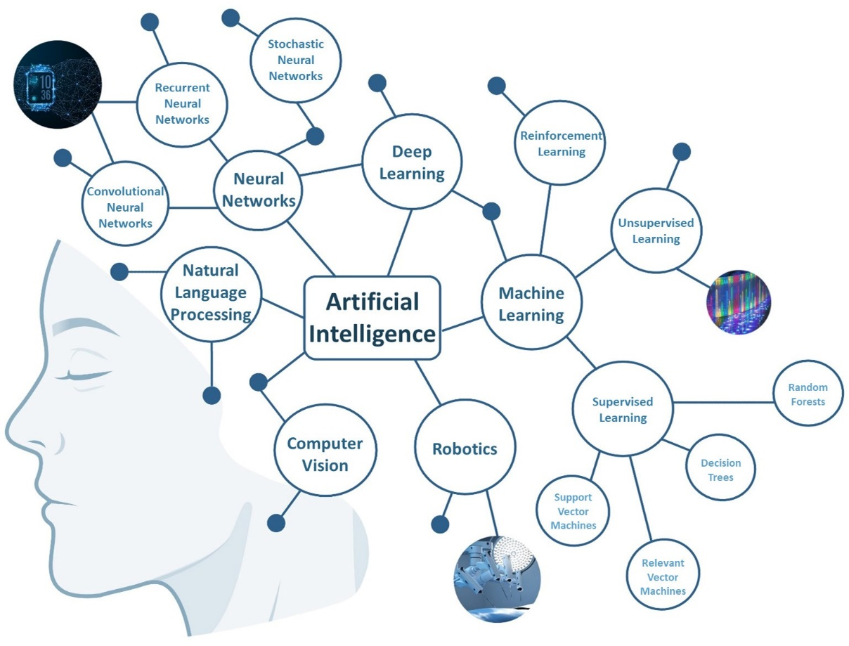
AI structure
The main fields and subfields of AI

Slide 7
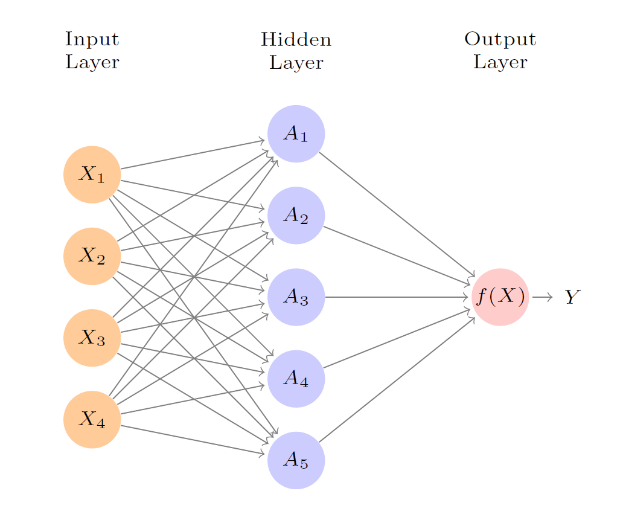

AI structure
Methodology structure:
The NN models offer a wide range of possibilities, but for the purposes of this research, we have narrowed the focus to feed-forward networks with a single hidden layer. The NN is represented in Equation:
$z_{j}=\sum_{i=1}^{n}{w_{i,j}x_{i}}+b_{j}$
With activation function in each node of the network:
$$s\left(z\right)=\frac{1}{1+e^{−z}}$$

Slide 8
CASE STUDY
Bearing in the mind-changing market environment the NN will use different data inputs (historical data, social factors, Covid 19 data, consumer price index, retail price, promotions, etc..).
NN will generate future forecasts of the demand for each ham product, each category of ham products, each customer and on total level (manufacturing level).
Future actions (to be):
The DSS will instantly determine optimal levels of stocks for each ham product (Design of inventory).
Additionally, the DSS will be able to trigger the manufacturing (Smart production) of the hams.
Finally, the DSS will generate ordering of the hams via the material resource plan (MRP), which will generate future orders from local producers of raw hams.

Slide 9
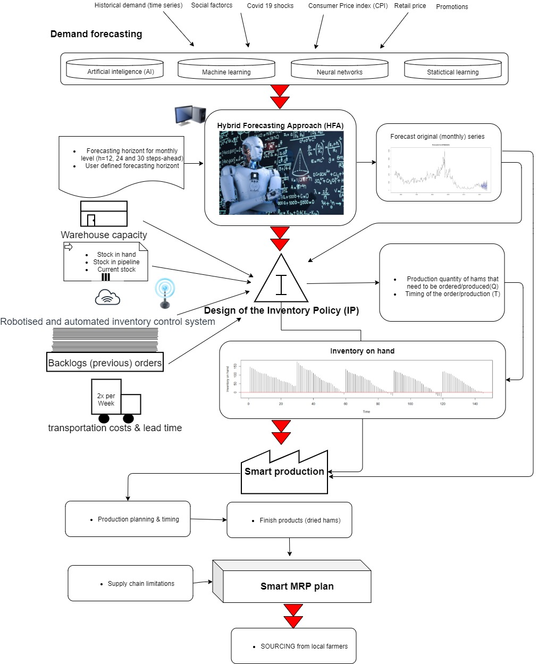
CASE STUDY

Slide 10
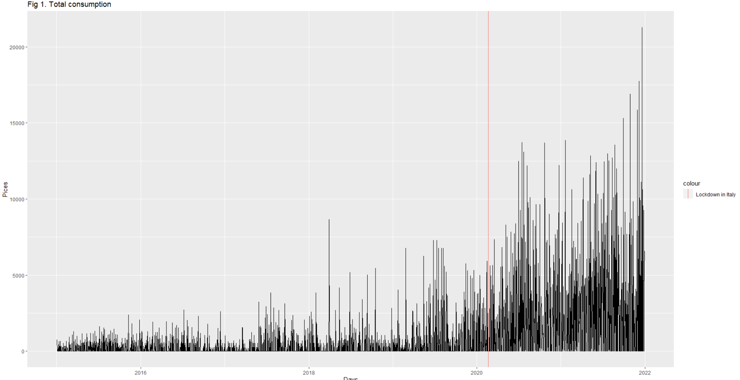
CASE STUDY
Daily demand of presliced hams (2015-2022)
There is a notable change in the hams demand from the start of the Corona pandemic. The first lockdown in Italy was 2020-02-21, after which demand for presliced hams erupted and reached a historical maximum. The demand was constantly trending, reaching the highest peak on 2021-12-20, with 21280 sliced pieces sold.
The daily demand shows highly volatile behaviour, therefore aggregation of the demand through different time horizons (weekly, monthly, etc) demonstrate a clear galloping demand trend.

Slide 11
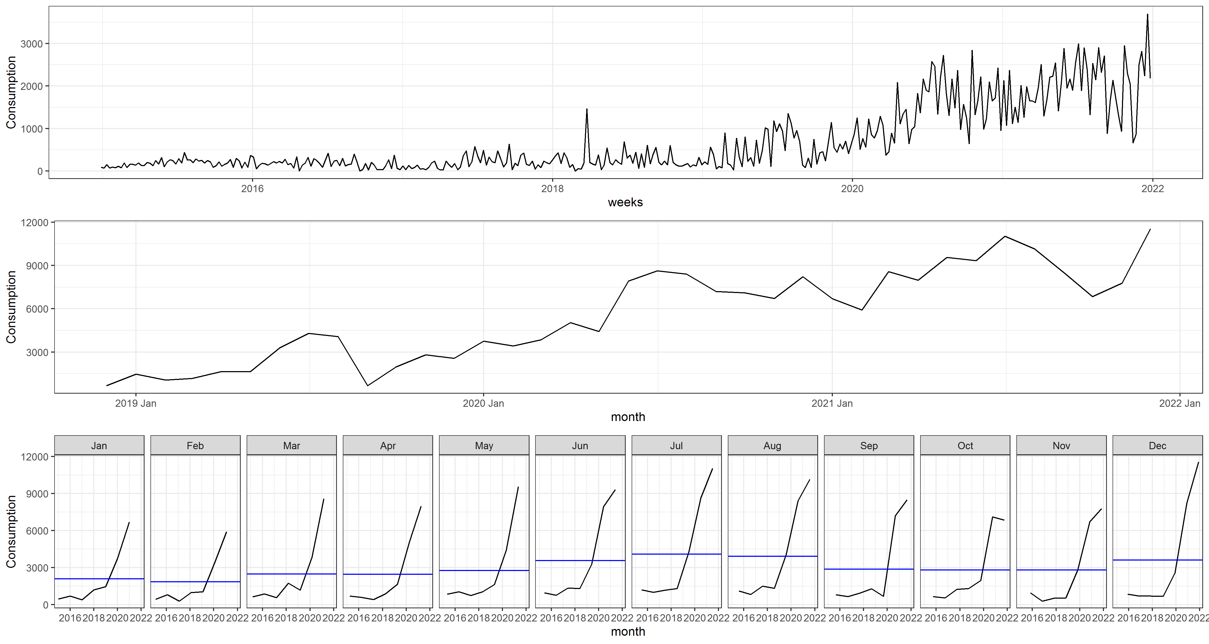
Figure 3 The comparative view of different time aggregations of the data (first panel-weekly, second – monthly, third – demand and historical averages per each month)

Slide 12
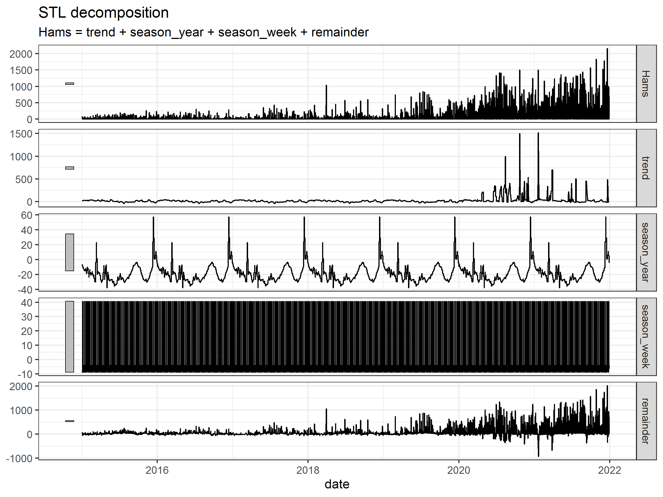

Slide 13

Training and testing data (cross-validation)
Training set 1: January 2015 – December 2017; test set 1: January 2018– December 2018
Training set 2: January 2015 – December 2018; test set 2: January 2019– December 2019
Training set 3: January 2015 – December 2019; test set 3: January 2020– December 2020
Training set 4: January 2015 – December 2020; test set 4: January 2021– December 2021
Training set 5: January 2015 – December 2021; test set 5: January 2022– December 2022
In order to compare the given models we have used the following forecasting metrics:
root mean scaled squared error (RMSSE)
mean absolute percentage error (MAPE) and
mean absolute scaled error (MASE) forecasting errors.
The metrics are presented in the Equation 5.
$RMSSE= \sqrt{\sum_{t=1}^{n}{q_{j}^{2}}}$;$MAPE= \frac{1}{N}\sum_{t=1}^{n}{\left[e_{t}\right]}$; $MASE= \sum_{t=1}^{n}{\left|q_{j}\right|}$; (5)
$e_{t}=y_{t}−{\hat{y}}_{t};$
$$q_{j}^{2}=\frac{e_{j}^{2}}{\frac{1}{T−m}\sum_{t=m+1}^{T}{{\left(y_{t}−y_{t−m}\right)}^{2}}};q_{j}=\frac{e_{j}}{\frac{1}{T−m}\sum_{t=2}^{T}{\left|y_{t}−y_{t−1}\right|}}$$
Where y_{t} represents the real outcome of the observed demand, ${\hat{y}}_{t}$ is the forcasted value, m is the number of seasonal periods, e_{j} is the j-th residual, $j∈\left\{1, 2, …n\right\}$.

Slide 14
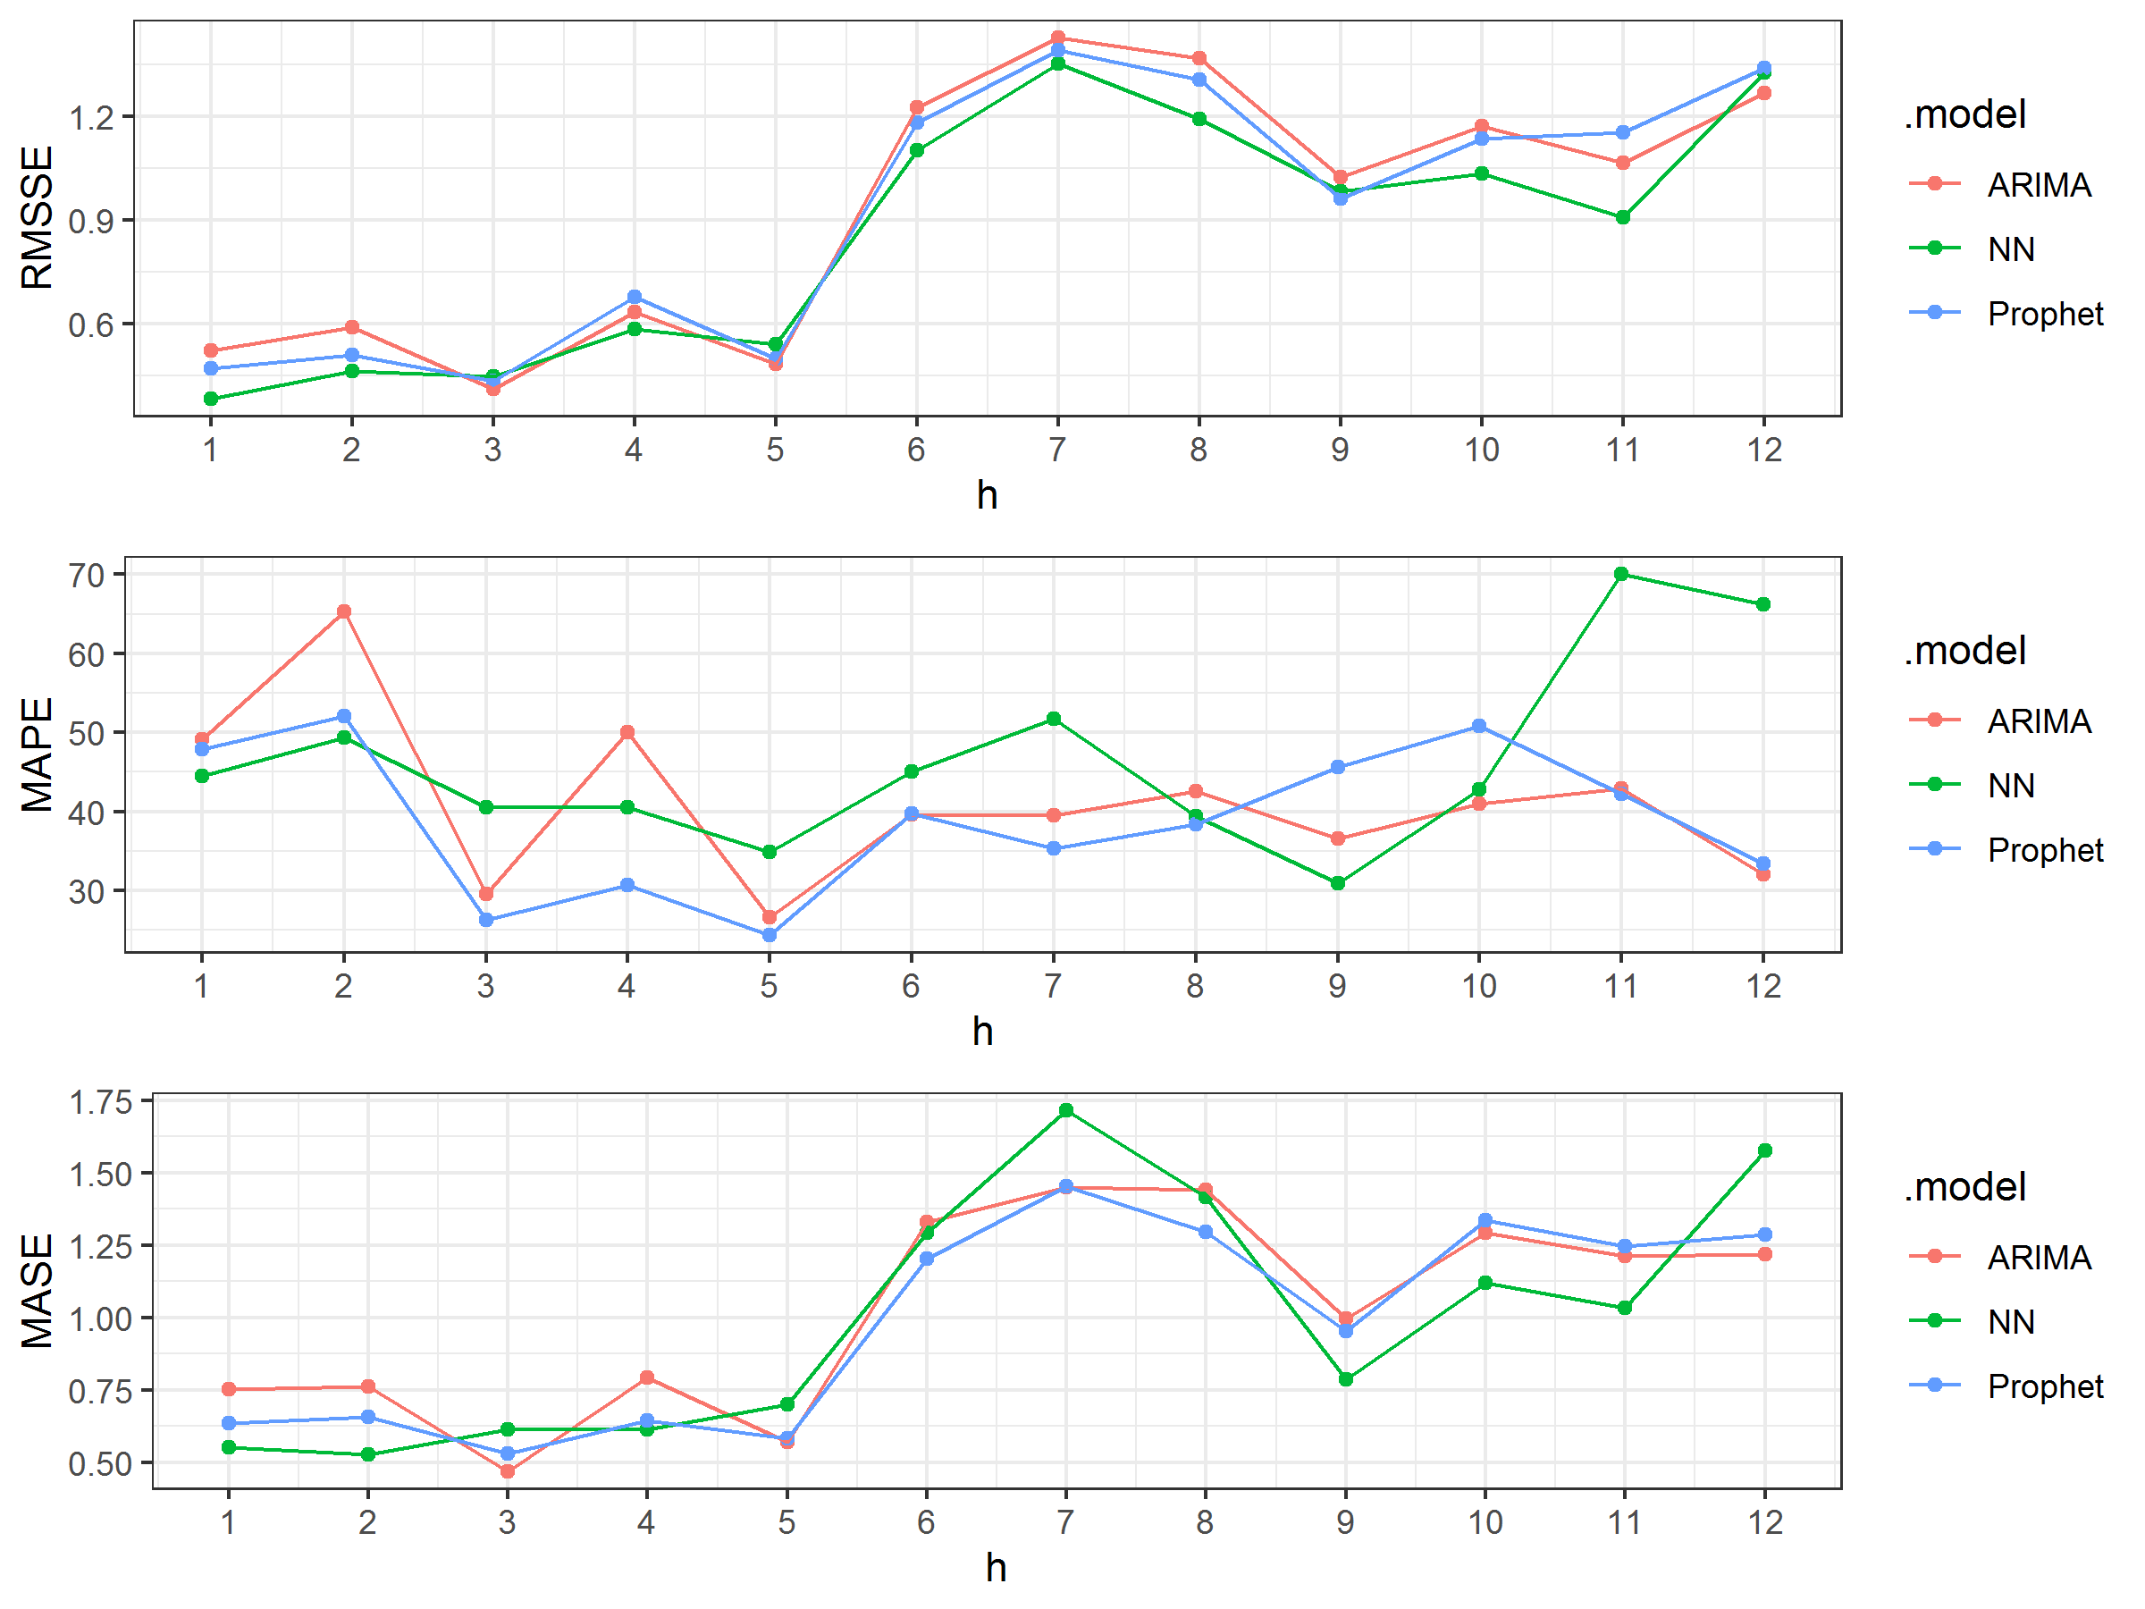
Figure 4 The h-steps ahead forecasting performance of predictive algorithms (first panel - RMSSE, second panel - MAPE, third panel - MASE)

Slide 15
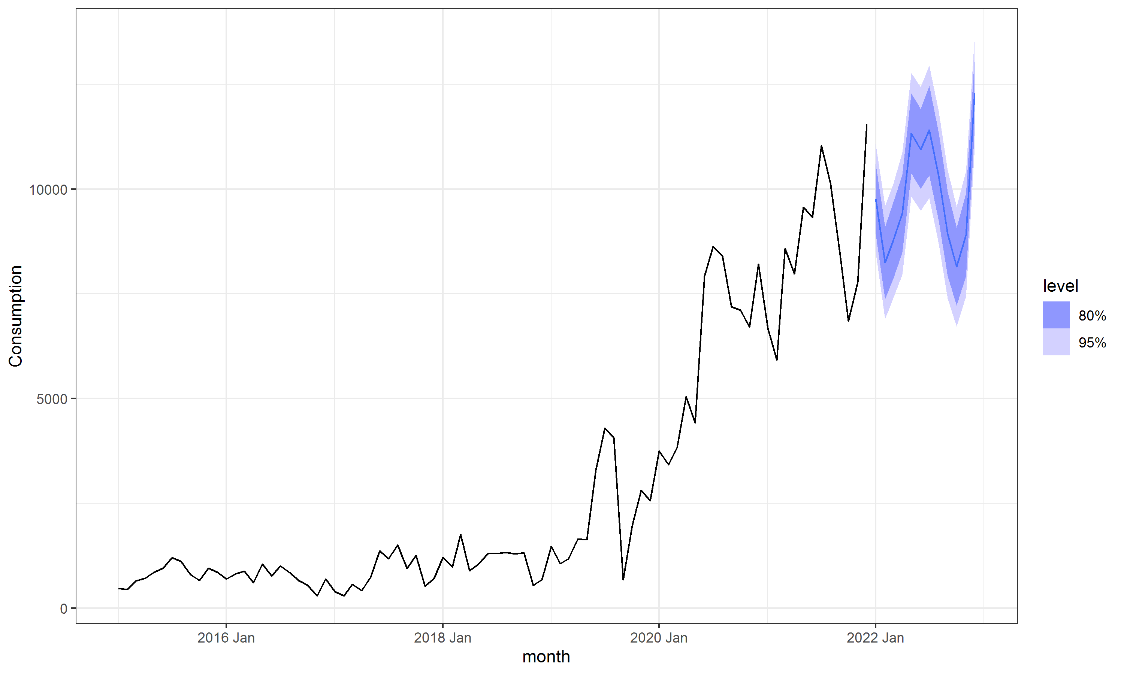
Table 1 Comparative review of different predictive algorithms.
 | RMSSE | MAPE | MASE
NN | 0.840 | 41.9 | 0.970
Prophet | 1.07 | 38.8 | 1.11
ARIMA | 1.08 | 41.2 | 1.15
Figure 5 The forecasts from the NN model for the next 12 steps, accompanied by 80% and 95% prediction intervals, indicate a sustained increase in demand throughout 2023.

Slide 16
CONCLUSION
Uncertainty surrounding market conditions and customer demand for products is one of the fundamental challenges in optimizing SCs. If demand could be predicted with certainty, SC processes would essentially be reduced to scheduling activities.
The results demonstrated significant potential for the current and future development of NN in the context of SC.
The NN model outperformed traditionally tested methods, such as ARIMA, which is widely used for time series forecasting, as well as Facebook's Prophet model, recognized as one of today’s state-of-the-art forecasting techniques.
This superior performance highlights the NN's ability to capture complex patterns in demand data that may be overlooked by more conventional models.
The NN model is currently under rigorous testing in order to be able to produce reliable future forecasts. Also, we are generating the features for the NN model to be able to work jointly with inventory control and generate manufacturing & ordering decisions based on the desired service level and demand on the market.

Slide 17
Authors:
Dario Šebalj
Dejan Mirčetić
Michał Adamczak
Final version: June 2025

Slide 18
Thank you for your attention

