Slide 1


Statistical methods for analysing logistics data
Demand forecasting, visualising and feature engineering of time series in supply chains
Lecture
BAS4SC
Business Analytics Skills
for the Future-proof Supply Chains
Project number – 2022-1-PL01-KA220-HED-000088856

Slide 2
Agenda
What is demand forecasting?
How can we effectively visualize and make conclusions about the customer data?
How to conduct the feature engineering of time series?

Slide 3
What is customer demand and demand forecasting?
The final customer’s demand sets the entire supply chain in motion, making it a key component for planning all logistical processes within the supply chain. Understanding and forecasting customer demand is crucial for supply chain managers, as it directly impacts the efficiency and effectiveness of supply chain operations (Syntetos et al., 2016). Accurate demand forecasting models are essential for planning and scheduling logistic activities, as they help in reducing logistics costs by providing reliable assessments of customer demand (Mircetic et al., 2017).
Demand forecasting in supply chains goes beyond simply predicting demand requirements at a single point. It involves complex challenges such as coordinating the supply chain and ensuring effective information sharing between multiple stakeholders (Syntetos et al., 2016). This complexity is driven by the inherent uncertainties in demand, which are influenced by various factors and make supply chain management particularly challenging (Rostami-Tabar, 2013). Managers must address these uncertainties to successfully plan and synchronize operations within the supply chain (Mircetic, 2018).

Slide 4
What is customer demand and demand forecasting?
One of the most significant challenges for modern supply chains is demand uncertainty. This issue was highlighted during the recent COVID-19 pandemic, which caused widespread disruptions and complicated supply chain planning and control (Nikolopoulos et al., 2020). Demand forecasting is not only about estimating future demand but also involves predicting demand for numerous items across the supply chain. Forecasters often extrapolate time series data for each stock-keeping unit (SKU) individually, which requires detailed and accurate data analysis (Mircetic et al., 2022).
In practical terms, demand forecasting in supply chains can be illustrated by how retailers use point-of-sale data to generate forecasts at individual store levels. This approach emphasizes the need for accurate data collection and analysis to predict customer demand at a granular level, ensuring that supply chain operations are responsive and efficient (Mircetic et al., 2022). The effectiveness of these forecasting efforts is crucial for maintaining supply chain coordination and reducing costs.

Slide 5
What is customer demand and demand forecasting?
The variability and uncertainty associated with demand make it a challenging aspect of supply chain management. If customer demand were constant or could be predicted with certainty, supply chain operations would be far simpler. However, because demand fluctuates and is often unpredictable, accurate forecasting is essential to avoid disruptions and inefficiencies (Syntetos et al., 2016). The success of supply chain operations depends on the ability to anticipate and respond to these fluctuations effectively.
In conclusion, the ability to forecast customer demand accurately is a critical factor in the success of supply chains. It not only influences the cost and efficiency of logistics but also plays a pivotal role in ensuring that supply chain operations are well-coordinated and responsive to market demands. As supply chains become more complex and interconnected, the importance of demand forecasting and the challenges associated with it will continue to grow.

Slide 6
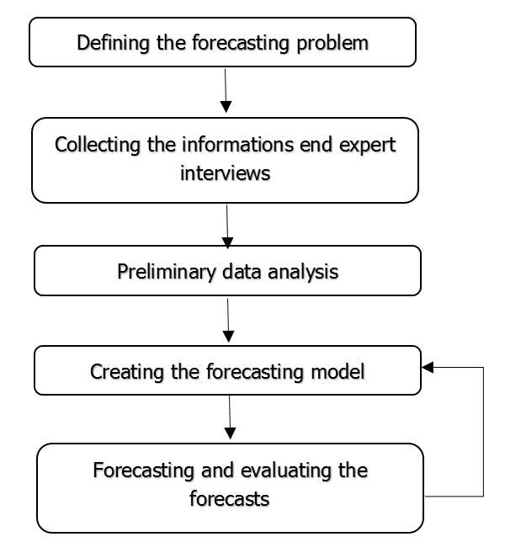
Demand forecasting steps in supply chains?
Figure. The basic steps for proper implementation of forecasts within a company.

Slide 7
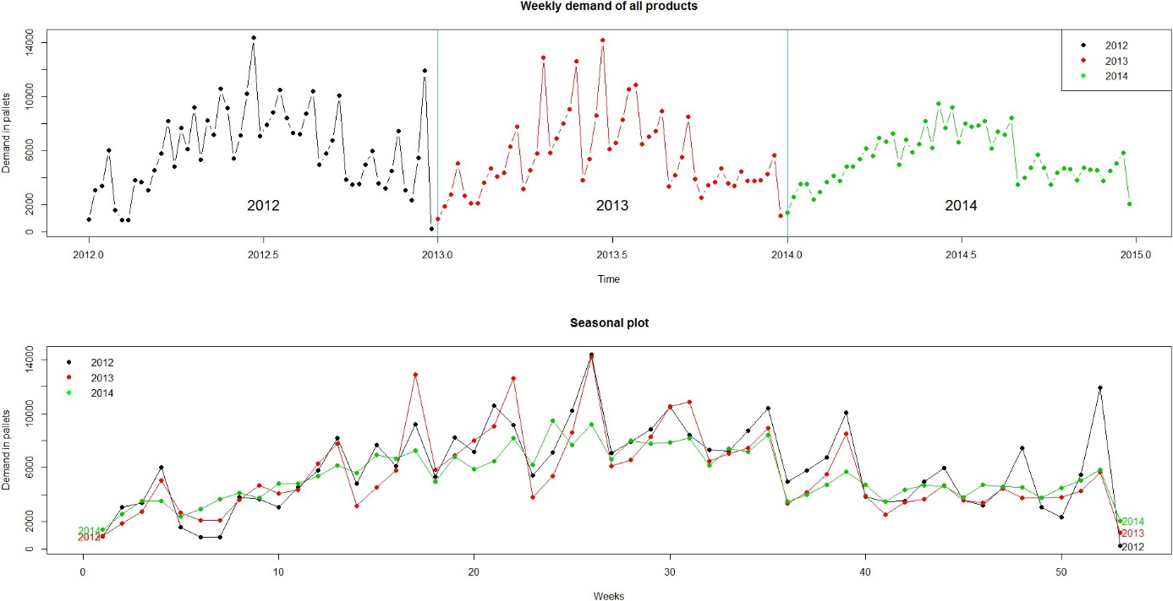
Demand forecasting in food industry
Figure. The demand data for the observed food company.

Slide 8
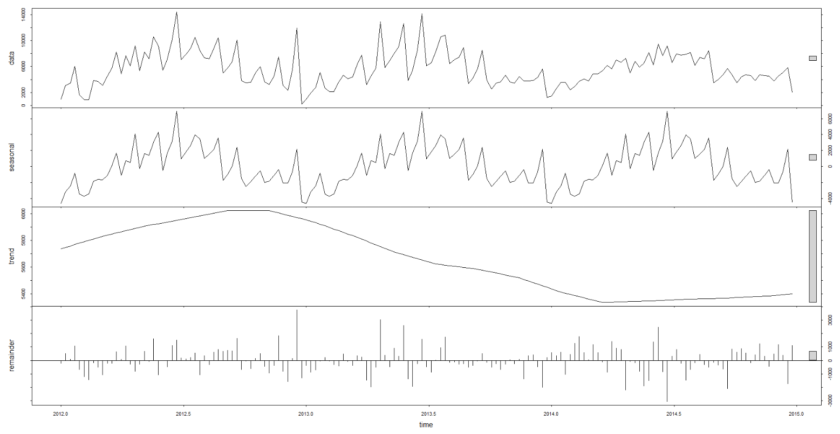
Demand forecasting in food industry
Figure. The STL decomposition of demand data.

Slide 9
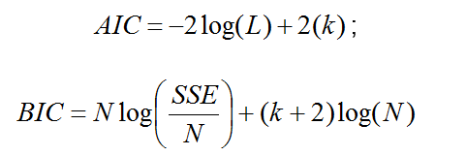
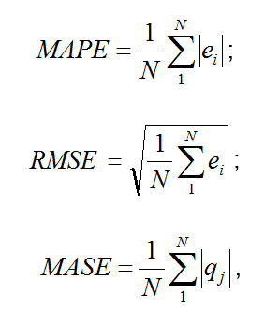
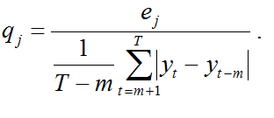
Demand forecasting in food industry

Slide 10
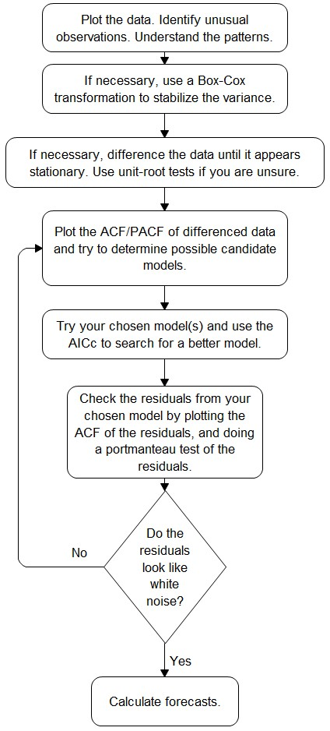
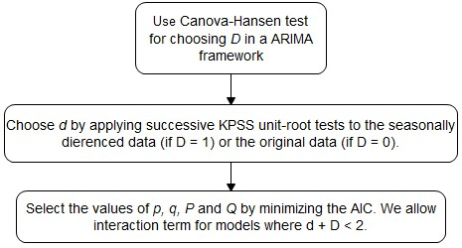
Demand forecasting in food industry

Slide 11
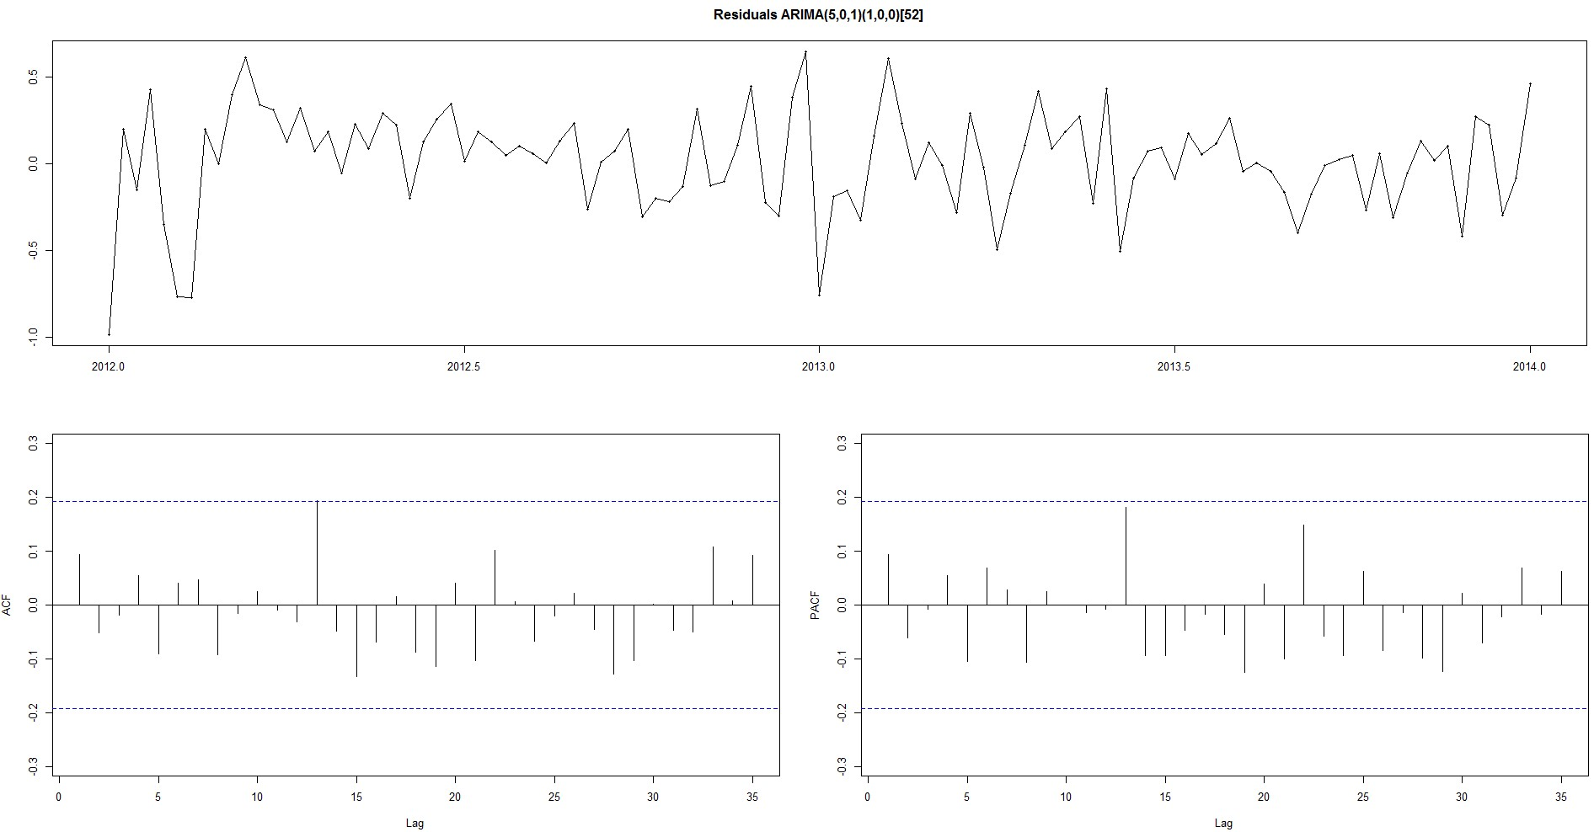
Demand forecasting in food industry

Slide 12
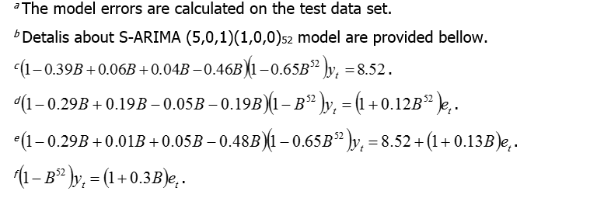
Demand forecasting in food industry
Modelsª | RMSE | MAPE | MASE | AIC | BIC
S-ARIMA (5,0,1)(1,0,0)₅₂^{b} | 1023 | 14.18 % | 0.60 % | 86.62 | 110.50
S-ARIMA (4,0,0)(1,0,0)₅₂^{c} | 1041 | 14.53 % | 0.62 % | 86.73 | 105.31
S-ARIMA (4,0,0)(0,1,1)₅₂^{d} | 1882 | 22.12 % | 1.05 % | 41.74 | 53.560
S-ARIMA (4,0,1)(1,0,0)₅₂e | 1050 | 14.18 % | 0.60 % | 88.23 | 109.47
S-ARIMA (0,0,1)(0,1,0)₅₂^{f} | 1797 | 21.42 % | 1.02 % | 36.52 | 40.460

Slide 13
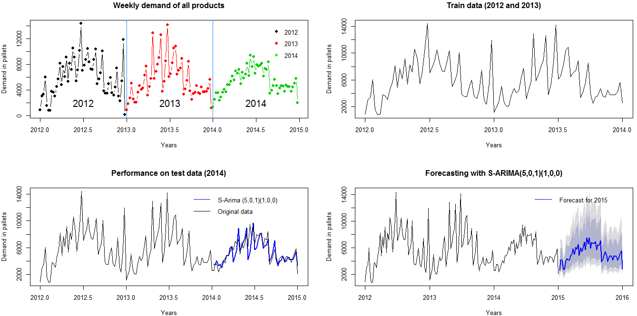
Forecasts of the future demand
Figure. Train, test and forecasted demand of S-ARIMA (5,0,1)(1,0,0)₅₂ model.

Slide 14
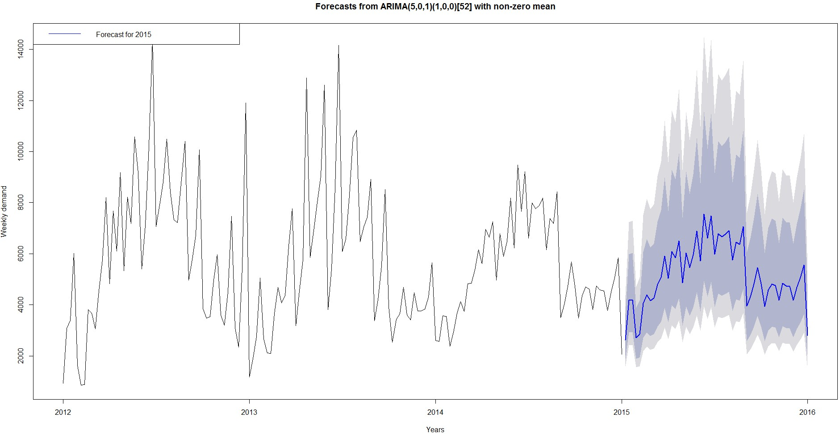
Demand forecasting in food industry

Slide 15
Summary
Customer demand is the primary driver of supply chain operations.
Accurate demand forecasting is essential for reducing logistics costs.
Demand forecasting involves complex coordination among supply chain stakeholders.
Uncertainties in demand make supply chain management challenging.
The COVID-19 pandemic has highlighted the importance of managing demand uncertainty.
Effective handling of these uncertainties is crucial for supply chain success.
The most accurate model was of S-ARIMA (5,0,1)(1,0,0)_{52.}

Slide 16
Authors:
Sanja Bojić, Kristijan Brglez , Maja Fošner, Roman Gumzej, Rebeka Kovačič Lukman, Benjamin Marcen, Marinko Maslarić, Boško Matović, Dejan Mirčetić
Final version: June 2025

Slide 17
Thank you for your attention

