Slide 1


Statistical methods for analysing logistics data
Statistical data processing SPSS
Lecture
BAS4SC
Business Analytics Skills
for the Future-proof Supply Chains
Project number – 2022-1-PL01-KA220-HED-000088856

Slide 2
Agenda
Short description of the SPSS software
Short basics of SPSS software use
Short explanation of normality test and example for three most common methods
Example of Students T-Test
Example of Correlation
Example of Chi-Square
Example of One-Way ANOVA

Slide 3
About SPSS software
SPSS or „Statistical Package for the Social Sciences“ is a software created in 1968 by Norman H. Nie, C. Hadlai Hull and William G. Greene. It was originally designed to enable social science research, but it has since then evolved to be one of the most widely used statistical analysis tool in fields of business, healthcare, education and government.
Similar to the Microsoft Excel counterpart, SPSS features a graphical user interface that allows users to perform complex statistical analyses without requiring extensive programmming knowledge. The accessibility makes it a key point for researchers, analysts and students in using the software.
Source: Almquist et al. (2019)

Slide 4
About SPSS software
SPSS provides a broad range of statistical techniques, including descriptive statistics, inferential statistics, regression analysis, ANOVA, factor analysis, and more. Users can also perform data manipulation, transformation, and visualization, facilitating in-depth data analysis.
The software enables users to import data from various sources, such as Excel, databases, and text files. It also supports data cleaning and preparation, allowing users to manage missing values, recode variables, and merge datasets effectively.
In addition to standard statistical procedures, SPSS offers advanced analytics options, such as predictive modeling, time series analysis, and machine learning algorithms. Users can generate comprehensive reports, including charts, tables, and visualizations, to communicate their findings effectively.
Source: Almquist et al. (2019)

Slide 5
Basic functions 1
SPSS software enables similar data manipulation as its counterpart Microsoft Excel software;
Both the SPSS and Excel have the functionality to import the others export files;
To import data from an Excel spreadsheet file, you have to navigate to:
  File;
  Import Data;
  Select the format of your data file;
  Locate the data file on your computer;
  Select setting on how SPSS should distribute the data in its spreadsheet

Slide 6
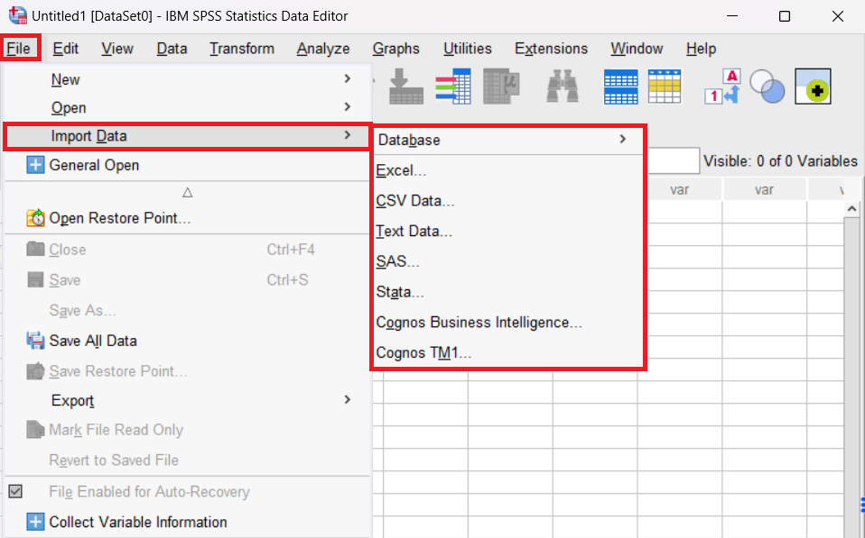
Basic functions 1
Figure 1. Importing data from multiple databases (Excel, SAS, Strate,…)

Slide 7
Basic functions 2
The data in SPSS is categorized under two primary types: a) numerical data which consists of numbers (discrete or continuous), and b) categorical data, which comprises words (ordinal or nominal);
When importing existing spreadsheets, the SPSS will automatically set the variables depending on the outline provided in the spreadsheet;
If you want to manipulate the variables, you can do this under:
  View;
  Variable view;
  Adjust Name, Type, Width, Measure and other options.

Slide 8
Basic functions 2
If you want you can also Redefine the variable by:
  Transform;
  Recode into Different Variables;
  Highlight your variable move it into Input Variable > Output Variable;
  In Output Variable select name of your new variable;
  Click on Old and New Values
  In Old Value correctly Input your values name (e.g. Rail) and in New Value Input new values (e.g. 1)
  Click Add and continue adding rules
  After you finish, click Ok and you should get a new variable
This is extremelly usefull if you have a Variable with names (e.g. names, transport modes, etc.), which are not available to be included in some analysis. By transforming them to numerical values, you can then use them in an analysis.

Slide 9
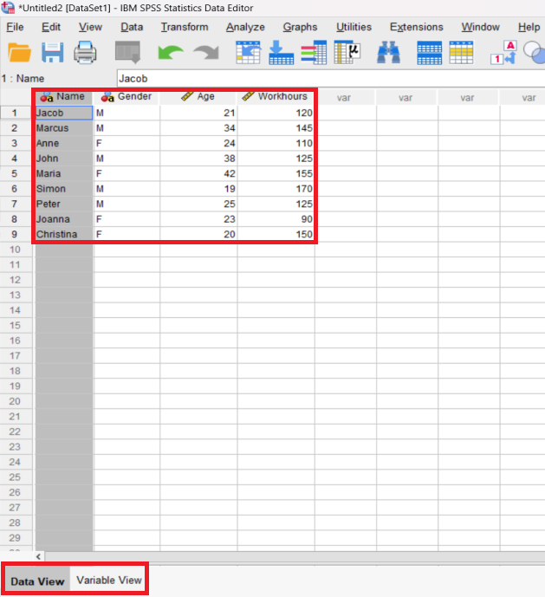
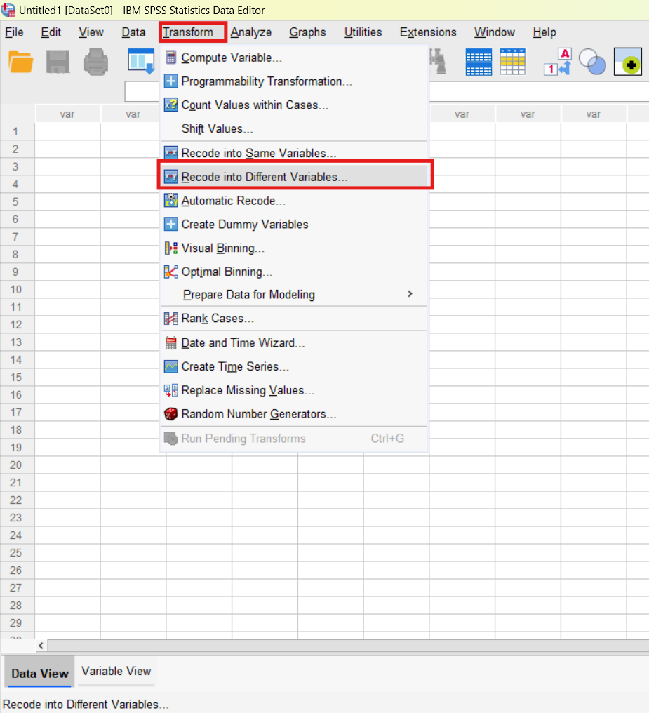
Basic functions 2
Figure 2. Variable view
Figure 3. Recoding variables

Slide 10
Basic functions 3
When you curated data in the SPSS spreadsheet you can start performing simple statistical analysis;
Simple analysis can be undertaken by using the „Descriptive Statistics“ function;
To access the Descriptive Statistics, you have to go to:
  Select Analyze;
  Descriptive Statistics;
  Explore;
  Select what you want to analyze.
As a side note, many of the Descriptive Statistics are included in the more complex statistical methods we will cover. Depending on what you want to represent, consider which statistical analysis methods you want to include in your results report.

Slide 11
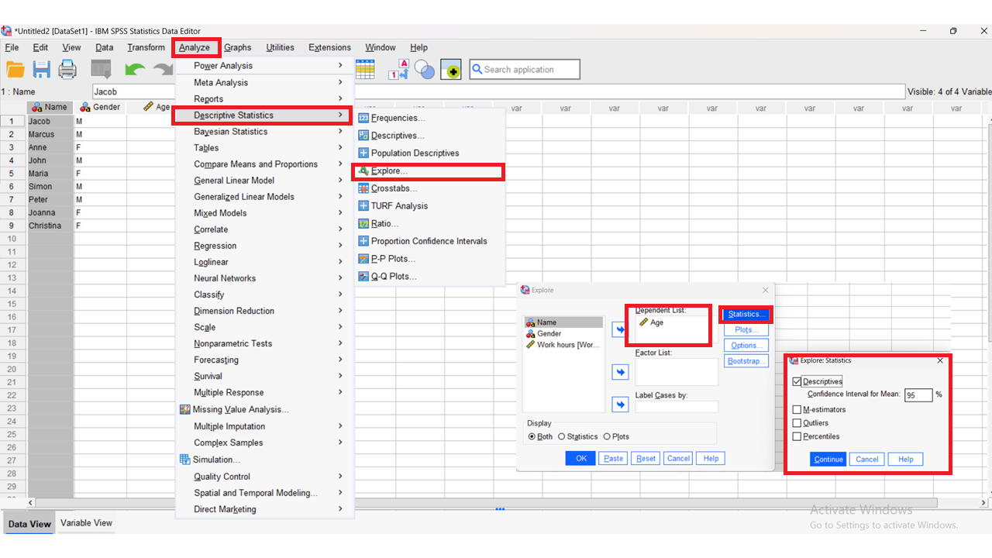
Basic functions 3
Figure 4. Simple descriptive statistics settings

Slide 12
Basic functions 4
SPSS allows its users to visualize their data, including histograms, box plots, bar charts, scatterplots, line charts, pie graphs, etc.;
The selection of graphs is up to the user, the data they want to visualize and what they want to visualize based on the data;
To create a graph, you need to:
  Select Graphs;
  Select Chart Builder;
  Select the type of graph and the variables;
  Click Finish.
As a side note, in some methods that we are going to cover, the software will automatically create visualizations. In others, you have to specify if you want to include them by correctly adjusting the settings of the analysis.

Slide 13
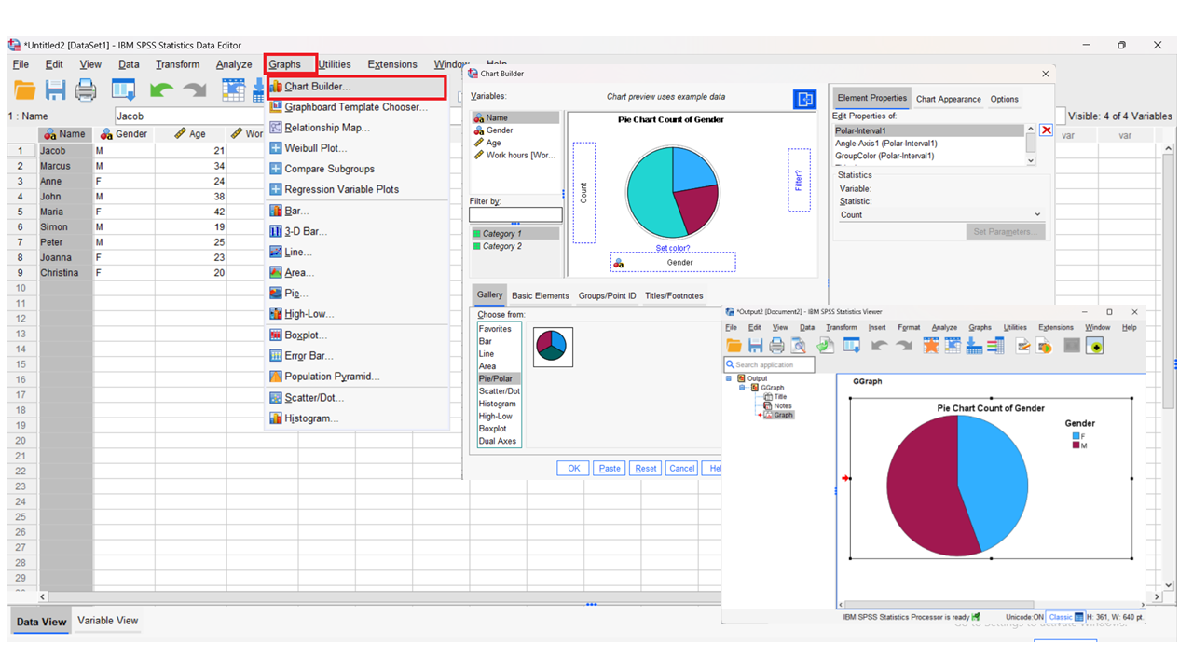
Basic functions 4
Figure 5. Graph settings

Slide 14
Basic functions 5
At this point, we covered three of the four rules for „Exploring data“:
  Raw data exploration;
  Determining data types;
  Conducting descriptive statistics and visualization.
The final rule covers the so-called „Question Formulation“
Here, the main goal is to formulate the main objective of our research and answer the questions:
  What do we want to achieve with the selected data and data analysis?
  What the questions do we want to answer with the data analysis?
  Which approach we will undertake to achieve our goals and answer the questions?
The questions are also an important part when constructing hypothesis related to our goals and questions.

Slide 15
Normality test explanation
Before conducting a simple statistical test, it is important to conduct a normality test;
Normality test provides researchers and practitioners with important information regarding their statistical database/s:
  It provides information if the data follows a normal distribution. This is important due to many statistical tests being parametric in their nature and would cause incorrect or unreliable results,
  Many tests follow the assumption of normality, which needs to data be normally distributed,
  It would cause interpretability of the statistical tests p-values being wrongly presented,
  It could cause unreliability of the statistical tests results, especially in the case of smaller sample size databases.
For this reason, it is advisable to conduct at least two, if not three most common tests. This include the histogram approach, Q-Q plot or the Test of normality, which will be covered in the following slides.
Source: DeCoster, J., & Claypool, H. M. (2004).
Link to video on youtube: https://www.youtube.com/watch?v=DhySnPB1afQ

Slide 16
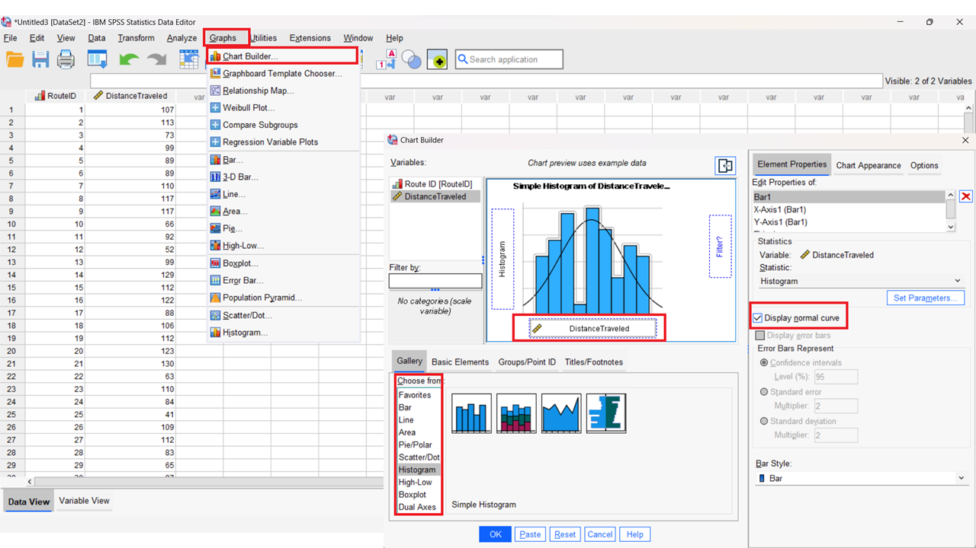
Histogram approach
Histogram is the simplest of the methods for normality tests;
The test is positive if the bars follow the “curve bell” of the chart;
The test is negative if the bars deviate to either side of the chart – in this case we have a exponential distribution;
In SPSS we can make histogram test, by clicking “Graphs” option, select “Chart Builder” and then from selection choose “Histogram”.
Figure 6. Histogram settings

Slide 17
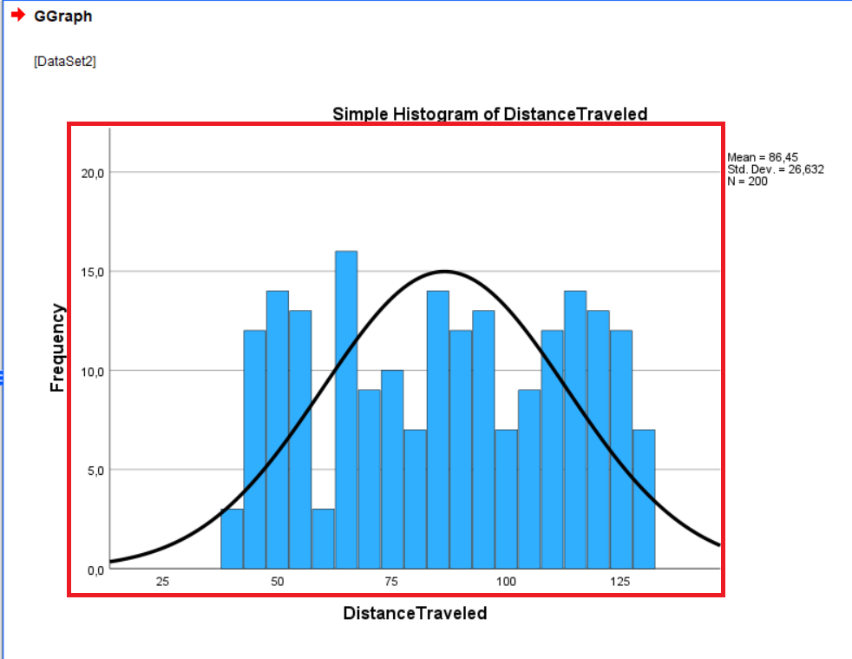
Histogram example
We have a database of two-hundred variables with associated values for traveled distance (in km);
Using the histogram method, we gained the following result;
We can notice that the bars approximate around the curve bell, which makes our test positive.
Figure 7. Histrogram visualization

Slide 18
Q-Q Plot approach
The second most common method for normality test is the Q-Q Plot approach;
In this approach a chart is also created, where a straight line represents the normal distribution;
If the points (representing our values) are clustering closely to the straight line, the test can be considered positive;
If the points deviate or create noticeable tails from the straight line, there is a clear indication of exponential function.
To initiate the Q-Q Plot, click “Analyze”, select “Descriptive Statistics” and select “Q-Q Plots from the list”.

Slide 19
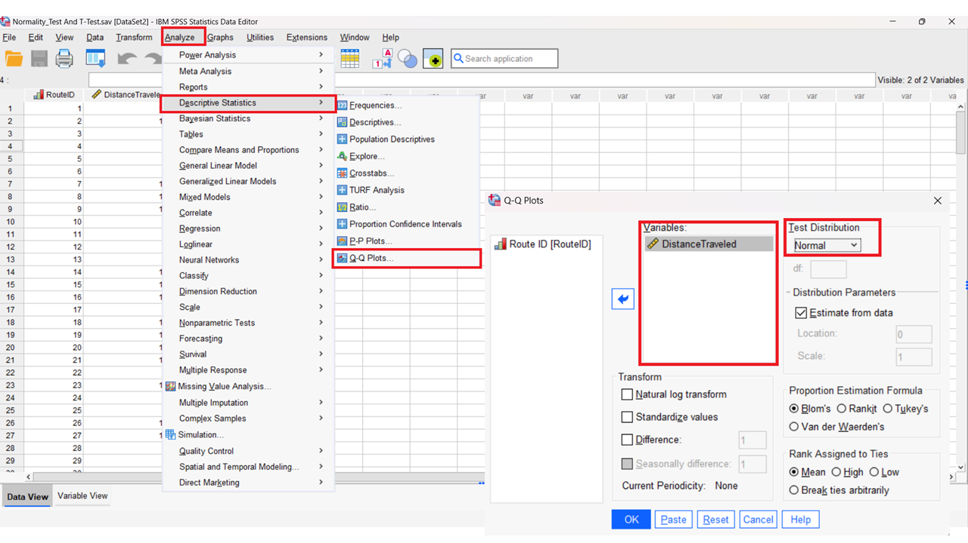
Q-Q Plot approach
Figure 8. Q-Q plot settings

Slide 20
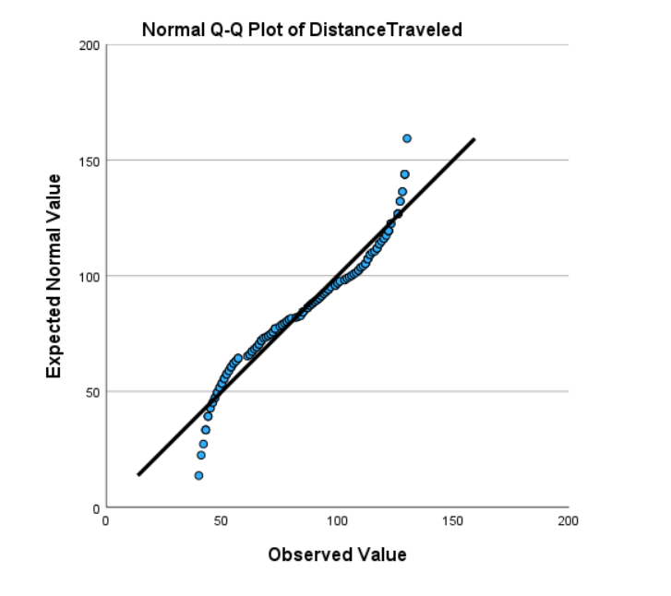
Q-Q Plot example
We once more use the database from the histogram test;
The Q-Q Plot provides us with the following chart as results;
We can see that we have small tails at both ends, indicating some deviations;
However, most points are close to the provided line, which makes our test positive;
If the sensitivity for your follow up tests are important, additional curation of data would be needed.
Figure 9. Q-Q plot results

Slide 21
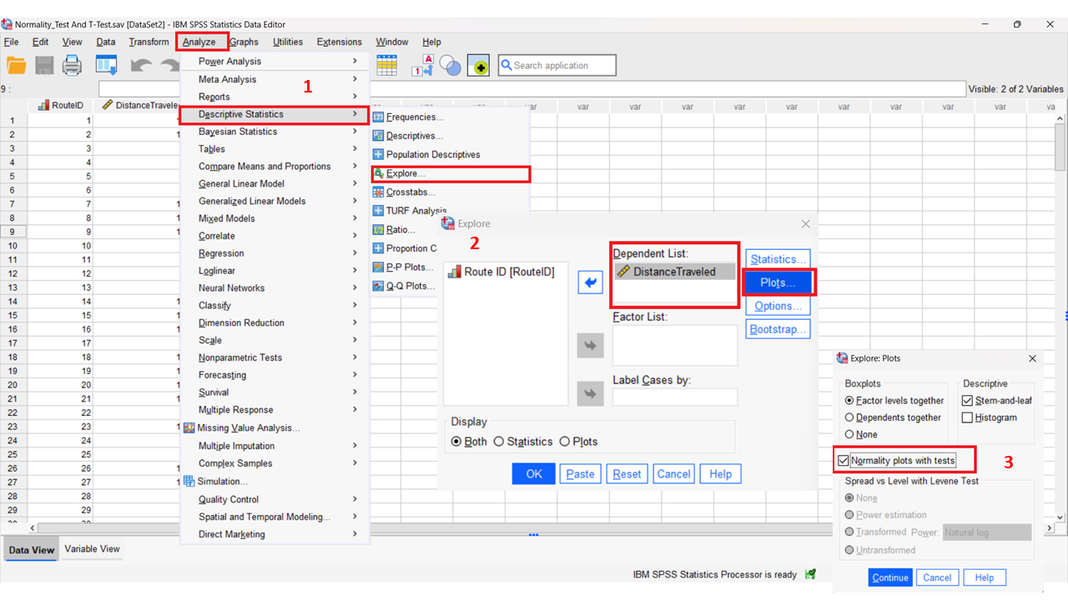
Test of normality approach
The final test is the Test of normality;
Normally not needed if the histogram and Q-Q Plot were positive;
More complex and sensitive, which can lead to conflicting results and interpretation;
To initiate go “Analyze”, “Descriptive Statistics”, “Explore” and input your variable in Dependent List, then select under “Plots” list “Normality plots with tests”.
Figure 10. Test of normality settings

Slide 22
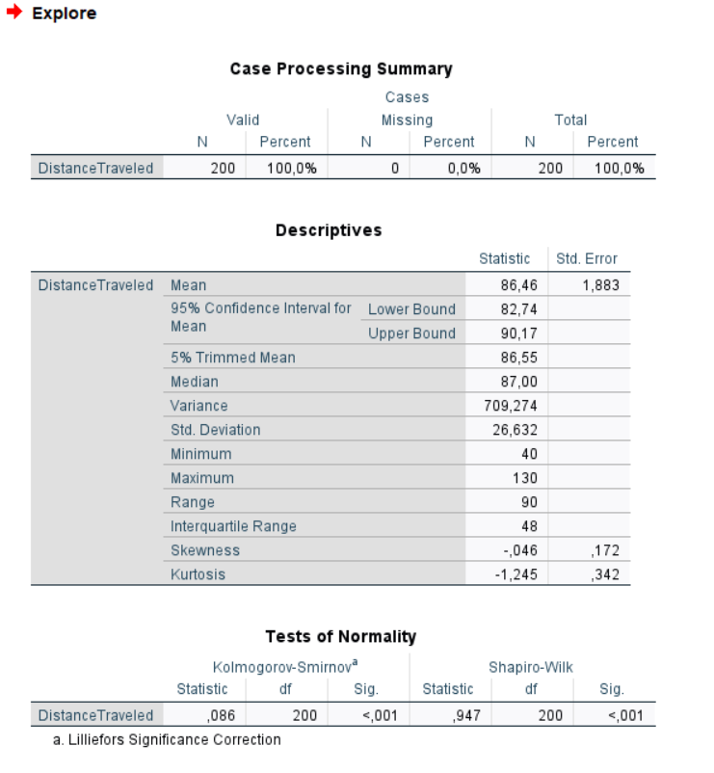
Test of normality example
The test of normality is positive if either Kolmogorov-Smirnov or Shapiro-Wilk Significance value (p-value) have a value higher than 0.05;
Shapiro-Wilk is more sensitive and more reliable for the positivity of the test;
In our case both cases a p-value of <0,001 was detected which indicates that the test is negative;
However, this could be the result of our large database of 200 variables;
Considering the Statistic values for both tests, it provides an indication for normal distribution, while p-value denies it.
Figure 11. Test of normality results

Slide 23
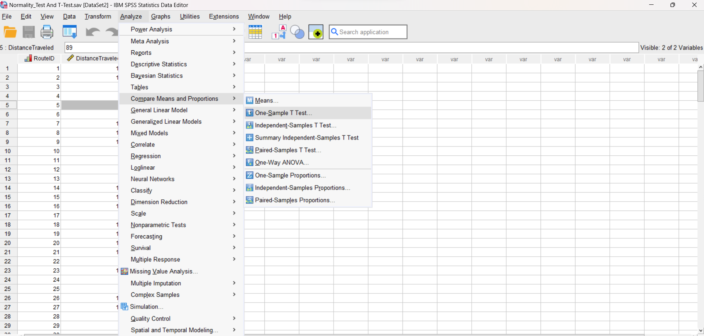
Students T-Test
The first statistical test we will experiment with is the students T-test;
The test consists of 1 categorical variable and 1 numerical variable;
We will employ the database from previous examples, while providing a hypothesis;
The logistic company that gathered the distances for their deliveries, needs an answer on the following question: “Is the average distance of their deliveries lower than 70 kilometers?”
To conduct the test, we go “Analyze”, “Compare Means” and the “One-Sample T-Test”.
Figure 12. Students T-Test settings
Source: Cronk (2016)
Link to video on youtube: https://www.youtube.com/watch?v=nwiVH6O_CRQ

Slide 24
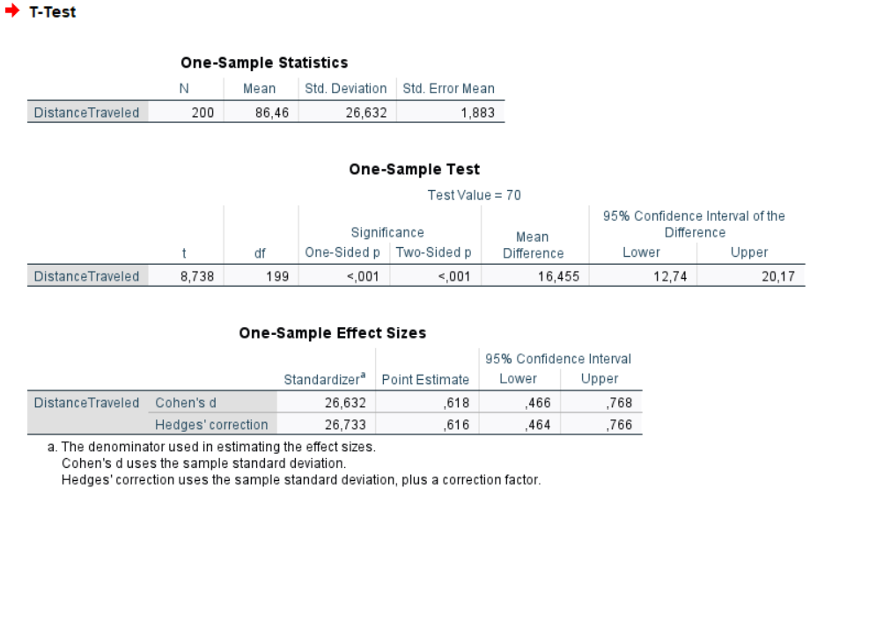
Students T-Test
For the results, several information are important;
Firstly, the One-tailed and Two-tailed p-values are well bellow the 0.05 value, meaning our test has a high statistical significance;
Secondly the t-value is quite high, indicating a greater difference between the sample mean and the hypothesized mean;
Thirdly, the mean difference value is 16.46. This means that on average the distance is higher for 16.455 kilometers that hypothesized 70 kilometers;
Considering the results, our null hypothesis is rejected (the average distance is equal to 70 km);
Instead, the alternative hypothesis is confirmed (the average distance is higher that 70 km).
Figure 13. Students T-Test results

Slide 25
Correlation
Lets continue with the Correlation;
Here we have two numerical variables we analyze to identify correlations between the two;
We have a logistics company, that has a history of the last 50 deliveries, with both number of vehicles and total delivery time;
The manager wonders, if there is a correlation between the number of delivery vehicles and the delivery time – simply told if more vehicles lower or increase the delivery time.
We first make normality tests. After concluding we go “Analyze”, “Correlate” and “Bivariate”.
Make sure “Pearson”, “Two-tailed” and “Flag significant” are also selected.
Source: Meyers et al. (2013)
Link to video on youtube: https://www.youtube.com/watch?v=2BeYY8JgokU

Slide 26
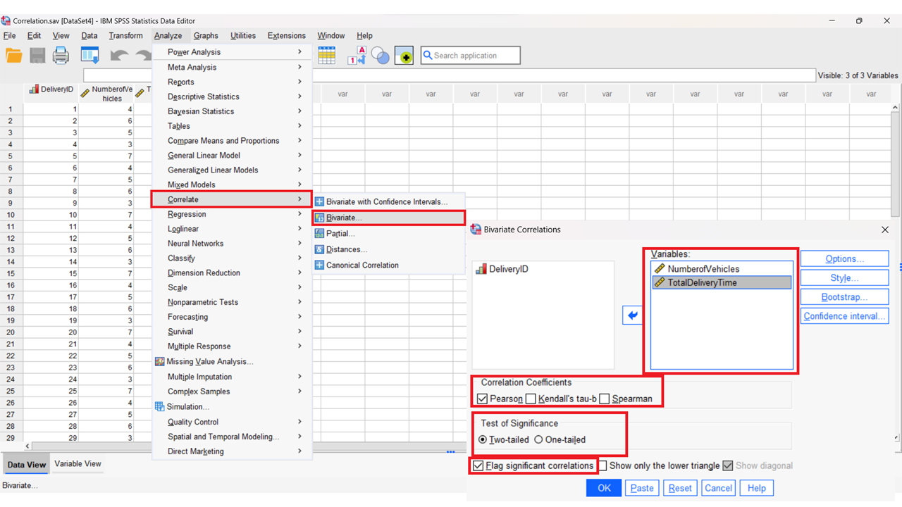
Correlation
Figure 14. Correlation settings
Note: If not normal distribution, choose “Spearman” instead!

Slide 27
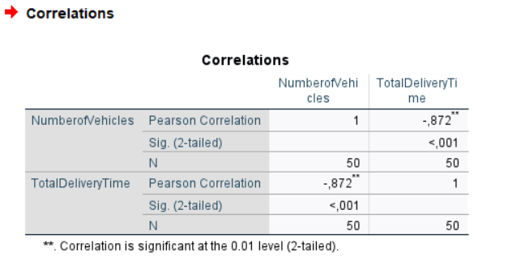
Correlation
The results we gained are positive oriented;
The p-values from Sig. (2-tailed) are less that 0.05, indicating high statistical significance of our results;
The p-values also indicates that there is possible correlation between the two variables;
The negative value Pearson Correlation of -0,872 is also quite high (the closer to 1, the higher the correlation);
Based on the negative value of -0,872 it indicates that increasing number of vehicle negatively affects delivery time through lowering the needed delivery time.
Figure 15. Correlation results

Slide 28
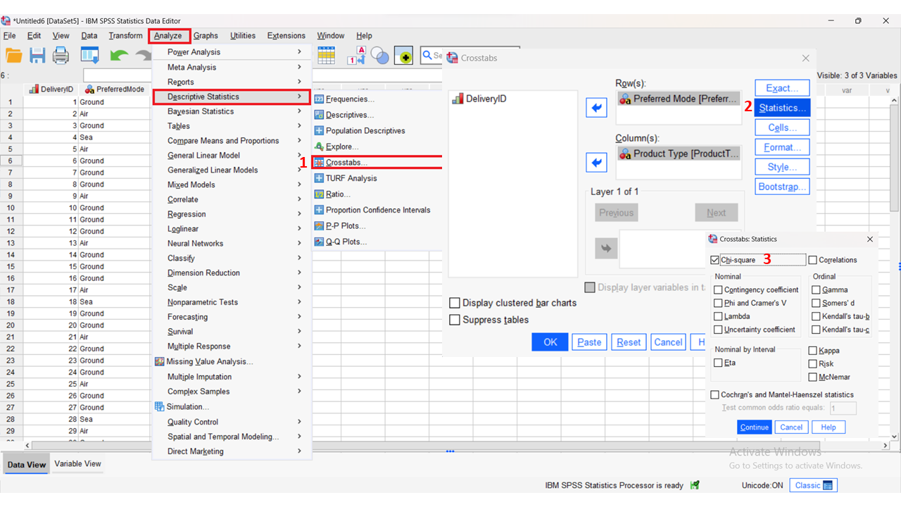
Chi-Square Test
The next test is Chi-Square;
Here we have two categorical variables, for which we compare for any relatedness;
We have a logistical company, that has 50 delivery information’s, which include delivery type and the goods delivered.
The companies questions is “If there is a significant relationship between the two variables?”
We click on “Analyze”, “Descriptive Statistics” and “Crosstabs”. Under “Statistics” we select “Chi-Square”.
Figure 16. Chi-Square Test settings
Source: Meyers et al. (2013)
Link to video on youtube: https://www.youtube.com/watch?v=7oq6snUiXb0

Slide 29
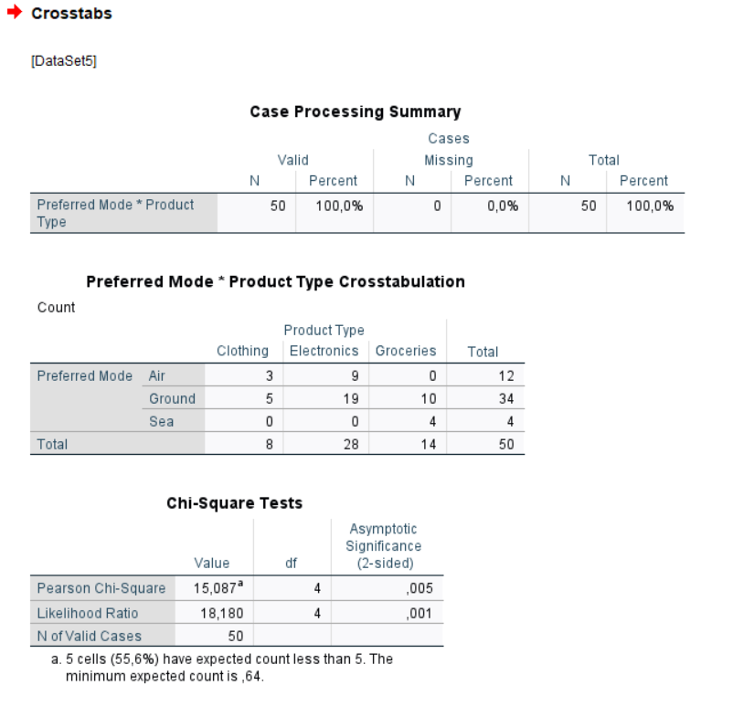
Chi-Square Test
The results from the Pearson Chi-Square value (χ²) provided a value of 15.087, which could indicate some level of correlations between the two variables;
The p-value is just on the limit of 0.05, meaning that the results are statistically significant;
Considering the question, we can relate that a null hypothesis was rejected (no correlation between the mode and goods);
Instead the alternative hypothesis is confirmed (there is a correlation between mode and goods);
This could indicate, that company should follow up with more analysis regarding its current delivery practices.
Figure 17. Chi-Square Test results

Slide 30
ANOVA Test
The last test we will experiment with is the ANOVA or more specifically the one-way ANOVA test;
We have a logistics company that cooperates with three different air carriers and has delivery times (in days) for their deliveries.
The company's question is “Does the choice of the air carrier affect the delivery time?”
Go to “Analyze”, “Compare Means and Proportions” and “One-way ANOVA”.
The dependent variable goes into “Dependent List” box and the Factor variable in the “Factor” box.
Source: Gamst et al. (2008)
Link to video on youtube: https://www.youtube.com/watch?v=OEOeXpxSjf8

Slide 31
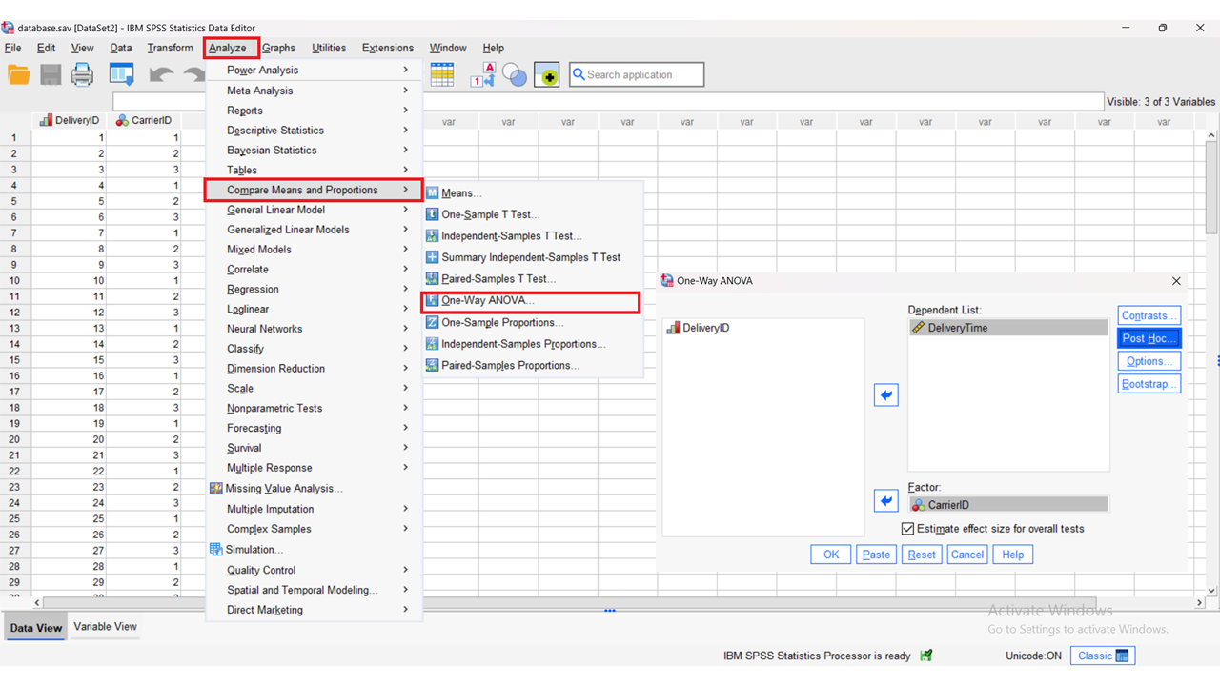
ANOVA Test
Figure 18. ANOVA settings

Slide 32
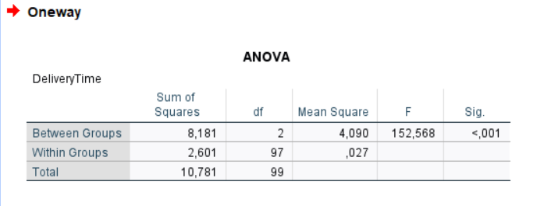
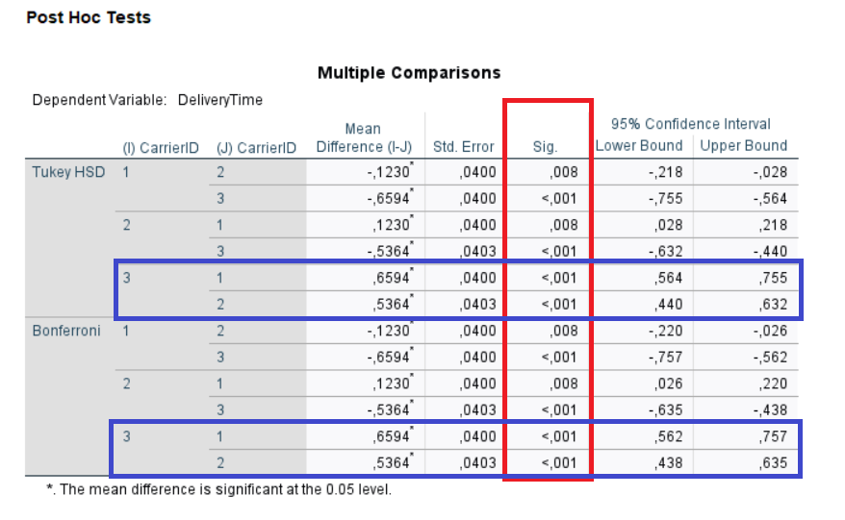
ANOVA Test
The results from ANOVA are positive;
Especially the F-value is vital, as at 152.568 indicates that the variation between groups is higher than the variation within the groups (namely air carriers);
The p-value of <0.001 indicates a high statistical significance, which can be used to reject null hypothesis (there is no difference between delivery times of air carriers).
This indicates that a post hoc analysis is viable. Going back to the settings for the ANOVA, click on “Post hoc” button, and choose the Tukey and Bonferroni for the calculation.
In both cases, we can notice that the best result is for Air carrier 3 regarding delivery times.
Figure 19. ANOVA results

Slide 33
ANOVA Test - Scenario
From the dataset provided, we were able to conclude that the best option is Carrier No.3;
Let's create a scenario where the logistics company starts to cooperate with a fourth carrier company;
For the new carrier, generate random numbers and rerun the ANOVA Test;
Which carrier is the most viable option currently?

Slide 34
Summary
We learned the basic functions of SPSS software
We learned data management with SPSS software
We learned how to conduct normality tests as a preparation before statistical tests
We learned how to set the Student T-Test, Correlation, Chi-Square and ANOVA test in the SPSS software
We learned how to read the results of statistical tests in the SPSS software

Slide 35
References
Almquist, Ylva B; Kvart, Signild; Brännström, Lars (2019). A practical guide to quantitative methods with SPSS. Research Reports in Public Health Sciences. Preprint. https://doi.org/10.17045/sthlmuni.10321829.v2
DeCoster, J., & Claypool, H. M. (2004). Data Analysis in SPSS. Retrieved <June, 4th, 2024> from http://www.stat-help.com/notes.html
Cronk, B. C. (2016). How to use IBM SPSS statistics: A step-by-step guide to analysis and interpretation. Routledge.
Meyers, L. S., Gamst, G. C., & Guarino, A. J. (2013). Performing data analysis using IBM SPSS. John Wiley & Sons.
Gamst, G., Meyers, L. S., & Guarino, A. J. (2008). Analysis of variance designs: A conceptual and computational approach with SPSS and SAS. Cambridge University Press.

Slide 36
Authors:
Sanja Bojić, Kristijan Brglez , Maja Fošner, Roman Gumzej, Rebeka Kovačič Lukman, Benjamin Marcen, Marinko Maslarić, Boško Matović, Dejan Mirčetić
Final version: June 2025

Slide 37
Thank you for your attention

