Slide 1


STATISTICAL METHODS FOR ANALYSING LOGISTICS DATA
Data Management
Slides
BAS4SC
Business Analytics Skills
for the Future-proof Supply Chains
Project number – 2022-1-PL01-KA220-HED-000088856

Slide 2
Agenda
Information - Data – Knowledge
Information in logistics
Logistic data standards
Data organization and management
Data acquisition, filtering and presentation

Slide 3
Information-Data-Knowledge
In computer based information systems the representation of information varies depending on its purpose and use. It may be alphanumeric or binary considering the fact whether it represents a text, figure, sound or executable program…
The process of transforming data from their original analogue into the digital form is popularly termed digitization.
When collected, data of various types may be joined and organized into tables of data, data bases, data warehouses (chronological order) or knowledge bases (conceptual order).
Higher levels of data organization allow for automated classification, reasoning and representation of the hereby accumulated knowledge for analytic purposes.

Slide 4
Information in Logistics
„Logistics – that part of the supply chain process that plans, implements, and controls the efficient, effective forward and reverse flow and storage of goods, services, and related information between the point of origin and the point of consumption to meet customers' requirements.“
CSCMP Definition of Logistics (Management)

Slide 5
Logistic Data
In logistics Electronic Data Interchange (EDI) is used to transmit transaction data between business partners.
Since they may use different languages and applications their conversion to a common format (e.g., XML, JSON) is necessary to be interpretable by different partner’s information systems.
For quick identification and manipulation barcodes and RFID tags were devised.
Source: (GS1, 2023), (W3 Schools, 2023)

Slide 6


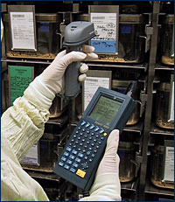

Transactions...
POS
STORAGE/DISTRIBUTION
INFORMATION CHANNEL
MATERIALS PLANING
INVENTORY MANAGEMENT
COMPUTER CENTRE

Slide 7
Tagging technologies
Technology | Application
Bar 1D | Retail items and product components
Bar 2D | Services (e.g., UPS, air-tickets), wholesale items requiring tracking
RFID class 1 (passive, R-tags) | Items requiring mass identification, access control
RFID class 2 (passive, RW-tags) | Items requiring tracking
RFID class 3 (semi-active, RW-tags) | Access control with added tracking information
RFID class 4 (active, RW-tags) | Closed space tracking and tracing
RFID class 5 (active tags/interrogators) | Open space tracking and tracing, proximity services with enabled devices, location-based services
Source: (GS1, 2024)

Slide 8
Future trends in tagging and tracing
Future trends in tagging, tracking and tracing follow two main directions:
  miniaturization and
  diversity.
The databar (1D) codes shall also enable tagging miniature items (e.g., medical capsules).
Novel datamatrix (2D) codes shall not only enable error correction while scanning but also data encryption.
RFID continues to spread to other usage areas like the identification by service providers (e.g., rail-card, registration at work, etc.), contactless payments (e.g., wireless money transfers, payments at vending machines) and smart solutions (e.g., smart home management, remotely operating smart devices, etc.) as well as e-currencies.

Slide 9
Data organization
Apart from having a certain format the data may be organized in different ways to facilitate their management, processing and presentation.
Although data on their input are mostly unstructured, by their storage, transmission and processing their organization increases.
The usual forms of data organization by increasing complexity represent semi-structured (e.g., CSV) and structured (e.g., spreadsheets, databases, etc.) data formats:
  The first form of data organization is by two-dimensional arrays of fields, also called tables or spreadsheets.
  There are various forms of DB organization with the relational model (RDB) being the most common. The RDB model is based on the concept of entities and relations.
  Since there are usually no fixed paths of searching through the database files, various query languages (e.g., SQL) have been devised for data retrieval and manipulation.
Source: (W3 Schools, 2023)

Slide 10
Raw transaction data (CSV)
descriptor
transactions
Date,SellerID,CustomerID,TransactionID,ProductID,ProductPrice
1.10.24,1,12,1,101,195
1.10.24,1,12,1,102,45
1.10.24,1,12,1,103,35
1.10.24,2,14,2,104,55
1.10.24,2,14,3,101,195
2.10.24,3,15,4,105,85
2.10.24,3,15,4,101,195
2.10.24,3,15,4,103,35
2.10.24,3,16,5,104,55
2.10.24,1,17,6,101,195
2.10.24,1,17,6,102,45
...
CSV (Comma Separated Values)

Slide 11
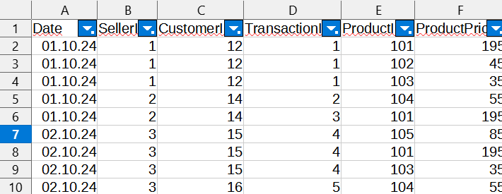
CSV to spreadsheet data
column
row
cell
Source: LibreOffice screenshot of the DB (2024) spreadsheet

Slide 12
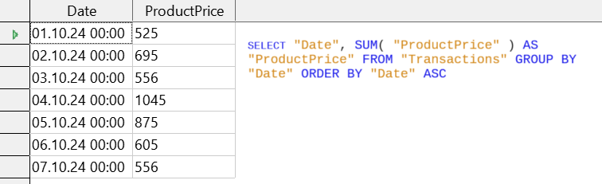
Spreadsheet to database data + SQL query
Source: LibreOffice screenshot of the DB (2024) database

Slide 13
RDB construction
In general, there are two approaches to constructing a RDB: analytic and synthetic.
The analytic approach to RDB construction comprises the following four steps:
  Real world analysis - global model
  Determine entities and relations – conceptual model (e.g., E-R diagram)
  Determine logical model – relational schema
  Build the database (DBMS) – physical model
The synthetic approach to an RDB comprises the following three steps:
  Data analysis – list of all relevant attributes
  Determine logical model by normalization – relational schema
  Physical model (DBMS)
Source: (Codd, 1970), (Kent, 1983)

Slide 14
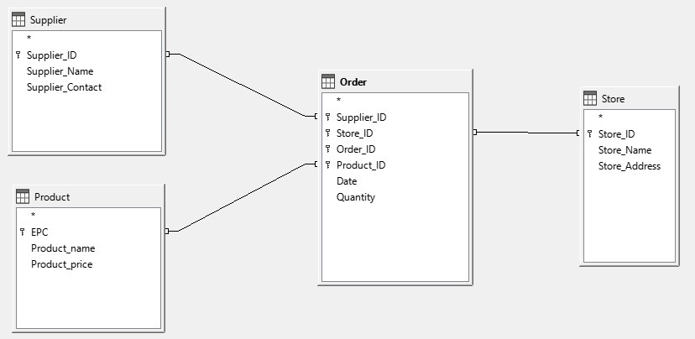
E-R diagram (RDB conceptional model)
entity
keys
relation
Source: LibreOffice screenshot of the MyStore (2024) database

Slide 15
RDB Queries
Query languages are mainly of two types:
  Structured Query Language (SQL) and
  Query by Example (QBE).
While SQL (on previous slide) is considered a programming language and a DBMS’s API, QBE (on next slide) is mainly used with the DBMS directly for DB management and data warehousing.
Queries produce tables of results, which can be used for building data warehouses or reused in further queries.
Source: (W3 Schools, 2023)

Slide 16
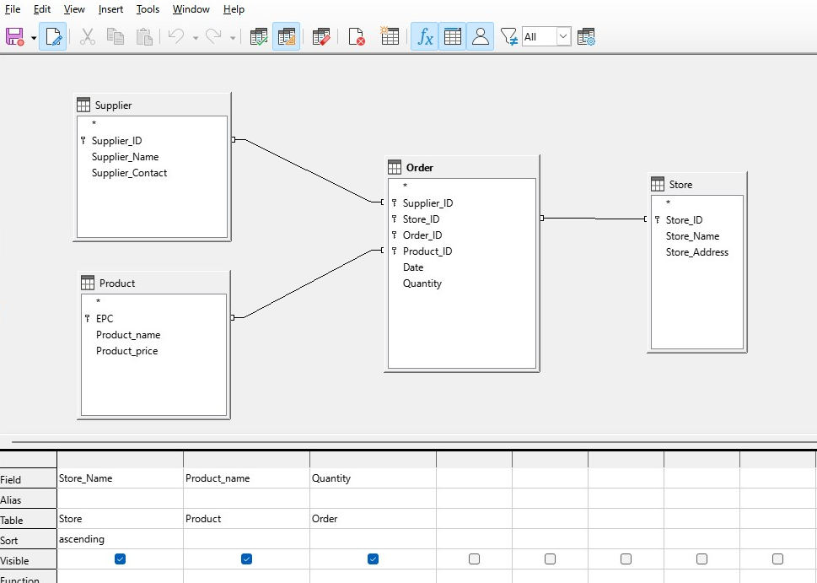
Query by Example (QBE)
Source: LibreOffice screenshot of the MyStore (2024) database

Slide 17
Data preparation
In order to prevent erroneous or incomplete data, which could interfere with their processing and interpretation, additional precautions should be applied:
  Filtering out empty rows and columns;
  Applying strong data typing to prevent computational errors;
  Defining input masks to prevent input of wrong data;
  Data biasing to prevent erroneous results.

Slide 18
Summary
In this chapter different aspects of data management in logistics have been dealt with.
Apart from data representations and data storage standards, different data organization and retrieval mechanisms have been presented.
Finally, some common mistakes in automated data processing have been addressed.

Slide 19
References
Codd E.F. (1970). A relational model of data for large shared data banks. Communications. ACM 13, 6, pp. 377–387.
GS1 (2023). GS1 Standards. [available at: https://www.gs1.org/standards, access October 27th, 2023]
Kent, W. (1983). A Simple Guide to Five Normal Forms in Relational Database Theory, Communications of the ACM, vol. 26, pp. 120-125.
W3schools (2023). XML Tutorial [available at: https://www.w3schools.com/xml/, access November 3rd, 2023]
W3schools (2023). JSON - Introduction [available at: https://www.w3schools.com/js/js_json_intro.asp, access November 3rd, 2023]
W3schools (2023). Database Normalization [available at: https://www.w3schools.in/DBMS/database-normalization/, access December 7th, 2023]

Slide 20
Authors:
Sanja Bojić, Kristijan Brglez , Maja Fošner, Roman Gumzej, Rebeka Kovačič Lukman, Benjamin Marcen, Marinko Maslarić, Boško Matović, Dejan Mirčetić
Final version: June 2025

Slide 21
Thank you for your attention

