Slide 1


Statistical methods for analysing logistics data
Linear regression with single and multiple regressors
Lecture
BAS4SC
Business Analytics Skills
for the Future-proof Supply Chains
Project number – 2022-1-PL01-KA220-HED-000088856

Slide 2
Introduction to
Regression Analysis
In this chapter, you learn:
How to use regression analysis to predict the value of a dependent variable based on a value of an independent variable
To understand the meaning of the regression coefficients b₀ and b₁
To evaluate the assumptions of regression analysis and know what to do if the assumptions are violated
To make inferences about the slope and correlation coefficient
To estimate mean values and predict individual values

Slide 3
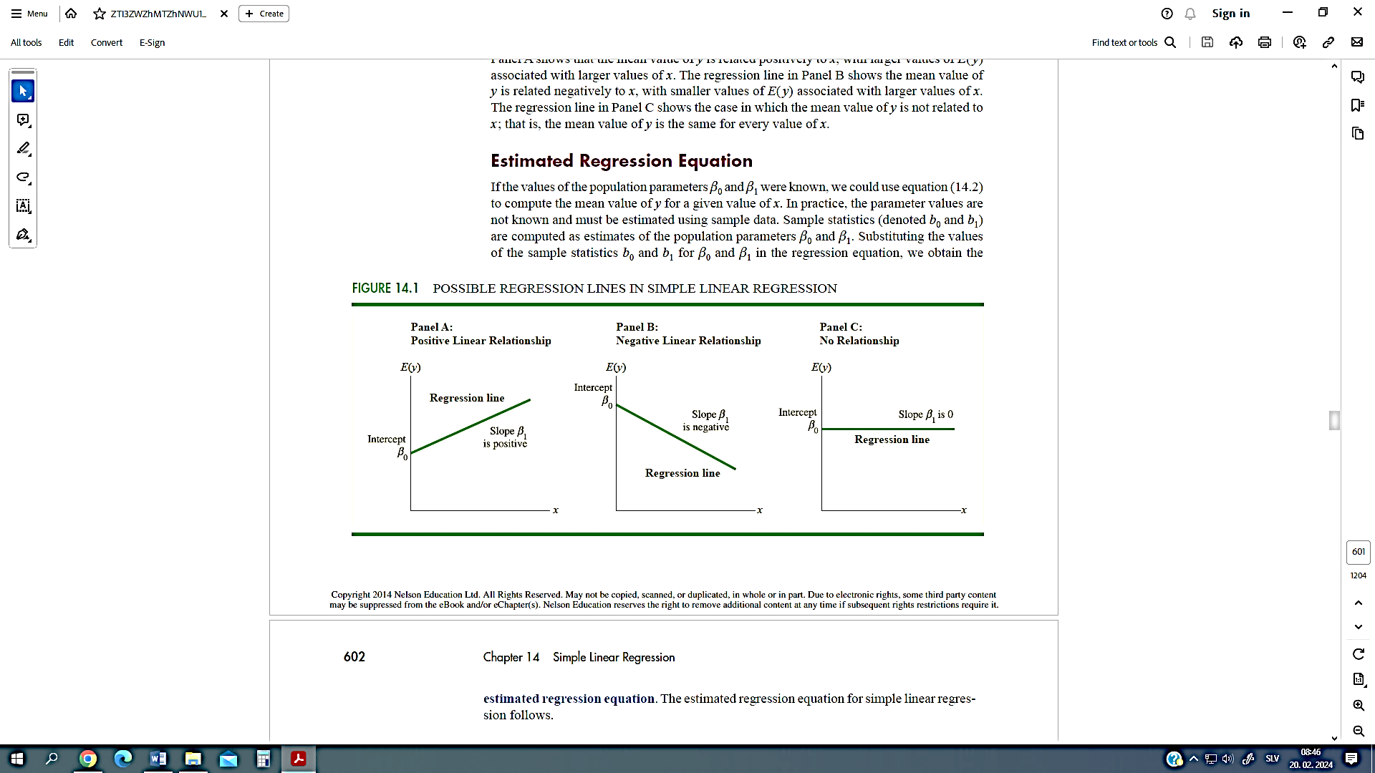
Correlation vs. Regression
A scatter plot can be used to show the relationship between two variables
Correlation analysis is used to measure the strength of the association (linear relationship) between two variables
  Correlation is only concerned with strength of the relationship
  No causal effect is implied with correlation

Slide 4
Introduction to
Regression Analysis
Regression analysis is used to:
  Predict the value of a dependent variable based on the value of at least one independent variable
  Explain the impact of changes in an independent variable on the dependent variable
Dependent variable: the variable we wish to predict or explain
Independent variable: the variable used to predict or explain the dependent variable

Slide 5
Simple Linear Regression Model
Population Slope
Coefficient
Random Error term
Population
Y intercept
Independent Variable
Only one independent variable, X
Relationship between X and Y is described by a linear function
Changes in Y are assumed to be related to changes in X
Linear component
Random Error
component
Dependent Variable

Slide 6
Simple Linear Regression
Model
Y
Observed Value of Y for X_{i}
ε_{i}
Slope = β₁
Predicted Value of Y for X_{i}
Random Error for this X_{i} value
Intercept = β₀
X_{i}
X

Slide 7
Simple Linear Regression Equation (Prediction Line)
The simple linear regression equation provides an estimate of the population regression line
Estimated (or predicted) Y value for observation i
Estimate of the regression
intercept
Estimate of the regression slope
Value of X for observation i

Slide 8
The Least Squares Method
b₀ and b₁ are obtained by finding the values that minimize the sum of the squared differences between Y and Y :
Source: Source

Slide 9
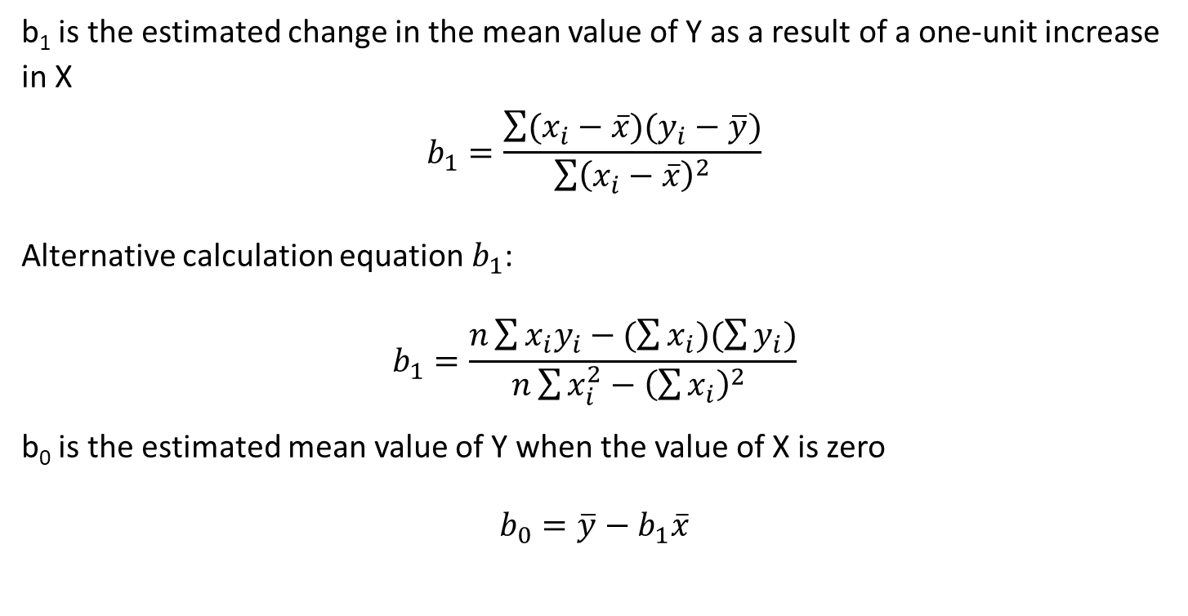
Interpretation of the
Slope and the Intercept
b₁ is the estimated change in the mean value of Y as a result of a one-unit increase in X
$$b_{1}=\frac{\sum{(x_{i}−\overline{x})(y_{i}−\overline{y})}}{\sum{{\left(x_{i}−\overline{x}\right)}^{2}}}$$
Alternative calculation equation $b_{1}$:
$$b_{1}=\frac{n\sum{x_{i}y_{i}−(\sum{x_{i}})(\sum{y_{i}})}}{n\sum{x_{i}^{2}−{\left(\sum{x_{i}}\right)}^{2} }}$$
b₀ is the estimated mean value of Y when the value of X is zero
$$b_{0}=\overline{y}−b_{1}\overline{x}$$

Slide 10
Simple Linear Regression
Example
As an illustration of simple linear and multiple regression analysis, we will consider the problem faced by Logist Trucking Company, an independent trucking company in Italy. The largest part of Logist's business involves deliveries throughout the local area. For better development
work schedules, managers want to plan a common daily travel time for their drivers.
Initially, managers believed that the total daily journey time would be closely linked to the number of km travelled in daily deliveries. A simple random sample of 10 driver assignments provided the data shown in next table and a scatter plot.

Slide 11
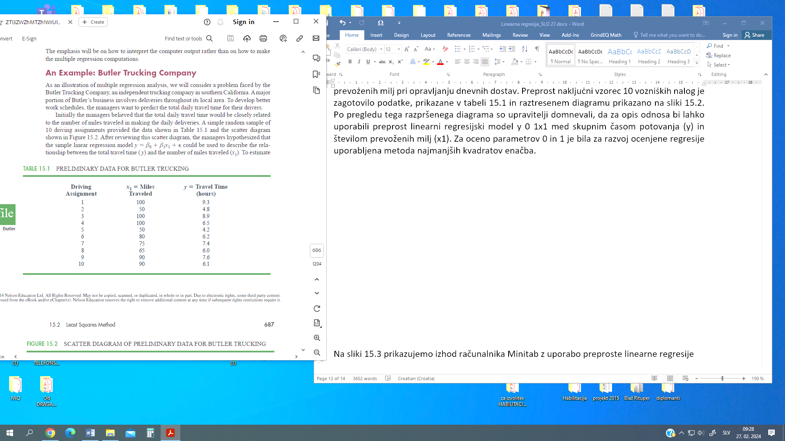
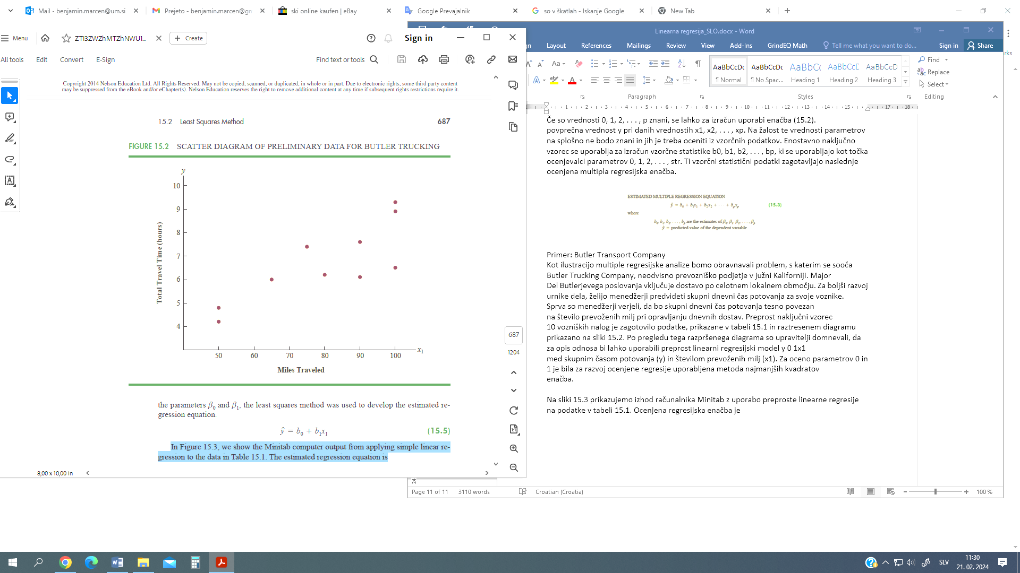
Simple Linear Regression
Example

Slide 12
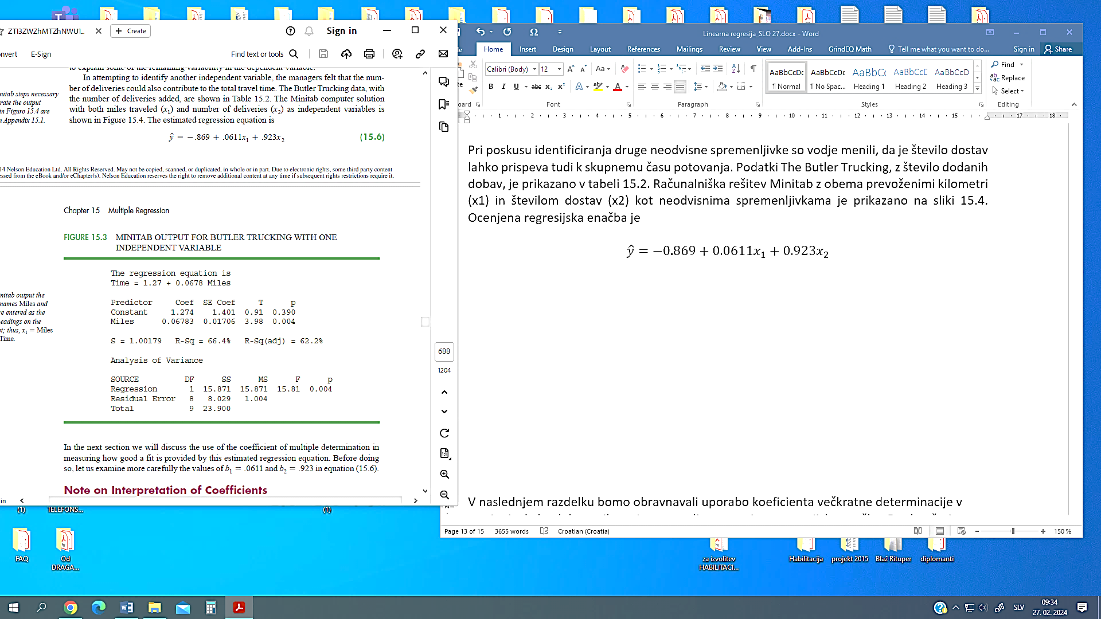
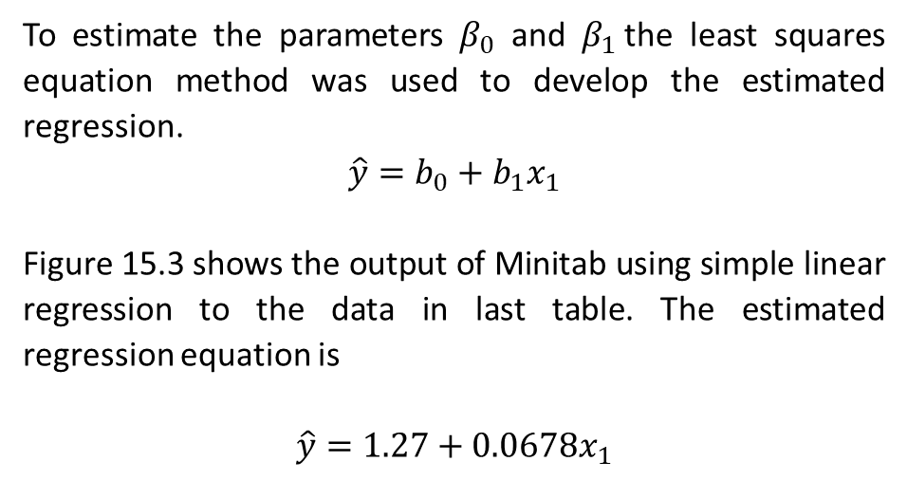
Simple Linear Regression
Example
To estimate the parameters $β_{0}$ and $β_{1}$the least squares equation method was used to develop the estimated regression.
$$\hat{y}=b_{0}+b_{1}x_{1}$$
Figure 15.3 shows the output of Minitab using simple linear regression to the data in last table. The estimated regression equation is
$$\hat{y}=1.27+0.0678x_{1}$$

Slide 13
Multiple Regression Model
In this section, we continue our study of regression analysis by considering situations involving two or more independent variables. This subject area, called multiple regression analysis, allows us to take more factors into account and thus obtain better predictions than are possible with simple linear regression.
Multiple regression analysis is the study of how the dependent variable y is related to two or more independent variables. In the general case, we will denote by p the number of independent variables.

Slide 14
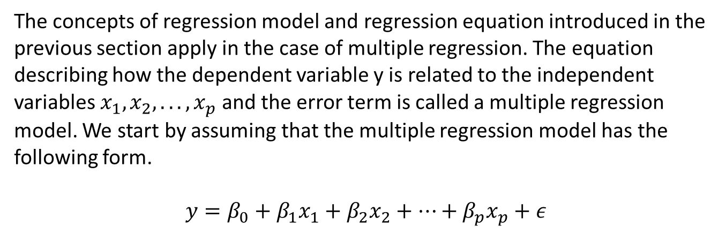
Regression model and regression equation
The concepts of regression model and regression equation introduced in the previous section apply in the case of multiple regression. The equation describing how the dependent variable y is related to the independent variables $x_{1}, x_{2}, . . . , x_{p}$and the error term is called a multiple regression model. We start by assuming that the multiple regression model has the following form.
$$y=β_{0}+β_{1}x_{1}+β_{2}x_{2}+…+β_{p}x_{p}+ε$$

Slide 15
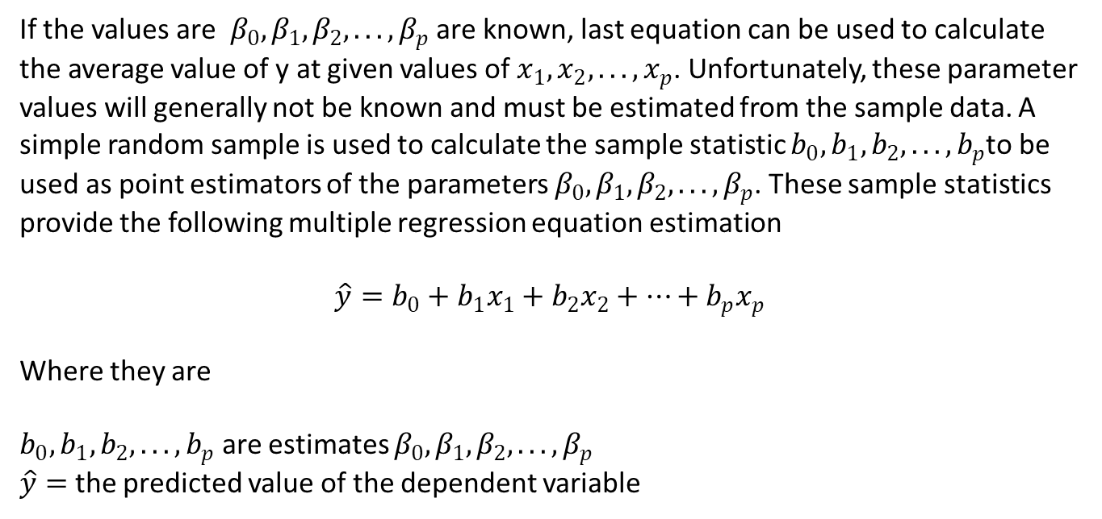
Estimated multiple regression equation
If the values are $β_{0},β_{1}, β_{2}, . . . , β_{p}$ are known, last equation can be used to calculate the average value of y at given values of $x_{1}, x_{2}, . . . , x_{p}$. Unfortunately, these parameter values will generally not be known and must be estimated from the sample data. A simple random sample is used to calculate the sample statistic $b_{0},b_{1}, b_{2}, . . . , b_{p}$to be used as point estimators of the parameters $β_{0},β_{1}, β_{2}, . . . , β_{p}$. These sample statistics provide the following multiple regression equation estimation
$$\hat{y}=b_{0}+b_{1}x_{1}+b_{2}x_{2}+…+b_{p}x_{p}$$
Where they are
$b_{0}, b_{1}, b_{2}, . . . , b_{p}$ are estimates $β_{0}, β_{1}, β_{2}, . . . , β_{p}$
$\hat{y}=$ the predicted value of the dependent variable

Slide 16
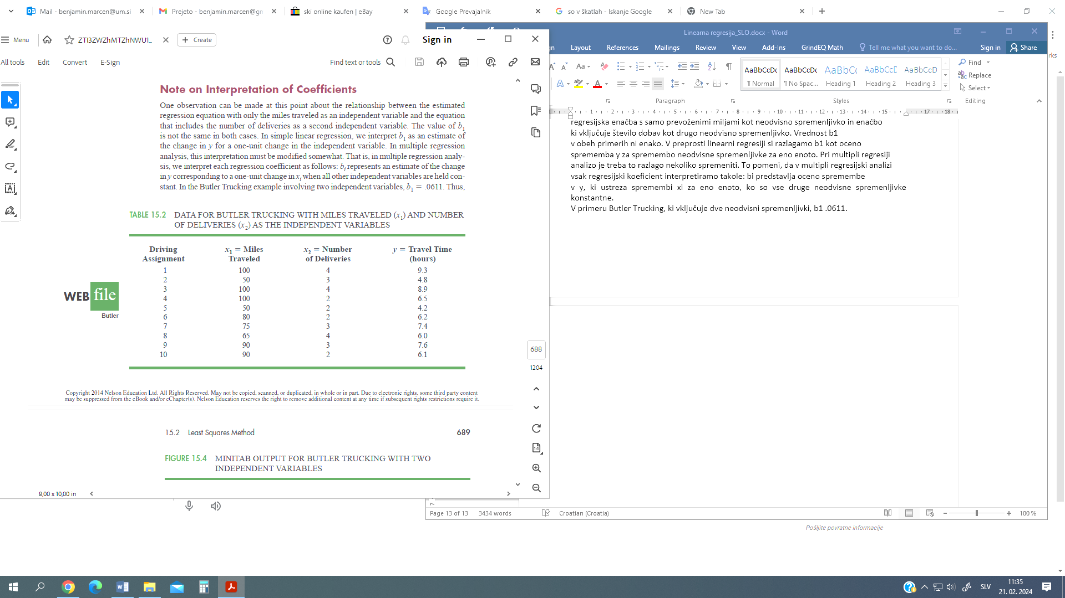
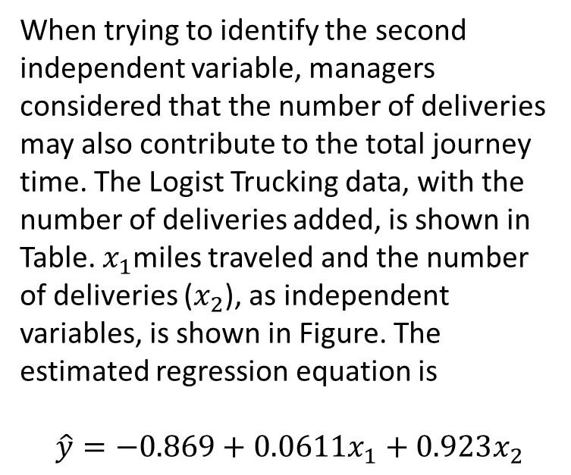
Simple Multiple Regression
Example
When trying to identify the second independent variable, managers considered that the number of deliveries may also contribute to the total journey time. The Logist Trucking data, with the number of deliveries added, is shown in Table. $x_{1}$miles traveled and the number of deliveries ($x_{2}$), as independent variables, is shown in Figure. The estimated regression equation is
$$\hat{y}=−0.869+0.0611x_{1}+0.923x_{2}$$

Slide 17
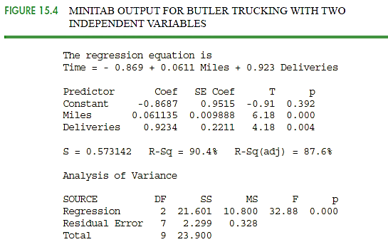
Simple Multiple Regression
Example
In multiple regression analysis this interpretation needs to be modified slightly. That is, in multiple regression analysis, each regression coefficient is interpreted as follows: would represent an estimate of the change in the ycorresponding to the change in xi by one unit when all other independent variables are held constant.
In the case of Logist Trucking, that involves two independent variables, b1=0.0611.
Thus, 0.0611 hours is an estimate of the expected increase in travel time corresponding to an increase in one mile per distance travelled when the number of deliveries is constant. Similarly, since b2 .923, the estimate of the expected increase in journey time corresponding to an increase of one delivery when the number of miles travelled is constant is 0.923 hours.

Slide 18
Literature:
Introductory Statistics 2e, Openstax, Rice University, Houston, Texas 77005, Jun 23, senior contributing authors: Barbara Illowsky and Susan dean, De anza college, Publish Date: Dec 13, 2023, (https://openstax.org/details/books/introductory-statistics-2e);
Introductory Statistics 4th Edition, Susan Dean and Barbara Illowsky, Adapted by Riyanti Boyd & Natalia Casper (Published 2013 by OpenStax College) July 2021, (http://dept.clcillinois.edu/mth/oer/IntroductoryStatistics.pdf );
Introductory Statistics 7th Edition, Prem S. Mann, eastern Connecticut state university with the help of Christopher Jay Lacke, Rowan university, John Wiley & Sons, Inc., 111 River Street, Hoboken, NJ 07030-5774, 2011
Introduction to statistics, made easy second edition, Prof. Dr. Hamid Al-Oklah Dr. Said Titi Mr. Tareq Alodat, March 2014
Statistics for Business and Economics, Thirteenth Edition, David R. Anderson, Dennis J. Sweeney, Thomas A. Williams, Jeffrey D. Camm, James J. Cochran, 2017, 2015 Cengage Learning®
Statistics for Business, First edition, Derek L Waller, 2008 Copyright © 2008, Derek L Waller, Published by Elsevier Inc. All rights reserved

Slide 19
Internet pages:
https://open.umn.edu/opentextbooks/textbooks/196
https://www.scribbr.com/category/statistics/
https://stats.libretexts.org/Bookshelves/Introductory_Statistics
https://assets.openstax.org/oscms-prodcms/media/documents/IntroductoryStatistics-OP_i6tAI7e.pdf
https://saylordotorg.github.io/text_introductory-statistics/
https://drive.uqu.edu.sa/_/mskhayat/files/MySubjects/20178FS%20Elementary%20Statistics/Introductory%20Statistics%20(7th%20Ed).pdf
https://dept.clcillinois.edu/mth/oer/IntroductoryStatistics.pdf
https://www.geeksforgeeks.org/introduction-of-statistics-and-its-types/
https://onlinestatbook.com/Online_Statistics_Education.pdf
https://www.researchgate.net/profile/Tareq-Alodat-2/publication/340511098_INTRODUCTION_TO_STATISTICS_MADE_EASY/links/5e8de3dc4585150839c7b58a/INTRODUCTION-TO-STATISTICS-MADE-EASY.pdf
https://byjus.com/maths/statistics/
https://www.khanacademy.org/math/statistics-probability
Youtube links (Regression):
https://www.youtube.com/watch?v=ZkjP5RJLQF4
https://www.youtube.com/watch?v=owI7zxCqNY0
https://www.youtube.com/watch?v=P8hT5nDai6A
https://www.youtube.com/watch?v=HBdJGj_7FHQ
https://www.youtube.com/watch?v=WWqE7YHR4Jc
https://www.youtube.com/watch?v=dQNpSa-bq4M
https://www.khanacademy.org/math/statistics-probability/describing-relationships-quantitative-data/more-on-regression/v/regression-line-example
https://www.youtube.com/watch?v=xZ_z8KWkhXE
https://www.youtube.com/watch?v=11c9cs6WpJU
https://www.youtube.com/watch?v=4EXNedimDMs
https://www.khanacademy.org/math/ap-statistics/bivariate-data-ap/correlation-coefficient-r/v/correlation-coefficient-intuition-examples
https://www.youtube.com/watch?v=9Q5ErbQF_vk
https://www.youtube.com/watch?v=F_mfuifKzgw

Slide 20
Authors:
Sanja Bojić, Kristijan Brglez , Maja Fošner, Roman Gumzej, Rebeka Kovačič Lukman, Benjamin Marcen, Marinko Maslarić, Boško Matović, Dejan Mirčetić
Final version: June 2025

Slide 21
Thank you for your attention

