Slide 1

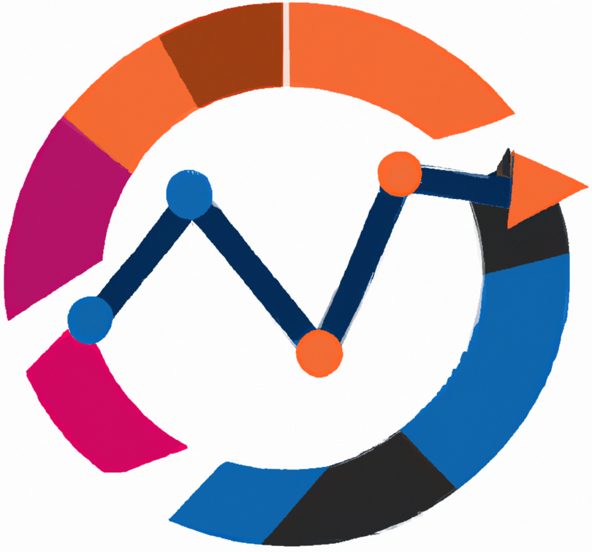

Business Intelligence
Data visualization methods
Lecture
BAS4SC
Business Analytics Skills
for the Future-proof Supply Chains
Project number – 2022-1-PL01-KA220-HED-000088856

Slide 2
Agenda
Understanding of the situation context
Methods of attracting attention
Choosing the right visualization method
The guidelines for good visualization design

Slide 3
Data visualization
a fundamental component of business intelligence that helps decision-makers discern trends, outliers, and patterns hidden within raw data
the process of converting information into a visual context, like a map or graph, and it is used to make data easier for the human mind to comprehend and draw conclusions from
general types of data visualization are charts, tables, maps, and dashboards
visualization is now more crucial than ever due to the growing popularity of big data and data analysis projects.
businesses are employing machine learning more and more to collect vast volumes of data that can be challenging and slow to process, understand, and explain.

Slide 4
Understanding of the situation context
First and most important step before engaging with data visualization techniques and storytelling methods
From the collected and analyzed data, only what is important for the target audience should be displayed
  Who is our target audience
  What do you want your audience to know or do?
  How do you use data to prove something?

Slide 5
Anscombe’s quartet
Variable | 1st set |  | 2nd set |  | 3rd set |  | 4th set
 | x | y | x | y | x | y | x | y
1. 2. 3. 4. 5. 6. 7. 8. 9. 10. 11. | 10 8 13 9 11 14 6 4 12 7 5 | 8,0 7,0 7,6 8,8 8,3 10,0 7,2 4,3 10,8 4,8 5,7 | 10 8 13 9 11 14 6 4 12 7 5 | 9,1 8,1 8,7 8,8 9,3 8,1 6,1 3,1 9,1 7,3 4,7 | 10 8 13 9 11 14 6 4 12 7 5 | 7,5 6,8 12,7 7,1 7,8 8,8 6,1 5,4 8,2 6,4 5,7 | 8 8 8 8 8 8 8 19 8 8 8 | 6,6 5,8 7,7 8,8 8,5 7,0 5,3 12,5 5,6 7,9 6,9
Mean Variance Correlation Regression | 9,0 11,0 0,816 y=3+0,5x | 7,5 4,1 0,816 y=3+0,5x | 9,0 11,0 0,816 y=3+0,5x | 7,5 4,1 0,816 y=3+0,5x | 9,0 11,0 0,816 y=3+0,5x | 7,5 4,1 0,816 y=3+0,5x | 9,0 11,0 0,816 y=3+0,5x | 7,5 4,1 0,816 y=3+0,5x

Slide 6
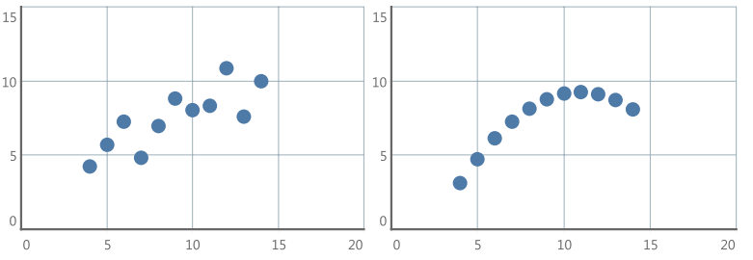
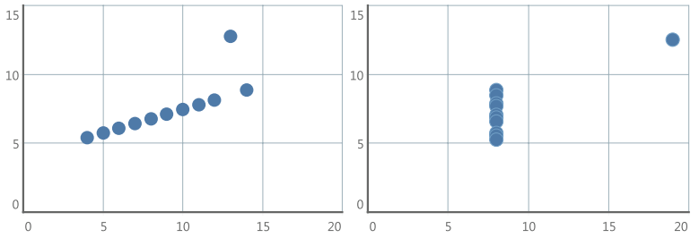
Anscombe’s quartet
Source: Schwabish (2021)

Slide 7
Methods of attracting attention
Gestalt principles
Developed in 1912
The goal was to discover how we perceive patterns, shapes and how we organize the information we see
Gestalt (German) → pattern
Gestalt principles revealed that we try to group objects in certain ways
Source: Brackett (2015); Dalkir (2023); Cotton (2023)

Slide 8
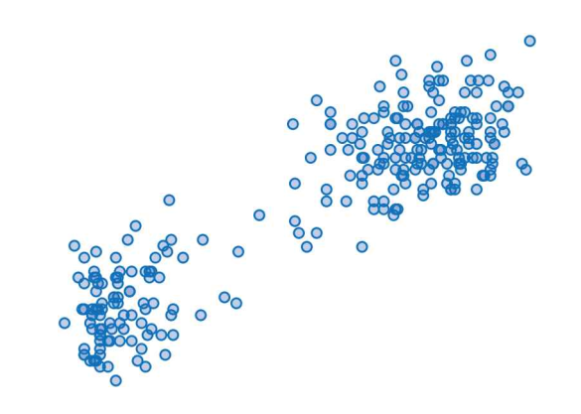
Gestalt principles
Proximity
We perceive objects that are close to each other as belonging to a group
Source: Schwabish (2021)

Slide 9
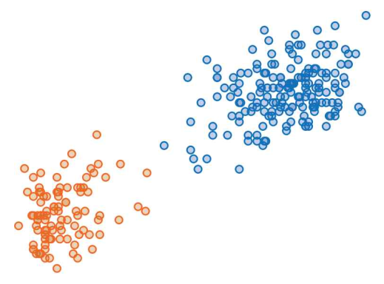
Gestalt principles
Similarity
Our brain groups objects that have the same color, shape, size or direction
Source: Schwabish (2021)

Slide 10
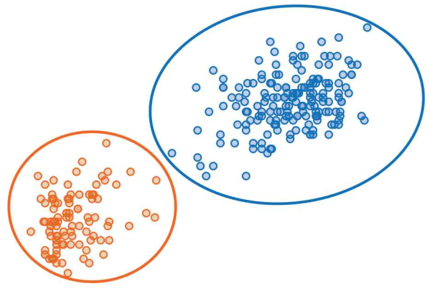
Gestalt principles
Enclosure
If we enclose objects, we will perceive them as a group
Source: Schwabish (2021)

Slide 11
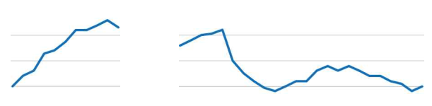


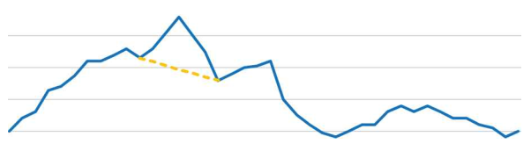

Gestalt principles
Closure
Our brain automatically closes certain unfinished objects or lines
Source: Schwabish (2021)

Slide 12
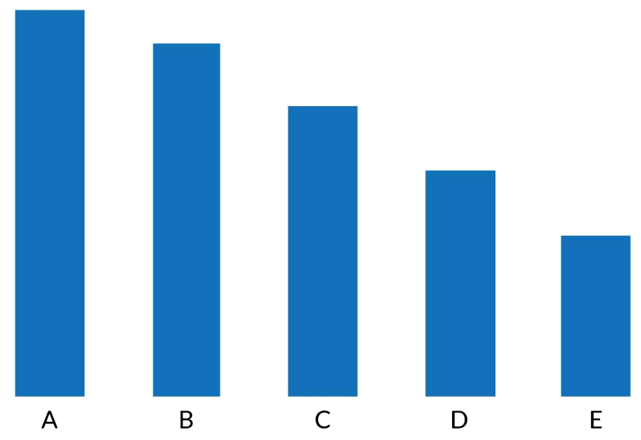
Gestalt principles
Continuity
Looking at an object, our eyes look for the most logical path and naturally create continuity where it may not be indicated
Source: Schwabish (2021)

Slide 13
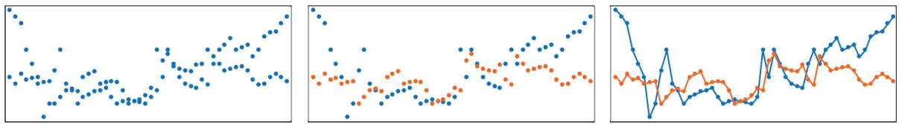
Gestalt principles
Connection
We perceive connected objects as belonging to the same group
Source: Schwabish (2021)

Slide 14
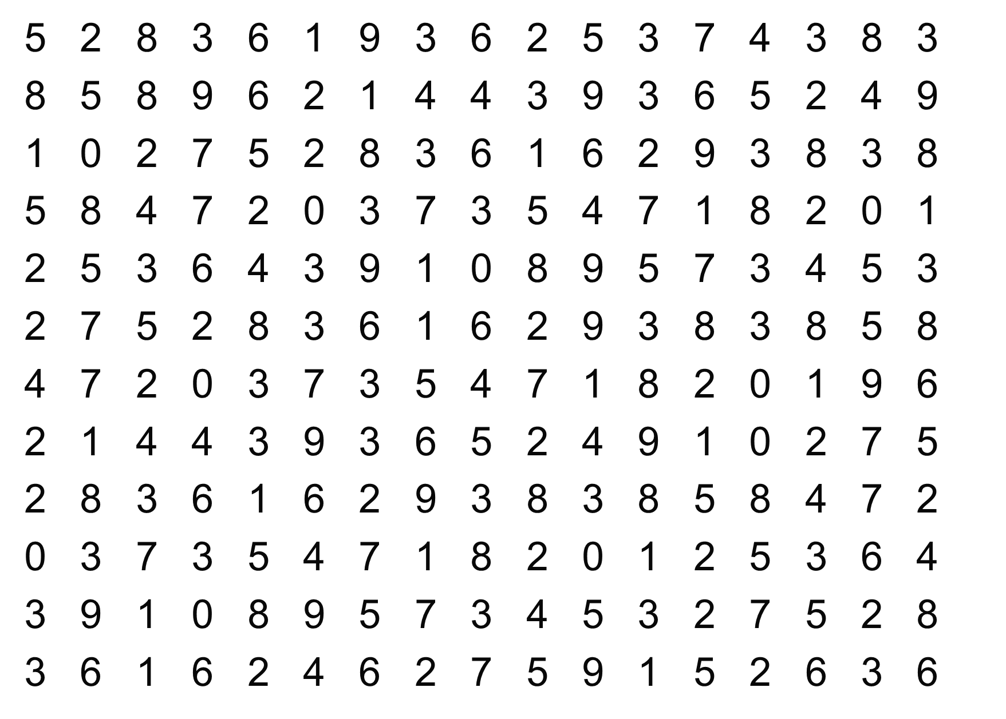
Preattentive attributes
Find how many numbers 7 there are
Source: Wexler et al. (2017)

Slide 15
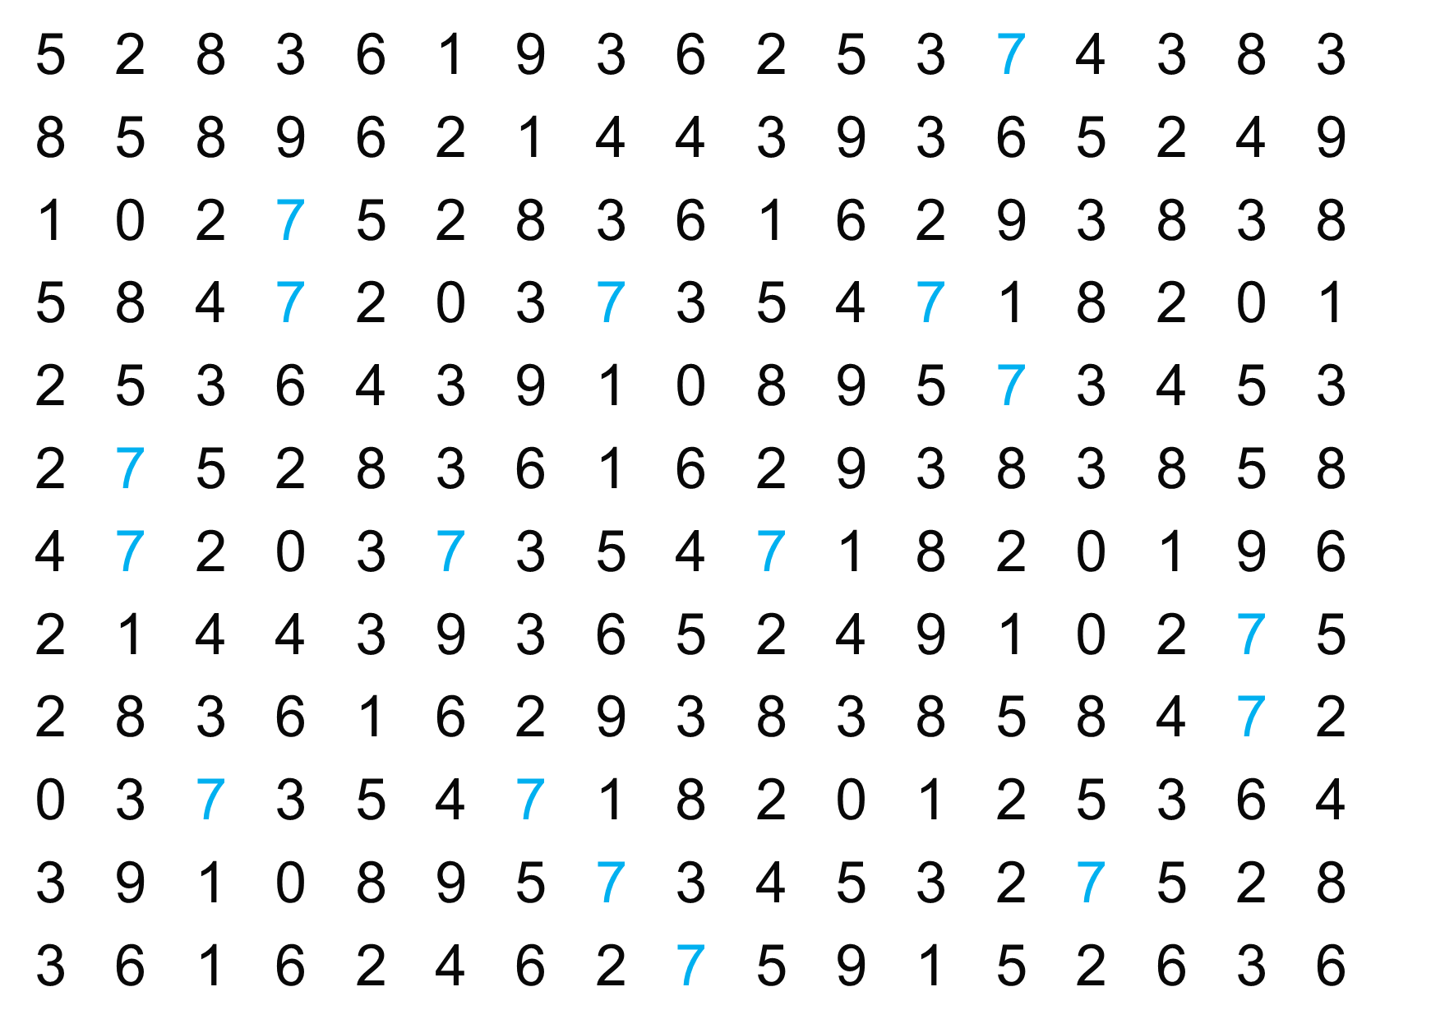
Preattentive attributes
And now?
Source: Wexler et al. (2017)

Slide 16
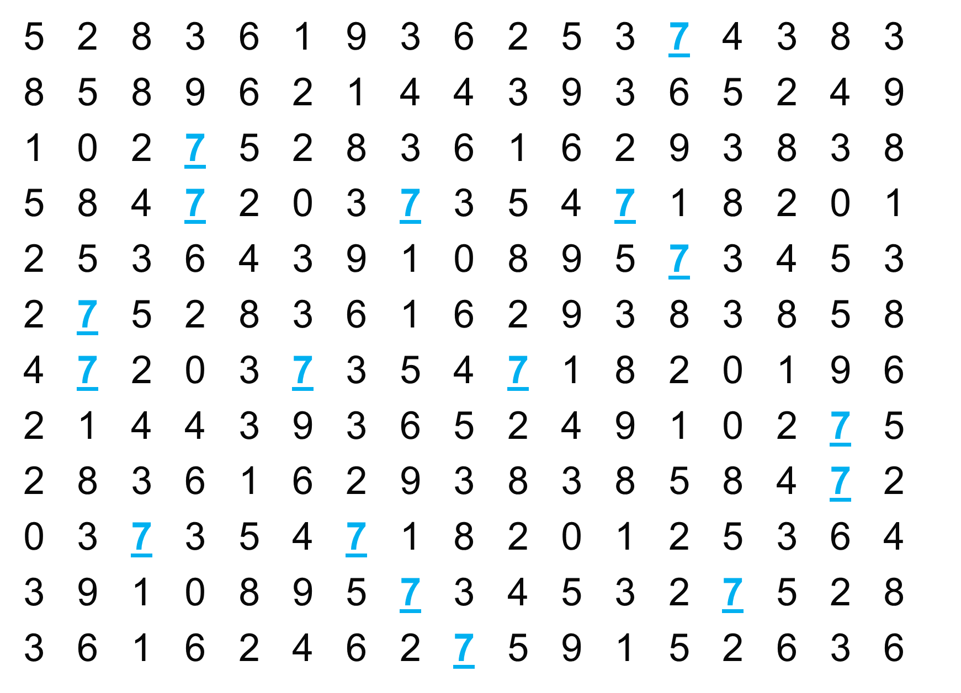
Preattentive attributes
And now?
Source: Wexler et al. (2017)

Slide 17
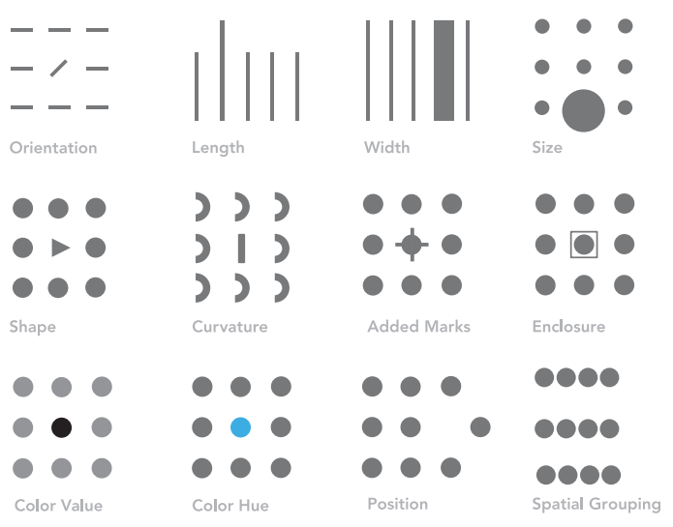
Preattentive attributes
Source: Wexler et al. (2017)

Slide 18
Choosing the right visualization method
The first step in selecting the appropriate method is a thorough understanding of the data
  What are the key messages that we want to convey?
  What is the data type?
  Are we working with time-series data, geographic information, or hierarchical structures?
Depends on:
  The questions you plan to ask
  Data types
  The way you want to present and communicate information to others
  Audience

Slide 19
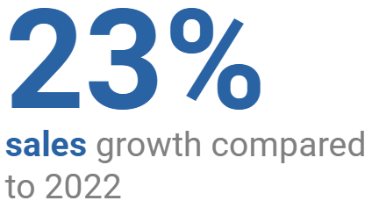
Simple text
Use when you need to provide information about several numbers (numerical indicators)
Number + short accompanying text
BAN (Big Ass Numbers)
Source: opracowanie własne

Slide 20
Tables
Use if we want to see individual values ​​(e.g. through years)
Good for comparing individual values
Use if we want to display very precise data (with all decimals)
To display data with different units of measure
They are not suitable for displaying something that the audience will immediately notice, but are useful if you want to display the data exactly as it is
Well known, they are understandable to those who read them

Slide 21
Formating tables
remove all borders around the table
lighten the gridlines as much as possible or remove them completely
clearly separate the header from the body of the table
align the text in the table and header to the left, and the numbers to the right
use an appropriate level of data detail (e.g. use numbers with one decimal place if this is sufficient to understand the data)

Slide 22
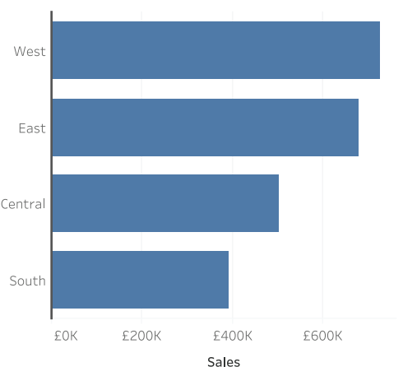
Bar chart
great for displaying numerical values by groups or categories
it can be oriented vertically or horizontally
the most effective way to show measures related to discrete items on a nominal or ordinal scale
needs to begin at zero
Source: Wexler et al. (2017)

Slide 23
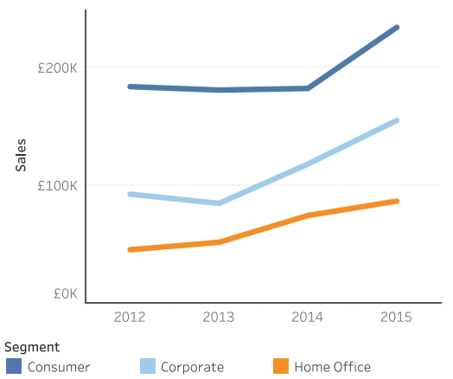
Line chart
used to show change of some quantitative value, placed on the y-axis, over time which is positioned on the horizontal x-axis
that a line chart should include no more than five lines
Source: Wexler et al. (2017)

Slide 24
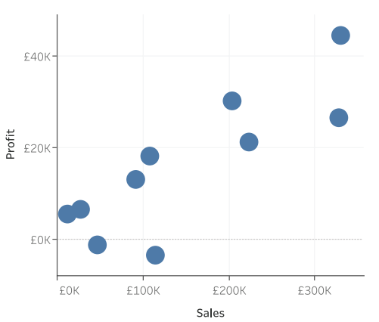
Scatterplot
is there any relationship between two quantitative variables
the patterns seen on a scatterplot can be used to interpret the type of correlation
  Positive (values increase together)
  Negative (one value decreases as the other increases)
  Null (no correlation)
Source: Wexler et al. (2017)

Slide 25
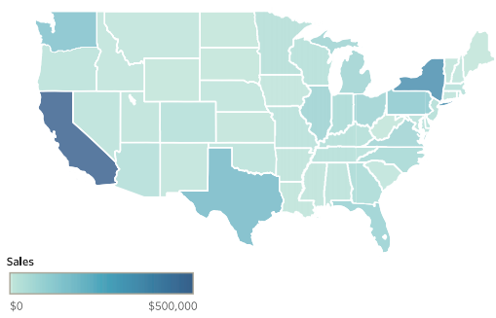
Choropleth map
uses differences in shading or coloring within predefined areas to indicate the values or categories in those areas
color palette on the choropleth map is easy to understand, smaller values correspond to lighter colors and larger values to darker colors
Source: Wexler et al. (2017)

Slide 26
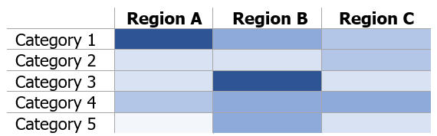
Heatmap
Visualization of data in tabular format, where colored cells represent the relative magnitude of the numbers
Source: Author, adapted from Nussbaumer Knaflic (2015)

Slide 27
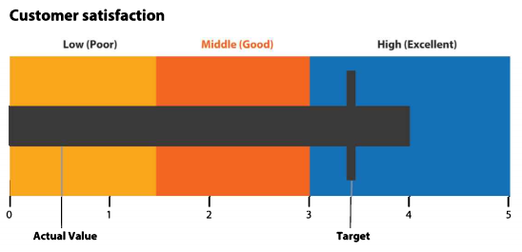
Bullet graph
a bar chart with a single black horizontal bar which represents an actual value, an additional (vertical) mark for a target value (which we want to achieve) and shaded areas in the background which represent a scale of success (e.g. poor, good, excellent)
Source: Schwabish (2021)

Slide 28
The guidelines for good visualization design
Choose appropriate color combination
Choose appropriate color schemes
Use color sparingly
Consider color blindness
Colors should be consistent
Use color to highlight important data
Keep it simple

Slide 29
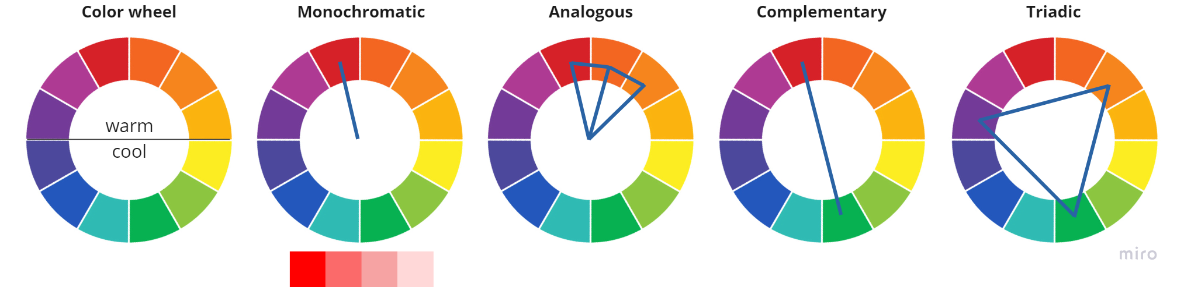
Color theory
Color wheel
Source:Author, adapted from Lidwell (2023)

Slide 30
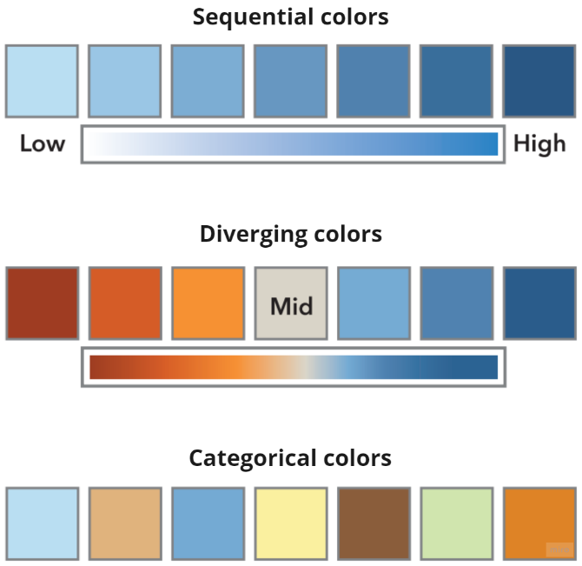
Color schemes
Sequential colors - the use of one color from light to dark and is ideal for showing numerical data that progresses from low to high
Diverging colors - useful for highlighting values above or below a midpoint (e.g. profit/loss)
Categorical colors - best for categorical data where the colors need to distinguish different groups without implying order or value
Source: Wexler et al. (2017)

Slide 31
Summary
Data visualizations primary goal: to communicate complex information in a way that is accessible and understandable to all audiences
The effective data visualization is a critical component in the process of data-driven decision-making
The chapter emphasized the importance of tailoring visualizations to fit the specific needs of the intended audience
Thoughtful visual representation of data is important to facilitate clearer understanding and communication of complex information

Slide 32
Authors:
Dario Šebalj
Dejan Mirčetić
Michał Adamczak
Final version: June 2025

Slide 33
Thank you for your attention

