Slide 1



Business Intelligence
GIS in logistics
Lecture
BAS4SC
Business Analytics Skills
for the Future-proof Supply Chains
Project number – 2022-1-PL01-KA220-HED-000088856

Slide 2
Agenda
Geographic Information Systems (GIS)
GIS layers
GIS data
GIS in logistics
Future trends in GIS

Slide 3
GIS
Geographic Information Systems (GIS) have revolutionized the logistics industry by providing powerful tools for spatial analysis and decision-making
As businesses increasingly operate in a globalized environment, the ability to visualize and analyze geographical data is essential for optimizing supply chains, managing transportation networks, and enhancing overall efficiency
GIS technology enables logistics professionals to map routes, track shipments, and analyze spatial patterns, leading to more informed decisions and improved resource allocation

Slide 4
GIS – definition and history
Computer-based tool that integrates, stores, analyzes, and visualizes geographic data.
It connects spatial data with descriptive information to help users understand and interpret spatial relationships, patterns, and trends.
GIS is used across various industries for mapping, analysis, and decision-making, providing valuable insights into the spatial dimensions of data
the history of Geographic Information Systems (GIS) dates back to the early 1960s when the first computerized GIS was developed by Roger Tomlinson, often referred to as the "father of GIS„
In 1969, Esri (Environmental Systems Research Institute) was founded and became a pivotal player in the GIS industry, introducing the ArcGIS platform, which significantly enhanced the capabilities and accessibility of GIS technology
Today, GIS is an integral tool in various sectors, including transportation, logistics, agriculture, and public safety, providing critical insights and aiding in decision-making processes
Source: Jonker, 2023; GisGeography, 2024a; Esri, n.d.a; National Geographic, n.d.

Slide 5
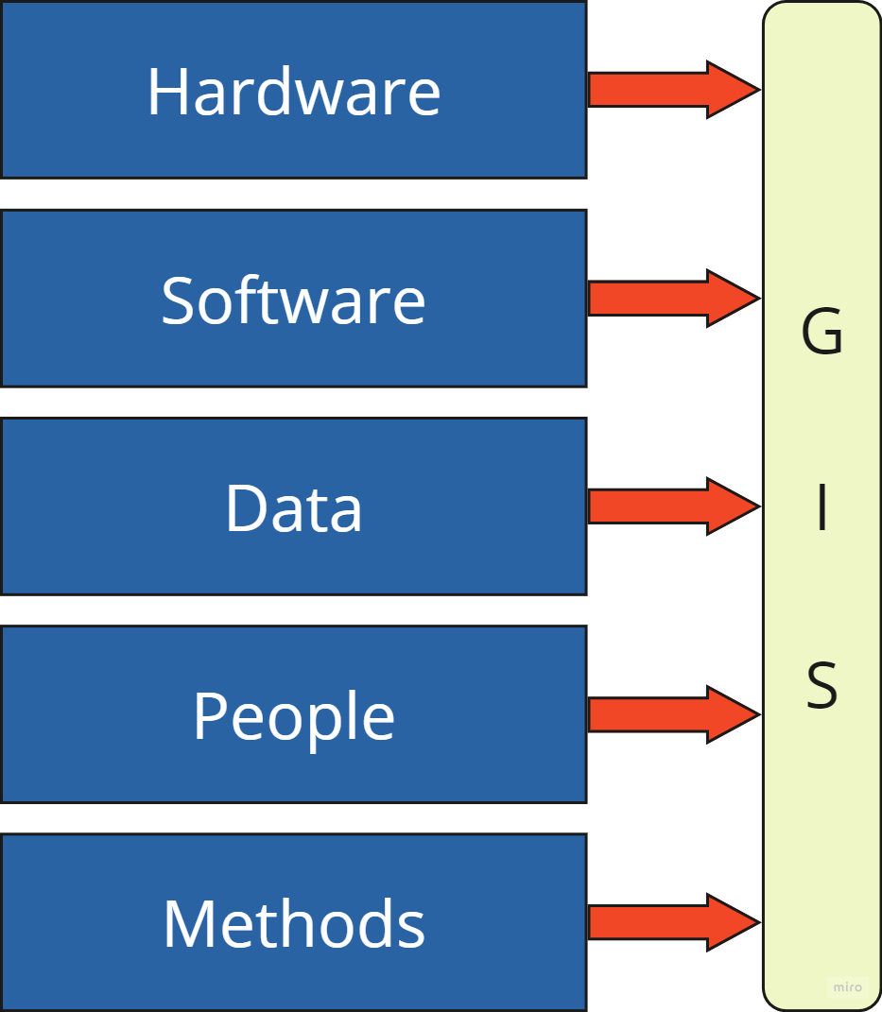
GIS components
Hardware: The physical devices used to run GIS software and store data, such as computers, servers, GPS devices, and other peripherals.
Software: The programs and applications that perform GIS functions, enabling users to analyze and visualize spatial data.
Data: The spatial and non-spatial information that GIS systems analyze, including maps, satellite imagery, and tabular data.
Methods: The techniques and procedures used to analyze GIS data, such as algorithms and statistical models.
People: The professionals and users who operate and manage GIS technology, from data analysts to decision-makers.
Source: Kishore and Rautray (n.d.)

Slide 6
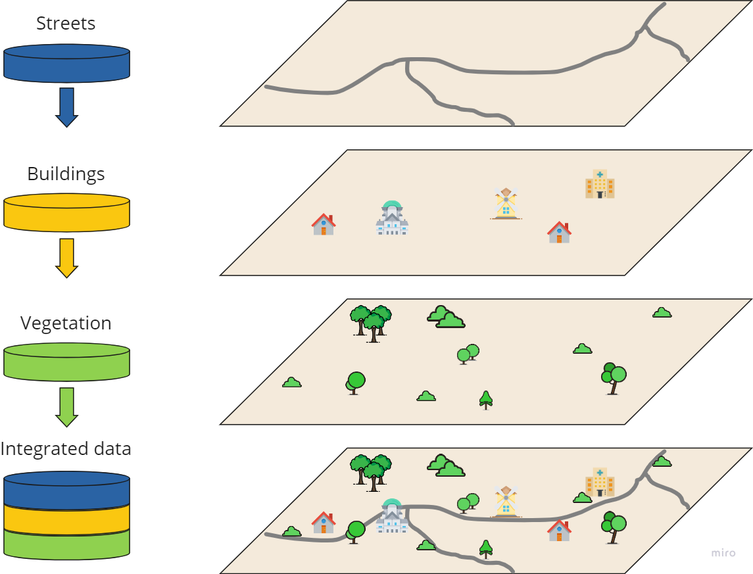
GIS layers
One of the core components of GIS technology is the concept of layers
A layer is a slice of the geographic reality in a particular area. Each layer in a GIS corresponds to a specific type of data, such as roads, land use, elevation, water bodies, or population density
Source: Esri (n.d.c)

Slide 7
GIS data
Geographic information systems rely on a variety of data types to represent, analyze, and visualize geographical information.
GIS data can be broadly categorized into two main types: raster and vector data.
Vector data:
  points, lines and polygons used to represent geographic data
  all lines are captured as points connected by precisely straight lines
  point data represent discrete data points or specific locations, like schools, city names or points of interest. Line data represent linear features like roads and rivers and polygons are used for area features such as lakes, administrative boundaries, and forests
Raster data:
  grid-based data structure composed of pixels or cells, each with an associated attribute
  the most common sources of raster data are satellite imagery, aerial imagery, remotely sensed data, and data with shaded relief and topography
Source: Dempsey (2024); Longley et al. (2015)

Slide 8

GIS data
Vector image
Raster image
Source: Authors

Slide 9
GIS in logistics
GIS have fundamentally transformed the logistics sector, providing tools that enable more efficient, cost-effective, and strategic decision-making processes
The integration of GIS in logistics allows the visualization, analysis, and interpretation of spatial data, which is crucial for optimizing routes, managing supply chains, and enhancing overall operational efficiency
Logistics professionals can see patterns, relationships, and trends that are not visible in traditional data formats by using it to make it easier to overlay different data sets on a map
Strategic planning and operational optimization benefit greatly from this spatial perspective

Slide 10
GIS in logistics
One of the primary applications of GIS in logistics is route optimization.
By analyzing spatial data, logistics companies can determine the most efficient routes for delivery, reducing travel time, fuel consumption, and overall operational costs.
For instance, GIS can account for traffic patterns, road conditions, speed limits to optimize routing in real time (Ramzan, 2023).
This capability not only improves efficiency but also enhances customer satisfaction by ensuring timely deliveries.

Slide 11
GIS in logistics
GIS enables real-time data application for dynamic traffic adjustments and comprehensive spatial analysis by facilitating the integration of various data types, including GPS and satellite imagery
Because of this integration, there are major time and cost savings due to shorter travel distances and less fuel used
Decision-making processes are improved by the spatial visualization capabilities of GIS, which reveal patterns and trends that are hidden in conventional data formats
GIS-based route optimization not only lowers environmental impact and increases operational efficiency, but it also offers a strong framework for dealing with intricate urban traffic issues

Slide 12
GIS in logistics
The application of GIS in optimizing municipal solid waste collection routes has proven to be highly effective in enhancing operational efficiency and reducing costs
Singh and Behera (2018) demonstrated that the integration of GIS and the network analyst tool in ArcGIS significantly reduced haul distances by an average of 27.78%
By leveraging GIS for spatial analysis and route optimization, municipalities can achieve more sustainable and efficient waste management practices, thereby enhancing overall service delivery and reducing environmental impact.
GIS-based analytics significantly enhance blood supply chain management by providing real-time visibility and facilitating better decision-making.
The integration of GIS with data mining and other analytic techniques allows for efficient tracking, management, and optimization of blood resources, leading to improved operational efficiency and reduced wastage

Slide 13
GIS in logistics
GIS plays a vital role in urban infrastructure planning and management by providing a robust platform for integrating and analyzing spatial data
GIS enhances operational efficiency by integrating spatial data with advanced analytical tools, facilitating real-time decision-making and optimizing resource utilization.
Studies have shown significant cost reductions and improved service delivery through GIS-based route optimization, underscoring its critical role in managing complex logistical operations.
By leveraging GIS technology, organizations can achieve sustainable practices, reduce environmental impacts, and enhance overall operational effectiveness.

Slide 14
GIS trends
The future of GIS is shaped by several key trends and innovations that are transforming how we collect, analyze, and utilize spatial data
A significant trend is the integration of advanced technologies such as cloud computing, AI, machine learning (ML), and drone-based data collection.
These technologies enhance the efficiency and capabilities of GIS, allowing for real-time data processing and more sophisticated spatial analyses

Slide 15

GIS trends – cloud computing
Cloud computing is revolutionizing GIS by providing scalable and accessible platforms for storing and processing large datasets.
This shift enables organizations to leverage vast amounts of geospatial data without the need for significant on-premises infrastructure.
The adoption of GIS as a service is growing, allowing users to access powerful GIS tools and data analysis capabilities through cloud platforms.
This trend is making GIS more accessible and cost-effective, particularly for smaller organizations and industries with limited resources

Slide 16

GIS trends – AI and ML
AI and ML are playing important roles in automating and enhancing spatial data analysis.
These technologies can identify patterns, make predictions, and provide insights from complex datasets that would be challenging to analyze manually.
For instance, AI algorithms can process satellite imagery to detect changes in land use, while ML models can predict traffic patterns based on historical data.
The integration of AI and ML with GIS is enabling more accurate and timely decision-making across various sectors, from urban planning to disaster management.

Slide 17
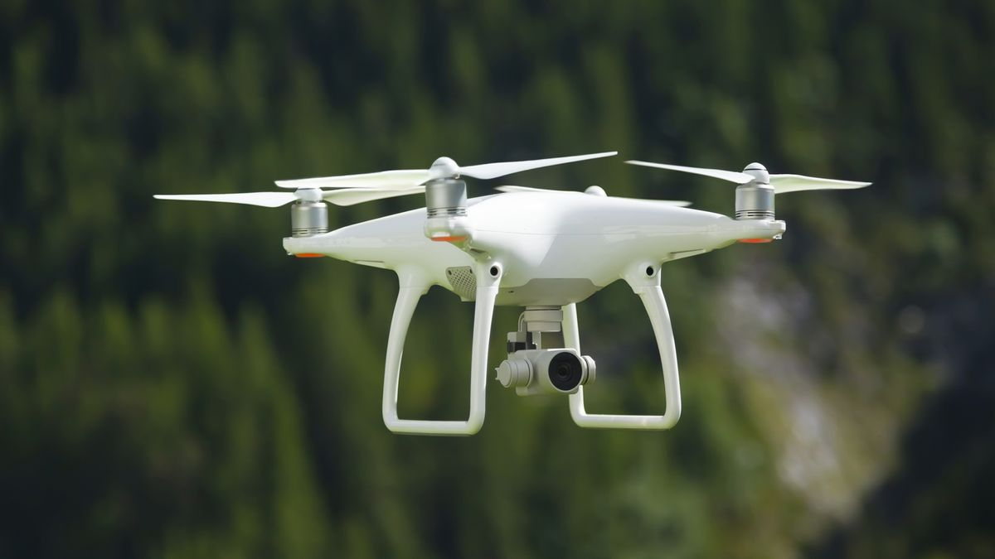
GIS trends – drones
The advancements in drone technology are also significant trends in GIS.
Drones equipped with high-resolution cameras and sensors are increasingly used for data collection in hard-to-reach areas.
These tools provide real-time, high-accuracy data that can be integrated into GIS for detailed mapping and analysis.
This trend is particularly beneficial for environmental monitoring, infrastructure inspection, and agricultural management.

Slide 18

GIS trends – AR and VR
Augmented reality (AR) and virtual reality (VR) technologies offer new ways to visualize and interact with spatial data, providing immersive experiences that can enhance understanding and decision-making.
For example, AR can overlay geospatial data onto real-world views, helping users visualize underground utilities or navigate complex environments.
VR can create detailed simulations of urban landscapes, allowing planners to explore different scenarios and their potential impacts

Slide 19
GIS trends – Real-time data analysis
Real-time data analysis is becoming increasingly important in GIS applications.
The ability to process and analyze data as it is collected enables more responsive and dynamic decision-making.
This capability is enhanced by the integration of GIS with the Internet of Things (IoT), where data from connected devices can be continuously monitored and analyzed.
Real-time GIS is being used in applications such as traffic management, emergency response, and environmental monitoring, where timely information is critical

Slide 20
Summary
Geographic Information Systems (GIS) have revolutionized the logistics industry by providing powerful tools for spatial analysis and decision-making
GIS data can be broadly categorized into two main types: raster and vector data.
The integration of GIS in logistics allows the visualization, analysis, and interpretation of spatial data, which is crucial for optimizing routes, managing supply chains, and enhancing overall operational efficiency
As GIS technology continues to evolve, its applications in logistics will expand, offering even more sophisticated tools for addressing complex challenges.

Slide 21
Authors:
Dario Šebalj
Dejan Mirčetić
Michał Adamczak
Final version: June 2025

Slide 22
Thank you for your attention

