Slide 1



BUSINESS INTELLIGENCE
E-Logistics
Lecture
BAS4SC
Business Analytics Skills
for the Future-proof Supply Chains
Project number – 2022-1-PL01-KA220-HED-000088856

Slide 2
Agenda
E-business
Definition of e-logistics
Development of e-logistics
Modern technologies supporting e-logistics
E-logistics in practice
Summary

Slide 3

E-business
E-logistics is a solution operating within the broader concept of e-business. E-business can be loosely defined as a business process that uses the Internet or other electronic medium as a channel to complete business transactions
Source: [Jayashankar et al., 2003]

Slide 4
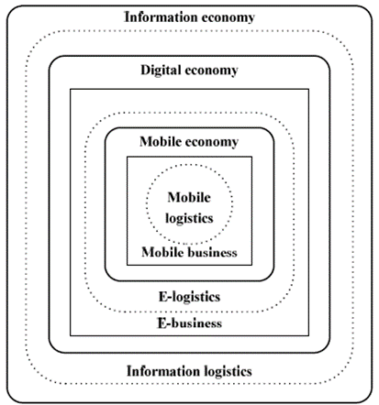
E-business
Within e-business, we can distinguish such detailed activities as:
  e-commerce,
  e-advertising,
  e-marketing,
  electronic banking,
  electronic auctions etc.
  In these types of business activity, the adjective "electronic" indicates that these activities are carried out strictly in electronic (digital) form using the Internet, mobile connection etc.
Source: [Skitsko, 2016]

Slide 5
E-business
B2C (business-to-customer) - In this model, the company interacts with its end consumer.
C2C (customer-to-customer) - In this model, people (physical persons) interact with each other with the help of various communication means and technology.
C2B (customer-to-business) - In this model opinions or ideas of the end consumers expressed by various means, in particular, on various Internet forums, social media, email etc. considerably influence the products making (their characteristics, features, price etc.) by the producer.
Source: [Skitsko, 2016]

Slide 6
E-business
B2G (business-to-government). In this model, the company interacts with the state administrative organs.
C2G (customer-to-government). In this model, there is interaction between a person and state administrative organs.
G2B (government-to-business), G2C (government-to-customer). In these models state administrative organs provide the companies (enterprises) and physical persons with information services via Internet.
Source: [Skitsko, 2016]

Slide 7
Definition of e-logistics
„E-Logistics is a dynamic set of communication, computing, and collaborative technologies that transform key logistical processes to be customer-centric, by sharing data, knowledge and information with the supply chain partners.”
Source: [Wang et al., 2004]
„E-Logistics is using Internet-based technologies for supporting the acquisition of material, warehousing, transportation and enables distribution through routing optimization with inventory tracking”
Source: [Quirk et al., 2003]

Slide 8
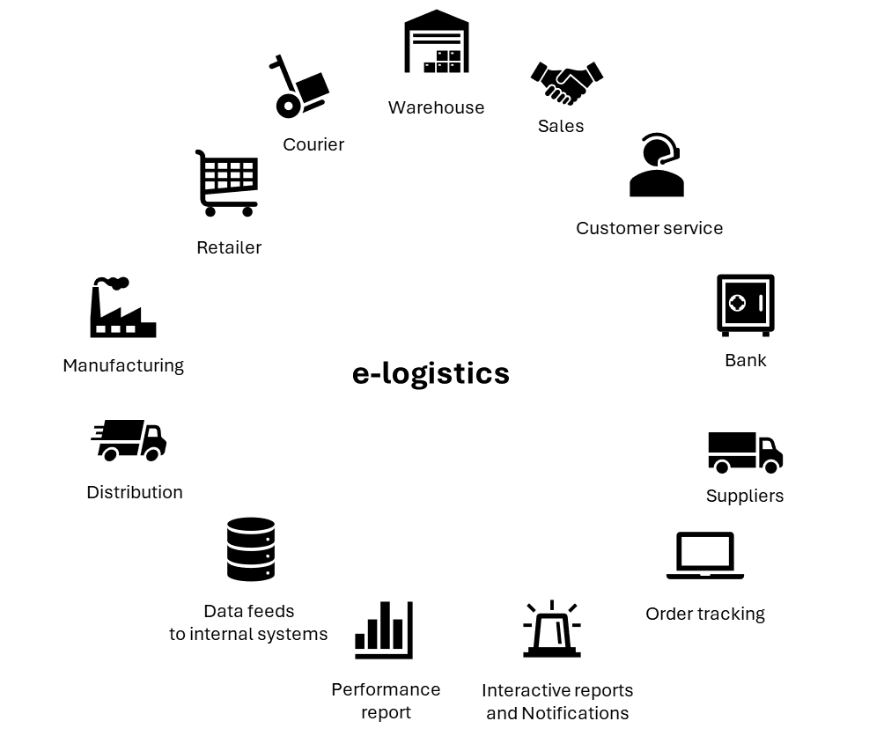
Definition of e-logistics
„e-logistics are logistic processes implementing the flow of products purchased in electronic sales channels”
Source: [Erceg & Damoska Sekuloska, 2019]
Source: [Moroz et al., 2014]

Slide 9
Definition of e-logistics
The basic functions of e-logistics in creating transferring of data describing the material flow are:
formation of an information environment in which interact the participants of the logistics chain of goods supply;
definition of characteristics of electronic information flows;
formation of requirements and needs to the companies which provide information and communication services and corresponding connections;
organization of the use of international standards of product identification;
maintenance of correct and reliable operation, development of the information system of the company;
collection, analysis, storage, transformation and organization of information transfer in electronic form;
selection of the necessary data for management decision-making.
Source: [Skitsko, 2016]

Slide 10
Definition of e-logistics
Basic differences between traditional and e-logistics
Scope | Traditional logistics | E-logistics
Shipment type | Bulk | Parcel
Customer | Strategic | Unknown
Customer service | Reactive, Rigid | Responsive, flexible
Distribution model | Supply-driven push | Demand-driven pull
Inventory / Order flow | Un-directional | Bidirectional
Destinations | Concentrated | Highly dispersed
Demand | Stable consistent | Highly seasonal, fragmented
Orders | Predictable | Variable
  The second face of e-logistics
  is the logistical support of goods flows initiated through electronic communication. In this approach,
  e-logistics is equal to traditional logistics.
Source: [Song & Hou, 2004]

Slide 11
Development of e-logistics
material requirement planning (MRP)
distribution resource planning (DRP)
enterprise resource planning (ERP)
transport management systems (TMS)
warehouse management systems (WMS)
First IT systems supporting the management of material flow, material requirement planning (MRP) and distribution resource planning (DRP) systems were created. These systems began to develop in the 1960s.
The development of ERP systems, and especially the concentration of data and the multidimensionality of this data, allowed the creation of decision support systems (DSS)
Systems dedicated to individual logistics functions were developed: transport management systems (TMS) and warehouse management systems (WMS)
Decision Support Systems (DSS)
The creation of platforms connecting enterprises directly with customers
(and other configurations presented in the subsection on e-business) allowed for the creation of new business models
and thus requirements for logistics
Electronic marketplaces (EM)
Source: [Wang, 2016]

Slide 12
Modern technologies supporting e-logistics
The development of Industry 4.0 and Logistics 4.0 provides additional opportunities to expand the solutions and services offered within e-logistics. Among the main technologies supporting e-logistics are currently:
  Blockchain
  Internet of Things and sensors (IoT)
  Generative Artificial Intelligence (AI)

Slide 13
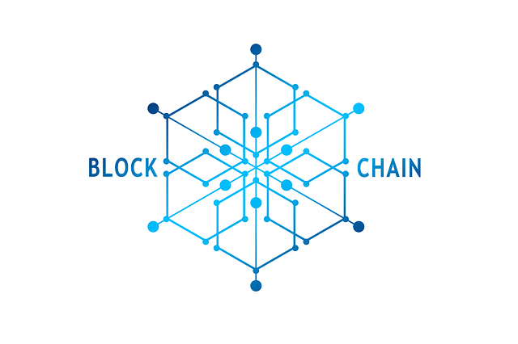
Modern technologies supporting e-logistics
Blockchain is a distributed database system between
all participants in the same network. This system records
and stores data in the form of linked blocks forming a collection of records. They are permanent and therefore cannot be deleted. It is important to know that there is no possibility
of making updates or any modifications. However, it is possible to add or read a recording.
Blockchain technology makes it possible to track different transactions along the whole supply chain in a secure
and traceable manner. The documented transactions and data are irrevocably stored in the blockchain and cannot be used
or read without consensus. Every time a consignment is being transported or handled, the transaction can be documented, creating a permanent history from the manufacturer
to the trader or consumer
Source: [Dutta et al., 2020], [Aritua et al., 2021].

Slide 14

Modern technologies supporting e-logistics
The Internet of Things (IoT) allows non-computer devices to communicate with each other. The concept is based on a wide range of technologies, from communication protocols through sensors collecting data, infrastructure enabling data transmission to systems analyzing the collected data.
IoT solutions are often combined with RFID (radio-frequency identification) sensors, giving the possibility of not only local identification of goods or cargo but also transferring this data to any user. IoT solutions can be created in two variants:
  Internet-centric – the main element of the system are services offered in cloud computing and the system objects are data providers;
  Object-centric – a solution in which the central point of the network is object that can be controlled using messages transmitted over the Internet.
Source: [Minerva, 2015], [Idrissi et al., 2022]

Slide 15

Modern technologies supporting e-logistics
AI is the simulation of human intelligence processes by machines and computer systems. Knowledge generation by artificial intelligence is carried out in three steps
  learning - the acquisition of information and its rules of use;
  reasoning - the use of rules to conclude;
  self-correction.
The AI application allows the system to give precise indications to each operator on each order. The system can do this through history-based learning. This helps achieve maximum efficiency, especially in picking-intensive warehouses, such as e-commerce
Source: [Samoili et al., 2020]; [Dash et al., 2019].

Slide 16

E-logistics in practice
Practical e-logistics solutions are offered by virtually all logistics operators, especially those operating on the global market.
An excellent example of solutions used within e-logistics is those offered by Dachser. This European logistics operator provides its customers with a direct connection to transport and warehouse management systems, thanks to which customers have uninterrupted real-time access to data
on the implementation of this operator's logistics processes.
Source: [https://www.dachser.pl/pl/elogistics-116]

Slide 17
E-logistics in practice
Functions offered by Dachser within e-logistics include:
online ordering - automatic import of data to orders saves time. The address import function from the ERP system complements address management. This functionality also allows you to send documents, save information on dangerous goods, as well as send future orders and use your own barcodes;
control of all transport costs - allows you to quickly obtain information on the transport price without having to submit extensive inquiries;
inventory tracking - allows you to track processes taking place in warehouses - from checking the status of order receipts to batch monitoring. This functionality allows you to immediately determine shortages and inventory levels;
current information on the status of the shipment and its location - the Track & Trace function allows you to create an individual link for each shipment, which will inform you about the current status of the shipment. This link can then be forwarded to customers or partners;
online invoice management - online access to all shipment data. Data is available in PDF files, Excel tables and CSV files. We can also send this data digitally via the EDI center.;
electronic pallet accounting - manages loading equipment that requires tracking, i.e. euro pallets and racks.
Source: [https://www.dachser.pl/pl/elogistics-116]

Slide 18

E-logistics in practice
In addition to the very similar functions presented above for another operator, DHL also uses solutions from the field of machine learning, augmented reality and artificial intelligence to a large extent. Augmented reality is used to optimize the warehouse infrastructure and logistics operations conducted there. Machine learning
and artificial intelligence are used to increase the efficiency
of the business and increase the organization's resilience by focusing the actions taken on proactive instead of reactive actions.
Taking proactive actions is possible thanks to the analysis of large data sets and searching for relationships between causes and effects in them. It is therefore possible to predict the formation of future phenomena based on past events. Such actions also have an impact on increasing the value of services directed to DHL customers
and increase their competitive position.
Source: [DHL, 2017]

Slide 19
Summary
The solutions operating within e-logistics are as diverse as the definitions of this concept. Two main trends in defining this concept can be distinguished.
  In a broader sense, e-logistics are all kinds of digital solutions that accompany the flow of materials.
In a narrower sense, e-logistics is defined as the implementation of logistics processes accompanying
e-commerce.
Material flow will not be replaced by information flow. Information flow determines the efficiency of material flow. Supporting information processes implemented within e-logistics with methods and data analysis tools seems to be particularly important in this respect. Modern technical solutions allow for the collection of large sets of data and the search for relationships between these data in order to prepare information useful in making managerial decisions.

Slide 20
Summary
The impact of the development of data processing technologies and the Internet on supply chains can be distinguished in three areas:
  development of systems supporting enterprise management (ERP) and material flow planning (APS);
  development of systems supporting the business decision-making process that operates in real-time;
  sharing information between enterprises.
The lack of a clear context for defining the concept of e-logistics is caused by the rapid development of the subject and the blurring of the boundaries between individual solutions supporting the implementation of information flow.

Slide 21
Sources
[1.] Aritua, B., Wagener, C., Wagener, N. & Adamczak, M. (2021). Blockchain solutions for international logistics networks along the new silk road between Europe and Asia, Logistics, 5(3), pp. 1-14.
[2.] Dachser – e-logistics (2024) [available at: dachser.pl/pl/elogistics-116 access: April 07, 2024]
[3.] Dash, R., McMurtrey, M., Rebman, C. & Kar U.K. (2019). Application of Artificial Intelligence in Automation of Supply Chain Management, Journal of Strategic Innovation and Sustainability, West Palm Beach, 14(3), pp. 43-53.
[4.] DHL 2017. The 21st Century Spice Trade: A Guide to the Cross-Border E-Commerce Opportunity. [available at: http://www.dhl.com/content/dam/downloads/g0/press/publication/g0_dhl_express_cross_border_ecommerce_21st_century_spice_trade.pdf, access: June 23, 2018].
[5.] Dutta, P., Choi, T.M., Somani, S. & Butala, R. (2020). Blockchain technology in supply chain operations: applications, challenges and research opportunities. Transp Res Part E: Logist Transp Rev,142(102067).
[6.] Erceg. A.& Damoska Sekuloska J. (2019). E-logistics and e-SCM: how to increase competitiveness. LogForum,15 (1), pp. 155-169.
[7.] Idrissi, Z.K., Lachgar M. & Hrimech H. (2022). Blockchain, IoT and AI revolution within transport and logistics, 2022 14th International Colloquium of Logistics and Supply Chain Management (LOGISTIQUA), EL JADIDA, Morocco, 25-27 May 2022.
[8.] Merali Y., Papadopoulos, T., Nadkarni, T. (2012). Information systems strategy: past, present, future? The Journal of Strategic Information Systems, 21(2), pp. 125–153.
[9.] Minerva, R., Biru A., & Rotondi, D., (2015). Towards a definition of the Internet of Things (IoT), IEEE.
[10.] Moroz, M., Nicu, C., Pawel I. D.D., Polkowski Z., 2014. The transformation of logistics into e-logistics with the example of electronic freight exchange, Zeszyty Naukowe Dolnośląskiej Wyższej Szkoły Przedsiębiorczości i Techniki. Studia z Nauk Technicznych, 3, pp. 111-128.
[11.] Samoili, S., Cobo, M.L., Gomez, E., De Prato, G. Martinez-Plumed, F. & Delipetrev, B. (2020). Defining Artificial Intelligence. Towards an operational definition and taxonomy of artificial intelligence, Joint Research Centre, Luxembourg: Publications Office of the European Union, pp. 1-97.
[12.] Skitsko V.I., (2016). E-logistics and m-logistics in information economy. LogForum, 12(1), pp. 7-16.
[13.] Song, Y. & Hou, H., (2004). On traditional M. F and Modern M. F, Journal of Beijing Jiaotong University (Social Sciences Edition), 3(1), pp. 10-16.
[14.] Quirk, A., Forder, J. & Bentley D., (2003). Electronic Commerce and the Law, 2nd edition, John Wiley & Sons Ltd., USA.
[15.] Wang, J., Yang, D., Guo, D. & Huo Y., (2004). Taking Advantage of E-Logistics to Strengthen the Competitive Advantage of Enterprises in China [in:] Proceedings of The Fourth International Conference on Electronic Business, Bejing, pp. 185-189.
[16.] Wang, Y., Potter, A. & Naim, M.M. (2007). Electronic marketplaces for tailored logistics, Industrial Management and Data Systems, 107 (8), pp. 1170–1187.
[17.] Wang, Y. (2016). E-logistics: an introduction, in Wang Y.I. & Pettit S., E-Logistics: Managing Your Digital Supply Chains for Competitive Advantage,Kogan Page, pp. 3-31

Slide 22
Authors:
Dario Šebalj
Dejan Mirčetić
Michał Adamczak
Final version: June 2025

Slide 23
Thank you for your attention

