Slide 1



Business Intelligence
Business Process Management and Process Mining
Lecture
BAS4SC
Business Analytics Skills
for the Future-proof Supply Chains
Project number – 2022-1-PL01-KA220-HED-000088856

Slide 2
Agenda
Business process
Business Process Management
Business Process Modeling
Process Mining

Slide 3
Business process
Every organization is a complex system of interconnected processes
Processes - structured activities undertaken to accomplish a specific organizational goal
  in a manufacturing company, key processes might include product design, raw materials procurement, manufacturing, quality control, and distribution
  in a service-oriented business like a bank, processes include account opening, loan processing, customer service, and compliance checks
Business process consists of:
  Events - things which do not have a duration and happen atomically (e.g. ‘Order received’)
  Activities - tasks or operations that are interconnected and whose execution fulfills the goal of the business process (e.g. ‘Pay the invoice’)
  Decisions - stage at which the process decides which direction it will go in the future
  Actors - people, organizations or software systems that perform the process activities
  Objects - equipment, materials, paper documents (physical objects), electronic documents and records (informational objects)

Slide 4
Business process
The execution of a process results in one or more outcomes.
An outcome should, in theory, benefit all parties involved in the process (positive outcome). Sometimes this value is only partially or never reached (negative outcome).
Business process is a collection of tasks and activities (business operations and actions) consisting of employees, materials, machines, systems, and methods that are being structured in such a way as to design, create, and deliver a product or a service to the consumer (von Scheel et al., 2015)

Slide 5
Business process management
a discipline that uses various methods to discover, model, analyze, measure, improve and optimize business processes (Gartner, n.d.)
a systemic approach for capturing, designing, executing, documenting, measuring, monitoring, and controlling both automated and non-automated processes to meet the objectives and business strategies of a company (Camunda, n.d.)
a discipline involving any combination of modeling, automation, execution, control, measurement, and optimization of business activity flows in applicable combination to support enterprise goals, spanning organizational and system boundaries, and involving employees, customers, and partners within and beyond the enterprise boundaries (Swenson and Rosing, 2015)

Slide 6
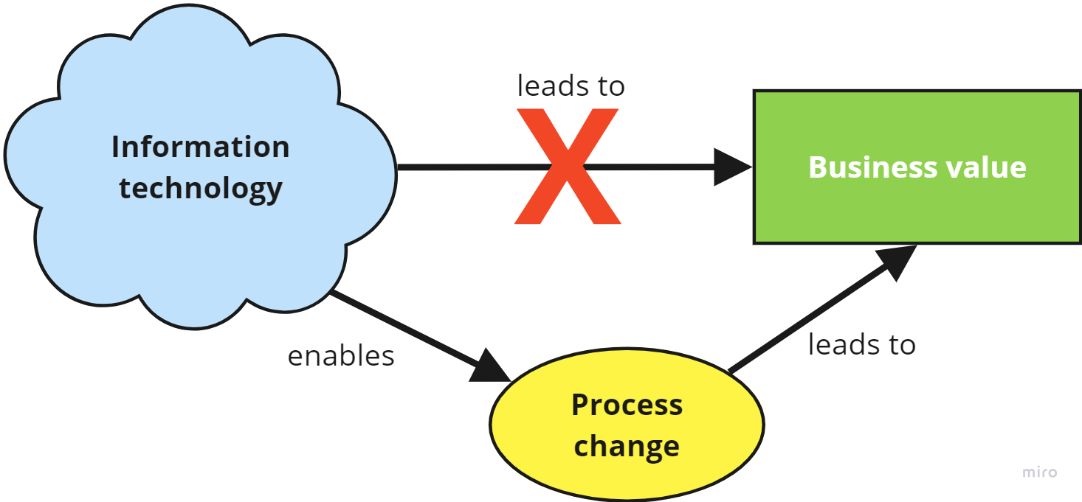
Business process management
A set of methods, techniques and tools for identification, detection, analysis, redesign, execution and monitoring of business processes with the aim of improving their performance.
  Improving performance → cost reduction, reduction of activity execution time, errors/problems reduction
BPM is not about improving individual activities, but about managing the entire chain of events, activities and decisions that add value to the company and its customers.
Source: Authors

Slide 7
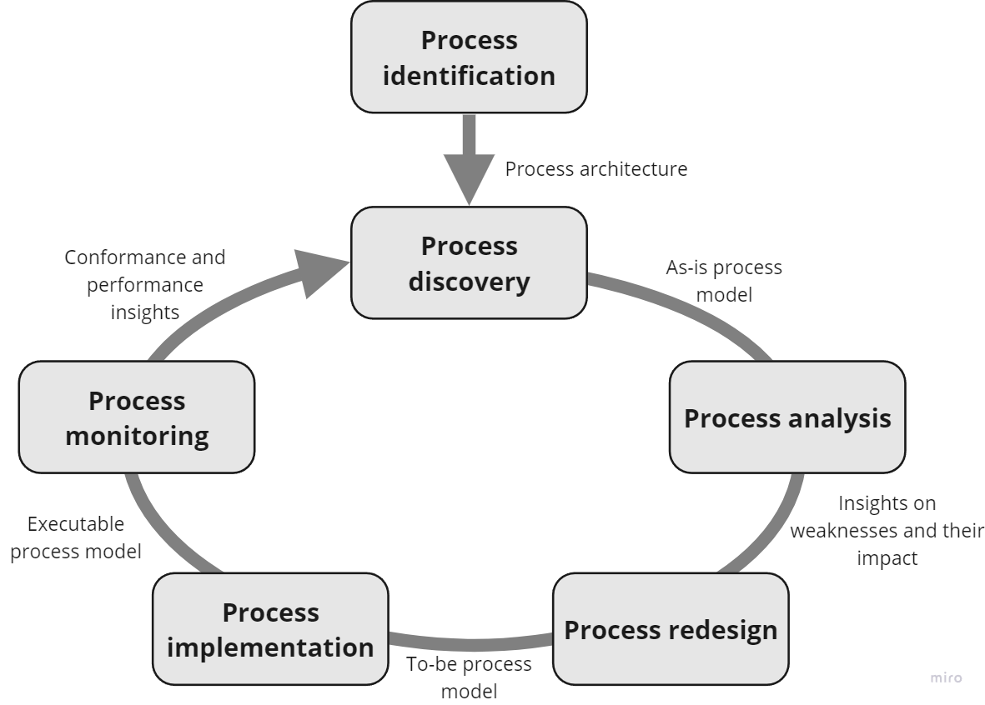
BPM lifecycle
Source: Dumas et al. (2018)

Slide 8
Process categories
Key processes (primary activities) – refer to the creation of company value, i.e. the production of goods and services paid for by customers. This includes design and development, production, marketing and sales, delivery, post-sales activities and direct procurement (procurement of materials for the manufacture of products or delivery of services).
Support processes (support activities) - enable the execution of key processes. They include indirect procurement (procurement of hardware, furniture, etc.), HRM, IT management, accounting, legal services, etc.
Management processes – provide rules and directives for key and support processes. They include strategic planning, budgeting, risk management and management of suppliers, investors and partners.

Slide 9
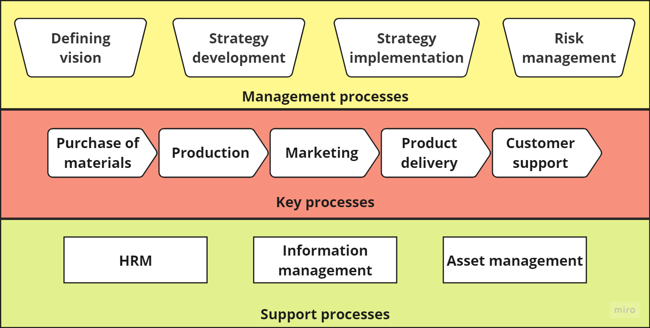
Process categories
Source: Authors

Slide 10
Choosing the process
AIM: to define criteria for evaluating the performance of identified business processes
Selection criteria:
  Strategic importance – find the processes that have the greatest impact on the organization's strategic goals (e.g., which are the most profitable)
  Health - find processes that have the biggest problems, i.e. processes that are inefficient, produce low-quality outputs or do not meet the needs of customers (such processes should be the focus of BPM)
  Feasibility - for each process determine whether the process can be improved at all, whether we have the necessary human resources, financial resources, whether a certain level of effort can be invested in the improvement at all

Slide 11

Process performance measurement
It is necessary to accurately measure the health of the business process
  GENERIC MEASURES: time, cost and quality
TIME
  Cycle time – the time required to process some case from start to finish
  Processing time – the effective time that a resource (process participant or software) spends in processing a case
  Waiting time – the time a case spends waiting for processing (e.g. waiting in a queue)
Source: Authors

Slide 12
Process performance measurement
COST
process improvement is most often associated with cost reduction
Direct costs – costs directly related to the process (cost of labor, materials, equipment...)
Indirect costs - costs that are not related to the process (rent, utilities, administrative costs...)
Fixed costs – costs that do not change (rent, salaries, software maintenance)
Variable costs – costs that change with a change in output level (cost of materials, transport costs...)

Slide 13
Process performance measurement
It is observed from the client's point of view and from the point of view of the participants in the process
External quality – client's satisfaction with the product or process
  Satisfaction with the product - how much the product met his expectations
  Satisfaction with the process - how the process was carried out (quantity, importance, quality and timeliness of information that the client receives during the execution of the process)
  External quality measures:
    Churn rate – refers to communication with the client via the Internet. It shows how many customers have interrupted their cooperation in some way during the execution of the process (online shopping).
    Net promoter score - most often defined in the range from 1 to 10, and measures how willing a customer is to recommend a product or service to someone else
Internal quality - how satisfied is the process participant with how the process is executed - is it efficient, adaptable to changes in the environment, compliant with company policies and rules, etc.

Slide 14
Roles in BPM projects
Process owner – person who has strategic responsibility for the processes. He has budget authority, and he is often a member of the first or second tier of management. For example, the process owner can be the company’s CEO.
Process manager – person who has operational responsibility for the processes. He is often a low- or middle-level manager. For example, the sales manager could be the process manager.
Process participant – person who works with the process and creates value (e.g. salesperson).
Process analyst – person who understands BPM in general and BPMN in particular, and he is a center of every BPM project.

Slide 15

Business Process Modeling
BPMN (Business Process Model and Notation)
A business process consists of events and activities
  Events are executed instantly (e.g. Invoice received)
  Activities represent units of work that have a duration (e.g. Payment of invoices, Receipt of goods...)
  Events and activities are connected by links (there is a sequence of activities)
Source: Authors

Slide 16
Business Process Modeling
BPMN elements:
  Flow objects: events, tasks (activities), and gateways
  Connecting objects: sequence flow, message flow and association
  Participants: pool and lanes
  Artifacts: data objects, data store and annotations
Source: Brackett (2015); Dalkir (2023); Cotton (2023)

Slide 17

Events
something that happens in a process
Start events determine where the process begins
  It must exist in the business process
Intermediate events occur within a process, between the start and end event
  It affects the flow of the process, but will not start or end it
  They can mark milestones in processes
  They are most often used to show the time difference (waiting) within the process
End events determine when a process ends
  It must exist in the business process
[object] + [verb in past participle]
  Invoice sent
  Order submitted
Source: Authors

Slide 18
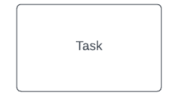
Task
something that is carried out during a process, activities performed by a person or system
Task vs. Sub-process
[verb in imperative] + [object]
  Send the invoice
  Submit the order
Source: Authors

Slide 19
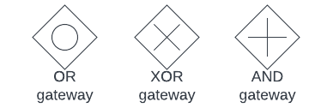
Gateway
locations where processes split or merge
XOR (exclusive), OR (inclusive), AND (parallel) gateway
Source: Authors

Slide 20
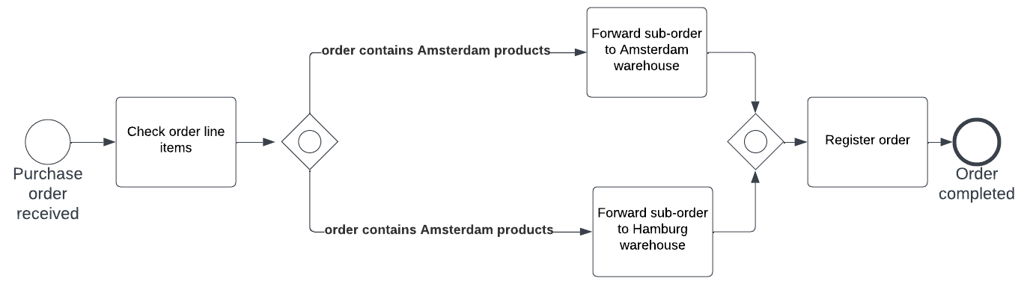
OR gateway
The correct alternative path does not exclude others, all paths can be considered
It is possible to take only one route or all of them at the same time
Before merging, all active incoming branches must be completed in order to continue the flow
Source: Dumas et al. (2018)

Slide 21
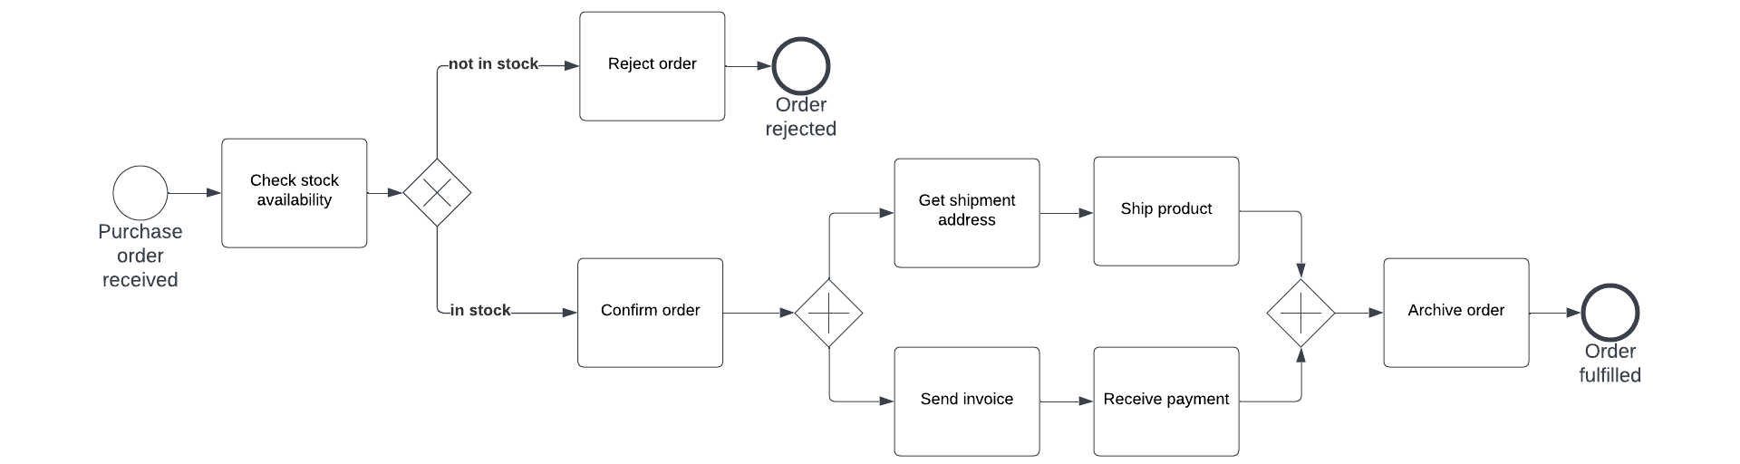
XOR and AND gateways
XOR
  routes sequence flow to only one of the outgoing branches, based on conditions
  when merging, it awaits one incoming branch to complete before continuing the flow
AND
  used to execute two or more tasks that do not have any order dependencies on each other and can be executed simultaneously
  when merging, it awaits all the in branches to complete before continuing the ﬂow
Source: Dumas et al. (2018)

Slide 22

Connecting objects
three types of connecting objects: sequence flow, message flow and association
Source: von Rosing et al. (2015)

Slide 23
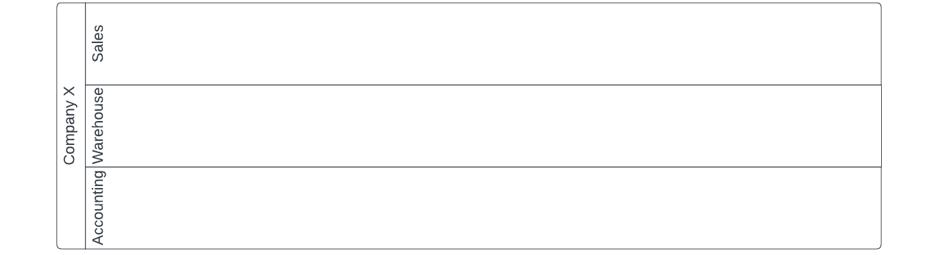
Participants
Pools and lanes
pools are used to model a whole organization, and a lane to model a department or business unit
  Pool – company X
  Lane – Sales department
Source: Authors

Slide 24
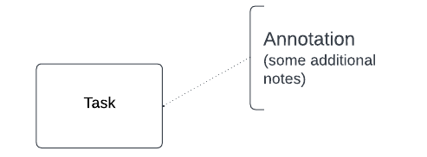
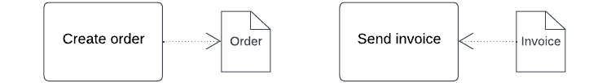
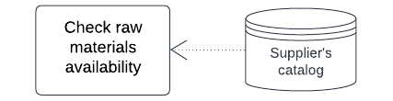
Artifacts
data objects, data store and annotations
Data objects represent the data that is required to perform certain tasks (data as input) or is a result of the task execution (data as output)
data store is a place which contains data objects, e.g. database for electronic objects or a filling cabinet for physical ones
Annotations are a mechanism for a modeler to provide additional text information for the reader of the BPMN diagram
Sources: Authors

Slide 25
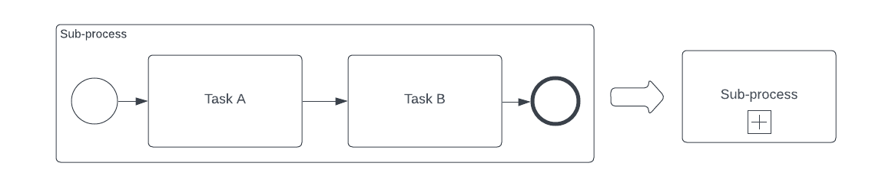
Process decomposition
Breaking down processes into smaller parts – subprocesses
Each subprocess must have a start and end event
It is used to visually simplify the model
When to decompose a process?
  When the model becomes too large so that it is difficult to understand
  If there are more than 30 flow objects (activities, events, decisions)
Sources: Authors

Slide 26
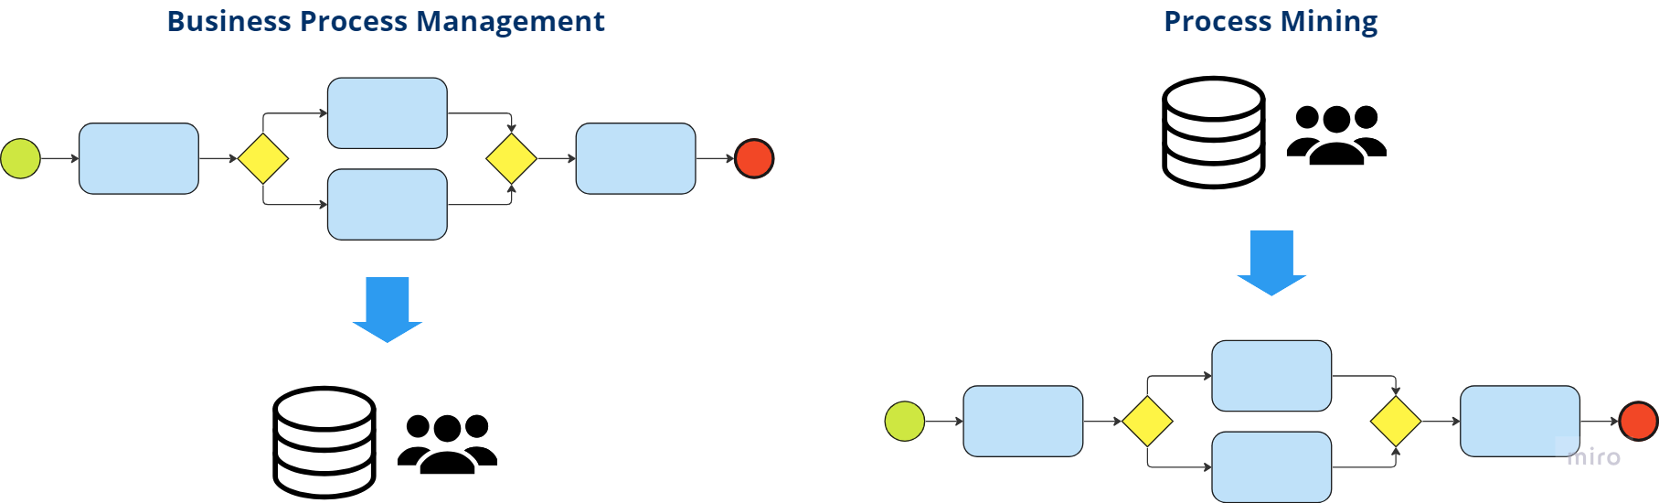
Process Mining
intersection of data mining and process modeling
an innovative approach to understanding and enhancing business processes
techniques, tools, and methods to discover, monitor and improve real processes (i.e., not assumed processes) by extracting knowledge from event logs commonly available in today's (information) systems
Sources: Authors

Slide 27
Event log example
Event log must contain a case ID, an activity name and a timestamp
  A case (process instance) is the entity being handled by the process that is analyzed
  an activity is a well-defined step in the process
  a timestamp is the date and time at which the activity is performed
Case ID | Activity Name | Timestamp | Resource
1001 | Call Received | 2023-15-12 09:00 | Agent A
1001 | Issue Identified | 2023-15-12 09:15 | Agent A
1002 | Call Received | 2023-15-12 10:17 | Agent C
1001 | Escalation | 2023-15-12 10:20 | Agent A
1002 | Information Given | 2023-15-12 10:26 | Agent C
1002 | Call Concluded | 2023-15-12 10:28 | Agent C
1001 | Tech Support Call | 2023-15-12 11:43 | Agent B
1001 | Issue Resolved | 2023-15-12 11:59 | Agent B

Slide 28
Process mining
After extracting the data (event logs) from the information systems (e.g. as a CSV or XLS file), the data is imported into special process mining software
Based on the imported data, the process mining software discovers a process model
This model can then be analyzed to determine whether there are some bottlenecks, problems or opportunities for improvement
Process Mining is applicable to all kinds of operational processes (organizations and systems)
  Analyzing hospital treatment procedures
  enhancing customer service procedures in a multinational
  comprehending booking site users' browsing habits
  assessing baggage handling system malfunctions

Slide 29
Summary
To stay competitive in today's business environment, effective management and ongoing process improvement are critical
Business Process Management (BPM) and Process Mining are two important parts of business intelligence that help companies analyze, optimize, and enhance their operational processes
BPM provides an organized and structured method for identifying, designing, executing, monitoring, and improving business processes while aligning them with the organization's strategic objectives
Process mining, on the other hand, is a tool for identifying and enhancing actual processes through the extraction of knowledge from event logs found in modern business information systems

Slide 30
Authors:
Dario Šebalj
Dejan Mirčetić
Michał Adamczak
Final version: June 2025

Slide 31
Thank you for your attention

