Slide 1



Business Intelligence
Machine learning
Lecture
BAS4SC
Business Analytics Skills
for the Future-proof Supply Chains
Project number – 2022-1-PL01-KA220-HED-000088856

Slide 2
Agenda
What is machine learning?
Foundations and theoretical assumptions of ML
Business intelligence and ML in SCs
ML and SC business data
ML for SC business problem

Slide 3
What is machine learning?
Machine learning is a subset of artificial intelligence (AI) that involves the development of algorithms and statistical models that enable computers to perform tasks without being explicitly programmed for those tasks. The primary goal of machine learning is to enable computers to learn from data and improve their performance over time without human intervention.
ML arises from this question: could a computer go beyond "what we know how to order it to perform" and learn on its own how to perform a specified task? Could a computer surprise us? Rather than programmers crafting data-processing rules by hand, could a computer automatically learn these rules by looking at data?

Slide 4
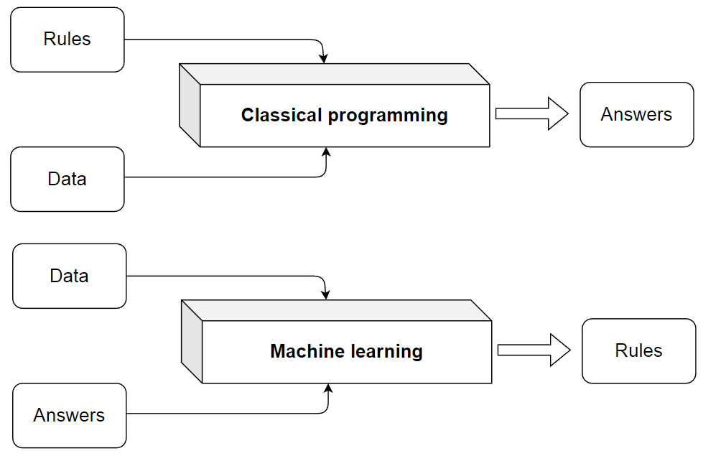
What is machine learning?
Figure. The classical programing vs. machine learning system training
Source: Chollet (2021)

Slide 5
Foundations and theoretical assumptions of ML
Machine learning's integration into business intelligence (BI) has transformed decision-making.
ML rooted in mathematics, especially statistics.
Ongoing debate: Is ML its field or part of statistics?
ML algorithms often operate beyond traditional mathematical boundaries.
ML vital in BI for data preprocessing, mining, and applying insights.
ML enhances decision-making in organizations.
Integration of ML into BI workflows for actionable insights.
Bridging mathematics and practice in ML for effective BI.
Strategies for optimizing ML algorithms for real-world BI applications.
Importance of using ML outputs in decision-making.

Slide 6
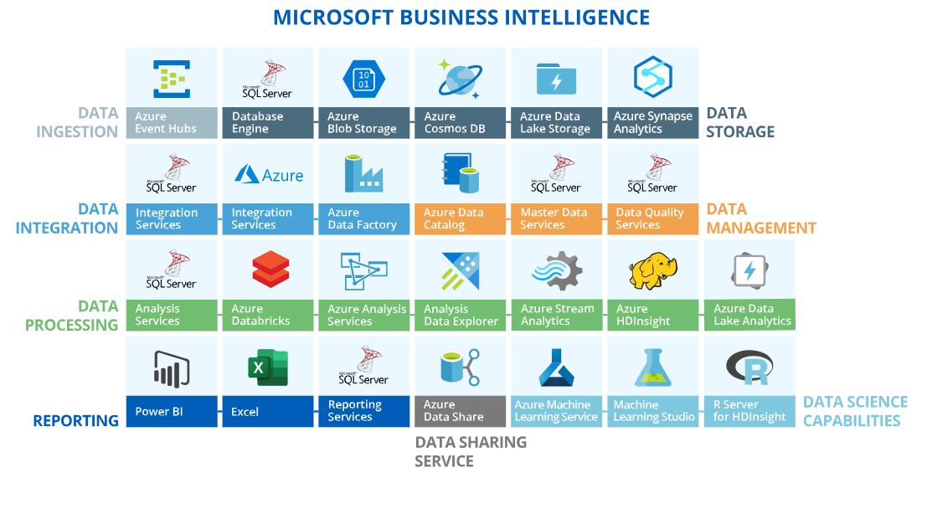
Business intelligence and ML in SCs
Figure. Microsoft business intelligence architecture.
Figure was addpted from https://www.scnsoft.com/services/business-intelligence/microsoft

Slide 7
Business intelligence and ML in SCs
Business intelligence (BI) in SCs involves drawing conclusions about observed processes based on data modeling.
Incorporation of Mathematics: BI relies heavily on statistics but also utilizes operations research, linear algebra, fuzzy logic, numerical optimization, metaheuristics, etc.
Emerging Technologies: New disruptive technologies such as machine learning, artificial intelligence, digital twins, smartization, living labs, etc., are gaining importance in data analysis and conclusions delivery.
Lack of Strict Procedures: BI and ML workflows lack strict organization but rely on successful guidelines from practice and literature.
Diverse Procedures: BI procedures vary based on the software used. For instance, Microsoft's Business Intelligence package offers tools for data ingestion, storage, integration, management, processing, reporting, sharing, and data science.
Tools Offered: Microsoft's BI package provides tools for different tasks, including data ingestion, storage, integration, management, processing, reporting, sharing, and data science.

Slide 8
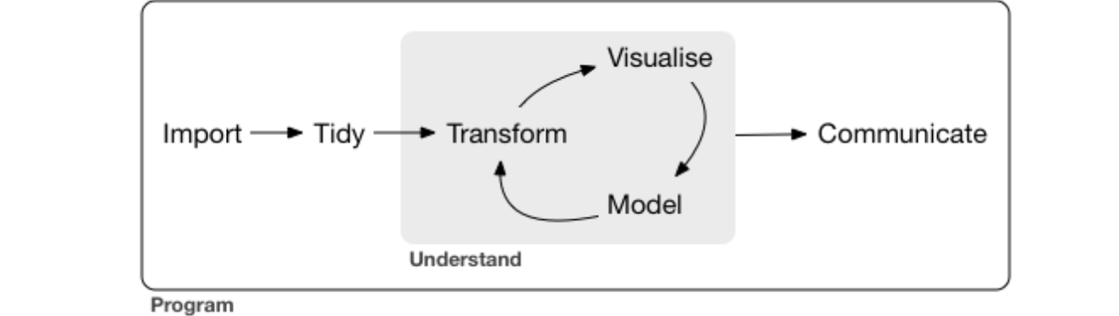
Business intelligence and ML in SCs
Figure. ML Data analysis steps in R
Source: Wickham et al. (2023)
ML procedures are primarily applied at the data science level using tools like Azure ML services, ML Studio, and R Server for HDInsight.
Misconception: There's a common misconception that building ML algorithms consumes the majority of time and effort.
Reality Check: In reality, most time is spent on data wrangling and preprocessing tasks, rather than the modeling process.
Complementary Roles: Visualization and modeling serve distinct but complementary roles in data analysis.

Slide 9
Business intelligence and ML in SCs
Visualization: Offers insights that may elude formalized approaches and prompts new inquiries.
Modeling: Provides a mathematical framework for answering precisely formulated questions and handling large datasets.
Synergy: The synergy between visualization and modeling enhances the data analysis process, leading to more comprehensive insights.
Vital Step: Communication is crucial for the success of data analysis.
Decision Making: Providing information to decision-makers in a clear and consistent manner is essential.
Ensuring Value: Effective communication ensures that the insights derived from data analysis contribute to informed decision-making and organizational success.

Slide 10
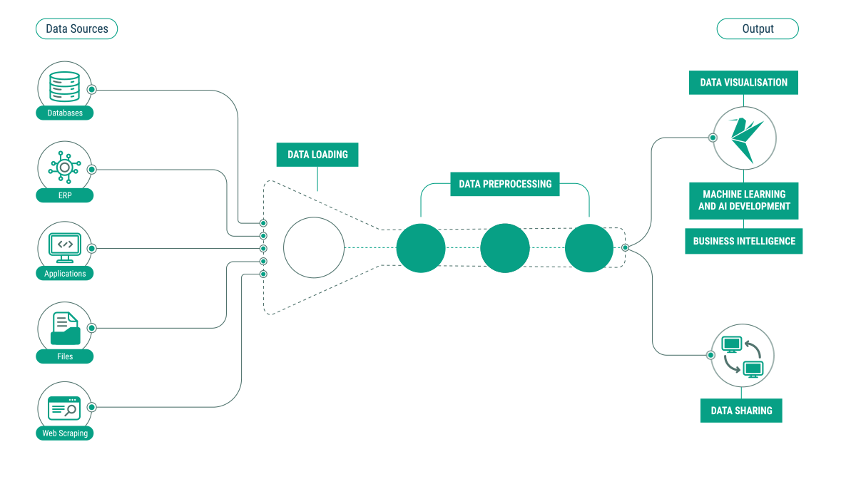
ML data & knowledge pipeline
Figure. The ML data & knowledge pipeline for company Equilibrium AI
Source: https://eqains.com

Slide 11
ML data & knowledge pipeline
Key Element: ML models are crucial in deriving conclusions about business processes in data analytics.
Tackling Specific SC Problems: To address specific supply chain (SC) issues, both the architecture for general-purpose business intelligence applications and ML models need refinement.
Equilibrium AI's Solution: Equilibrium AI developed an AI & ML platform to transform supply chain operations, enhance operational efficiency, improve decision-making, and achieve corporate objectives.
Overview: Equilibrium AI's ML data & knowledge pipeline involves backend and frontend operations to create value for users.
Data Extraction: Data is sourced from databases, enterprise resource planning systems, applications, flat files, and web/internet sources.
Data Loaders: Preprogrammed data loaders clean and preprocess data from various sources.

Slide 12
ML data & knowledge pipeline
Preprocessing Steps: Checking for wrong inputs, non-logical values, outliers, and merging external factors with internal data.
Importance of External Factors: External factors such as weather data, consumer price index, and demographic characteristics enrich the dataset for ML models.
Preprocessed Data: After preprocessing, data undergoes signal detection, noise removal, feature engineering, and division into train and test sets.
Output: The output stage involves data visualization, ML & AI development, and data sharing, sometimes without ML model application for reporting purposes.
Impact: ML models and insights derived from the pipeline contribute to informed decision-making and organizational success in supply chain operations.

Slide 13
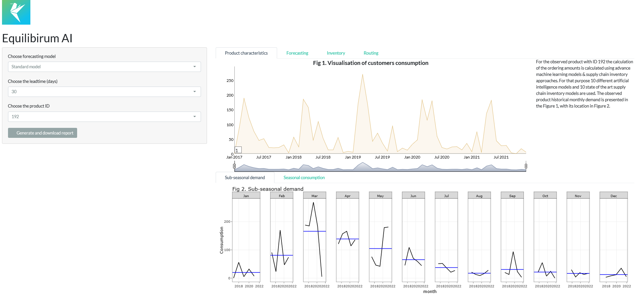
ML data & knowledge pipeline
Figure. The typical visualization part of ML platform in SCs.
Source: Equilibrium AI (n.dd.)

Slide 14
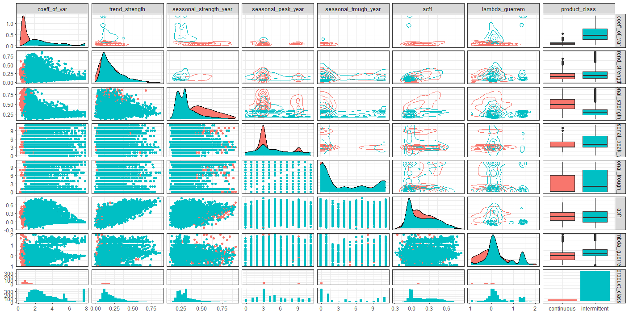
ML and SC business data
Figure. Statistical characteristics of products in the food supply chain (summarized for all products).
Source: Authors

Slide 15
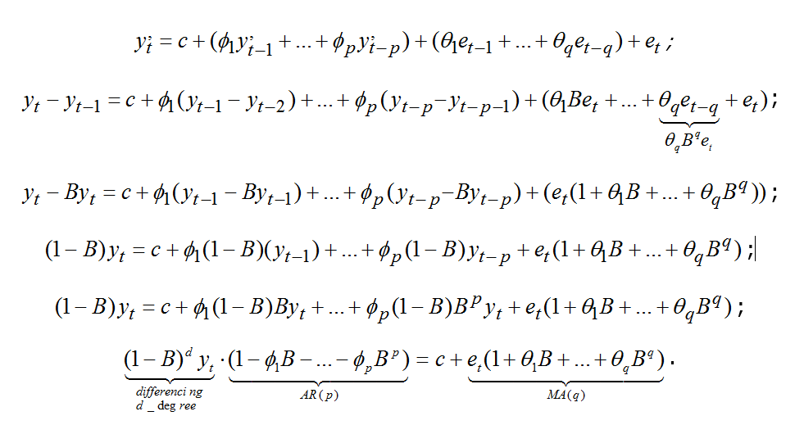
ML for SC business problem

Slide 16
Summary
The integration of machine learning (ML) into business intelligence (BI) processes revolutionizes data-driven decision-making.
Equilibrium AI's AI & ML platform transforms supply chain operations by enhancing efficiency and decision-making.
Data preprocessing, including data extraction and cleaning, is crucial for ML model effectiveness.
External factors enrich datasets for ML models, contributing to more accurate insights.
Feature engineering, including the selection and transformation of variables, significantly impacts the predictive power of ML models in BI.

Slide 17
Summary
Automated ML (AutoML) solutions streamline model selection and hyperparameter tuning, making advanced analytics more accessible.
Real-time data processing and predictive analytics enhance supply chain resilience by identifying potential disruptions before they occur.
Explainability and interpretability of ML models are essential for gaining stakeholder trust and ensuring regulatory compliance.
Cloud-based AI & ML solutions enable scalability and integration across multiple supply chain touchpoints.
Ultimately, ML models and insights derived from data analytics empower informed decision-making and drive organizational success in supply chain operations.

Slide 18
Authors:
Dario Šebalj
Dejan Mirčetić
Michał Adamczak
Final version: June 2025

Slide 19
Thank you for your attention

