Slide 1



Business Intelligence
Business data analytics
Lecture
BAS4SC
Business Analytics Skills
for the Future-proof Supply Chains
Project number – 2022-1-PL01-KA220-HED-000088856

Slide 2
Agenda
Business analytics
  Key pillars
  Rationale for business data analytics
  Trends & tools in business data analytics
  Enhanced decision making
  Trends in industry & education
Business analytics real applications
  Better factory (Italian producer of food)
  Predictive supply chain for family planning in Cote D’Ivoire (humanitarian project)
  Carlsberg brewery (global beverage producer)

Slide 3
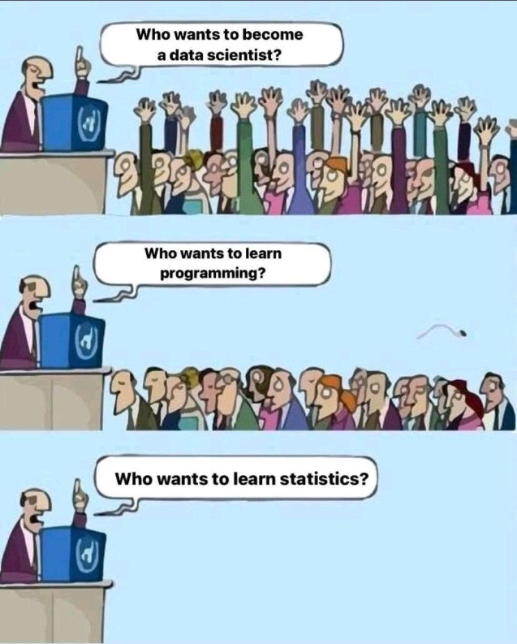
Business Analytics key pillars
AIMS & PURPOSE
  Business Data Analytics (BDA) represents a holistic approach of analysing data and making business decisions. It is a data and business driven environment with aim of boosting companies business performance by providing foundations for enhanced decision making.
  BA provides a coherent connection between raw data and business decisions.
TECHNOLOGY BACKGROUND
  BDA has a strong background in various mathematically driven approaches. The backbone of BA is in: statistical theory, operation research, predictive analytics, artificial intelligence, programming, deep learning, and etc.
END USERS DOMAIN
  Supply Chain Analytics, Financial Analytics, Web Analytics, Google Analytics, Software Analytics, Crisis Analytics, Knowledge Analytics, Marketing Analytics, Customer Analytics, Service Analytics, Human Resource Analytics, Talent Analytics, Process Analytics, Risk Analytics, etc.

Slide 4
Rationale for analytics
Trends, Tools & Benefits
BUSINESS DATA ANALYTICS
machine learning
statistics
digital twins
Achieve a competitive advantage
Support of an organization’s strategic and tactical goals
Better organizational performance
Better decision outcomes
Better or more informed decision processes
Knowledge production
Obtaining value from data
digitalization
predictive analytics
artificial inteligence
disruptive technologies
Maximising
business value
living lab
test beds
supervised learning
deep learning
neural networks
Source: Authors

Slide 5
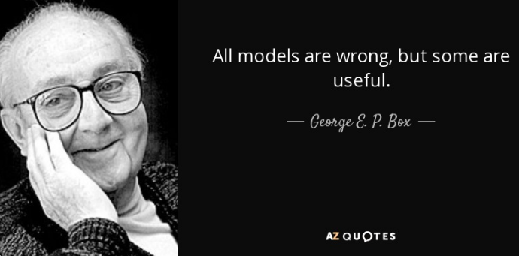
Enhanced Decision Making
Decision support
At its core, BDA is about leveraging value from data, where data has recently been deemed ‘the new oil.’
Transforming data in business usable knowledge. Not the case in many practical applications (to model-centric and mathematically centric, requires deep expertise in mathematics, metrics not aligned with business utility).
“All models are wrong but some are useful!” George Box
“Don't fall in love in your models!” Foresight journal
In practice BDA is usually derived to the final users in a form of decision support systems (DSS), expert systems (ES), forecasting support systems (FSS), upcoming in nearby future: automated artificial intelligence (AI) BDA systems!
Business analytics
Raw data

Slide 6




Trends in Industry & Education
In the past few years, the BDA is becoming increasingly popular in the industry. Industry recognized the added value which can BA bring.
Examples:
Response of education:
  “Interdisciplinary approach for enhancing knowledge in supply chain analytics (SCAN)”
  15 different Universities in 10 central European countries. Joint PhD study program in supply chain analytics.

Slide 7
Case studies (deep dive)
BETTER FACTORY (Italian producer of food) => Automated AI
PREDICTIVE SUPPLY CHAIN FOR FAMILY PLANNING IN CÔTE D’IVOIRE (humanitarian project) => DSS
CARLSBERG BREWERY (global beverage producer) => FSS

Slide 8
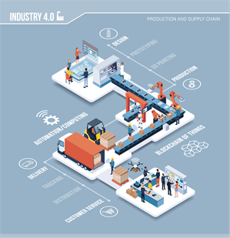
Better factory (2021-2022)
Food producer of one of the finest hams in the world, with a Protected Designation of Origin (PDO) certificate. The consortium consists of more than 50 000 workers.
Goal:
  Create a fully automated BDA platform based on deep learning and state of the art AI models.
  The platform will utilize advanced AI models which will deliver totally automated, self-dynamic, self-optimizing Smart production system.

Slide 9
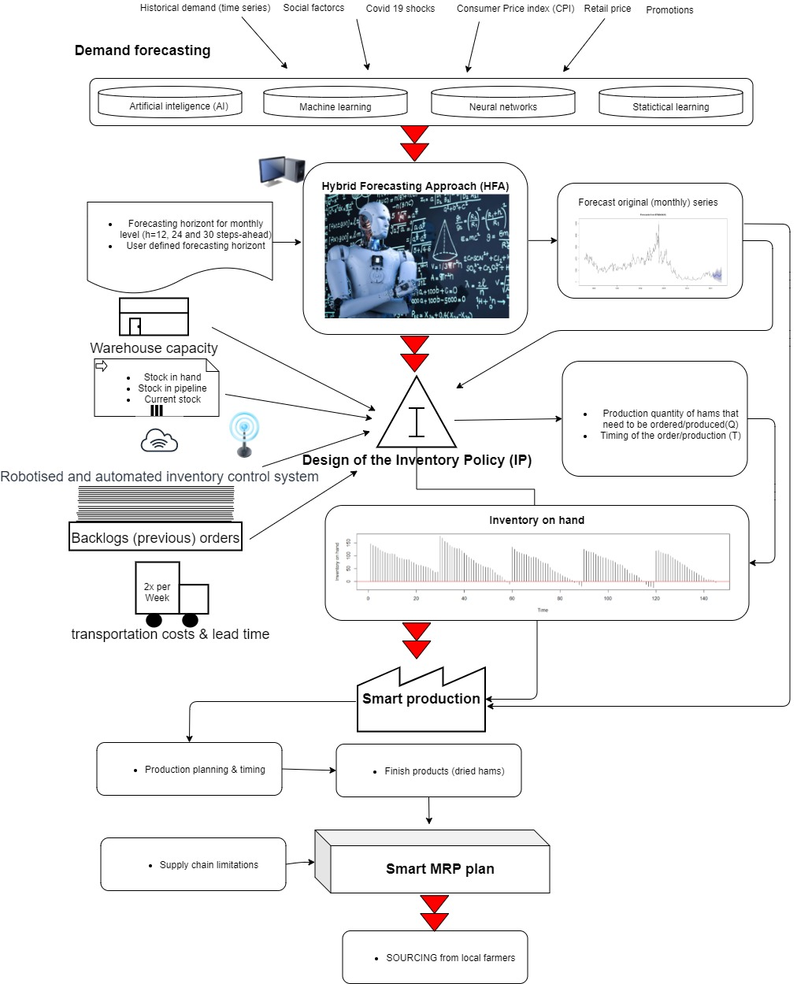
The architecture of the BDA Smart production system is presented in Figure.
Presented BDA will allow totally automated, self-dynamic, self-optimizing smart production system without the need for expert decision making.
Is that good? Can we trust that AI can really totally replace human experts? Should we reduce the freedom of the BA solution and subdue it to a human expert?
Source: Authors

Slide 10




USAID's Humanitarian project (2021-2022)
Predictive Supply Chain for Family Planning in Côte d’Ivoire
  Design the BDA platform based on AI for predicting the consumption of contraceptives and accompanying supply chain for 25 million users in 1752 locations.
Goal:
  Make the world a better place, by helping people in developing countries to receive better health care.

Slide 11
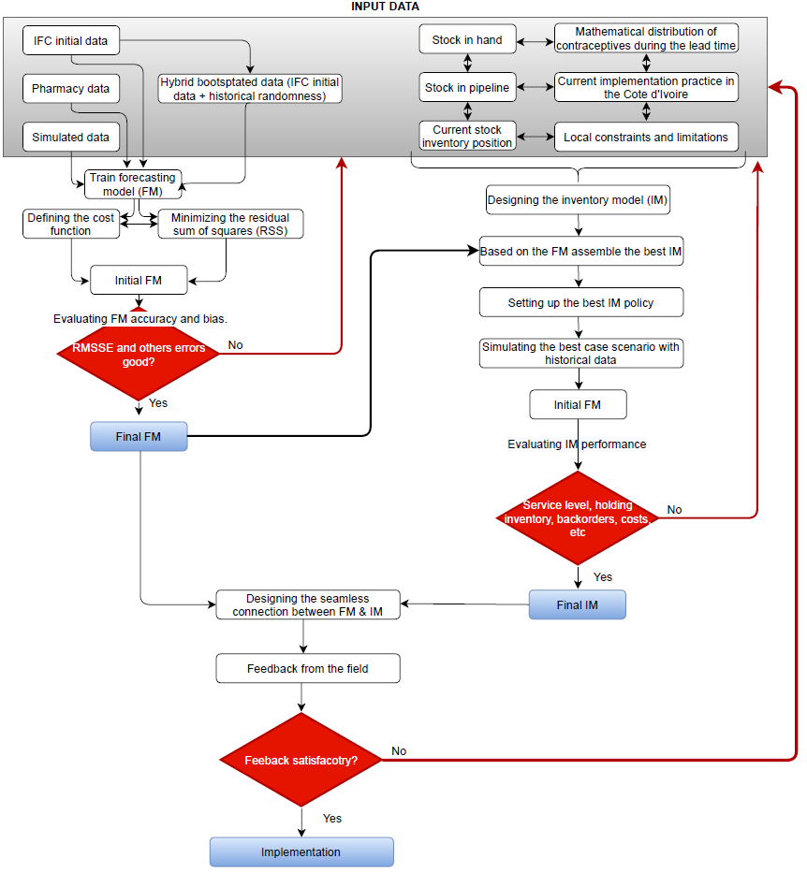
The design structure of the Côte d’Ivoire healthcare BDA system.
The system is very fragile, hard to model. Main limitations: non-reliable data (90% of the modeling time), bad coordination between decision-makers, IT background, etc).
Presented BDA will serve as DSS for decision-makers in operational, tactical and strategic levels in Côte d’Ivoire healthcare supply chain.
Demo of the DSS
Source: Authors

Slide 12



Carlsberg FSS (2015-2018)
In this case study, the FSS is developed. The model is developed for one of the beverage market leaders in a Europe.
Goal:
  Create the FSS which will:
    generate accurate forecasts to reduce overall planning and operational costs,
    design the FSS for coherent intersectional decision making (production, marketing, finance and marketing).

Slide 13
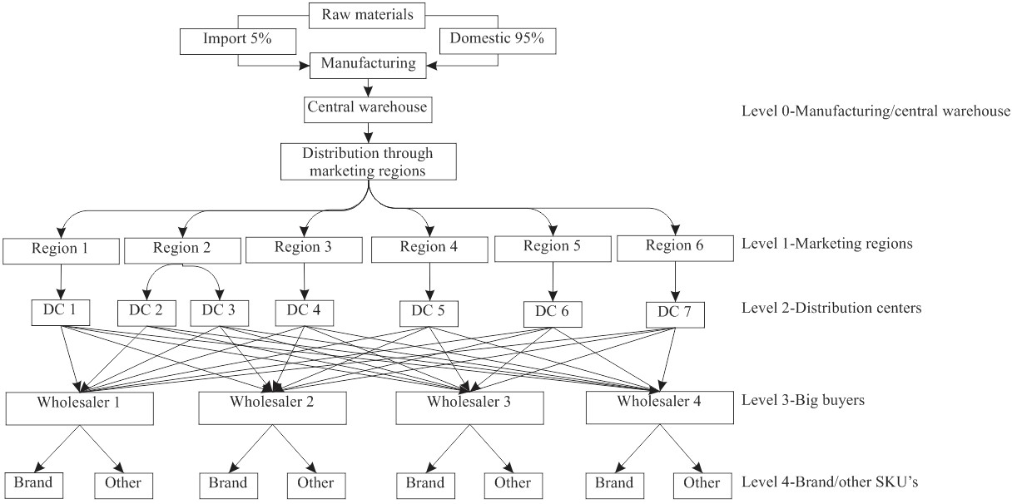
Supply chain structure
Multi-echelon brewery distribution network
Source: Authors

Slide 14
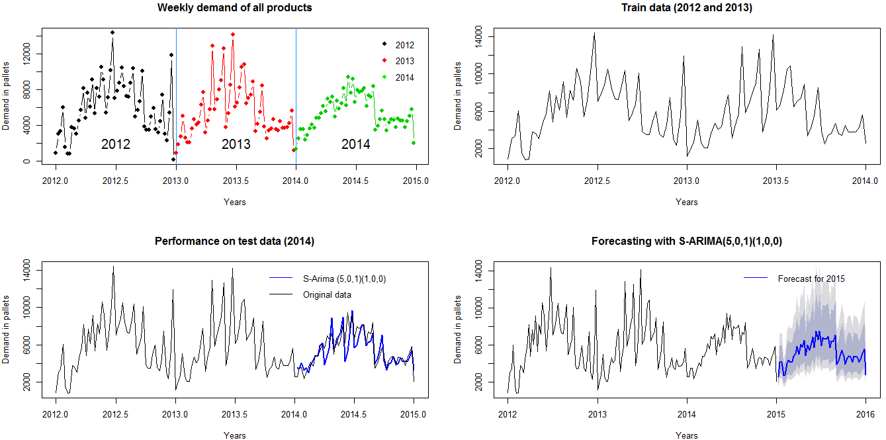
Carlsberg FSS
Source: Authors

Slide 15
Authors:
Dario Šebalj
Dejan Mirčetić
Michał Adamczak
Final version: June 2025

Slide 16
Thank you for your attention

