Slide 1



Business Intelligence
Understanding and interpreting data
Lecture
BAS4SC
Business Analytics Skills
for the Future-proof Supply Chains
Project number – 2022-1-PL01-KA220-HED-000088856

Slide 2
Agenda
Importance of data analysis
Data, information, knowledge, wisdom
Data sources and data types
Data modeling and design
Data-driven decision making
Data quality

Slide 3
Benefits of data analysis
Extraction of valuable insights from the vast ocean of available information
It enables organizations to make decisions that are more objective and grounded in facts by enabling them to go beyond assumptions and intuition
Finding organizational inefficiencies and areas for improvement
Organizations can find bottlenecks, stremline workflows, and enhance the general efficiency of business processes
But first – explanation of fundamental concepts of understanding and interpreting data

Slide 4
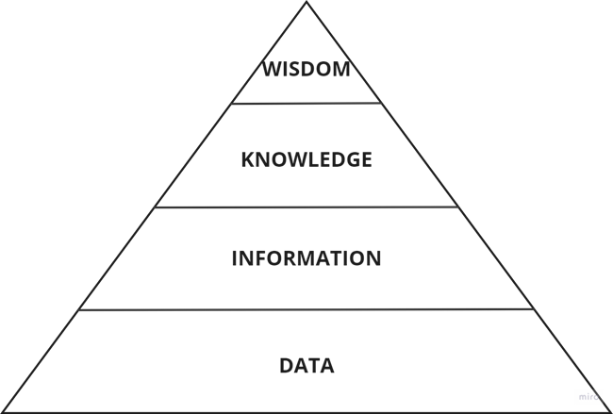
DIKW pyramid
Source: Rowley (2007)

Slide 5
DIKW pyramid
Data - raw material that has no meaning. Data can be in the form of numbers, text, images, etc. Without interpretation, data will remain meaningless.
  Example of data: a dataset which contains temperature readings collected from weather stations
Information - A collection of data in context that is relevant to one or more persons at a given time. It is processed, organized, structured, and contextualized data.
  Example of information: By analyzing the temperature data, it can be seen that the average temperature in the past month is higher than in the same period last year
Knowledge - the outcome of information analysis and interpretation, which reveals patterns, trends, and connections.
  Example of knowledge: With the knowledge gained from analyzing historical temperature data, a meteorologist can predict the weather conditions for the upcoming week.
Wisdom - the capacity to understand the underlying facts and make well-informed decisions and effective actions
  Example of wisdom: using weather forecasts and understanding local climatic conditions, a farmer can make a decision to plant a certain type of crop.
Source: Brackett (2015); Dalkir (2023); Cotton (2023)

Slide 6
Data sources and data types
Data – „the new oil”
There are 97 zettabytes of data in the world
90% of the data was generated over the last two years
Sources of data:
  surveys, laboratory tests, field experiments, computer experiments, simulations, web searches, mobile recordings, devices, sensors…

Slide 7
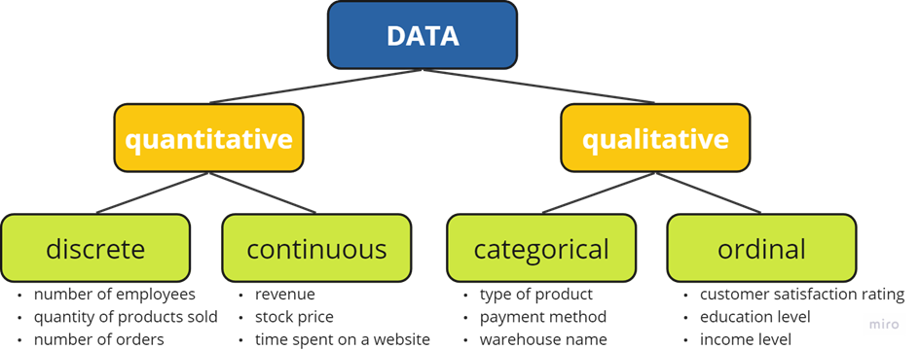
Types of data
Source: Authors

Slide 8
Data types
Quantitative (numerical) data
  data expressed in numbers
  can be further divided into discrete and continuous data
    Discrete data is data that can have only a certain value (e.g. number of employees).
    Continuous data can have an infinite number of possible values (e.g. price of the product).
Qualitative data
  can be divided into categorical and ordinal data
    Categorical data represent text data which can be grouped into distinct categories (e.g. birthplace, region, product category)
    Ordinal data can be ranked or ordered (e.g. customer satisfaction – very unsatisfied, unsatisfied, neutral, satisfied, very satisfied; education level – elementary, high school, bachelor’s degree, master’s degree, PhD).

Slide 9
Data types
Structured data
  can be stored, processed and manipulated in a traditional relational database management system. This data comes from a variety of sources, including clickstreams, web-based forms, point-of-sale transactions, sensors, and machines. It can be produced by humans or machines
Semi-structured data
  organized by tags that help give the data a hierarchy and order even if it doesn't fit into a structured database system. Databases and file systems frequently contain semi-structured data.
  Log files, HTML-tagged text, XML files…
Unstructured data
  typically produced by human activity and does not fit into a structured database format.
  Text documents, PDFs, blog entries, emails, pictures, and videos
Source: EMC Education Services (2015); Person & Porway (2015); McKinsey Global Institute (2011)

Slide 10
Big data
„data whose scale, distribution, diversity, and/or timeliness require the use of new technical architectures and analytics to enable insights that unlock new sources of business value” (McKinsey Global Institute, 2011)
3V’s of Big data:
  volume (consisting of enormous quantities of data)
  velocity (created in real-time)
  variety (being structured, semi-structured and unstructured)
Source: Kitchen and McArdle (2016)

Slide 11
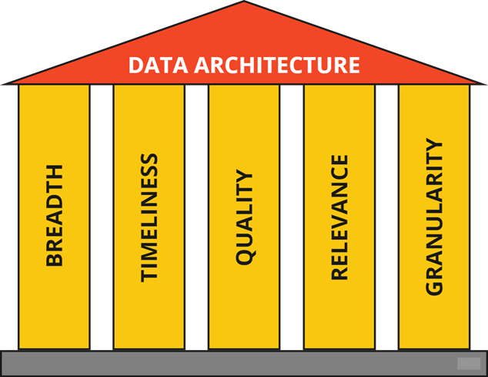
Data architecture
Foundation for successful business intelligence
It consists of six important aspects regarding data:
  breadth
  timeliness
  quality
  relevance
  granularity
Data quality is the center pillar because so much effort
goes into ensuring and improving data quality
Source: Author, adapted from Howson (2014)

Slide 12
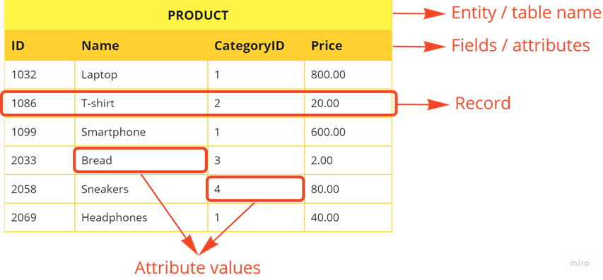
Data modeling and design
A data model is a formal representation of the data that a business system uses and generates
Structured data is usually stored in a relational database management system (RDBMS)
Data are organized into tables which contain a collection of records that store information about a particular entity
Source: Dennis et al. (2018)

Slide 13
Data modeling and design
Attribute - a particular kind of data about an entity
  Customer ID, First Name, Last Name, Address, Postal Code, City, Country, Email Address are the attributes of a Customer entity
Record - a row in a table, or a collection of related fields describing a single instance of an entity (such as a customer)
Primary key - a field (or set of fields) that gives every product in the table a distinct identity.
  It means that there cannot be two products with the same ID in the table.
The tables in a database are often connected to other tables in the database, i.e. there is a relationship between them
Source: Tilley (2020)

Slide 14
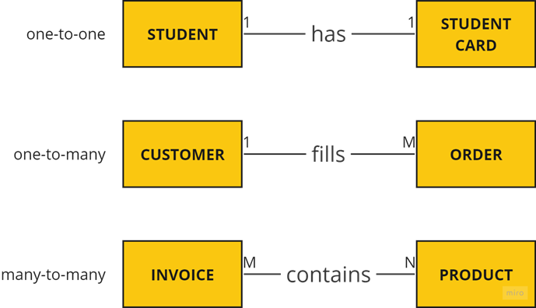
Types of relationships
Source: authors

Slide 15
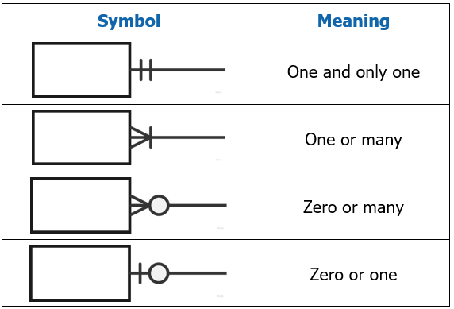
ER diagram
Visual representation of the logical structure of a database and the relationships between the tables
Chen vs. Martin (Crow’s foot) notation
Entity – rectangle with listed attributes
Cardinality - shows how many instances of one
entity are associated with an instance of the other
Source: Tilley (2020)

Slide 16
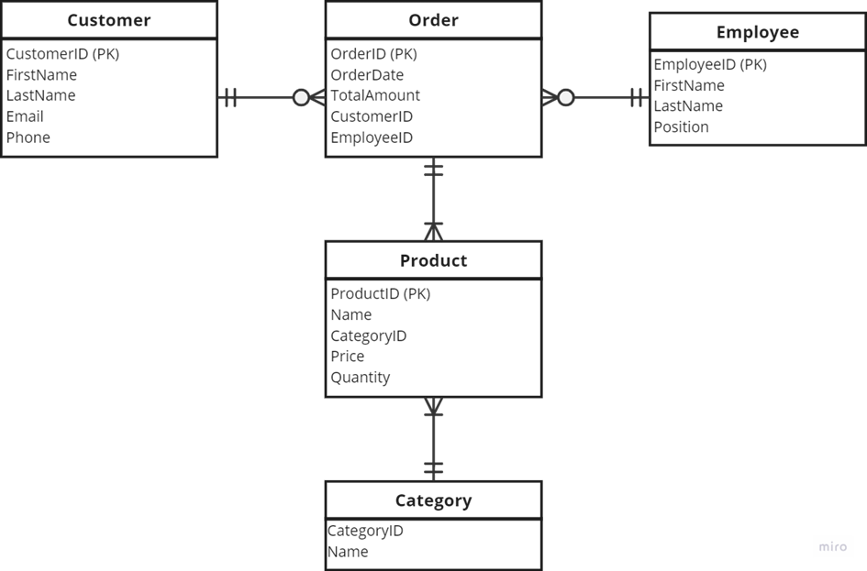
ER diagram - example
Source: Authors

Slide 17
Data-driven decision making
A strategic approach that relies on analyzing and interpreting data to guide choices and actions
The process of making strategic business decisions that are in line with the aims, objectives, and initiatives of the organization by utilizing facts, metrics, and data (Nelson, 2022)
The process of making choices that rely more on data analysis than intuition (Provost & Fawcett, 2013)
Steps for making data-driven decisions:
  Understanding company’s vision
  Finding data sources
  Cleaning and organizing data
  Performing data analysis
  Drawing conclusions

Slide 18
Data quality
The degree of accuracy, consistency, reliability, and suitability for a given purpose
Very important since the conclusions and judgments made from the data mostly depend on its accuracy and reliability
Data quality can be characterized by the six most commonly used dimensions (Foote, 2022):
  Accuracy: how accurate are the attribute values in the data?
  Completeness: is the data complete, without missing information?
  Consistency: how consistent are the values in and between the databases?
  Timeliness: how timely is the data?
  Validity: how data conforms to pre-defined business rules?
  Uniqueness: is each record uniquely identified, without redundant storage?

Slide 19
Data quality
Data can be considered high-quality if they have the following characteristics (five Cs of data):
  Clean – refers to missing items, invalid entries and other similar problems
  Consistent - uniformity and coherence of data across different sources and within the dataset itself
  Conformed – it refers to data that adheres to predefined data standards and rules
  Current - it is essential to use the most current data for decision-making and analysis
  Comprehensive - it includes all the essential data elements required for the intended decision-making process without omitting critical information.
Almost all data has to be cleaned before it can be used for further analysis
The objective determines the degree of cleanliness and the data cleaning strategy.

Slide 20
Summary
Understanding the interplay between data, information, knowledge, and wisdom forms the fundamental basis for harnessing the potential of Business Intelligence
Main data types include quantitative (numerical) and qualitative data
A foundational understanding of data modeling and design, as demonstrated by ER diagrams and RDBMS, is essential for the efficient utilization of data
By integrating data into the decision-making process, organizations become more adaptable, responsive, and resistant to change, thereby fostering innovation and sustainable growth
Data quality is important in the context of business intelligence and data analysis since the conclusions and judgments made from the data mostly depend on its accuracy and reliability

Slide 21
Authors:
Dario Šebalj
Dejan Mirčetić
Michał Adamczak
Final version: June 2025

Slide 22
Thank you for your attention

