Slide 1



Advanced use of a spreadsheet to analyse logistics data
Transport optimisation
Lecture
BAS4SC
Business Analytics Skills
for the Future-proof Supply Chains
Co-funded by the European Union
Views and opinions expressed are however those of the author(s) only and do not necessarily reflect those of the European Union or the National Agency (NA). Neither the European Union nor NA can be held responsible for them
Project number – 2022-1-PL01-KA220-HED-000088856

Slide 2
Agenda
Basic definitions of the transport system;
The nature and importance of transport system optimisation;
Optimisation modeling of transport system;
Example of transport task in MS Excel.

Slide 3
Definition of transport
Transport belongs to the field of production of material services, performs transportation of people and goods, provides distribution and supply of raw materials and products of industry and agriculture to all regions of the world at home and abroad.
The main task of transport is to fully and timely meet the transport needs of the national economy and population, to increase the efficiency and quality of the transport network. Given the leading role of transport in the market economy, transport management is assigned to a separate field, called transport logistics.
Source: Yahiaoui, 2019, pp. 190-199, Vakulenko & Evreenova, 2019

Slide 4
Transport logistics elements
Transport logistics
loads
consolidation stations
transport hubs
transport network
rolling stock
handling equipment
logistics process participants
transport containers
packaging.
Source: Yahiaoui, 2019, pp. 190-199, Vakulenko & Evreenova, 2019

Slide 5
Definition of transport optimisation
Transport system optimisation research and work is linked to important transport policy issues, playing an important role in the development of transport economics theory.
Optimisation in transport is a very broad concept that covers a variety of processes. Their aim is to improve the situation of the parties involved in transport (shippers, receivers, employees).
Source: De Maio, Vitetta, 2015; Optifacility, accessed 30.05.2024

Slide 6
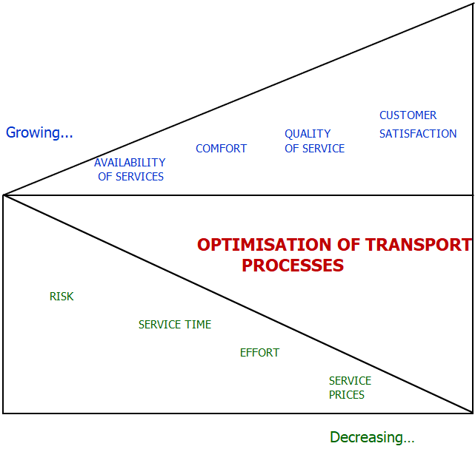
Advantages of optimisation
QUALITY OF SERVICE
CUSTOMER SATISFACTION
Growing…
The advantages of a properly conducted optimisation process include:
  increased safety;
  better service quality;
  greater availability of goods and services.
COMFORT
AVAILABILITY OF SERVICES
OPTIMISATION OF TRANSPORT PROCESSES
RISK
SERVICE TIME
EFFORT
SERVICE PRICES
Decreasing…
Figure 1: Changes resulting from the use of optimisation of transport processes
Source: Zajdel, Filipowicz, 2008, p. 999

Slide 7

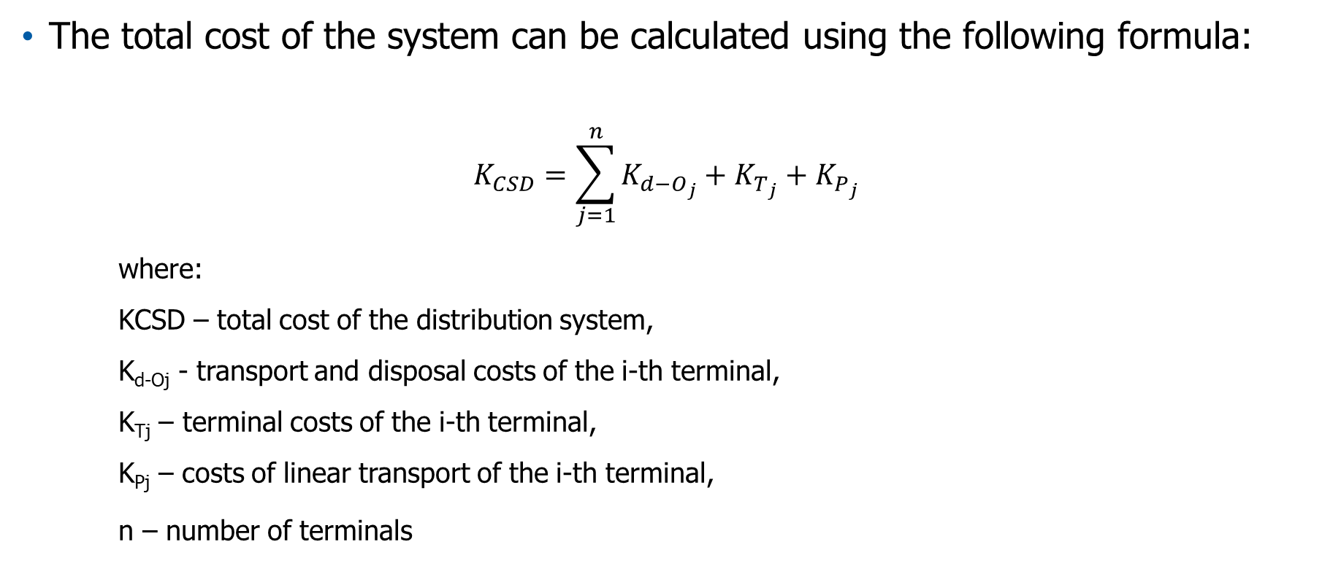
Costs of distribution system
The total cost of the system can be calculated using the following formula:
$$K_{CSD}=\sum_{j=1}^{n}{K_{d−O_{j}}}+K_{T_{j}}+K_{P_{j}}$$
where:
KCSD – total cost of the distribution system,
K_{d-Oj} - transport and disposal costs of the i-th terminal,
K_{Tj} – terminal costs of the i-th terminal,
K_{Pj} – costs of linear transport of the i-th terminal,
n – number of terminals
Source: Milewski, 2011, p. 67

Slide 8
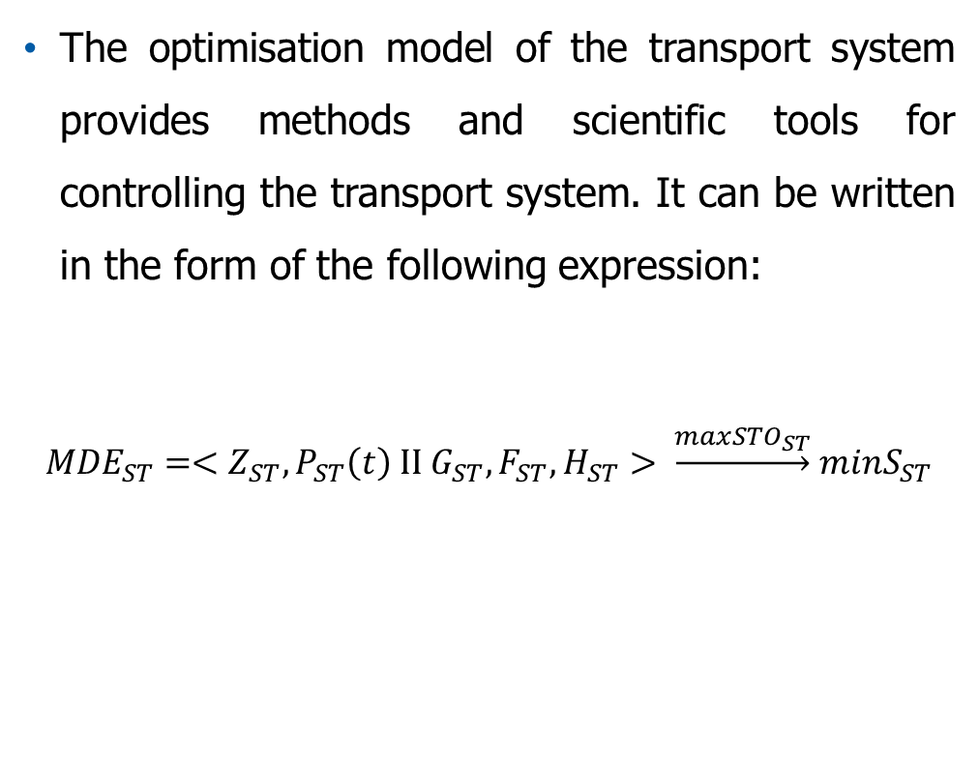
The optimization model of the transport system
where:
Z_{ST} – a set of operational (logistic) resources of the ST system,
P_{ST} - a set of operational (logistics) processes of the ST system,
G_{ST} – a set of constraints and boundary conditions of the ST system,
F_{ST} – ST system operation criterion function,
H_{ST} – a set of acceptable operating schedules for the ST system,
S_{ST} – global costs of functioning of the ST transport macrosystem,
STO – logistic customer service standards by the transport sector.
The optimisation model of the transport system provides methods and scientific tools for controlling the transport system. It can be written in the form of the following expression:
$${MDE}_{ST}=<Z_{ST}, P_{ST}\left(t\right) II G_{ST}, F_{ST}, H_{ST}> \underset{→}{max{STO}_{ST}} minS_{ST}$$
Source: Ficoń, 2010, p. 126

Slide 9
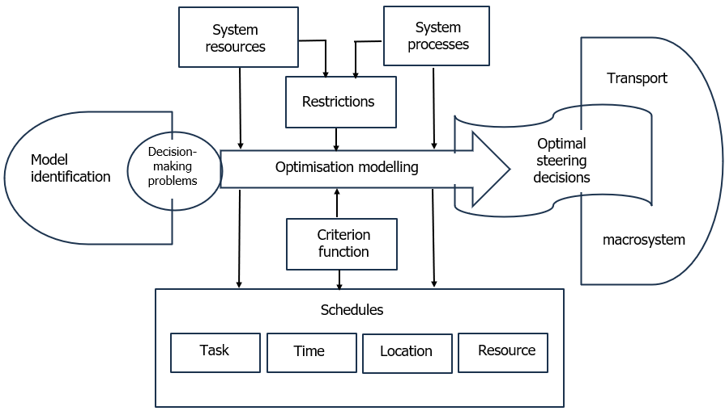
Optimization modeling of transport system
System resources
System processes
Transport
Restrictions
Optimal steering decisions
Model identification
Decision-making problems
Optimisation modelling
Criterion function
Macrosystem
Schedule
Task
Time
Location
Resource
Figure 2: The concept of optimization modeling of the transport system
Source: Ficoń, 2010, p. 126

Slide 10
Definition of route optimisation
One of the basic components of transport optimisation is route optimisation. This involves designing routes for the vehicles used to transport goods in order to optimise profits and customer service.
Route optimisation is one of the basic components of transport optimisation. This involves designing routes for the vehicles used to transport goods in order to optimise profits and customer service.
Source:Gaspars-Wieloch, H. in: Szymczak, M. (ed.), 2011

Slide 11
Travelling Salesman and Vehicle Routing Problems
The Traveling Salesman Problem (TSP) is a classical combinatorial optimisation problem, which involves planning the shortest and least expensive transportation route, passing through n specified sending and receiving points, with given travel costs between each pair of points.
The Vehicle Routing Problem (VRP) is a generalisation of the TSP. In it, it is possible to have multiple commuters (multiple vehicles), with the possibility of returning to the base multiple times before reaching all n locations.
Source: Optifacility, accessed 30.05.2024

Slide 12
Travelling Salesman Problem
TSP soultion
the level of product stock at each sending point
the volume of demand at each receiving point
the transport costs from each sending point to each receiving point
Source: Vinichenko, 2009, p. 133

Slide 13
Travelling Salesman Problem
If the cost of the journey is directly proportional to the quantity transported, we are dealing with a linear transport task. Otherwise, if this condition is not met, the transport task becomes a non-linear task;
One of the most popular optimisation methods is linear programming;
Although the linear programming method is quite practical, there are limitations to its use:
  the problem to be solved using it must be formulated deterministically;
  the problem should be subjected to a linear approximation
  the fixed and variable operating costs of logistics facilities cannot be taken into account in linear programming.
Source: Silaen, Savaluddin, Tulus, 2019; Gass, 2013; Sierksma, 2002;Biethahn & Nissen,1995; Coyle, Bardi, Langley, 2002

Slide 14
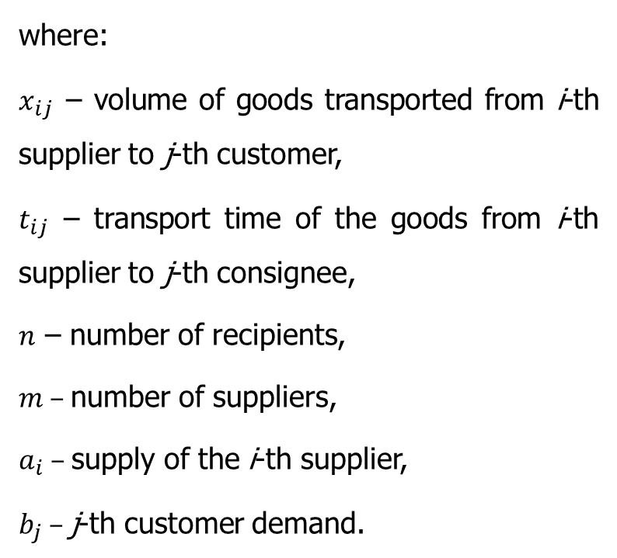
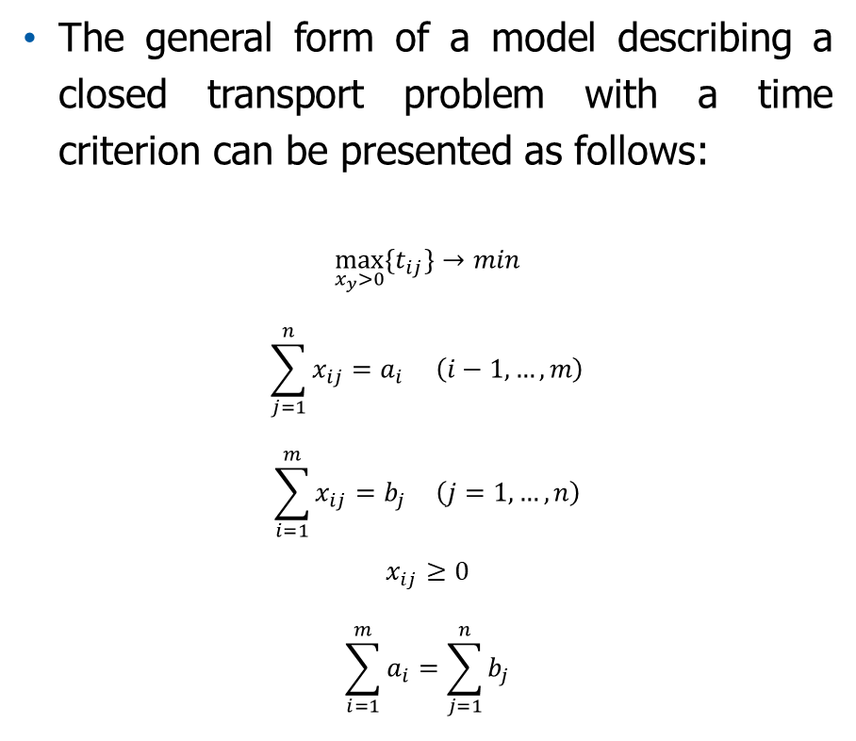
Mathematical model of the transport task
The general form of a model describing a closed transport problem with a time criterion can be presented as follows:
$$\max_{x_{y}>0}{\{t_{ij}\}→min}$$
$$\sum_{j=1}^{n}{x_{ij}}=a_{i} \left(i−1,…,m\right)$$
$$\sum_{i=1}^{m}{x_{ij}}=b_{j } \left(j=1,…,n\right)$$
$$x_{ij}≥0$$
$$\sum_{i=1}^{m}{a_{i}}=\sum_{j=1}^{n}{b_{j}}$$
where:
$x_{ij}$ – volume of goods transported from i-th supplier to j-th customer,
$t_{ij}$ – transport time of the goods from i-th supplier to j-th consignee,
$n$ – number of recipients,
$m$ – number of suppliers,
$a_{i}$ – supply of the i-th supplier,
$b_{j}$ – j-th customer demand.
Source: Gaspars-Wieloch, H. in: Szymczak, M. (ed.), 2011, pp. 14-15

Slide 15
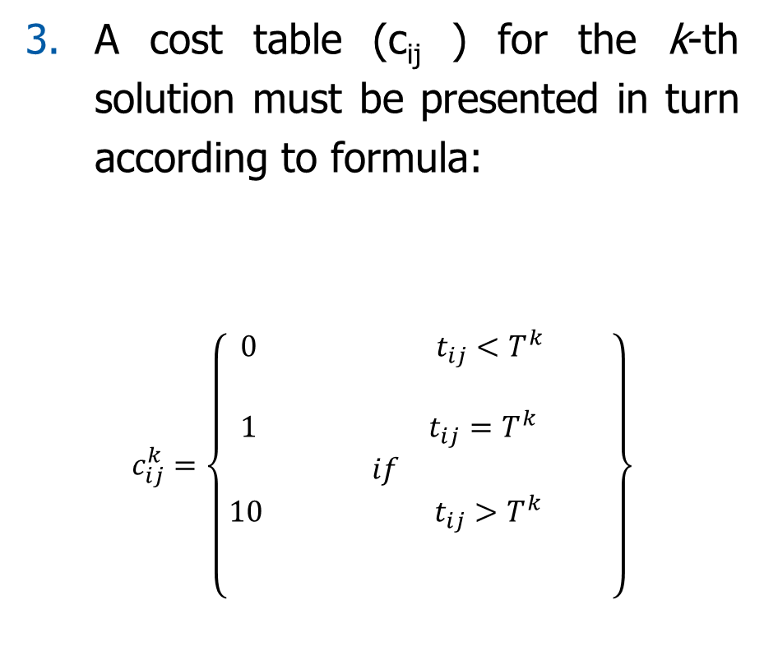
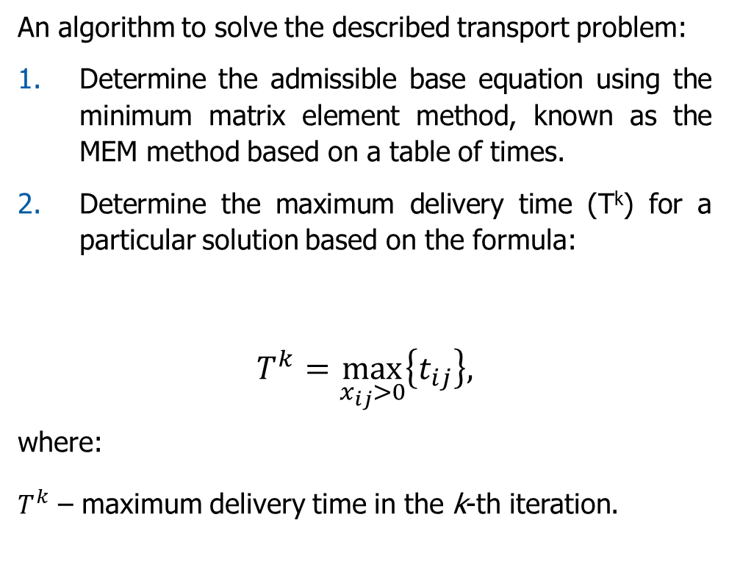
Mathematical model of the transport task
An algorithm to solve the described transport problem:
Determine the admissible base equation using the minimum matrix element method, known as the MEM method based on a table of times.
Determine the maximum delivery time (T^{k}) for a particular solution based on the formula:
$$T^{k}=\max_{x_{ij}>0}\left\{t_{ij}\right\},$$
where:
$T^{k}$ – maximum delivery time in the k-th iteration.
A cost table (c_{ij} ) for the k-th solution must be presented in turn according to formula:
$$c_{ij}^{k}=\left\{\begin{aligned}\begin{aligned} 0 t_{ij}<T^{k} \\ \\ 1 { t}_{ij}=T^{k} \\ if \\ 10 { t}_{ij}>T^{k}\end{aligned} \\ \\ \end{aligned}\right\}$$
Source: Gaspars-Wieloch, H. in: Szymczak, M. (ed.), 2011, pp. 14-15

Slide 16
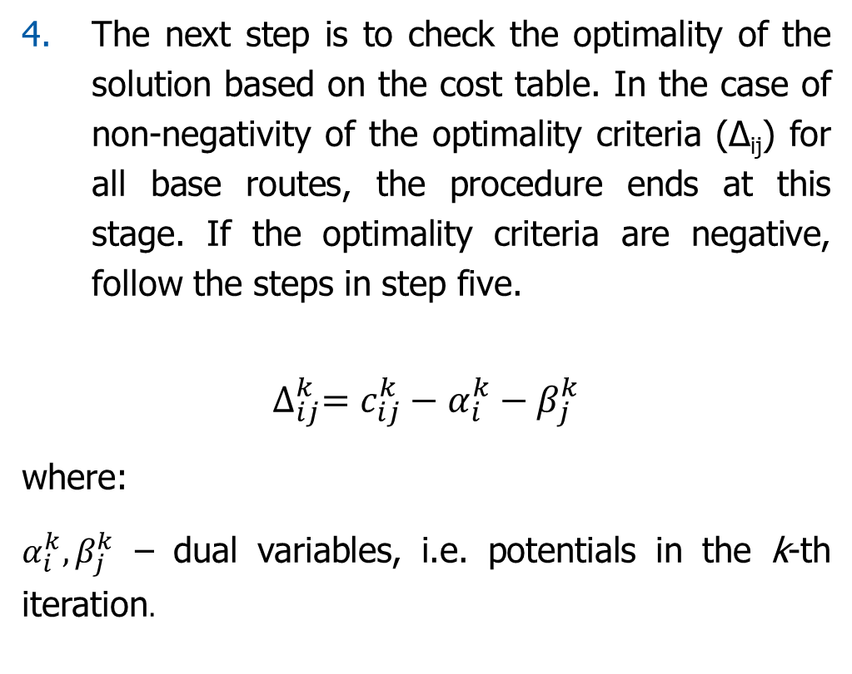
Mathematical model of the transport task
The next step is to check the optimality of the solution based on the cost table. In the case of non-negativity of the optimality criteria (∆_{ij}) for all base routes, the procedure ends at this stage. If the optimality criteria are negative, follow the steps in step five.
$$∆_{ij}^{k}=c_{ij}^{k}−α_{i}^{k}−β_{j}^{k}$$
where:
$α_{i}^{k}, β_{j}^{k}$ – dual variables, i.e. potentials in the k-th iteration.
The acceptable base solution should be redetermined, taking into account the most negative optimality criterion, and then return to step two.
Source: Gaspars-Wieloch, H. in: Szymczak, M. (ed.), 2011, pp. 14-15

Slide 17
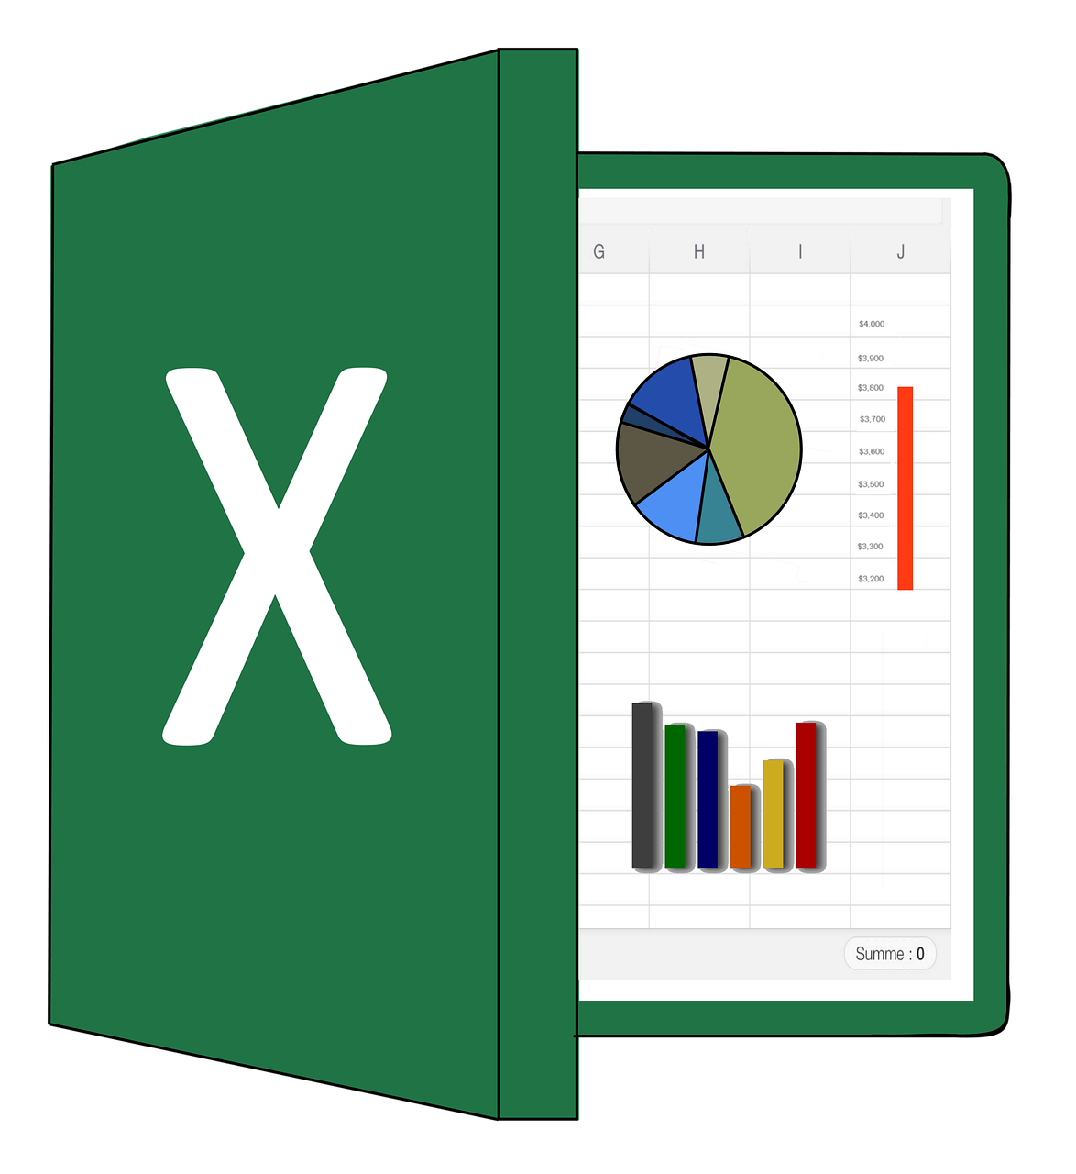
Transport task using MS Excel and Solver

Slide 18
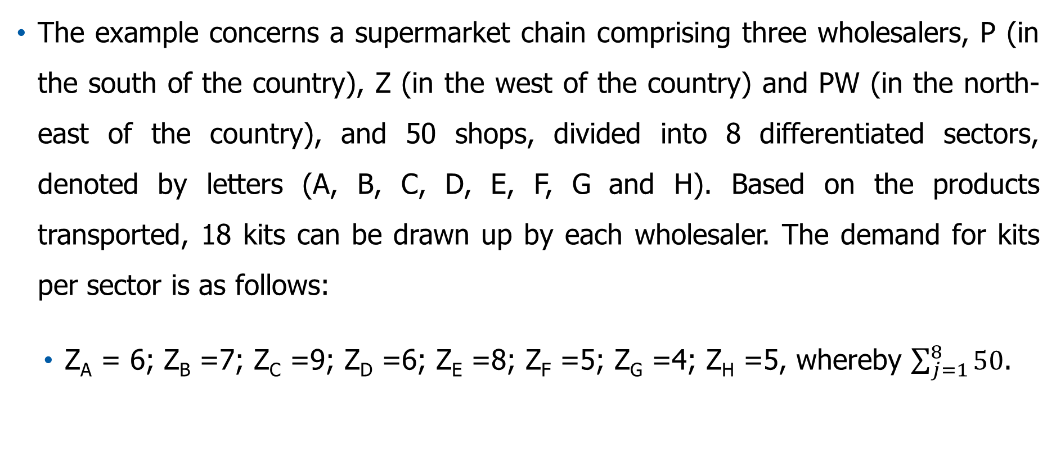
Transport task using MS Excel and Solver – An Example
The example concerns a supermarket chain comprising three wholesalers, P (in the south of the country), Z (in the west of the country) and PW (in the north-east of the country), and 50 shops, divided into 8 differentiated sectors, denoted by letters (A, B, C, D, E, F, G and H). Based on the products transported, 18 kits can be drawn up by each wholesaler. The demand for kits per sector is as follows:
Z_{A} = 6; Z_{B} =7; Z_{C} =9; Z_{D} =6; Z_{E} =8; Z_{F} =5; Z_{G} =4; Z_{H} =5, whereby $\sum_{j=1}^{8}{50}$.
Co-funded by the European Union
Views and opinions expressed are however those of the author(s) only and do not necessarily reflect those of the European Union or the National Agency (NA). Neither the European Union nor NA can be held responsible for them.
Source: Gaspars-Wieloch, H. in: Szymczak, M. (ed.), 2011, pp. 17

Slide 19
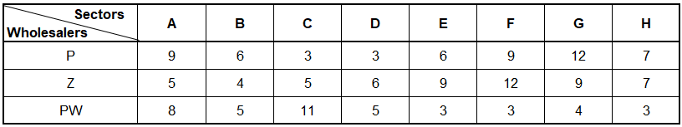
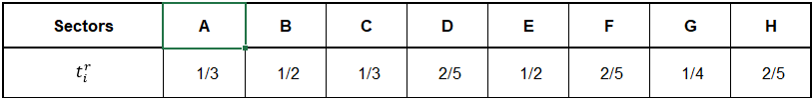
Transport task using MS Excel and Solver – An Example
Transport time in a sector, which in practice is determined by the distance between the shops in the sector, is taken into account in the unloading times of the assortment in each shop,
The aim is to minimise the delivery time taking the longest.
Table 1: Approximate journey time ($t_{ij}^{p}$, in hours ).
Table 2: Average unit unloading time ($t_{i}^{r}$, in hours).
Sectors
Source: Gaspars-Wieloch, H. in: Szymczak, M. (ed.), 2011, pp. 17

Slide 20
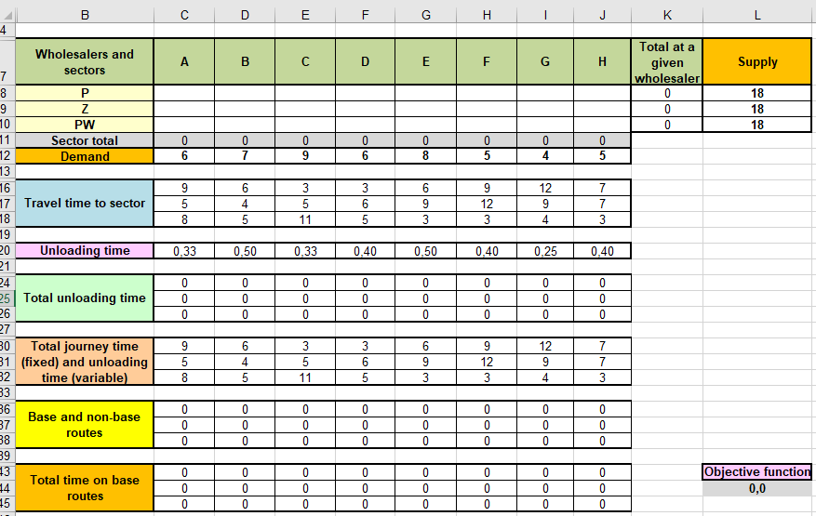
Transport task using MS Excel and Solver – An Example
Entering data into the spreadsheet in this example of a transport task.
Wholesalers and sectors
Total at a given wholesaler
Supply
Sector total
Demand
Travel time to sector
Unloading time
Source: Gaspars-Wieloch, H. in: Szymczak, M. (ed.), 2011, pp. 17
Total unloading time
Total journey time (fixed) and unloading time (variable)
Base and non-base routes
Total time on base routes
Objective function
Figure 3: Data entered into the spreadsheet in this example of a transport task

Slide 21
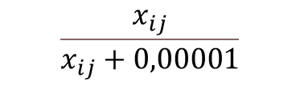
Transport task using MS Excel and Solver – An Example
Calculation of total unloading time
Figure 4: Calculation of total unloading time
Calculation of total journey time
Figure 5: Calculation of total journey time
Determination of base and non-base routes
$$\frac{x_{ij}}{x_{ij}+0,00001}$$
Figure 6: Determination of base and non-base routes
Source: Gaspars-Wieloch, H. in: Szymczak, M. (ed.), 2011, pp. 17

Slide 22
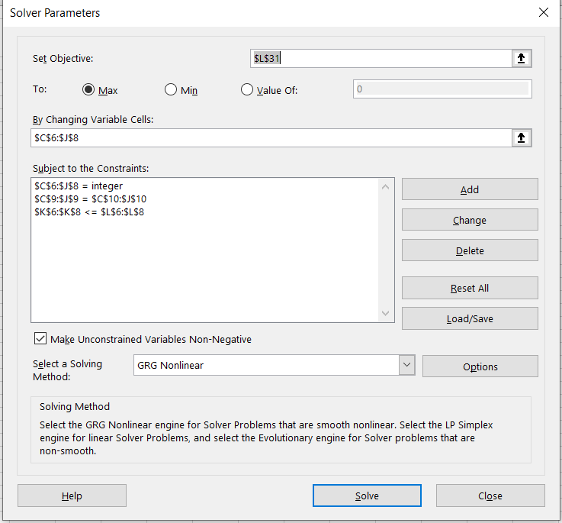
Transport task using MS Excel and Solver – An Example
Determination of total cost on base routes
Total time on base routes
Figure 7: Determination of total cost on base routes
Solving the problem using Solver
Source: Gaspars-Wieloch, H. in: Szymczak, M. (ed.), 2011, pp. 17

Slide 23
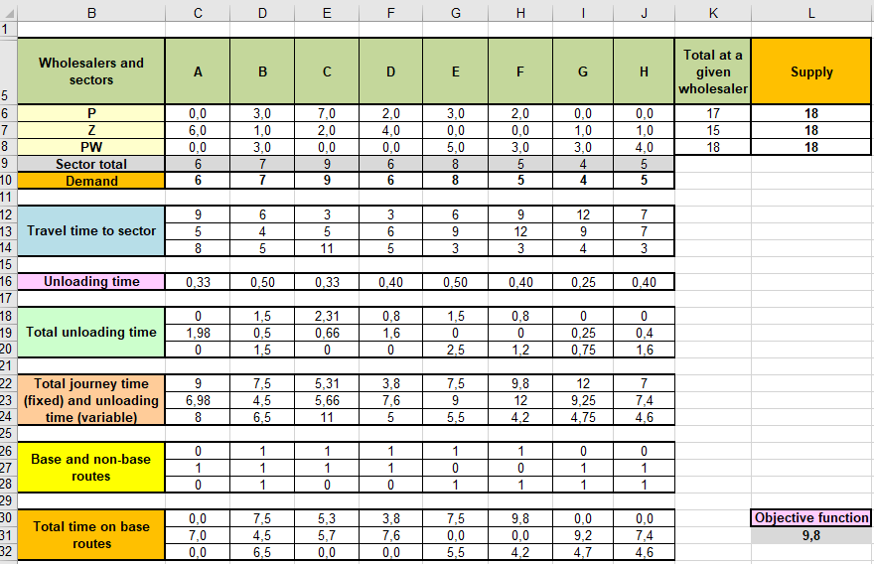
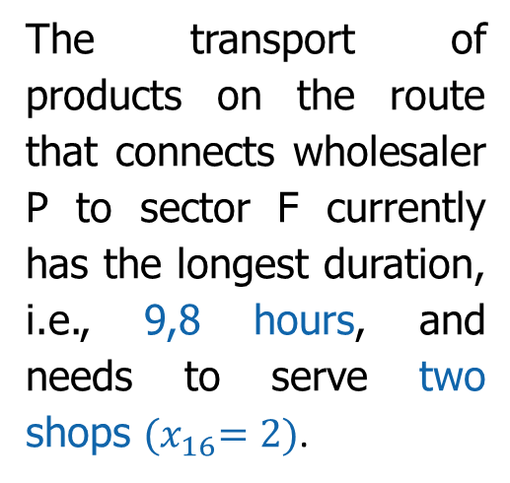
Transport task using MS Excel and Solver – An Example
1st solution
Wholesalers and sectors
Total at a given wholesaler
Supply
Sector total
The transport of products on the route that connects wholesaler P to sector F currently has the longest duration, i.e., 9,8 hours, and needs to serve two shops ${(x}_{16}=2)$.
Demand
Travel time to sector
Unloading time
Total unloading time
Total journey time (fixed) and unloading time (variable)
Source: Gaspars-Wieloch, H. in: Szymczak, M. (ed.), 2011, pp. 22
Base and non-base routes
Total time on base routes
Objective function
Figure 9: First solution to an optimisation task
Source: Gaspars-Wieloch, H. in: Szymczak, M. (ed.), 2011, pp. 17

Slide 24
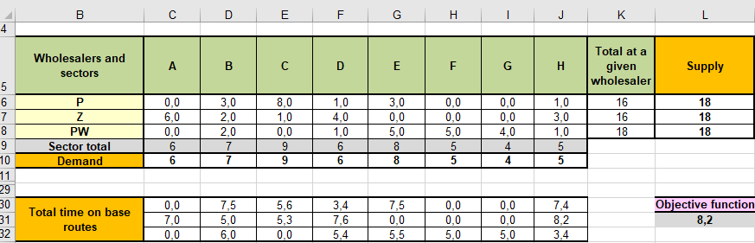
Transport task using MS Excel and Solver – An Example
2nd solution
Figure 10: Second solution to an optimisation task
In it, it is worth including the condition x_28≤2, i.e., $J$9≤2, as it will then contribute to reducing the delivery time on the Z-H route by at least 0.4 hours (the unloading time for products in the H sector will then be 8,2-0,4=7,8 hours)
Source: Gaspars-Wieloch, H. in: Szymczak, M. (ed.), 2011, pp. 22
Source: Gaspars-Wieloch, H. in: Szymczak, M. (ed.), 2011, pp. 17

Slide 25
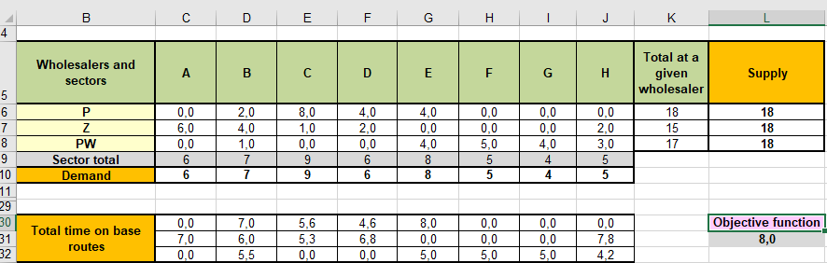
Transport task using MS Excel and Solver – An Example
3rd solution
Figure 11: The third solution to the optimisation task.
The time on the Z-H route decreased to 7,5 hours, but the longest time was recorded on the P-E route (8 hours).
Source: Gaspars-Wieloch, H. in: Szymczak, M. (ed.), 2011, pp. 23
Source: Gaspars-Wieloch, H. in: Szymczak, M. (ed.), 2011, pp. 17

Slide 26
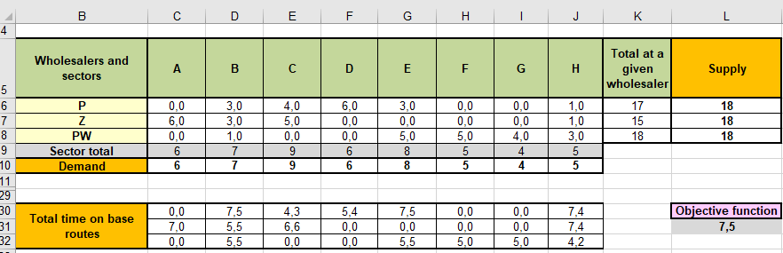
Transport task using MS Excel and Solver – An Example
4th solution
Figure 12: Fourth solution to an optimisation task.
The longest delivery time is already only 7,5 hours. After introducing constraints on the routes, which now determine the value of the objective function: x_12≤2, which is $D$8≤2 and x_15≤2, which is $G$8≤2.
Source: Gaspars-Wieloch, H. in: Szymczak, M. (ed.), 2011, pp. 23
Source: Gaspars-Wieloch, H. in: Szymczak, M. (ed.), 2011, pp. 17

Slide 27

Transport task using MS Excel and Solver – An Example
5th solution
Comparing the results obtained in the fourth and fifth solutions, one could end up implementing the fourth option due to the slight difference in time (7,5-7,4=0,1 h).
Wholesalers and sectors
Total at a given wholesaler
Supply
Sector total
Demand
Total time on base routes
Objective function
Figure 13: Fifth solution to an optimisation task
The assumption for the optimal solution to the task is that the longest delivery time of 7,4 hours will be recorded on the two routes: P-H and Z-H. Each sector will be supplied with kits in line with reported demand. The supply of PW wholesalers will be used to the maximum. 13 trucks will be required to supply the supermarket chain.
Source: Gaspars-Wieloch, H. in: Szymczak, M. (ed.), 2011, pp. 23
Source: Gaspars-Wieloch, H. in: Szymczak, M. (ed.), 2011, pp. 17

Slide 28
Summary
The main task of transport is to fully and timely meet the transport needs of the national economy and population, to increase the efficiency and quality of the transport network;
The optimisation model of the transport system provides methods and scientific tools for controlling the transport system;
Optimisation in transport is a very broad concept that covers a variety of processes;
An exemplary transport task using MS Excel’s Solver was presented during lecture.

Slide 29
Authors:
Katarzyna Grzybowska
Katarzyna Ragin-Skorecka
Katarzyna Siemieniak
Piotr Cyplik
Michał Adamczak
Jędrzej Jankowski-Guzy
Adrianna Toboła-Walaszczyk
Final version: June 2025

Slide 30
Thank you for your attention

