Slide 1



Advanced using of spreadsheet to analyse logistics data
Forecasting Techniques
Lecture
BAS4SC
Business Analytics Skills
for the Future-proof Supply Chains
Co-funded by the European Union
Views and opinions expressed are however those of the author(s) only and do not necessarily reflect those of the European Union or the National Agency (NA). Neither the European Union nor NA can be held responsible for them.
Project number – 2022-1-PL01-KA220-HED-000088856

Slide 2
Agenda
Forecasting definition;
Classification of forecasting methods;
Time series forecasting and decomposition;
Time series forecasting methods;
Forecast errors;
Forecasting in Excel;
Summary.

Slide 3
Forecasting definition
Forecasting can be called prediction; predicting future demand, predicting demand, predicting sales or a new trend;
However, not every prediction is forecasting, because forecasting (also called prediction) is based on a rational, usually scientific basis;
Forecasting is inferring about unknown events based on known events. For example, it can be predicted that:
  (1) the event will occur because it occurred in the past;
  (2) an event will occur because its frequency indicates it;
  (3) the event will occur because it is related to other events that have occurred.
Source: Cieślak, 2005; Dittmann, 2003

Slide 4
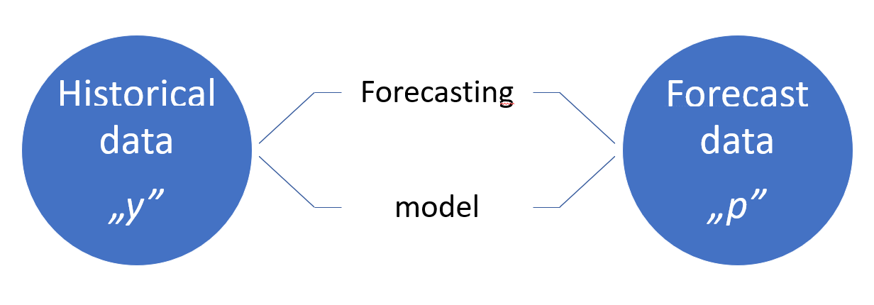
Forecasting horizons
The forecast always concerns a specific forecast horizon. The forecast horizon is the interval , where:
  T – current moment,
  T_{i} – final moment.
Depending on the time horizon, the forecasting problem is generally divided into three areas:
  short-term – it covers prediction horizons from one hour to a week;
  medium-term – refers to forecasts from one month to a maximum of a year;
  long-term forecasting – characterised by a prediction horizon longer than one year.
Historical data
„y”
Forecasting
Forecast
data
„p”
model
Figure 1: Generalised forecasting model
Source: Raza & Khosravi, 2015

Slide 5
Properties and functions of forecasts
Properties of forecasts:
  Forecasts are formulated using the achievements of science (developed and verified mathematical models);
  Forecasts refer to a specific future;
  Forecasts are verified empirically (after a specified period);
  Forecasts are acceptable to the person preparing the forecast.
Functions of forecasts:
  preparatory – the forecast is an impulse to take a specific action but has no impact on the forecasted phenomenon;
  activating – the forecast is an impulse to take a specific action and at the same time influences the forecasted phenomenon.
Source: Gajda, 2001

Slide 6
Classification of forecasting methods
Qualitative forecasts take a non-numerical form. They refer to the analysed phenomenon in the future and the estimation of its increase, decrease or lack of change;
Qualitative forecasts can be treated as based on the opinions of market experts.
Forecasting methods
Quantitative methods
Qualitative methods
Figure 2: Forecasting methods – types
Source: Dittmann, 2000

Slide 7
Classification of forecasting methods
Quantitative forecasts
Time series models
Econometric models
Analog models
Lead variable models
Cohort analysis models
Market tests
Quantitative forecasts can be classified considering the models used (Fig. 3);
This lecture is focused on time series models.
Figure 3: Quantitative methods of forecasting
Source: Dittmann, 2000

Slide 8
Time series forecasting
Time series is a methodology for exploring complex and sequential types of data;
In time series models, sequential data, which consists of strings of numeric data, is recorded at regular intervals (e.g., per minute, per hour, or per day);
Time series models have development potential.

Slide 9
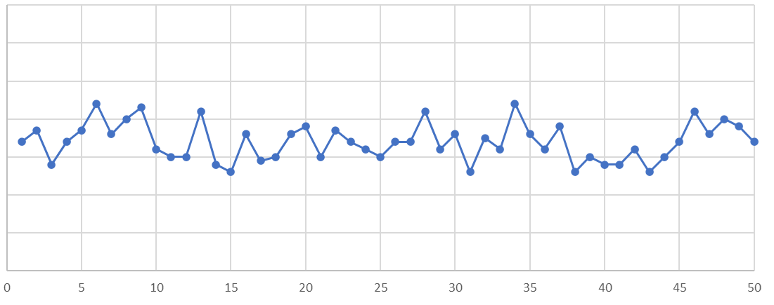
Time series decomposition
The components of the time series are random fluctuations, development tendency (trend), cyclical fluctuations and seasonal fluctuations;
The identification and analysis of the indicated components of a time series is called time series decomposition.
random fluctuations – these are random, accidental and unpredictable changes in a series variable of varying strength, which are observed over time and do not show any clear tendency.
Source: Cieslak, 1997

Slide 10
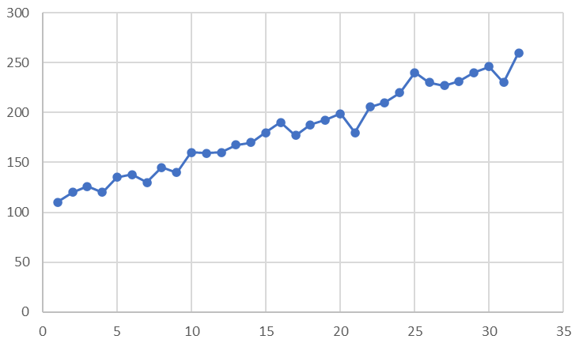
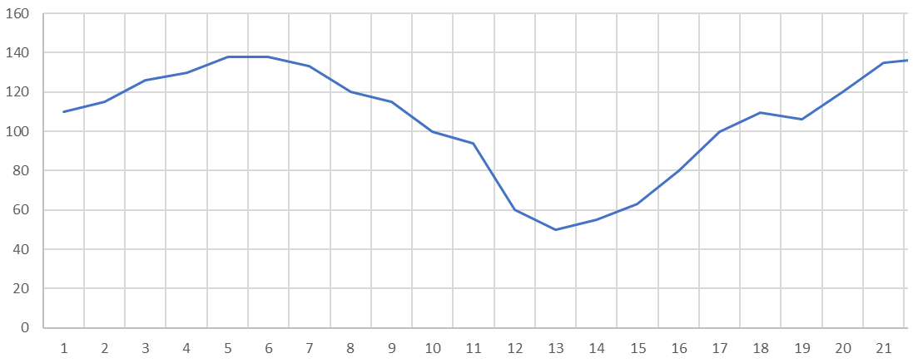
Time series decomposition
development tendencies (trend) – these are the long-term tendency of series data to one-way (monotonic) changes in the forecast variable. They are of an increase or decrease nature.
cyclical fluctuations – these are long-term, rhythmic fluctuations in the value of a variable around a trend or a constant level, which persist for a long time (longer than a year)
Source: Cieslak, 1997

Slide 11
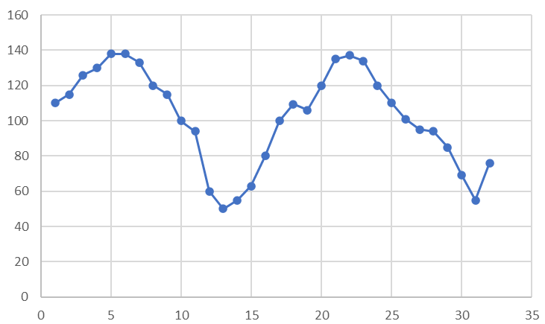
Time series decomposition
seasonal fluctuations – these are fluctuations in the value of a time series variable around a trend or constant level, which tend to repeat at regular (seasonal) intervals, not exceeding a year.
Source: Cieslak, 1997

Slide 12
Preparing time series data
Performing preliminary data processing, also known as data cleaning;
Various strategies for dealing with outlier data:
  no action – it involves ignoring atypical data;
  filtering cases with outlier data – this involves removing this data;
  replacing unusual data – this is a popular strategy in which outliers are replaced by: (1) a value of 0, (2) an average value; (3) the maximum/minimum value of the filter or (4) another value determined based on a substantive criterion.

Slide 13
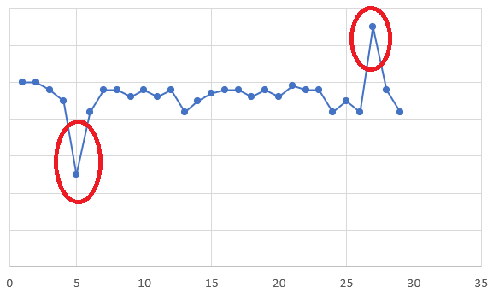
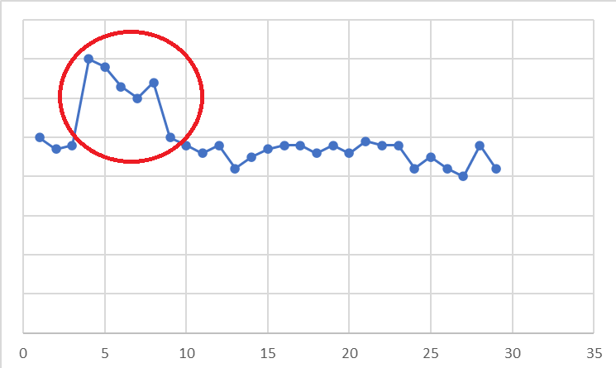
Selected types of outliers
Additive outlier – it appears as a surprisingly large or surprisingly small value for a single observation. It has no effect on subsequent observations – the value of the series does not deviate any further.
Innovative outlier – it occurs as a deviation with further effects on observations. An initial (first) effect with a delay and extension effect on subsequent observations (decreasing or increasing) can be observed.

Slide 14
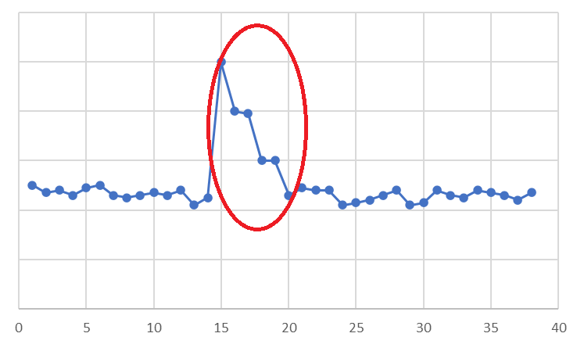
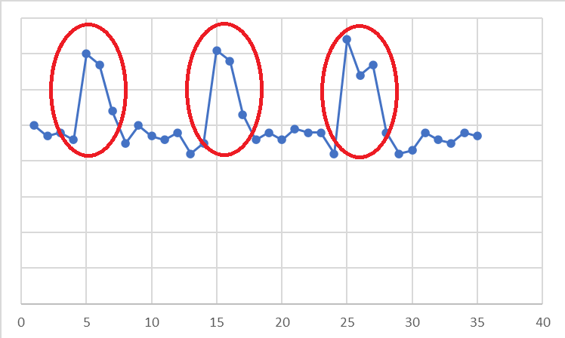
Selected types of outliers
Transient change outlier – it occurs when the influence decays exponentially with subsequent observations. Eventually the series returns to its normal level.
Seasonally additive outlier – it appears as a surprisingly large or surprisingly small value that occurs periodically (at regular intervals).

Slide 15
Preparing time series data
Reducing the forecaster's subjectivity when removing atypical cases is possible with quantitative data;
Standard deviation rule can be applied:
  Identifying the functional form of the series, which means determining the type of trend.
  Search for outlier observations and replace them with average values or so-called upper and/or lower filters.
  Verification whether the last observed data in the series behaves typically; if not cleansing it.
  Identification of the trend slope coefficient, to determine the stability of the main trend observed in the series.
  Examine the stability of the current short-term trend.

Slide 16
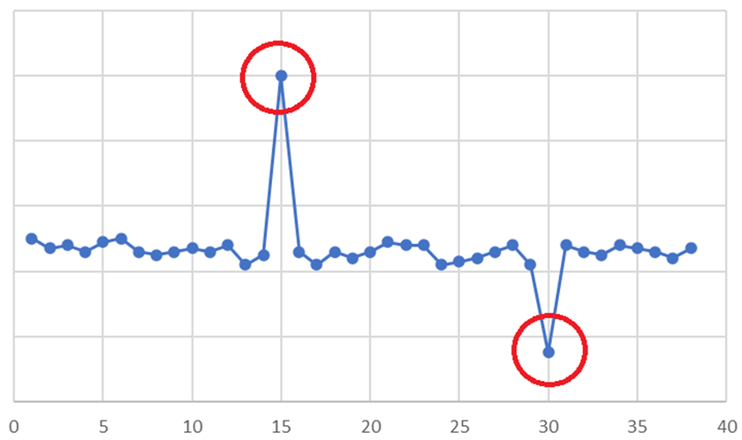
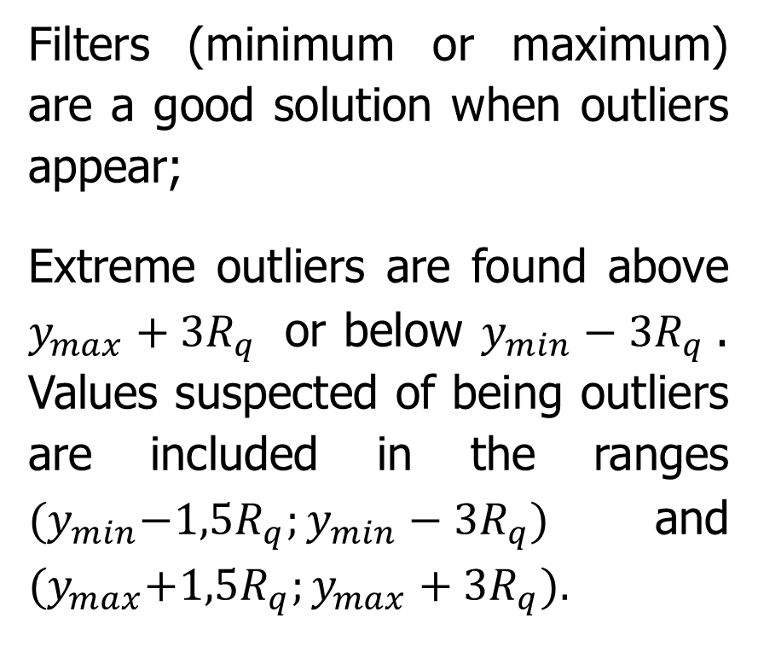
Preparing time series data
Filters (minimum or maximum) are a good solution when outliers appear;
Extreme outliers are found above $y_{max}+3R_{q}$ or below $y_{min}−3R_{q}$. Values suspected of being outliers are included in the ranges ${(y}_{min}−1,5R_{q};y_{min}−3R_{q})$ and ${(y}_{max}+1,5R_{q};y_{max}+3R_{q}).$
Figure 4: Clearly inconsistent values with the general regularity of the time series

Slide 17
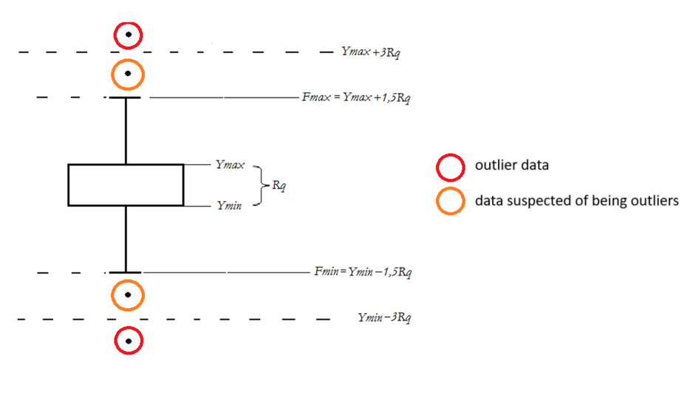
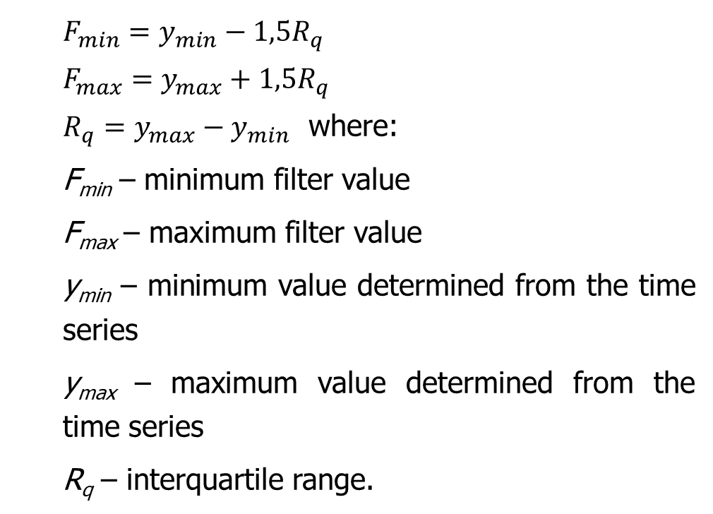
Preparing time series data
This is represented by the model:
$$F_{min}=y_{min}−1,5R_{q} \\ F_{max}=y_{max}+1,5R_{q}$$
$R_{q}=y_{max}−y_{min}$ where:
F_{min} – minimum filter value
F_{max} – maximum filter value
y_{min} – minimum value determined from the time series
y_{max} – maximum value determined from the time series
R_{q} – interquartile range.
Figure 5: Filter values and outliers
Source: Grzybowska, 2009

Slide 18
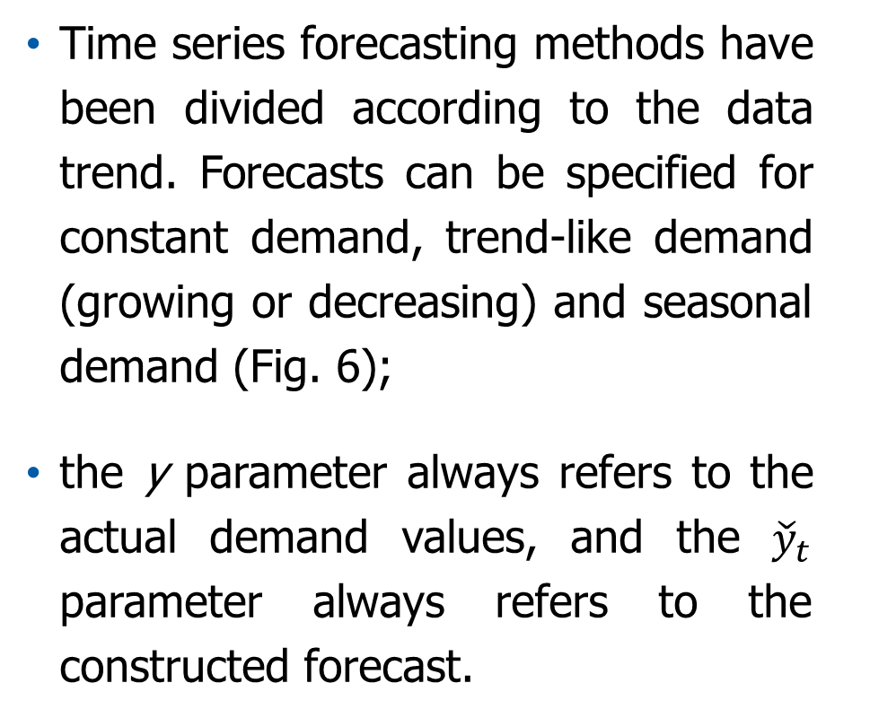
Time series forecasting
Time series forecasting methods have been divided according to the data trend. Forecasts can be specified for constant demand, trend-like demand (growing or decreasing) and seasonal demand (Fig. 6);
the y parameter always refers to the actual demand values, and the ${\check{y}}_{t}$ parameter always refers to the constructed forecast.
Constant demand
Naive methods
ARIMA model
Average methods
Trend-like demand
Simple linear regression method
Seasonal demand
Holt-Winters’ seasonal method (Holt-Winters)
Exponential smoothing method (Brown)
Linear exponential smoothing, LES (Holt)
RW model
ARIMA model
Figure 6: Quantitative methods for time series forecasting
Source: Dittmann, 2000

Slide 19
Naive methods
Naive methods
Naive forecast
Drift method
Seasonal naive method
Figure 7: Selected naive methods
Naive forecasting methods are characterised as simple, fast and cheap. They allow the development of forecasts from a small amount of historical data.

Slide 20

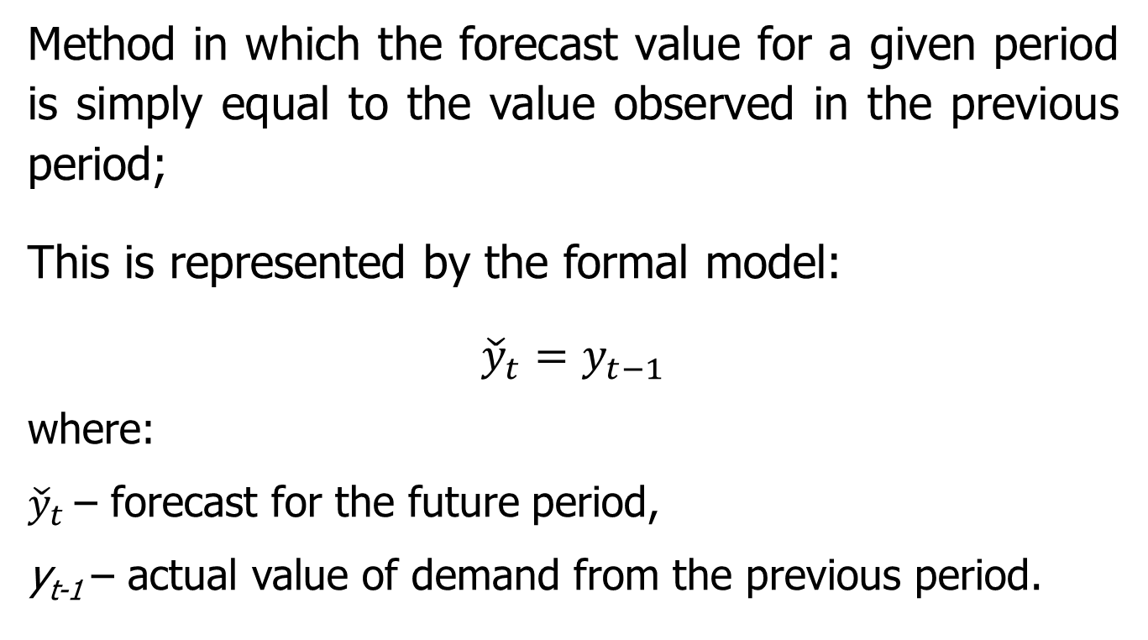
Naive methods
Naive forecast
Method in which the forecast value for a given period is simply equal to the value observed in the previous period;
This is represented by the formal model:
$${\check{y}}_{t}=y_{t−1}$$
where:
${\check{y}}_{t}$ – forecast for the future period,
y_{t-1} – actual value of demand from the previous period.
Formula used in Excel:
forecast_{(t)} = demand_{(t-1)}

Slide 21
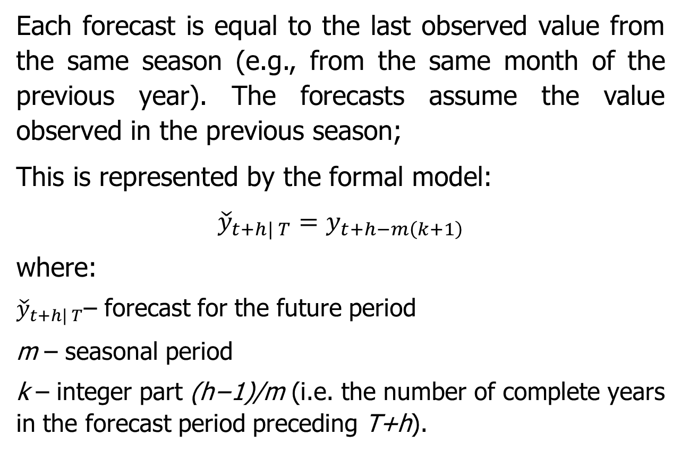
Naive methods
Seasonal Naive method
Each forecast is equal to the last observed value from the same season (e.g., from the same month of the previous year). The forecasts assume the value observed in the previous season;
This is represented by the formal model:
$${\check{y}}_{t+h| T}=y_{t+h−m\left(k+1\right)}$$
where:
${\check{y}}_{t+h| T}$– forecast for the future period
m – seasonal period
k – integer part (h−1)/m (i.e. the number of complete years in the forecast period preceding T+h).
This is explained by the formula used in Excel:
forecast_{(t)} = demand_{(t, previous year)}

Slide 22
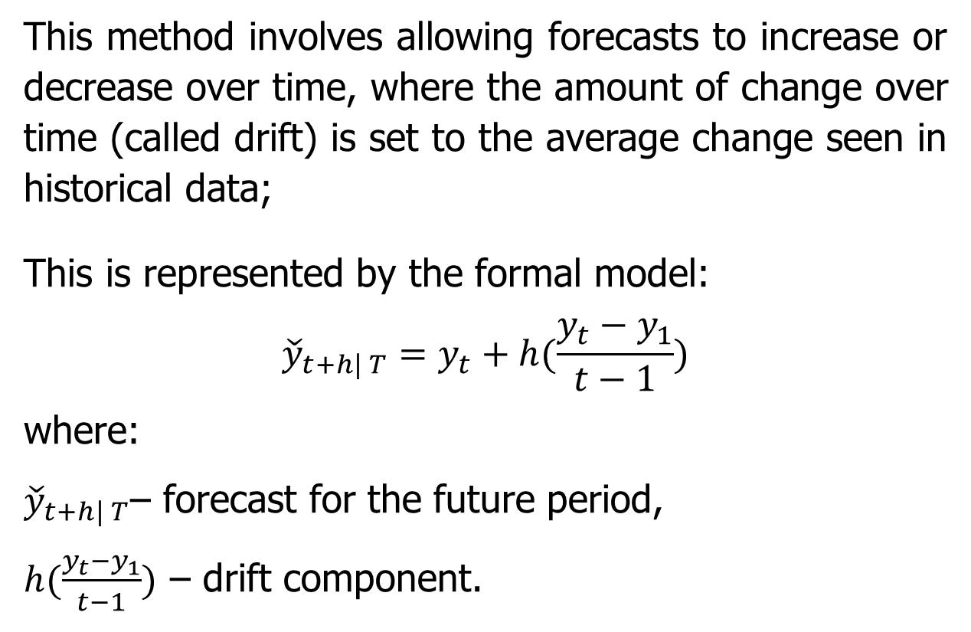
Naive methods
Drift method
This method involves allowing forecasts to increase or decrease over time, where the amount of change over time (called drift) is set to the average change seen in historical data;
This is represented by the formal model:
$${\check{y}}_{t+h| T}=y_{t}+h(\frac{y_{t}−y_{1}}{t−1})$$
where:
${\check{y}}_{t+h| T}$– forecast for the future period,
$h(\frac{y_{t}−y_{1}}{t−1})$ – drift component.
This is explained by the formula used in Excel:
forecast_{(t)} = demand(from the last period of the previous year) + [h *(demand(from the last period of the previous year) – demand(from the first period of the previous year)]/n-1

Slide 23
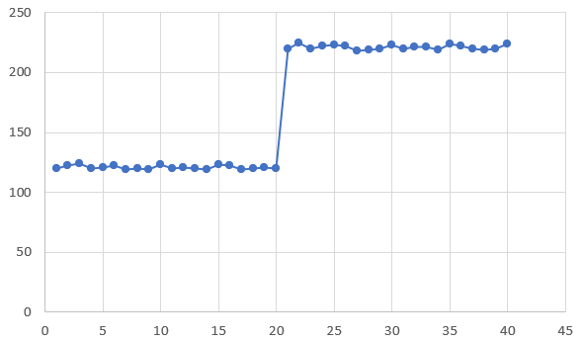
Naive methods
Drift method
Drift refers to the decline in model performance due to changes in data and the relationship between input and output variables. Changing the input data can be:
violent (sudden), e.g., due to lockdowns during the COVID-19 pandemic;
increasing (changing slowly);
impulse (one-off), e.g., in the case of incorrectly supplied data.
Types of drifts:
Change of input data – rapid (sudden)

Slide 24
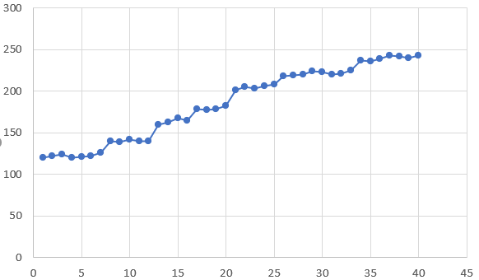
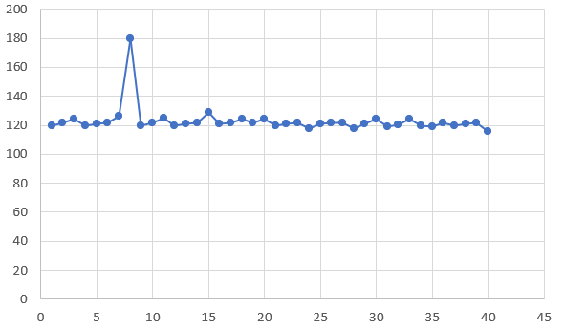
Naive methods
Drift method
Types of drifts:
Change of input data – incremental
Change of input data – impulse

Slide 25
Average methods
Average methods
Global Mean or Global Average
Weighted Moving Average, WMA
Simple Moving Average, SMA
Exponential moving average, EMA
Figure 8: Selected average methods
Moving average methods act as a filter because they eliminate short-term fluctuations from the data series. To build a forecast, moving average methods use a specific number of adjacent demand data.

Slide 26
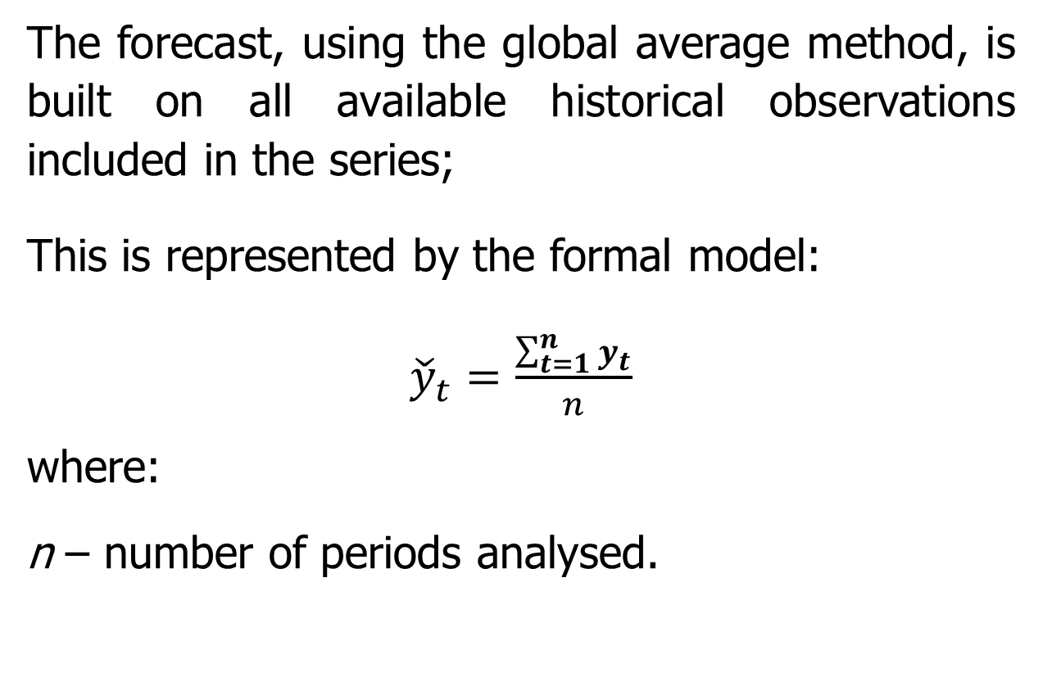
Average methods
Global Mean or Global Average
The forecast, using the global average method, is built on all available historical observations included in the series;
This is represented by the formal model:
${\check{y}}_{t}=\frac{\sum_{t=1}^{n}{y_{t}}}{n}$
where:
n – number of periods analysed.
This is explained by the formula used in Excel:
forecast_{(t)} = ∑demand/n

Slide 27
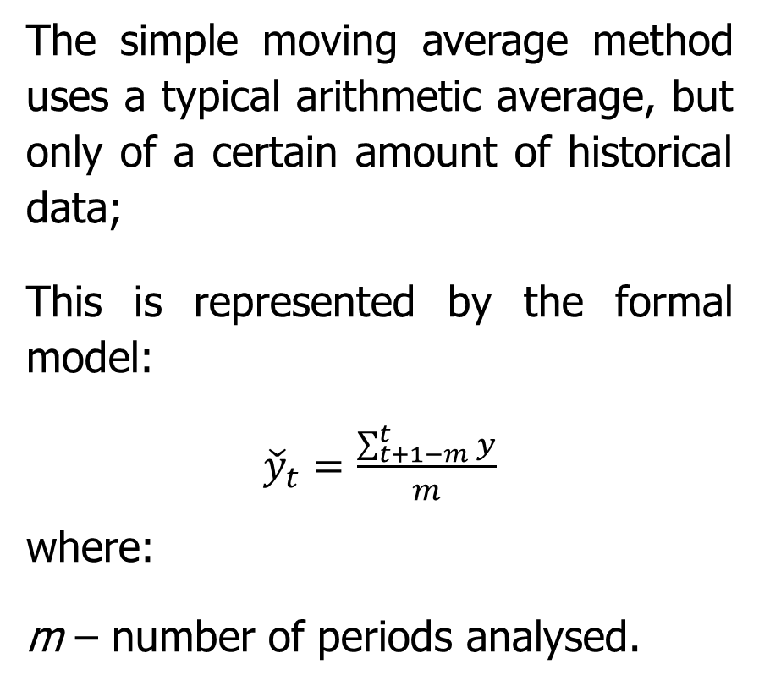
Average methods
Simple Moving Average, SMA
This is explained by the formula used in Excel:
for a 3-element average:
forecast_{(t)} = AVERAGE(demand_{(t-1)}; demand_{(t-2)}; demand_{(t-3)};)
for a 5-element average:
forecast_{(t)} = AVERAGE(demand_{(t-1)}; demand_{(t-2)}; demand_{(t-3)}; demand_{(t-4)}; demand_{(t-5)};)
To calculate a moving average, you can use a simple formula based on the AVERAGE function with relative references.
As the formulas are copied down the column, the range changes on each row to account for the values needed for each average.
The simple moving average method uses a typical arithmetic average, but only of a certain amount of historical data;
This is represented by the formal model:
${\check{y}}_{t}=\frac{\sum_{t+1−m}^{t}{y}}{m}$
where:
m – number of periods analysed.

Slide 28
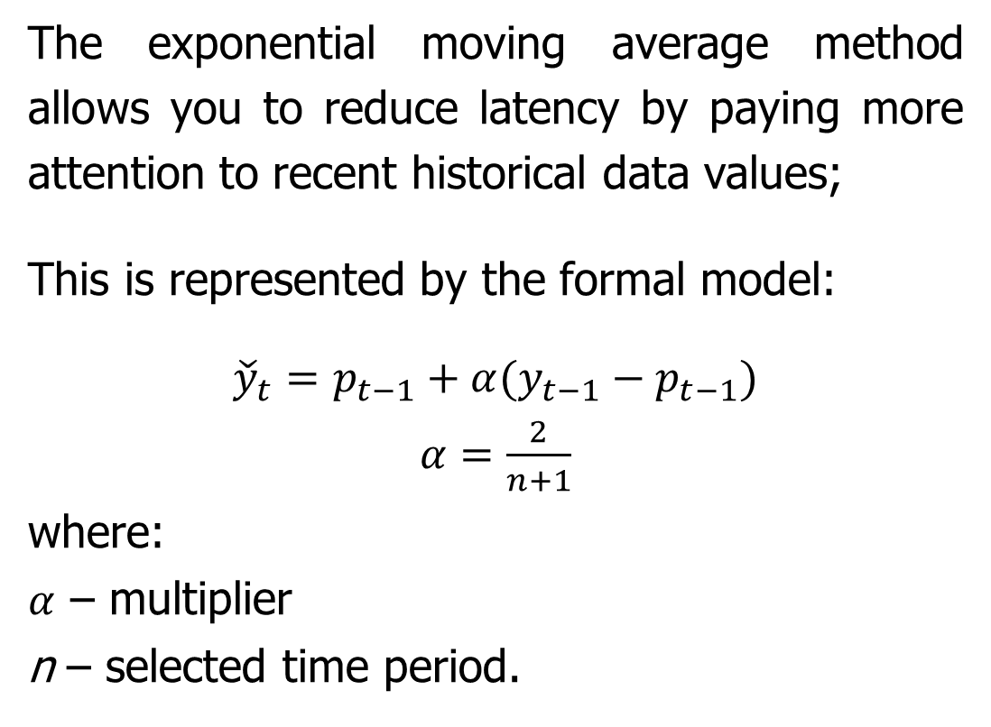
Average methods
Exponential Moving Average, EMA
The exponential moving average method allows you to reduce latency by paying more attention to recent historical data values;
This is represented by the formal model:
${\check{y}}_{t}=p_{t−1}+α(y_{t−1}−p_{t−1})$
$α=\frac{2}{n+1}$
where:
$α$ – multiplier
n – selected time period.
This is explained by the formula used in Excel:
forecast_{(t)} = forecast_{(t-1)} + multiplier * (demand_{(t-1)} – forecast_{(t-1)})

Slide 29
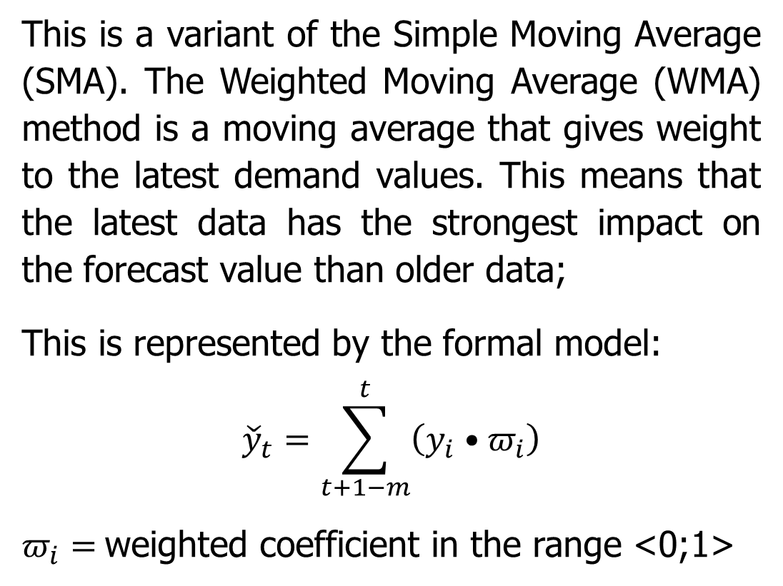
Average methods
Weighted Moving Average, WMA
This is a variant of the Simple Moving Average (SMA). The Weighted Moving Average (WMA) method is a moving average that gives weight to the latest demand values. This means that the latest data has the strongest impact on the forecast value than older data;
This is represented by the formal model:
$${\check{y}}_{t}=\sum_{t+1−m}^{t}{\left(y_{i}•π_{i}\right)}$$
$π_{i}=$weighted coefficient in the range <0;1>
This is explained by the formula used in Excel
for a 3-element weighted average:
forecast_{(t)} = (demand_{(t-3)} * ω₍₁₎) + (demand_{(t-2)} * ω₍₂₎) + (demand_{(t-1)} * ω₍₃₎)
for a 5-element weighted average:
forecast_{(t)} = (demand_{(t-5)} * ω₍₁₎) + (demand_{(t-4)} * ω₍₂₎) + (demand_{(t-3)} * ω₍₃₎) + (demand_{(t-2)} * ω₍₄₎) + (demand_{(t-1)} * ω₍₅₎)

Slide 30
Exponential Smoothing methods
Exponential smoothing methods
Simple Exponential Smoothing, SES (Brown’s model)
Linear Exponential Smoothing, LES (Holt’s model)
Holt-Winters’ seasonal method (Holt-Winters’ model)
Figure 9: Selected exponential smoothing methods
Exponential smoothing methods are widely used. There are 15 different methods. Each variant is specified for a different forecasting scenario.

Slide 31
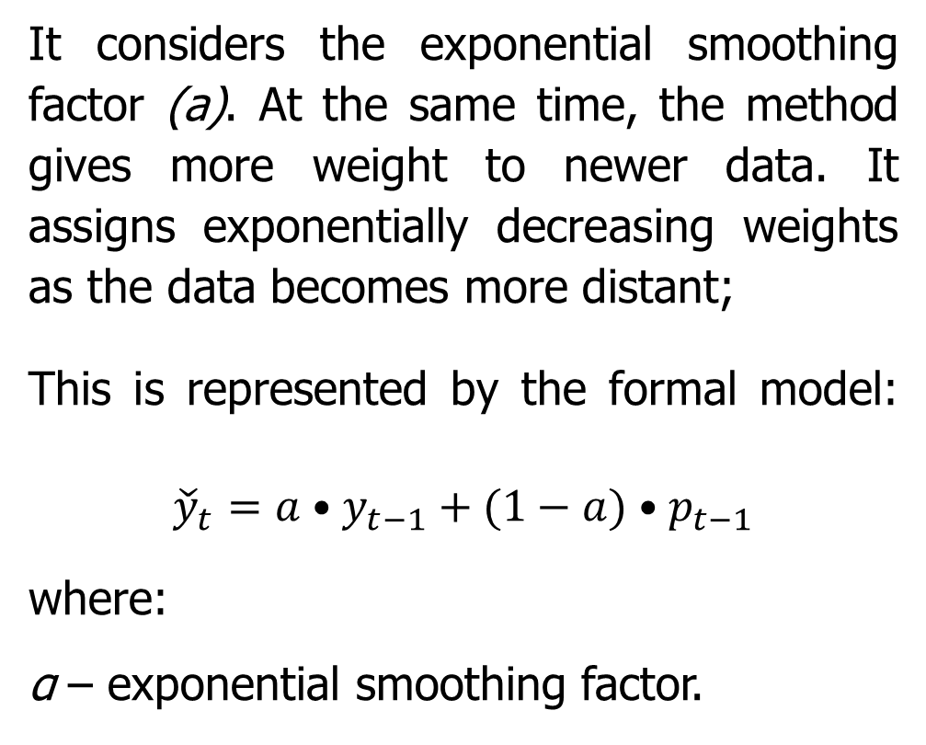
Exponential Smoothing methods
Simple Exponential Smoothing, SES (Brown’s model)
It considers the exponential smoothing factor (a). At the same time, the method gives more weight to newer data. It assigns exponentially decreasing weights as the data becomes more distant;
This is represented by the formal model:
$${\check{y}}_{t}=a•y_{t−1}+(1−a)•p_{t−1}$$
where:
α – exponential smoothing factor.
Formula used in Excel:
forecast_{(t)} = αlfa * demand_{(t-1)}+ +[(1 – αlfa) * forecast_{(t-1)}]

Slide 32
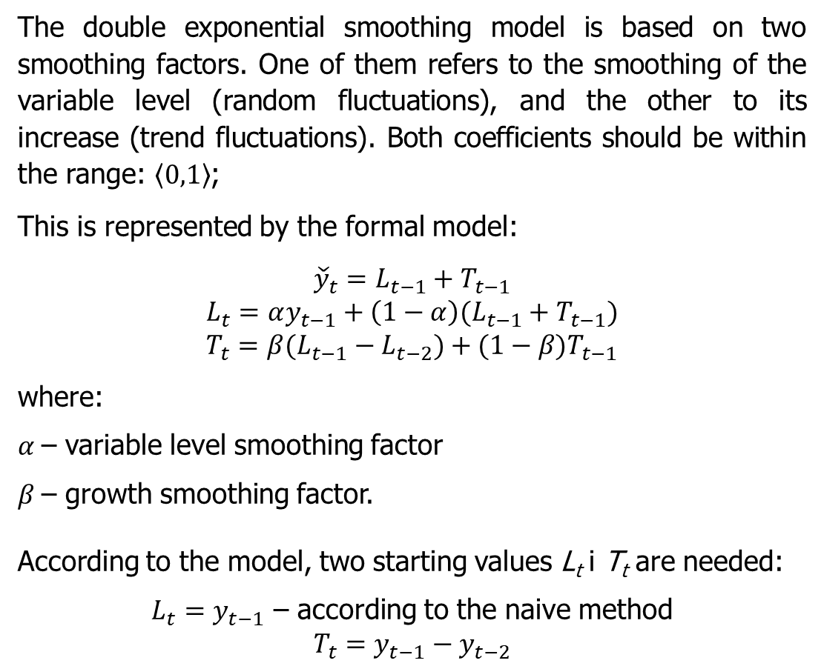
Exponential Smoothing methods
Linear Exponential Smoothing, LES (Holt’s model)
The double exponential smoothing model is based on two smoothing factors. One of them refers to the smoothing of the variable level (random fluctuations), and the other to its increase (trend fluctuations). Both coefficients should be within the range: $〈0,1〉$;
This is represented by the formal model:
$${\check{y}}_{t}=L_{t−1}+T_{t−1}$$
$$L_{t}=αy_{t−1}+\left(1−α\right)(L_{t−1}+T_{t−1})$$
$$T_{t}={β(L}_{t−1}−L_{t−2})+{(1−β)T}_{t−1}$$
where:
$α$– variable level smoothing factor
$β$– growth smoothing factor.
According to the model, two starting values L_{t} i T_{t} are needed:
$L_{t}=y_{t−1}$ – according to the naive method
$$T_{t}=y_{t−1}−y_{t−2}$$
Formula used in Excel:
forecast_{(t)} = [αlfa * demand_{(t-1)} + (1 – αlfa)(random fluctuation_{(t-1)} + trend fluctuation_{(t-1)})] + [beta * (random fluctuation_{(t-1)} – (random fluctuation_{(t-2)} ) + (1 – beta) * trend fluctuation_{(t-1)}]

Slide 33
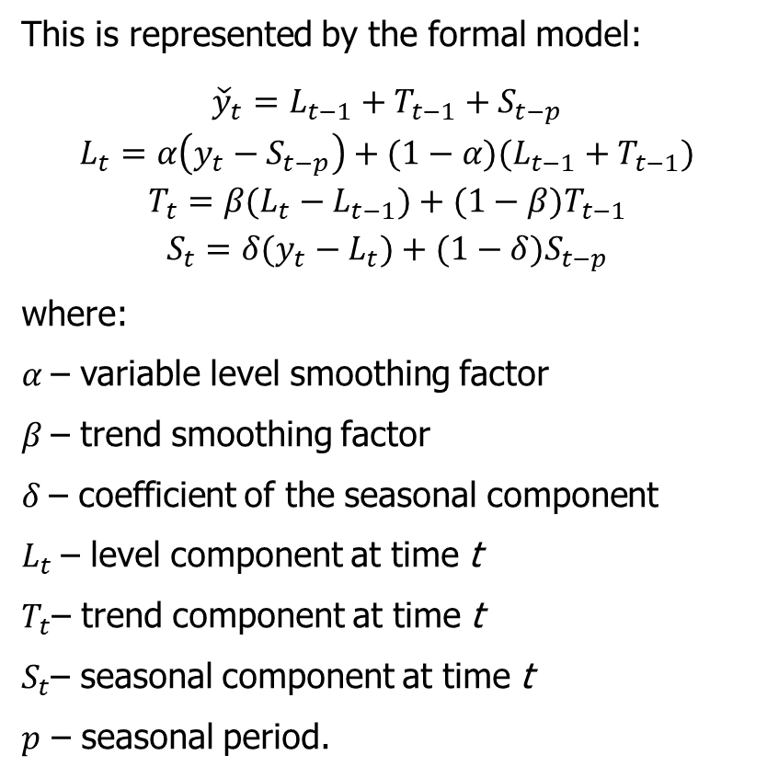
Exponential Smoothing methods
Holt-Winters’ Seasonal method (Holt-Winters’ Model)
This is represented by the formal model:
$${\check{y}}_{t}=L_{t−1}+T_{t−1}+S_{t−p}$$
$$L_{t}=α\left(y_{t}−S_{t−p}\right)+(1−α)(L_{t−1}+T_{t−1})$$
$$T_{t}={β(L}_{t}−L_{t−1})+{(1−β)T}_{t−1}$$
$$S_{t}={δ(y}_{t}−L_{t})+{(1−δ)S}_{t−p}$$
where:
$α$– variable level smoothing factor
$β$– trend smoothing factor
$δ$– coefficient of the seasonal component
$L_{t}$– level component at time t
$T_{t}$– trend component at time t
$S_{t}$– seasonal component at time t
$p$ – seasonal period.
The seasonal exponential smoothing method, also called the Holt-Winters model, is very suitable for forecasting demand for data characterised by both trend and seasonality;
Additive fluctuations occur when, in individual sub-periods of the seasonality cycle, deviations of the level of the analysed phenomenon from the average level or trend, in terms of absolute value, can be observed.

Slide 34
Exponential Smoothing methods
Holt-Winters’ Seasonal method (Holt-Winters’ Model)
Formula used in Excel:
forecast_{(t)} = level component _{(t-1)} + trend component_{(t-1)} + seasonality component_{(t-p)}
level component _{(t)} = alpha * [demand_{(t)} – seasonality component _{(t)}] + (1 – alpha) * (level component _{(t-1)} + trend component_{(t-1)})
trend component_{(t)} = beta * (level component _{(t)} - level component_{(t-1)} ) + [(1 – beta) * trend component_{(t-1)}]
seasonality component_{(t)} = gamma * (demand_{(t)} – level component _{(t)}) + (1 – gamma) * seasonality component_{(t-p)}
seasonality component_{(t-p)} for four quarters
seasonality component₍₁₎ = demand₍₁₎ / average demand₍₁₋₄₎
seasonality component₍₂₎ = demand₍₂₎ / average demand₍₁₋₄₎
seasonality component₍₃₎ = demand₍₃₎ / average demand₍₁₋₄₎
seasonality component₍₄₎ = demand₍₄₎ / average demand₍₁₋₄₎

Slide 35
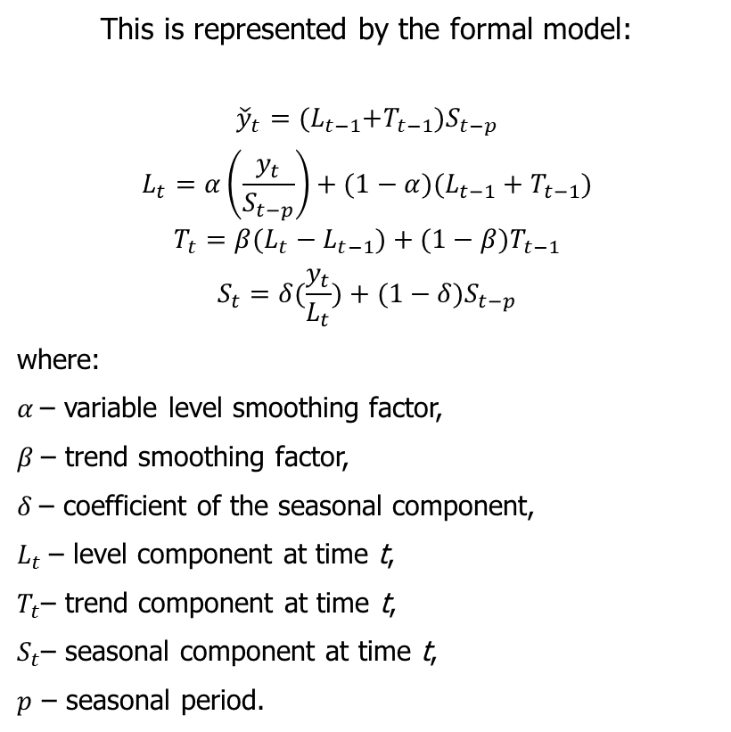
Exponential Smoothing methods
Holt-Winters’ Seasonal method (Holt-Winters’ Model)
This is represented by the formal model:
$${\check{y}}_{t}={(L}_{t−1}+T_{t−1})S_{t−p}$$
$$L_{t}=α\left(\frac{y_{t}}{S_{t−p}}\right)+(1−α)(L_{t−1}+T_{t−1})$$
$$T_{t}={β(L}_{t}−L_{t−1})+{(1−β)T}_{t−1}$$
$$S_{t}=δ(\frac{y_{t}}{L_{t}})+{(1−δ)S}_{t−p}$$
where:
$α$– variable level smoothing factor,
$β$– trend smoothing factor,
$δ$– coefficient of the seasonal component,
$L_{t}$– level component at time t,
$T_{t}$– trend component at time t,
$S_{t}$– seasonal component at time t,
$p$ – seasonal period.
The seasonal exponential smoothing method, also called the Holt-Winters model, is very suitable for forecasting demand for data characterised by both trend and seasonality;
Multiplicative fluctuations occur when, in individual sub-periods of the cycle, a deviation from the average level or trend by a certain constant relative amount can be observed.
Source: Sobczyk, 2006

Slide 36
Exponential Smoothing methods
Holt-Winters’ Seasonal method (Holt-Winters’ Model)
Formula used in Excel:
forecast_{(t)} = (level component_{(t-1)} + trend component_{(t-1)} ) * seasonality component_{(t-p)}
level component_{(t)} = alpha * [demand_{(t)} / seasonality component_{(t)}] + (1 – alpha) * (level component_{(t-1)} + trend component_{(t-1)})
trend component_{(t)} = beta * (level component_{(t)} – level component_{(t-1)} ) + [(1 – beta) * trend component_{(t-1)}]
seasonality component_{(t)} = gamma * (demand_{(t)} / level component_{(t)}) + (1 – gamma) * seasonality component_{(t-p)}
seasonality component_{(t-p)} for four quarters
seasonality component₍₁₎ = demand₍₁₎ / average demand₍₁₋₄₎
seasonality component₍₂₎ = demand₍₂₎ / average demand₍₁₋₄₎
seasonality component₍₃₎ = demand₍₃₎ / average demand₍₁₋₄₎
seasonality component ₍₄₎ = demand₍₄₎ / average demand₍₁₋₄₎

Slide 37
Autoregressive methods
Autoregressive methods
Autoregressive Integrated Moving Average (ARIMA)
Autoregressive Moving Average (ARMA)
Random Walk (RW)
Figure 10: Selected exponential smoothing methods
Autoregressive methods are models based on the phenomenon of autocorrelation, created by integrating the AR autoregressive model (AutoRegressive model) and the MA (Moving Average) model.

Slide 38
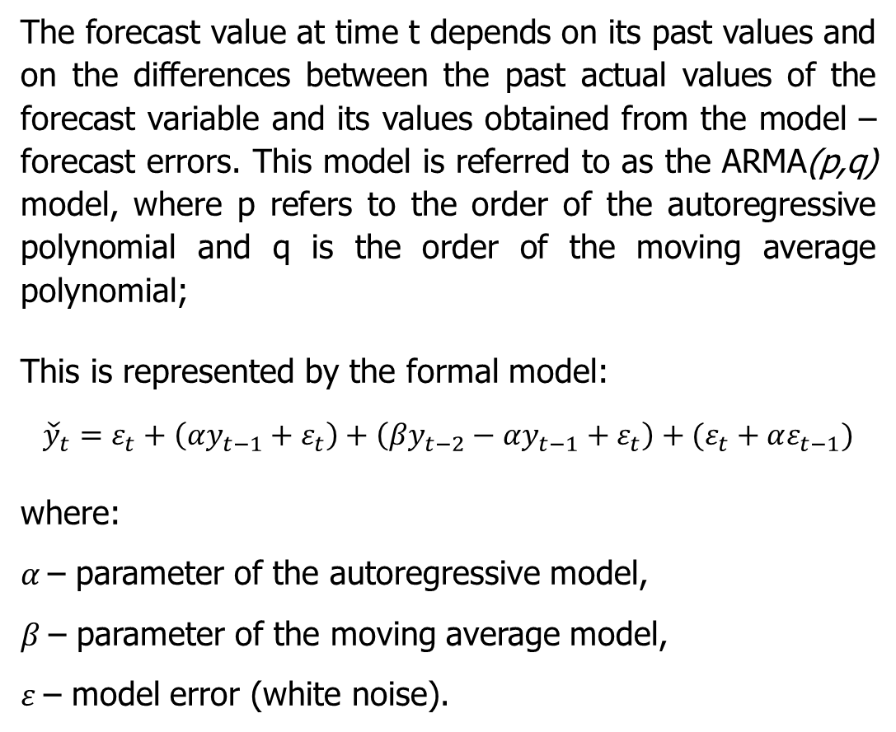
Autoregressive methods
Autoregressive Moving Average, ARMA
The forecast value at time t depends on its past values and on the differences between the past actual values of the forecast variable and its values obtained from the model – forecast errors. This model is referred to as the ARMA(p,q) model, where p refers to the order of the autoregressive polynomial and q is the order of the moving average polynomial;
This is represented by the formal model:
$${\check{y}}_{t}=ε_{t}+\left(αy_{t−1}+ε_{t}\right)+\left(βy_{t−2}−αy_{t−1}+ε_{t}\right)+(ε_{t}+αε_{t−1})$$
where:
$α$– parameter of the autoregressive model,
$β$– parameter of the moving average model,
$ε$– model error (white noise).
Formula used in Excel:
forecast_{(t)} = model error_{(t)} + component1 + component2 + component3
Model error_{(t)} = NORM.S.INV(rand())
component1 = alfa * component1_{(t-1)} + model error_{(t)}
component2 = beta * component2 _{(t-2)} – alfa * component2_{(t-1)} + model error_{(t)}
component3 = model error_{(t)} + alfa * model error_{(t-1)}

Slide 39
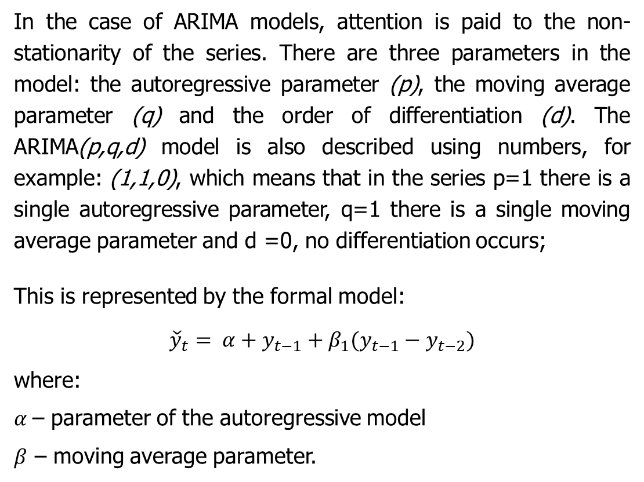
Autoregressive methods
Autoregressive Integrated Moving Average, ARIMA
In the case of ARIMA models, attention is paid to the non-stationarity of the series. There are three parameters in the model: the autoregressive parameter (p), the moving average parameter (q) and the order of differentiation (d). The ARIMA(p,q,d) model is also described using numbers, for example: (1,1,0), which means that in the series p=1 there is a single autoregressive parameter, q=1 there is a single moving average parameter and d =0, no differentiation occurs;
This is represented by the formal model:
$${\check{y}}_{t}= α+y_{t−1}+β_{1}(y_{t−1}−y_{t−2})$$
where:
$α$– parameter of the autoregressive model
$β$ – moving average parameter.
Formula used in Excel:
forecast_{(t)} = alfa + demand_{(t-1)} + beta * [demand_{(t-1)}- demand_{(t-2)}]

Slide 40
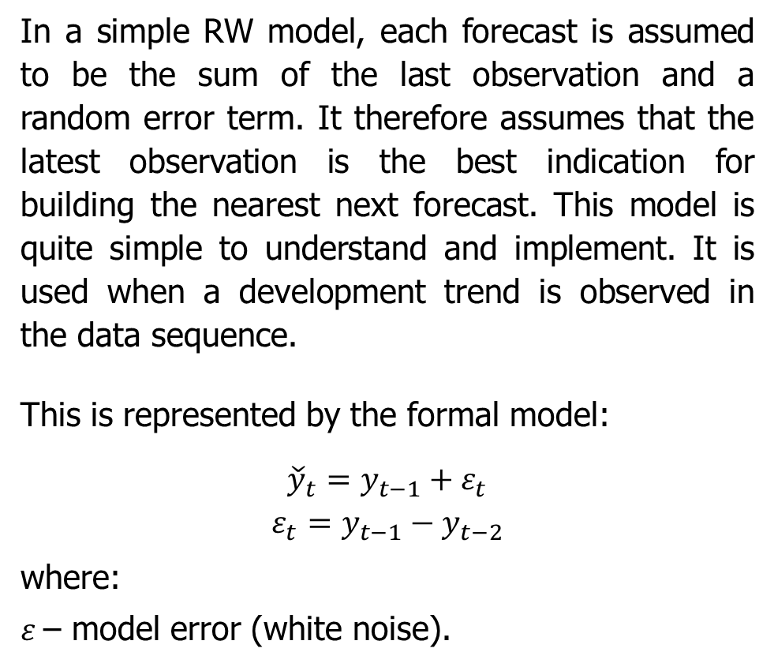
Autoregressive methods
Random Walk, RW
In a simple RW model, each forecast is assumed to be the sum of the last observation and a random error term. It therefore assumes that the latest observation is the best indication for building the nearest next forecast. This model is quite simple to understand and implement. It is used when a development trend is observed in the data sequence.
This is represented by the formal model:
$${\check{y}}_{t}=y_{t−1}+ε_{t}$$
$$ε_{t}=y_{t−1}−y_{t−2}$$
where:
$ε$– model error (white noise).
Formula used in Excel:
forecast_{(t)} = demand_{(t-1)} + [demand _{(t-1)} – demand _{(t-2)}]

Slide 41
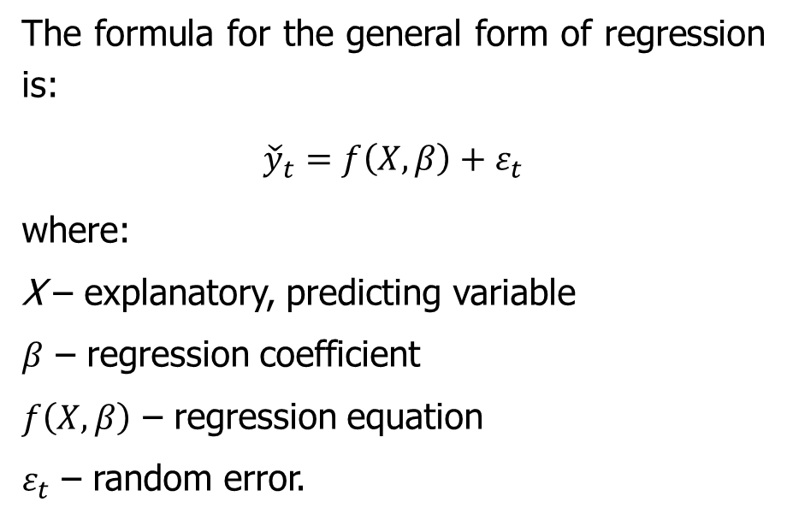
Regression methods
Many variants of regression models are known: linear regression, non-linear regression, logistic regression, stepwise regression, ordinal regression.
Regression methods
Trend Projection Method
Simple linear regression method
Multiple linear regression method
The formula for the general form of regression is:
$${\check{y}}_{t}=f\left(X,β\right)+ε_{t}$$
where:
X – explanatory, predicting variable
$β$ – regression coefficient
$f\left(X,β\right)$ – regression equation
$ε_{t}$ – random error.
Figure 11: Selected regression methods
In regression models, it is not possible to talk about the influence of one variable on another;
To apply regression methods, a larger amount of historical data is needed – the longer the observation period of historical data, the greater the possibility of precisely determining forecasts;

Slide 42
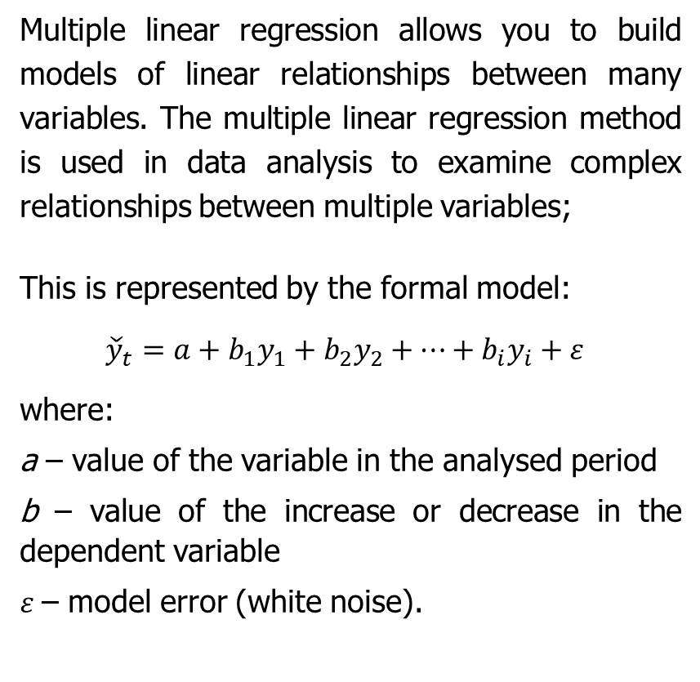
Regression methods
Multiple linear regression method
Trend Projection Method
Multiple linear regression allows you to build models of linear relationships between many variables. The multiple linear regression method is used in data analysis to examine complex relationships between multiple variables;
This is represented by the formal model:
${\check{y}}_{t}=a+b_{1}y_{1}+b_{2}y_{2}+…+b_{i}y_{i}+ε$
where:
a – value of the variable in the analysed period
b – value of the increase or decrease in the dependent variable
$ε$– model error (white noise).
The Trend Projection method is a variation of the straight line method. Jet is the most classic business forecasting method that deals with the movement of variables over time;
A distinction can be made between the graphical method – in which the data is displayed on a graph and a line is drawn manually through it. The line is drawn maintaining the smallest distance between the designated points and the line; trend equation fitting method using data and a straight or exponential line equation.

Slide 43
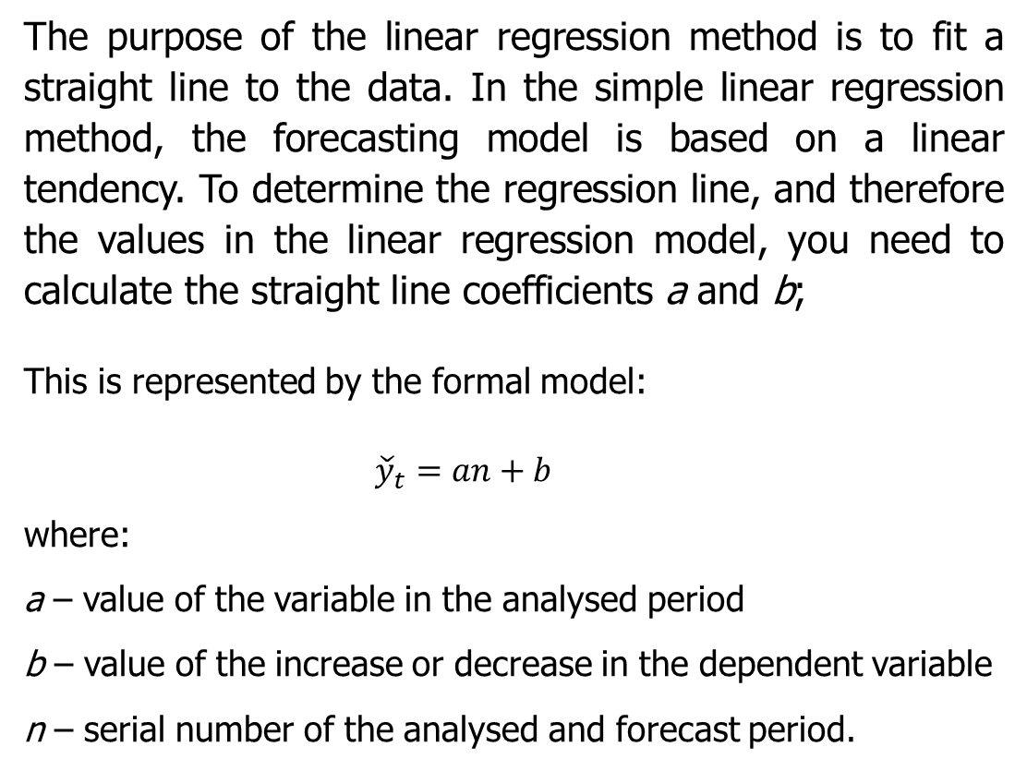
Regression methods
Simple Linear Regression Method
The purpose of the linear regression method is to fit a straight line to the data. In the simple linear regression method, the forecasting model is based on a linear tendency. To determine the regression line, and therefore the values in the linear regression model, you need to calculate the straight line coefficients a and b;
This is represented by the formal model:
${\check{y}}_{t}=an+b$
where:
a – value of the variable in the analysed period
b – value of the increase or decrease in the dependent variable
n – serial number of the analysed and forecast period.
The quickest way to calculate the above regression coefficients is to use the LINEST function.
Syntax: LINEST(known_y,[known_x],[constant],[statistics])

Slide 44
Regression methods
Simple Linear Regression Method
To determine the parameters a and b, you need to calculate a system of two equations. It has the following form:
The quickest way to calculate the above regression coefficients is to use the LINEST function.
Syntax: LINEST(known_y,[known_x],[constant],[statistics])
where:
t_{i} – the ordinal number of the period (t = 1, 2, 3, ...), which is the value of the independent time variable
y_{i} – dependent variable (e.g. demand for a given good in a given time period)
a – value of the variable in the analysed period
b – value of the increase or decrease in the dependent variable
n – number of all analysed periods.

Slide 45
Forecast errors
To assess forecast accuracy, forecast errors must be measured. Given that there is no guarantee of perfect prediction of future demand, every forecast is subject to error.
We can distinguish:
  systematic and
  unsystematic effects of forecast errors.
Source: Hopp & Spearman, 1999, Zeiml, et al., 2019; Shcherbakov et al., 2013

Slide 46
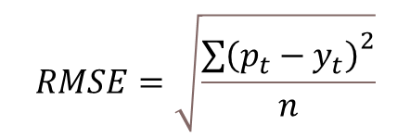
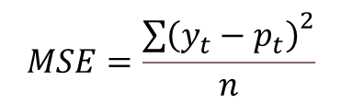
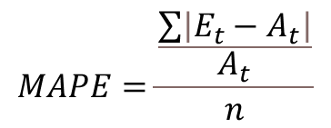
Forecast errors
Mean Squared Error (MSE)
Root Mean Squared Error (RMSE)
Mean Absolute Percentage Error (MAPE)
$$MSE=\frac{{\sum{\left(y_{t}−p_{t}\right)}}^{2}}{n}$$
$$RMSE=\sqrt{\frac{{\sum{\left(p_{t}−y_{t}\right)}}^{2}}{n}}$$
$$MAPE=\frac{\frac{\sum{\left|E_{t}−A_{t}\right|}}{A_{t}}}{n}$$
The mean squared error can only be positive and its value should be as small as possible. The value of this error, which is 0, indicates excellent forecast accuracy.
The error value should be as close to 0 as possible. The lower the root mean square error value, the better the model. And the perfect model has a value equal to 0.
This is one of the more popular measures of error. A value of 0 indicates that the model has no mean error, meaning the value should be as close to 0 as possible. For the same forecast errors, smaller actual values make the relative error larger.

Slide 47
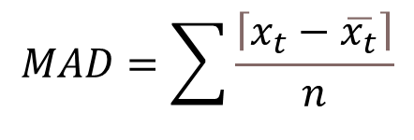
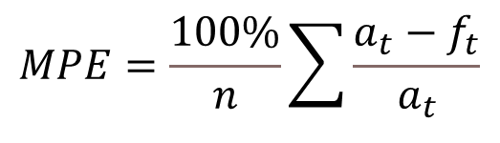
Forecast errors
Mean Percentage Error (MPE)
Mean Absolute Deviation (MAD)
$$MPE=\frac{100\%}{n}\sum{\frac{a_{t}−f_{t}}{a_{t}}}$$
$$MAD=\sum{\frac{\left\lceil x_{t}−\overline{x_{t}}\right\rceil }{n}}$$
This is the average percentage error (or deviation). It informs how much the deviation from the actual value will be on average during the forecast period.
MPE is useful because it allows you to check whether a forecast model systematically underestimates (more negative error) or overestimates (positive error).
It is a simple extension of absolute variance. The mean absolute deviation is used as a measure of the variation in the data.

Slide 48


Advantages and disadvantages of forecasting in Excel
The advantage of using Excel are:
a number of appropriate tools at its disposal;
data can be easily stored and calculated;
It can visualise the acquired and processed data in various ways.
Function | Explanation
=AVERAGE | The function allows you to calculate the average based on existing values.
=SUM | The function allows you to calculate a sum based on existing values.
=FORECAST | The function allows you to predict future value based on existing values using linear regression.
=FORECAST.ETS | Calculates or predicts a future value based on existing (historical) values using a version of the exponential smoothing (ETS) algorithm.
=LINEST | Calculates statistics for lines using least squares.
=FORECAST.LINEAR | Calculates or predicts future value based on existing values using linear regression.
=TREND | It will be used to determine a linear trend.
=FORECAST.ETS.SEASONALITY | Calculates the length of a seasonal pattern based on existing values and timeline.
The disadvantage are:
the need to synchronise and update data manually;
the possibility of making errors as a result of manual actions with data.

Slide 49
Summary
Forecasting is inferring about unknown events based on known events;
Forecast methods can be divided into qualitative and quantitative forecasts;
Time series is a methodology for exploring complex and sequential types of data;
Choosing the right method depends on the type of data and its value;
It is necessary to ensure that the data is prepared appropriately;
Forecasts can be determined manually (using calculation formulas), using MS Excel or using dedicated tools.

Slide 50
Authors:
Katarzyna Grzybowska
Katarzyna Ragin-Skorecka
Katarzyna Siemieniak
Piotr Cyplik
Michał Adamczak
Jędrzej Jankowski-Guzy
Adrianna Toboła-Walaszczyk
Final version: June 2025

Slide 51
Thank you for your attention

