Slide 1



Advanced using of spreadsheet to analyse logistics data
Outsourcing (Make or Buy)
Lecture
BAS4SC
Business Analytics Skills
for the Future-proof Supply Chains
Co-funded by the European Union
Views and opinions expressed are however those of the author(s) only and do not necessarily reflect those of the European Union or the National Agency (NA). Neither the European Union nor NA can be held responsible for them.
Project number – 2022-1-PL01-KA220-HED-000088856

Slide 2
Agenda
basic definitions;
types of outsourcing;
advantages and disadvantages of outsourcing;
description of make-or-buy analysis;
logistics outsourcing.

Slide 3
Outsourcing definition
Outsourcing is a management method (concept) that consists in limiting the scope of activities performed directly by a given company (referred to as the parent company) and outsourcing them for permanent implementation by external enterprises (referred to as service companies);
Outsourcing is defined as a method of permanent external service by specialised enterprises, externalisation, external management, or even deconcentration of the functioning of the organisation.
Source: Trocki, 2001

Slide 4
Examples of outsourcing services
Area | Examples of outsourcing tasks, functions or processes
Production and supply | production of components, semi-finished products and even finished products, product assembly, packaging, design
Transport and logistics | transport and distribution of products, courier services, warehousing
Research and development | research and development work, scientific research, implementation work
Computer science and information technologies | computer network support, data center support, IT infrastructure maintenance services, IT application support, end-user support, security services or internet services
Finance, accounting and tax and accounting services | accounting, debt management, controlling, audit, financial and analytical services, development of business plans, tax consultancy, taxpayer representation before tax authorities
Legal support | legal advice in various fields, or representation in legal matters
Customer service | telemarketing, running a reception, secretariat, hotline or call center
Marketing | monitoring changes taking place on the market, researching customer expectations, creating concepts for new products, defining promotional, advertising and distribution strategies, and shaping the public relations sphere
Staff and human resources, | recruitment and selection of candidates, employee training, creation of motivational systems, personnel management, administration of HR documentation, temporary employment, and payroll settlements
Management and administration | maintaining buildings and cleanliness, keeping archives, protection of people and property, managerial services
Source: Matejun, 2007

Slide 5
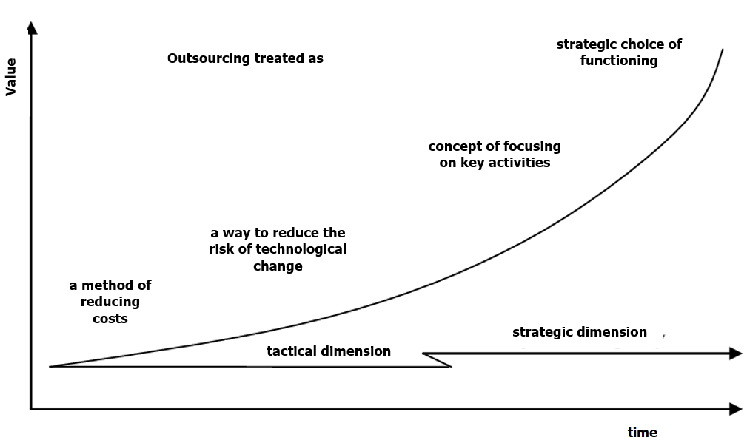
Evolution of outsourcing concept
Outsourcing treated as
strategic choice of functioning
value
concept of focusing on key activities
This diagram shows the evolution and increase in the importance of outsourcing for modern enterprises.
a way to reduce the risk of technological change
a method of reducing costs
strategic dimension
tactical dimension
time
Figure 1: Evolution of the outsourcing concept
Source: Matejun, 2015

Slide 6
Types of outsourcing
Outsourcing in business practice
Separation
Comission
Contract variant
Capital variant
Contract variant
Capital variant
Figure 2: Types of outsourcing
Source: Matejun, 2015

Slide 7
Types of outsourcing
Separation refers to the situation when a given sphere of activity (process, task, function) is performed within the organisational structure of the enterprise but does not belong to the main competences of the organisation. Analyses related to the costs of its maintenance and the quality, coordination and timeliness of activities show that it does not participate in the process of creating the value of services or products.
Commission occurs when a specific field of activity has not yet been performed within the company's organisational structure, and the analysis shows that it would be needed due to certain strategic benefits.
Source: Matejun, 2015

Slide 8
Types of outsourcing
In the contract variant, the external supplier, that is the service company, is a capital-independent, specialised enterprise with ties to the parent company only based on a contract;
The assumption of the capital variant is to enter into cooperation with a company dependent on ownership and capital;
As a result of the combination of capital and contract outsourcing with two basic methods of outsourcing services to an external service company, four basic variants of this method can be obtained.
Source: Matejun, 2015

Slide 9
Basic types of outsourcing
Table 2. Variants of capital and contract outsourcing depending on the form of transfer of activities to a service company
Outsourcing | Capital outsourcing | Contract outsourcing
Form of business activity transfer | permanent cooperation with an entity related by capital and ownership | permanent cooperation with an entity that is independent in terms of capital
Area separation | Capital separation | Contractual separation
 | creation of a new subsidiary on the resource base, which begins its independent market existence; it provides services to the parent company as well as to external entities. | liquidation of the previously performed function in the enterprise and establishment of formal cooperation with an external, independent supplier who ensures the implementation of tasks; possibility of partial transfer of staff and other resources to the supplier.
Commission an area | Capital commission | Contract commission
 | purchase of shares or stocks in a company that provides the required services or performs specific tasks; as a result, a capital takeover takes place, and a subsidiary is established | establishing cooperation with a supplier that is independent in terms of capital and ownership, which begins the implementation of a specific function.
Source: Matejun, 2006

Slide 10
Basic types of outsourcing
Division criterion | Types of outsourcing
Type of separated functions | outsourcing of auxiliary functions; outsourcing of management functions; | outsourcing of basic functions;
Type of separated activity | outsourcing of side activities; outsourcing of auxiliary activities; | outsourcing of core activities;
Type of outsourcing by function | outsourcing of IT services; financial services outsourcing; | logistics outsourcing; human resources outsourcing and others;
Complexity of separated functions | outsourcing of individual functions; process outsourcing (BPO); | outsourcing of functional areas;
Purpose of the separation | repair outsourcing; customization outsourcing; | development outsourcing;
Persistence of separation | strategic outsourcing; | tactical outsourcing;
Place of performance of the outsourcing service | services provided centrally; | services provided locally;
Scope of separation | total outsourcing; | partial (selective) outsourcing.
Table 1: Basic types of outsourcing
Source: Matejun, 2006

Slide 11
Advantages of using outsourcing in modern enterprises
Direct benefits:
  Legal benefits:
    sense of security resulting from constant cooperation with an external company;
    sharing the risk between the service company and the parent company;
    transfer of responsibility for providing services to the supplier;
  Motivational benefits:
    greater market orientation of management and employees;
    increased satisfaction and psychological comfort in managing the organisation;
    increasing the motivation of management and employees;
  Technical and technological benefits:
    establishing cooperation with partner companies with appropriate qualifications confirmed by certificates;
    increase in the level of use of enterprise resources;
    availability of external technological resources (know how);
    improvement of performance parameters of the spheres of operation outsourced to an external company (their implementation, costs, resource input, quality, time, etc.);
Source: Trocki, 2001; Górska, 2002; Małkus, 2002; Matejun, 2009; Lachiewicz, Matejun, 2012

Slide 12
Advantages of using outsourcing in modern enterprises
Direct benefits:
  Organisational and human resources benefits:
    simplification of the organisational structure and organisational procedures applicable in the company;
    faster information flow and better communication within the organisation;
    freeing internal resources and saving management time, which can be spent on the development of key activities;
    reducing the need to engage your own employees to perform certain tasks;
  Economic and financial benefits:
    increasing financial discipline and increasing control of costs and revenues;
    minimising financial outlays for the implementation of tasks (primarily by reducing employment and other resources needed to perform them);
    better structure of company expenses;
    transformation of fixed costs into variable costs thanks to payment only for the service provided by an external company, without the need to incur fixed costs for its implementation;
Source: Trocki, 2001; Górska, 2002; Małkus, 2002; Matejun, 2009; Lachiewicz, Matejun, 2012

Slide 13
Advantages of using outsourcing in modern enterprises
Direct benefits:
  Operational benefits:
    improving the quality and efficiency of operational processes in the company;
    reducing operational problems;
  Strategic benefits:
    increased strategic flexibility of operations;
    development of certain areas of the organisation without the need to invest - the service provider makes investments on its own in technology and resources necessary to perform specific functions;
    access to resources or qualifications that the company does not have in its structure or is unable to finance;
    the economic entity's focus on its core business and the development of key competences (areas of activity).
Source: Trocki, 2001; Górska, 2002; Małkus, 2002; Matejun, 2009; Lachiewicz, Matejun, 2012

Slide 14
Advantages of using outsourcing in modern enterprises
Indirect benefits
  diversification or enrichment of the company's market offer;
  increase in market share;
  acquiring new consumers;
  greater satisfaction and contentment of existing customers;
  better competitive position.
Source: Trocki, 2001; Górska, 2002; Małkus, 2002; Matejun, 2009; Lachiewicz, Matejun, 2012

Slide 15



Make-or-Buy analysis
One of the most important concepts that justify the use of outsourcing is the concept of make or buy dilemmas, which is related to the fundamental problems of the functioning of every enterprise:
to do it on its own (make) or
to outsource the work to an external company (buy).
Make
or
Buy
Source: Perechuda, 2000

Slide 16
Make-or-Buy analysis
Make (production) - allows the organisation to control its activities. It is especially recommended when the company has proprietary products or processes. It is recommended when:
the product is valuable and not easily replicated;
the supplier market is not very well developed;
the environment is stable.
Source: Blaut.

Slide 17
Make-or-Buy analysis
Buy (purchase) - purchasing services and products from external companies in the supply chain contributes to the increase in the company's flexibility and provides it with access to the most modern products. This concept is recommended when:
environmental instability causes high risk of internal investments;
we are dealing with competition on the supplier market;
the product is not treated as strategically important.
Source: Blaut.

Slide 18
Cost of Making vs. Buying
MAKE
BUY
Production costs
Purchase price
Extra labour costs
Sales tax
Monitoring costs
Shipping costs
Storage costs
Storage costs
Waste disposal costs
Ordering costs
Figure 3: Differences of Make and Buy costs
Source: https://projectskillsmentor.com.

Slide 19
Make-or-Buy analysis
Make-or-buy is a key company strategy, which includes, among others:
introducing a new product to the market;
production control;
quality systems;
human resources;
production process;
size of the enterprise and its location;
measuring efficiency.
Source: Blaut.

Slide 20

Make-or-Buy analysis
The calculations of production costs show that:
K_{p=} K_{s} +X* k_{v}
where:
K_{p} - total cost of producing x units of goods
K_{s} - fixed costs of production
X - expected production volume
k_{v} - unit variable costs
For purchases:
K_{z=} c*x
where:
K_{z} - cost of purchase
c - unit price,
x - purchase (production) volume
Source: Blaut.

Slide 21
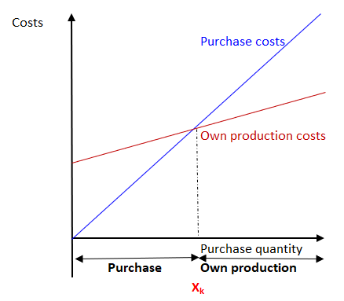
Make-or-Buy analysis
X_{k} is defined as the critical production volume for which the purchase cost is equal to the cost of own production. This is the value below which it is not profitable to undertake production;
Only when the X_{k} value is exceeded is the decision to start production justified;
If the purchase is accompanied by additional financial outlays (e.g., transport costs), then the pattern must be modified by expanding it with appropriate components.
Figure 4: Critical production volume
Source: Blaut.

Slide 22
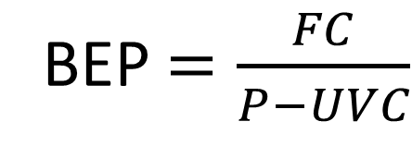
Make-or-Buy analysis
Break – even point is a point where the total sales are equal to total cost. To find the cut-off production volume from where a firm will make profit is the main objective of the break even analysis.
BEP $=\frac{FC}{P−UVC}$
BEP – break even point
FC – fixed cost
P – price per unit
UVC – variable cost per unit
Source: own elaboration

Slide 23
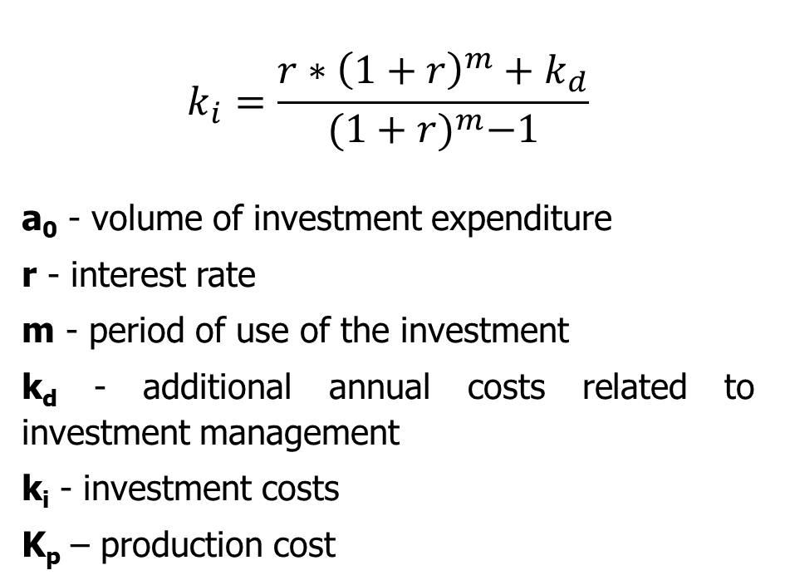
Make-or-Buy analysis in the context of investment expenditure on production
Therefore, the production cost will be calculated according to the formula:
K_{p}=k_{i}+x+k_{v}
and the purchase cost
K_{z=} c*x
If the inequality K_{z} < K_{p} is met, there are grounds for making a decision to purchase a given product.
$$k_{i}=\frac{r∗{\left(1+r\right)}^{m}+k_{d}}{{(1+r)}^{m}−1}$$
a₀ - volume of investment expenditure
r - interest rate
m - period of use of the investment
k_{d} - additional annual costs related to investment management
k_{i} - investment costs
K_{p} – production cost
Source: Blaut.

Slide 24
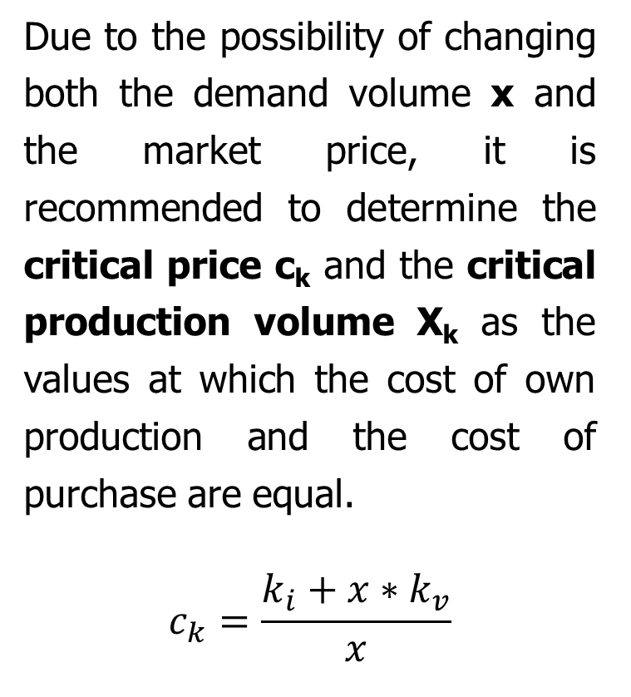
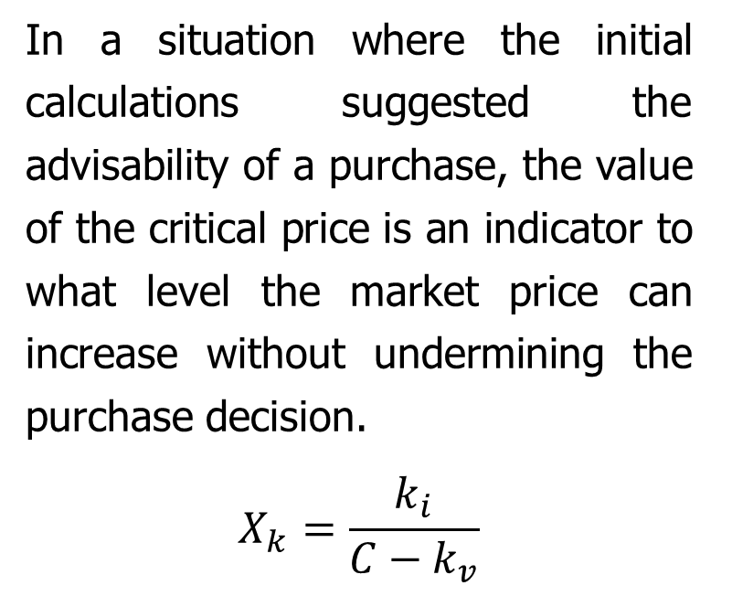
Make-or-Buy analysis
Due to the possibility of changing both the demand volume x and the market price, it is recommended to determine the critical price c_{k} and the critical production volume X_{k} as the values at which the cost of own production and the cost of purchase are equal.
$$c_{k}=\frac{k_{i}+x∗k_{v}}{x}$$
In a situation where the initial calculations suggested the advisability of a purchase, the value of the critical price is an indicator to what level the market price can increase without undermining the purchase decision.
$$X_{k}=\frac{k_{i}}{C−k_{v}}$$
Source: Blaut.

Slide 25
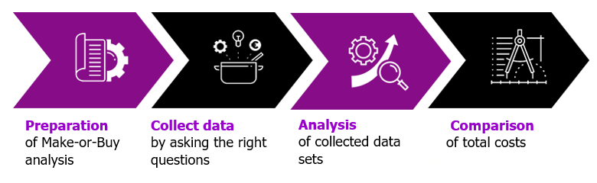
Stages of Make-or-Buy analysis
Preparation
Collect data
Analysis
Comparison
of Make-or-Buy analysis
by asking the right questions
of collected data sets
of total costs
The quality of the subsequent analysis results depends only on the correctness of the data. For this reason, it is necessary to collect or store in the company all the necessary data regarding staff and those answering the question whether logistics systems, e.g. industrial trucks or warehouse management, must be transferred or performed by external entities.
In this stage, the data is assessed and analysed. The results of make-or-buy analysis are most often carried out using a set of indicator values from comparative analysis (benchmark), which are collected during the operational execution of orders for clients.
A clear comparison between the logistics costs within the company and the logistics costs of the external service provider is made. In terms of employees, for example, the organisation's total personnel costs are compared with the total staff costs of an external entity.
There are standard logistics processes, such as transport, storage, shipping, import, export and customs clearance, and supporting logistics processes, which include, for example, preparation, commissioning, packaging, returns and inventory. This division is necessary to decide on the scope of outsourcing as well as the operating model.
Source: Müller-Die lila Logistik

Slide 26
Logistics outsourcing
As part of outsourcing, the most frequently outsourced areas are areas that are not the key competencies of a given company, but only support it;
If logistics is not a fundamental activity of the company, then delegating the organisation and/or execution of all or part of the logistics processes to competent suppliers specialising in the provision of logistics services may significantly increase the efficiency of logistics processes.
Source: Witkowski, 2008

Slide 27
Logistics outsourcing
As a result of cooperation between the organisation and the logistics operator, it is possible to achieve the following goals:
  improving the quality of customer service;
  shorter order cycle execution time;
  better quality and delivery guarantee;
  faster flow and increased transparency of information;
  more efficient use of assets.
Source: Gąsowska,2016

Slide 28
Logistics outsourcing indicatiors
Four indicators of logistics outsourcing:
  changes in costs;
  changes in profitability;
  changes in turnover;
  changes in the break-even point.
Source: Szukalski, 2016

Slide 29
Stages of logistics outsourcing
internal preparations of the company
inviting external companies
implementation
The purpose of this stage is to initiate discussions with logistics service providers.
External companies submit their proposals for logistics services, trade negotiations and selecting the organisation that will ultimately take over logistics services.
Working with the selected business entity to implement the project and physical transfer of warehouse stocks under the operator's management.
Source: Jaworski

Slide 30
Advantages and disadvantages of logistics outsourcing
Advantages of logistics outsourcing | Disadvantages of logistics outsourcing
Optimising expenses and reducing investment risk | Employees' fear of dismissal and demotivation
Ability to focus on the right business | Partial loss of control over order execution
Improving the flow of processes and division of responsibilities | Choosing a partner with a lack of competence
Improving the quality of consumer service | Becoming dependent on a service provider
Increasing competitiveness | Possible problems with coordination and internal communication
Source: Khaletskaya, 2021, Ware Teka

Slide 31
Make-or-Buy Analysis – Example 1
Organisation X must decide whether to produce a component for product A on its own or to purchase a ready-made component;
Fixed costs, unit variable costs and the purchase price of 1 piece of the component are specified below.
  Fixed costs: 50 000 EUR
  Variable costs: 16 EUR/pc
  Unit purchase price: 25 EUR/pc
Which variant to choose if you plan to produce 10 000 pcs per year?
At what volume of production total costs of both variants are the same?
Source: own elaboration

Slide 32
Make-or-Buy Analysis – Example 1 (solution)
Which variant to choose if you plan to produce 10 000 pcs per year?
Make Variant:
  Variable costs: 16 EUR/pc
  10 000 pcs per year
  Fixed costs: 50 000 EUR
K_{p=} K_{s} +X* k_{v}
K_{p=} 50 000 +10 000*16 = 210 000 EUR
Make Variant = 210 000 EUR / YEAR
Source: own elaboration

Slide 33
Make-or-Buy Analysis – Example 1 (solution)
Which variant to choose if you plan to produce 10 000 pcs per year?
Buy Variant:
  10 000 pcs per year
K_{z=} c*x,
K_{Z=} 10 000*25 = 250 000 EUR
Buy Variant = 250 000 EUR / YEAR
Company should choose Make Variant
Source: own elaboration

Slide 34
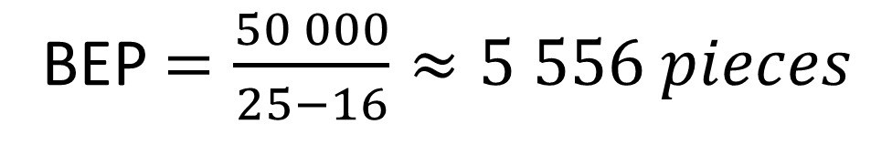
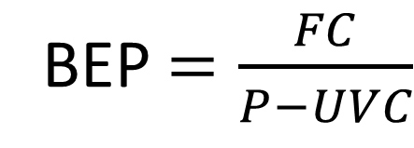
Make-or-Buy Analysis – Example 1 (solution)
At what volume of production total costs of both variants are the same?
  Fixed costs: 50 000 EUR
  Unit purchase price: 25 EUR/pc
  Variable costs: 16 EUR/pc
BEP $=\frac{FC}{P−UVC}$
BEP $=\frac{50 000}{25−16}≈5 556 pieces$
Make and Buy Variants would be equal when the production plan is approximately 5 556 pieces per year
Source: own elaboration

Slide 35
Summary
Outsourcing is a method of permanent external service by specialised enterprises, externalisation, external management, or even deconcentration of the functioning of the organisation;
There are many types of outsourcing, depending on the purpose and degree of use of external services;
Making the decision to outsource or not to outsource makes it easier to conduct a Make-or-Buy analysis;
Make-or-Buy analysis compares the costs of your own labour and external services;
Break – even point is a point where the total sales are equal to total cost;
If logistics is not a fundamental activity of the company it should be outsourced to an external logistics operator.

Slide 36
Authors:
Katarzyna Grzybowska
Katarzyna Ragin-Skorecka
Katarzyna Siemieniak
Piotr Cyplik
Michał Adamczak
Jędrzej Jankowski-Guzy
Adrianna Toboła-Walaszczyk
Final version: June 2025

Slide 37
Thank you for your attention

