Slide 1



Advanced using of spreadsheet to analyse logistics data
Controlling in Supply Chain Management
Lecture
BAS4SC
Business Analytics Skills
for the Future-proof Supply Chains
Co-funded by the European Union
Views and opinions expressed are however those of the author(s) only and do not necessarily reflect those of the European Union or the National Agency (NA). Neither the European Union nor NA can be held responsible for them.
Project number – 2022-1-PL01-KA220-HED-000088856

Slide 2
Agenda
concept of controlling;
objectives and scope of controlling in the supply chain;
basic Key Performance Indicators (KPIs) in the supply chain.

Slide 3
Concept of controlling
Controlling can be described as ”a system of mutually agreed measures, principles, goals, methods, and techniques that serves the internal control and management of outcome-related objectives”;
Controlling in the supply chain is the process of managing and optimising financial, material, and informational flows throughout the supply chain.
Source: Nowak, 2015; Chopra & Meindl, 2007

Slide 4
Concept of controlling
Supply Chain Controlling
data analysis
forecasting
performance monitoring
corrective interventions
Continuous adjustment of activities to changing market and operational conditions
Source: Cigolini et al., 2004

Slide 5
Concept of controlling
Table 1: Differences between controlling in the supply chain and in the enterprise
Differentiating criterion | Controlling in supply chain | Controlling in enterprise
Range of activity | includes the management and coordination of activities in many independent organisations that cooperate to produce and deliver products to the final recipient | focuses on the internal processes of one organization, focusing on optimisation and operational efficiency within the enterprise itself
Strategic goal | strives to optimise the entire process from suppliers to customers, focusing on the integration and synchronisation of activities between various entities | focuses on achieving the financial and operational goals of the enterprise itself, such as profitability, operational efficiency and compliance with the budget
Areas of intervention | deals with aspects such as order fulfilment time, logistics costs, quality of cooperation between partners and inventory management at the level of the entire chain | may focus on controlling internal costs, analysing the profitability of products or departments, and optimising business processes within the company
Tools and methodologies used | often uses advanced IT systems that integrate data from various enterprises, such as ERP or SCM systems | may use more company-centric tools and systems that may not necessarily be integrated with external business partners
Source: Mazur et al., 2021, Nesterak et al., 2020, Vollmuth, 2000

Slide 6
Controlling feedback
feedback (feed-back) – regulation that allows for identifying deviations in the plan-execution system and for taking appropriate corrective and preventive actions to avoid deviation from the set goal;
feed-forward – understood as control related to the use of forecasted quantities and information about past actions to determine what kind of actions should be taken in the future.
Source: Nesterak, 2002

Slide 7

Key objectives of Supply Chain Controlling
Increasing operational efficiency through process analysis, workflow optimisation, and waste minimisation, which improves the overall performance of the supply chain;
Cost reduction, as controlling and continuous monitoring of costs within the supply chain help identify areas where savings can be achieved without compromising quality;
Ensuring compliance and quality by monitoring and ensuring adherence to regulations and quality standards throughout the supply chain;
Source: Chopra & Meindl, 2007

Slide 8
Key objectives of Supply Chain Controlling
Improving collaboration between partners through better planning, communication, and coordination of activities;
Increasing the flexibility and resilience of the supply chain by developing the ability to quickly adapt to market changes or operational environments and minimising the risk of downtime or disruptions;
Optimising inventory management, which balances the needs for cost reduction with requirements for product availability;
Source: Chopra & Meindl, 2007

Slide 9
Key objectives of Supply Chain Controlling
Improving the decision-making process by providing key data and analyses that support strategic and tactical management decisions;
Ensuring continuous improvement by promoting a culture of continuous improvement within the supply chain through regular reviews, assessments, and process updates.
Source: Chopra & Meindl, 2007

Slide 10
Key Performance Indicators (KPI) in SCM
Key Performance Indicators (KPI) – financial and non-financial indicators used as measures in the processes of measuring the degree of achievement of the organisation's goals.
KPI
Specific
Measurable
Achivable
Time-bound
Relevant
Source: Dobroszek, 2011; https://www.salesbook.com/

Slide 11
Key Performance Indicators (KPI) in SCM
KPI
Specific
Measurable
Achivable
Time-bound
Relevant
supply chain pillar;
partner relationship pillar;
individual economic entity in the supply chain pillar.
Source: Dobroszek, 2011

Slide 12


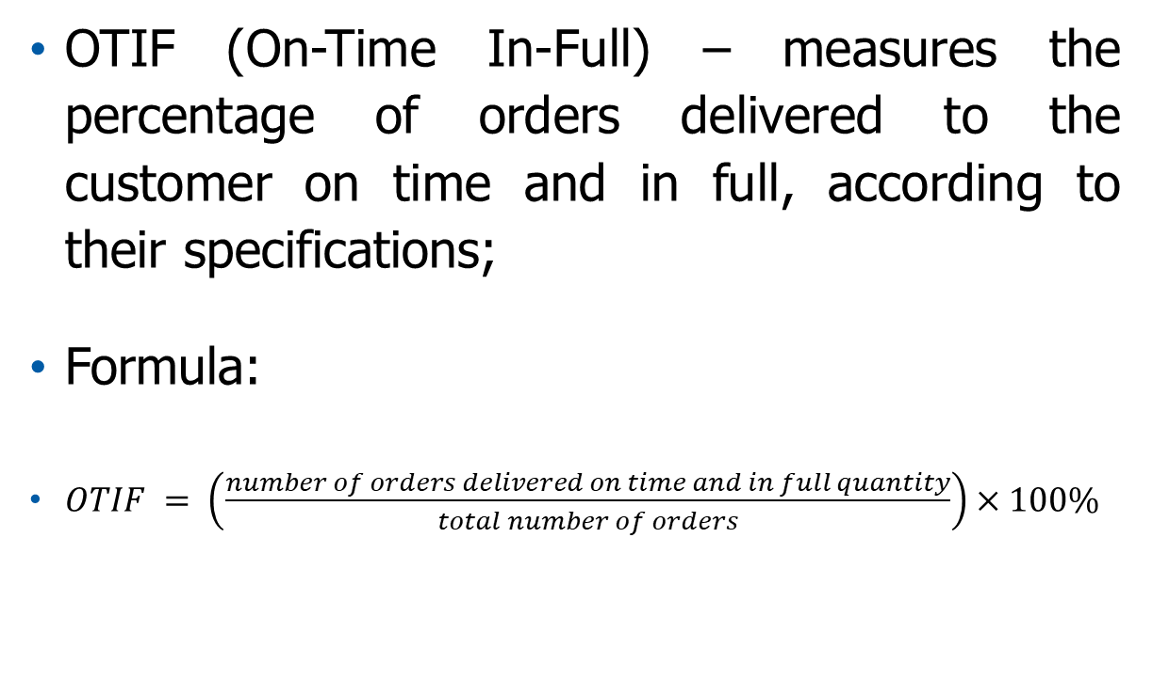
Key Performance Indicators (KPI) in SCM
OTIF (On-Time In-Full) – measures the percentage of orders delivered to the customer on time and in full, according to their specifications;
Formula:
$OTIF = \left(\frac{number of orders delivered on time and in full quantity}{total number of orders}\right)×100\%$
The high level of OTIF implementation indicates the effectiveness of inventory management, production planning, transportation time management and accuracy in the order acceptance process.
Source: Ahi et al., 2015; Anand & Grover, 2015; Dias & Silva 2021; Lehyani et al., 2018; Rasool et al., 2023; Yurtay et al., 2023; Zhu et al., 2017

Slide 13
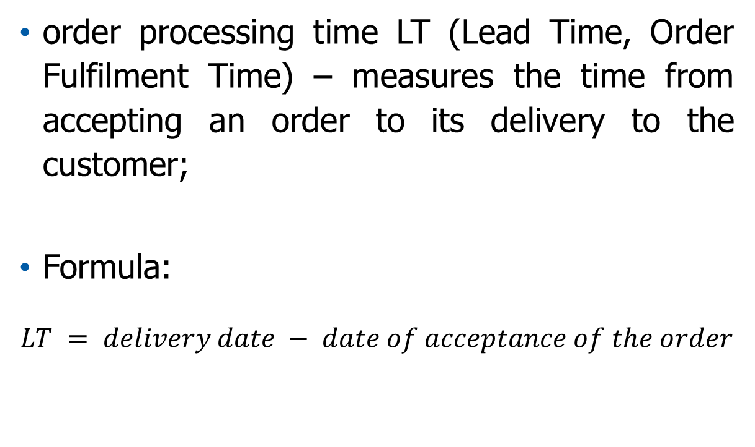
Key Performance Indicators (KPI) in SCM
order processing time LT (Lead Time, Order Fulfilment Time) – measures the time from accepting an order to its delivery to the customer;
Formula:
$$LT = delivery date − date of acceptance of the order$$
Lead time includes:
order preparation time;
production time;
delivery time.
Source: Ahi et al., 2015; Anand & Grover, 2015; Dias & Silva 2021; Lehyani et al., 2018; Rasool et al., 2023; Yurtay et al., 2023; Zhu et al., 2017

Slide 14
Key Performance Indicators (KPI) in SCM
customer service level – measures an organisation's ability to meet customer requirements, often defined as the percentage of orders fulfilled without errors;
the customer service level (CSL) from the point of view of a single product range can be considered:
  probabilistically – as the probability of no shortage occurring in stock in a given replenishment cycle (PSL),
  quantitatively – as the degree of quantitative demand fulfilment (DFR).
The probabilistic customer service level can be calculated from the formula:
PSL = (l_{d} – l_{dn}) / l_{d} × 100%
where:
PSL – probabilistic service level,
l_{d} – number of inventory replenishment cycles during the examined period,
l_{dn} – number of inventory replenishment cycles in which shortages were recorded during the examined period.
Source: Ahi et al., 2015; Anand & Grover, 2015; Dias & Silva 2021; Lehyani et al., 2018; Rasool et al., 2023; Yurtay et al., 2023; Zhu et al., 2017; Bowersox and Closs, 1996; Cyplik & Hadaś, 2012

Slide 15
Key Performance Indicators (KPI) in SCM
customer service level – measures an organisation's ability to meet customer requirements, often defined as the percentage of orders fulfilled without errors;
the customer service level (CSL) from the point of view of a single product range can be considered:
  probabilistically – as the probability of no shortage occurring in stock in a given replenishment cycle (PSL),
  quantitatively – as the degree of quantitative demand fulfilment (DFR).
The Demand Fill Rate can be calculated using the formula:
DFR = (PR – NB) / PR
where:
DFR – Demand Fill Rate,
PR – demand, total number of units ordered,
NB – number of deficiencies.
Source: Ahi et al., 2015; Anand & Grover, 2015; Dias & Silva 2021; Lehyani et al., 2018; Rasool et al., 2023; Yurtay et al., 2023; Zhu et al., 2017; Bowersox and Closs, 1996; Cyplik & Hadaś, 2012

Slide 16
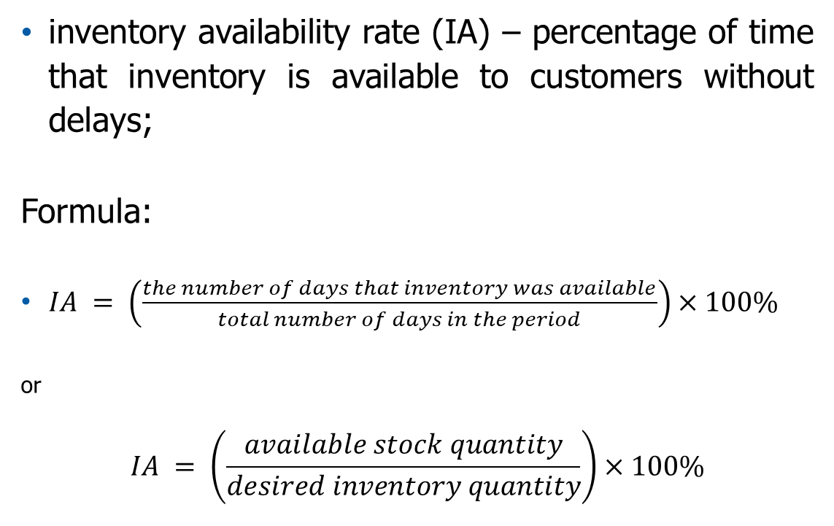
Key Performance Indicators (KPI) in SCM
inventory availability rate (IA) – percentage of time that inventory is available to customers without delays;
Formula:
$IA = \left(\frac{the number of days that inventory was available}{total number of days in the period}\right)×100\%$
or
$$IA = \left(\frac{available stock quantity}{desired inventory quantity}\right)×100\%$$
The indicator measures the percentage of days or instances in which inventory was available for immediate fulfilment relative to the overall demand or number of days in a specified period.
Source: Ahi et al., 2015; Anand & Grover, 2015; Dias & Silva 2021; Lehyani eta la., 2018; Rasool et al., 2023; Yurtay et al., 2023; Zhu et al., 2017

Slide 17
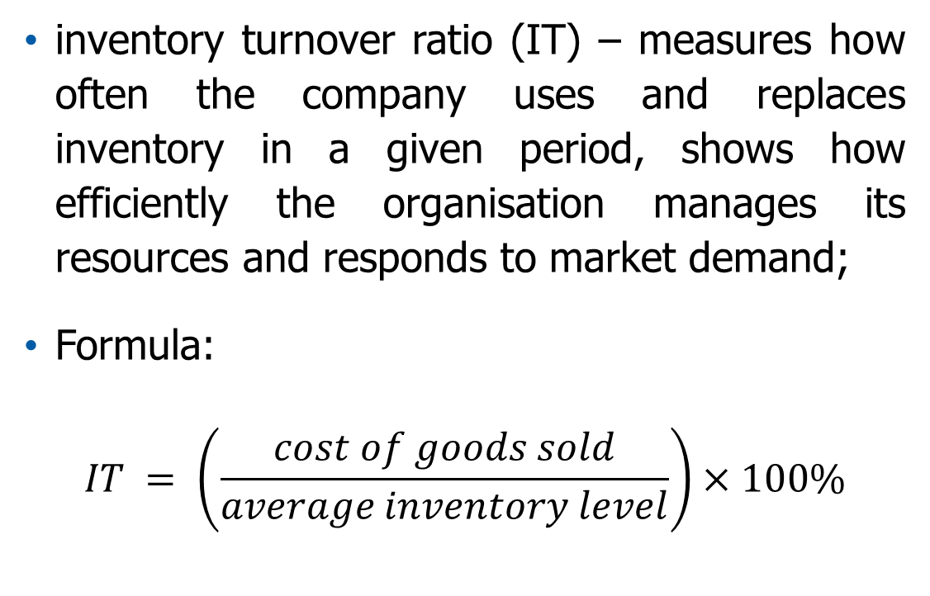
Key Performance Indicators (KPI) in SCM
inventory turnover ratio (IT) – measures how often the company uses and replaces inventory in a given period, shows how efficiently the organisation manages its resources and responds to market demand;
Formula:
$$IT = \left(\frac{cost of goods sold}{average inventory level}\right)×100\%$$
A too high indicator may indicate a risk of inventory shortages.
A too low indicator may signify excessive inventory or poor sales.
Source: Ahi et al., 2015; Anand & Grover, 2015; Dias & Silva 2021; Lehyani et al., 2018; Rasool et al., 2023; Yurtay et al., 2023; Zhu et al., 2017

Slide 18
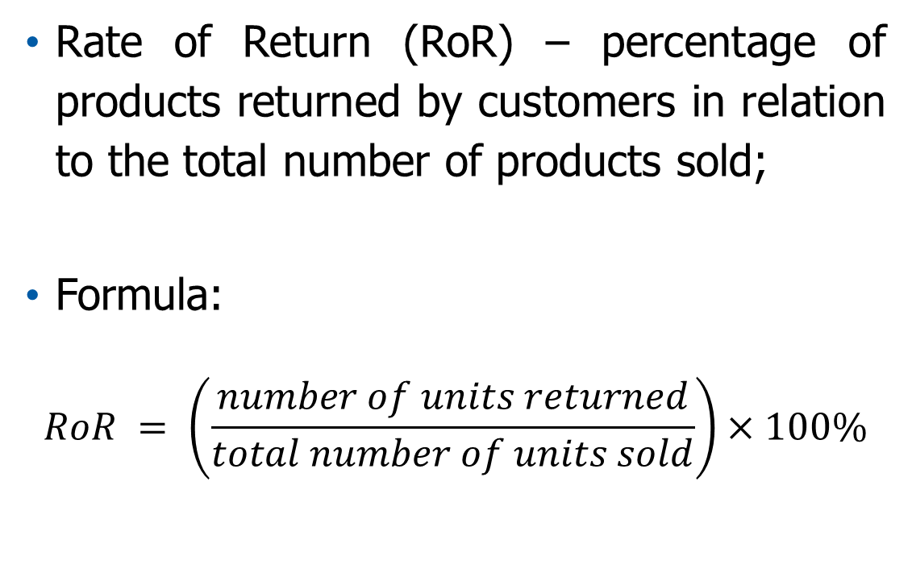
Key Performance Indicators (KPI) in SCM
Rate of Return (RoR) – percentage of products returned by customers in relation to the total number of products sold;
Formula:
$$RoR = \left(\frac{number of units returned}{total number of units sold}\right)×100\%$$
A high rate of returns may indicate problems with product quality, discrepancies in descriptions, or improper fulfilment of customer expectations, which negatively affects their satisfaction.
Source: Ahi et al., 2015; Anand & Grover, 2015; Dias & Silva 2021; Lehyani et al., 2018; Rasool et al., 2023; Yurtay et al., 2023; Zhu et al., 2017

Slide 19
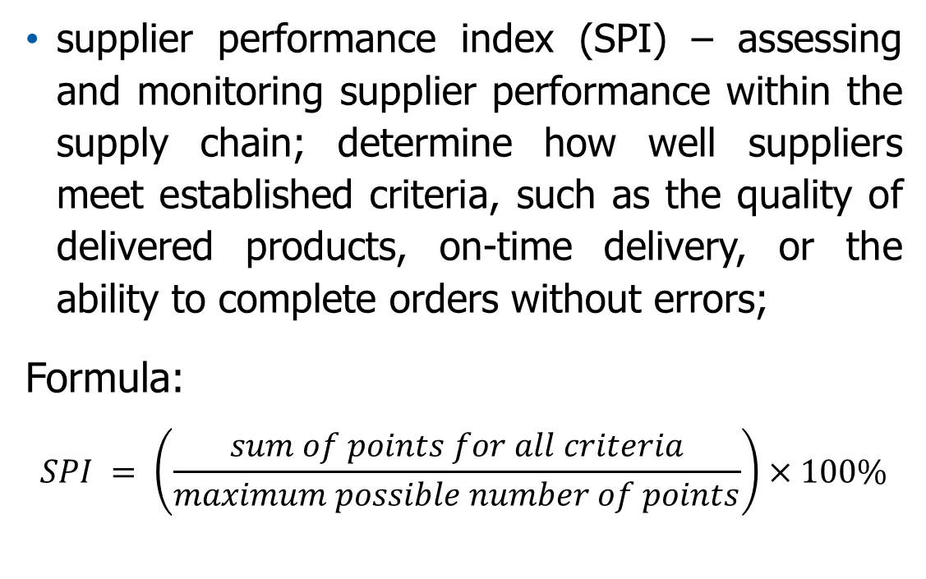
Key Performance Indicators (KPI) in SCM
supplier performance index (SPI) – assessing and monitoring supplier performance within the supply chain; determine how well suppliers meet established criteria, such as the quality of delivered products, on-time delivery, or the ability to complete orders without errors;
Formula:
$$SPI = \left(\frac{sum of points for all criteria}{maximum possible number of points}\right)×100\%$$
The SPI is usually calculated based on several individual performance indicators, such as delivery quality, timeliness and flexibility.
Source: Ahi et al., 2015; Anand & Grover, 2015; Dias & Silva 2021; Lehyani et al., 2018; Rasool et al., 2023; Yurtay et al., 2023; Zhu et al., 2017

Slide 20
KPI in SCM – Example
Orders placed by customers and their planned delivery dates are presented in the table below:
No. | Order quantity | Planned delivery date
1 | 200 | 16.01.2023
2 | 550 | 23.02.2023
3 | 480 | 08.03.2023
4 | 1000 | 12.04.2023
5 | 390 | 10.05.2023
6 | 620 | 21.06.2023
7 | 500 | 19.07.2023
8 | 780 | 11.08.2023
9 | 900 | 20.09.2023
10 | 380 | 06.10.2023
11 | 690 | 13.11.2023
12 | 250 | 08.12.2023
Source: own elaboration

Slide 21
KPI in SCM – Example
The quantities delivered to the customer along with the actual delivery date are shown in the table below:
No. | Order quantity | Planned delivery date | The quantity delivered | Actual delivery date
1 | 200 | 16.01.2023 | 200 | 16.01.2023
2 | 550 | 23.02.2023 | 550 | 27.02.2023
3 | 480 | 08.03.2023 | 480 | 08.03.2023
4 | 1000 | 12.04.2023 | 1000 | 12.04.2023
5 | 390 | 10.05.2023 | 390 | 10.05.2023
6 | 620 | 21.06.2023 | 600 | 21.06.2023
7 | 500 | 19.07.2023 | 500 | 19.07.2023
8 | 780 | 11.08.2023 | 780 | 11.08.2023
9 | 900 | 20.09.2023 | 900 | 20.09.2023
10 | 380 | 06.10.2023 | 300 | 06.10.2023
11 | 690 | 13.11.2023 | 690 | 13.11.2023
12 | 250 | 08.12.2023 | 250 | 08.12.2023
Based on data provided in the table, calculate OTIF
Source: own elaboration

Slide 22
KPI in SCM – Example
Verification of quantities delivered to the customer
No. | Order quantity | Planned delivery date | The quantity delivered | Actual delivery date
1 | 200 | 16.01.2023 | 200 | 16.01.2023
2 | 550 | 23.02.2023 | 550 | 27.02.2023
3 | 480 | 08.03.2023 | 480 | 08.03.2023
4 | 1000 | 12.04.2023 | 1000 | 12.04.2023
5 | 390 | 10.05.2023 | 390 | 10.05.2023
6 | 620 | 21.06.2023 | 600 | 21.06.2023
7 | 500 | 19.07.2023 | 500 | 19.07.2023
8 | 780 | 11.08.2023 | 780 | 11.08.2023
9 | 900 | 20.09.2023 | 900 | 20.09.2023
10 | 380 | 06.10.2023 | 300 | 06.10.2023
11 | 690 | 13.11.2023 | 690 | 13.11.2023
12 | 250 | 08.12.2023 | 250 | 08.12.2023
Source: own elaboration

Slide 23
KPI in SCM – Example
Verification of quantities delivered to the customer
No. | Order quantity | Planned delivery date | The quantity delivered | Actual delivery date
1 | 200 | 16.01.2023 | 200 | 16.01.2023
2 | 550 | 23.02.2023 | 550 | 27.02.2023
3 | 480 | 08.03.2023 | 480 | 08.03.2023
4 | 1000 | 12.04.2023 | 1000 | 12.04.2023
5 | 390 | 10.05.2023 | 390 | 10.05.2023
6 | 620 | 21.06.2023 | 600 | 21.06.2023
7 | 500 | 19.07.2023 | 500 | 19.07.2023
8 | 780 | 11.08.2023 | 780 | 11.08.2023
9 | 900 | 20.09.2023 | 900 | 20.09.2023
10 | 380 | 06.10.2023 | 300 | 06.10.2023
11 | 690 | 13.11.2023 | 690 | 13.11.2023
12 | 250 | 08.12.2023 | 250 | 08.12.2023
Source: own elaboration

Slide 24
KPI in SCM – Example
Verification of delivery dates
No. | Order quantity | Planned delivery date | The quantity delivered | Actual delivery date
1 | 200 | 16.01.2023 | 200 | 16.01.2023
2 | 550 | 23.02.2023 | 550 | 27.02.2023
3 | 480 | 08.03.2023 | 480 | 08.03.2023
4 | 1000 | 12.04.2023 | 1000 | 12.04.2023
5 | 390 | 10.05.2023 | 390 | 10.05.2023
6 | 620 | 21.06.2023 | 600 | 21.06.2023
7 | 500 | 19.07.2023 | 500 | 19.07.2023
8 | 780 | 11.08.2023 | 780 | 11.08.2023
9 | 900 | 20.09.2023 | 900 | 20.09.2023
10 | 380 | 06.10.2023 | 300 | 06.10.2023
11 | 690 | 13.11.2023 | 690 | 13.11.2023
12 | 250 | 08.12.2023 | 250 | 08.12.2023
Number of deliveries with incorrect quantity = 2
Number of delayed deliveries = 1
Total number of incorrect deliveries = 3
Source: own elaboration

Slide 25
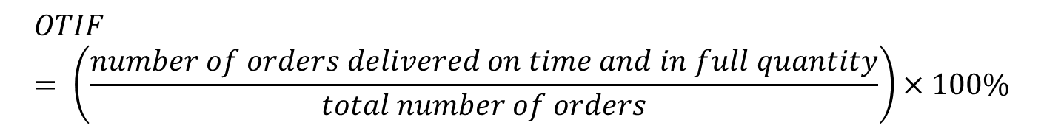
KPI in SCM – Example
OTIF calculation:
  Total numer of orders = 12
  Number of orders delivered on time and in full quantity = 12 – 3 = 9
$$OTIF = \left(\frac{number of orders delivered on time and in full quantity}{total number of orders}\right)×100\%$$
$$OTIF = \left(\frac{9}{12}\right)×100\%$$
$$OTIF =75\%$$
Source: own elaboration

Slide 26
Summary
Controlling in the supply chain is the process of managing and optimising financial, material, and informational flows throughout the supply chain;
Key Performance Indicators (KPI) – financial and non-financial indicators used as measures in the processes of measuring the degree of achievement of the organisation's goals;
KPIs are used as indicators for controlling the implementation of processes in the supply chain;
The OTIF indicator, as one of the most important indicators, is a tool that allows organisations to monitor and assess their effectiveness, efficiency and productivity in key areas of activity.

Slide 27
Authors:
Katarzyna Grzybowska
Katarzyna Ragin-Skorecka
Katarzyna Siemieniak
Piotr Cyplik
Michał Adamczak
Jędrzej Jankowski-Guzy
Adrianna Toboła-Walaszczyk
Final version: June 2025

Slide 28
Thank you for your attention

