Slide 1



Advanced using of spreadsheet to analyse logistics data
Optimisation in Supply Chain Management
Lecture
BAS4SC
Business Analytics Skills
for the Future-proof Supply Chains
Co-funded by the European Union
Views and opinions expressed are however those of the author(s) only and do not necessarily reflect those of the European Union or the National Agency (NA). Neither the European Union nor NA can be held responsible for them
Project number – 2022-1-PL01-KA220-HED-000088856

Slide 2
Agenda
concept of optimisation in logistics;
the role of the warehouse in the supply chain;
determining warehouse space;
selected methods of inventory management in the supply chain;
the Solver tool.

Slide 3
Optimisation
Optimisation in logistics is the process of finding the most effective way of organising the flow of goods, information, and resources throughout the entire supply chain;
The goal of optimisation in logistics is to improve various aspects of activity, such as:
  reduction of goods flow time;
  optimisation of transportation, warehousing, and handling costs;
  improvement of logistics service quality;
  increased flexibility and responsiveness to changes in demand;
  reduction of inventory levels while ensuring continuity of supply;
  improved management of warehouse space and transportation resources;
  integration and automation of logistics processes.
Source: Reszka, 2012; Antoniuk et al., 2021; Gupta et al., 2022; Kauf & Tłuczak, 2016; Konarzewska et al., 2020

Slide 4
Logistical Optimisation models
distribution network design (determining the locations of distribution centres);
designing transportation systems (optimisation of transport tasks, minimisation of empty runs, determining delivery routes);
inventory management (allocation of stocks, estimating their size, determining order placement timings);
designing and managing warehouse activities (maximising warehouse space efficiency).
Source: Powers, 1989; Smyk, 2023; Tylicki & Bartol, 2017

Slide 5
Optimisation methods
The main classification of optimisation methods is based on the type of optimisation task to be solved.
Type of problem being solved
linear programming methods
nonlinear optimisation methods
Optimisation methods
Constraints
unconstrained optimisation method
constrained optimisation methods
Dimension of the problem
univariate methods
multivariate methods
Optimisation criteria
single-criterion methods
multicriteria methods
Source: Jayarathna et al., 2021; Kusiak et al., 2021

Slide 6
Role of warehouse in supply chain
The warehouse is intended for storing material goods in a designated space of the warehouse building, according to established technology, equipped with appropriate devices and technical means, managed and serviced by a team of people equipped with the necessary skills;
In the context of the supply chain, the warehouse have an extremely important role, serving as a key center for coordination and storage of goods, which is essential to ensure the smooth flow of products from producers to consumers.
Source: Gołembska, 1999; Miszewski, 2019; Gu et al., 2007; Mason et al., 2003; Ramaa et al., 2012

Slide 7
Warehouse space
Calculating warehouse space requires consideration of its various types.
Total gross warehouse area
Construction area
Net area
Communication area
Service area
Usable area
Auxiliary surface
Basic surface
Handling surface
Storage area
Reception/release area
Figure 1: Division of warehouse space
Source: Dudziński & Kizyn, 2002; Zunic et al. 2017

Slide 8
Warehouse space
The size and shape of the warehouse depend on the following variables:
  the types, number, and dimensions of positions where warehouse activities are performed in the receiving and dispatching zones;
  the dimensions and quantities of storage fields in the storage area;
  the dimensions and quantities of laydown areas;
  parameters of shelving rows and the number of columns in rows;
  the width of the working aisle for the selected forklift;
  the width of communication paths for equipment and personel.
Source: Dudziński & Kizyn, 2002; Zunic et al. 2017

Slide 9

Warehouse space
The total warehouse area S can be expressed by the formula:
S = f_{s} + f_{p} = f_{s} + f_{w} + f_{d} + f_{a}
f_{s} – storage area
f_{p} – auxiliary area
f_{w} – area designated for receiving, sorting, and dispatching
Formula in Excel:
S = [the storage area] + [the auxiliary area] =
= [the storage area]+ [the area designated for receiving, sorting, and dispatching materials]+ [the area occupied by passages and driveways]+ [the administrative and social area]
Source: own elaboration

Slide 10
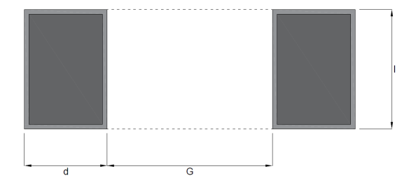
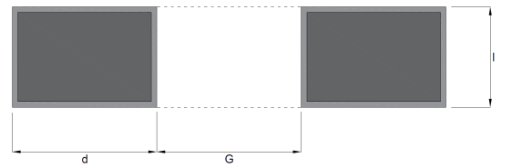
Warehouse storage space
The part of the warehouse area that includes the horizontal projection of the smallest repeatable part of two rows or blocks of load units (LU) along with handling clearances for storage and the handling path between them is the warehouse module;
Warehouse modules for row storage without equipment can be arranged in two ways:
Figure 2: A warehouse module for row storage without equipment with perpendicular arrangement of palletised LU
Figure 3: warehouse module for row storage without equipment with parallel arrangement of palletised LU
Source: own elaboration

Slide 11
Warehouse storage space
The area of a warehouse module for row storage without equipment is calculated using the formula:
M = (2 × d + G) × l [m²]
d – width of the laydown area [m],
G – width of the handling path [m],
l – length of the storage field [m].
The capacity of the module is equal to 2 palletised load units for single-level storage and 2×n palletised load units for stacked storage when stacking in n levels.
Formula in Excel:
M = (2*[width of the laydown area]+[ width of the handling path])*[length of the storage field]
Source: own elaboration

Slide 12
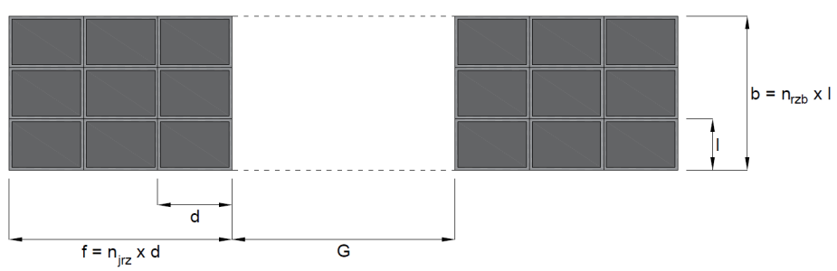
Warehouse storage space
The area of a warehouse module for block storage without equipment is calculated using the formula:
Mb = (2 x f + G) × b = (2 × n_{LUz} × d + G) × n_{LUb} × l [m²]
f – block width [m],
G – width of the handling path [m],
b – block length [m],
n_{LUz} – number of loading units in a block row,
d – width of the storage area [m],
n_{LUb} – number of rows in the block,
l – length of the storage field [m].
The capacity of the module is equal to 2×n_{LUz}×n_{LUb} palletised load units for single-level storage and 2×n_{LUz}×n_{LUb}×n palletised load units for stacked storage when stacking in n levels.
Warehouse modules for block storage without equipment can be arranged as shown below:
Figure 4: Warehouse module for block storage without equipment
Formula in Excel:
Mb = (2*[block width]+[width of the handling path])*[block length]
Source: own elaboration

Slide 13
Warehouse storage space
The volume of a storage module (module capacity) depends on its surface area (Mb) and the height at which the loading unit was formed (h). The volume of the module is calculated from the formula:
V_{M} = [(2 x f + G) x b] x h [m³]
h = n_{rh} x h₀ + h_{p} [m]
f – block width [m]
G – width of the handling path [m]
b – block length [m]
h – high palletised load units [m]
n_{rh} – number of layers per palletised load units
h₀ – height of the collective packaging [m]
h_{p} – media height [m]
Formula in Excel:
VM = {(2*[block width]+ [width of the handling path])*
[block length]}*[high palletised load units]
Source: own elaboration

Slide 14
Warehouse storage space
The volume of the warehouse module (module capacity) depends on its surface area (Mb) and the height to which the load unit (H) has been formed. The volume of the module is calculated using the formula:
V_{M} = [(2 x f + G) x b] x H [m³],
H = n x h = n x (n_{rh} x h₀ + h_{p}) [m]
f – block width [m]
G – width of the handling path [m]
b – block length [m]
H – block height [m]
n –number of stacked palletised load units
h – high of palletised load units [m]
n_{rh} – number of layers per palletised load units
h₀ – height of the collective packaging [m]
h_{p} – media height [m]
Formula in Excel:
VM = {(2*[block width]+ [width of the handling path])*
[block length]}*[block height]
Source: own elaboration

Slide 15
Selected methods of inventory management in the supply chain
Inventory management in the supply chain is a key element that ensures operational fluidity, cost minimisation, and customer satisfaction;
The classic concept of inventory management allows for managing inventories in a distribution network, where they are usually located in various places;
Solving the problems of inventories located in multiple locations focuses primarily on analysing the size of safety stocks;
Safety stock depends on the variability of demand in the inventory replenishment cycle, expressed as the standard deviation of demand in that period and a safety factor dependent on the adopted service level.
Source: Cyplik & Hadaś, 2012; Babaï & Dallery, 2005; Mascle & Gosse, 2014

Slide 16
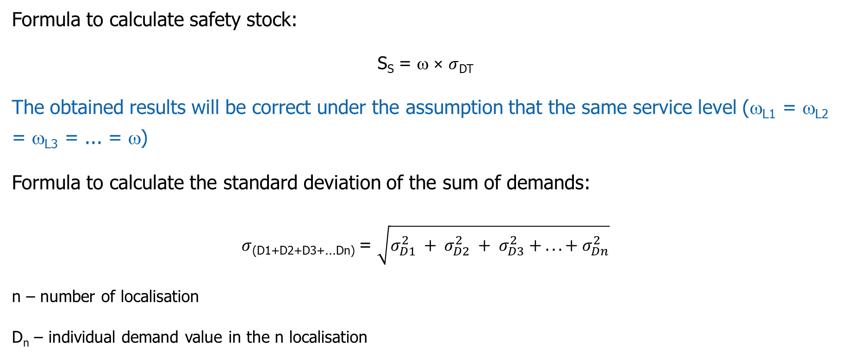
Safety stock calculation
Formula to calculate safety stock:
S_{S} = ω × $σ$_{DT}
The obtained results will be correct under the assumption that the same service level (ω_{L1} = ω_{L2} = ω_{L3} = ... = ω)
Formula to calculate the standard deviation of the sum of demands:
$σ$_{(D1+D2+D3+...Dn)} = $\sqrt{σ_{D1}^{2} + σ_{D2}^{2} + σ_{D3}^{2} + ... + σ_{Dn}^{2}}$
n – number of localisation
D_{n}​ – individual demand value in the n localisation
Source: Cyplik & Hadaś, 2012; Babaï & Dallery, 2005; Mascle & Gosse, 2014

Slide 17
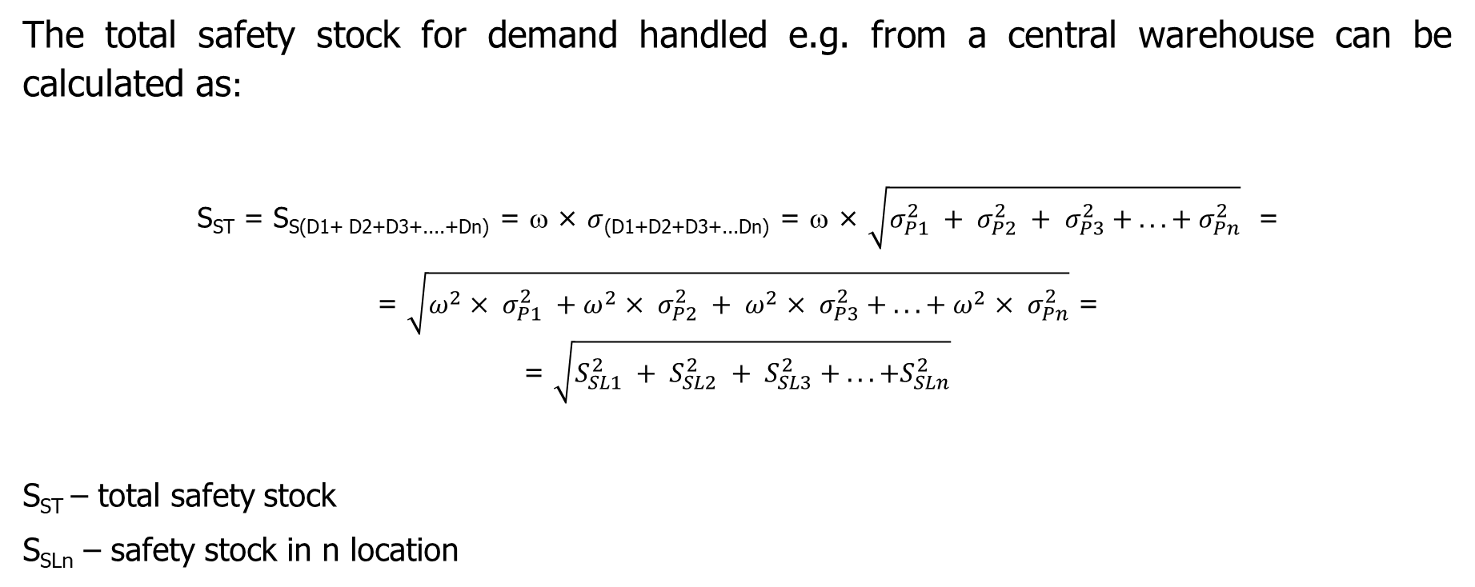
Safety stock calculation
The total safety stock for demand handled e.g. from a central warehouse can be calculated as:
S_{ST} = S_{S(D1+ D2+D3+....+Dn)} = ω × $σ$_{(D1+D2+D3+...Dn)} = ω × $\sqrt{σ_{P1}^{2} + σ_{P2}^{2} + σ_{P3}^{2} + ... + σ_{Pn}^{2}}$ =
= $\sqrt{{ω^{2}× σ}_{P1}^{2} +ω^{2}× σ_{P2}^{2} + ω^{2}× σ_{P3}^{2} + ... + ω^{2}× σ_{Pn}^{2}}$ =
= $\sqrt{{S_{SL1}^{2} + S_{SL2}^{2} + S_{SL3}^{2} + ... +S}_{SLn}^{2}}$
S_{ST} – total safety stock
S_{SLn} – safety stock in n location
Source: Cyplik & Hadaś, 2012; Babaï & Dallery, 2005; Mascle & Gosse, 2014

Slide 18
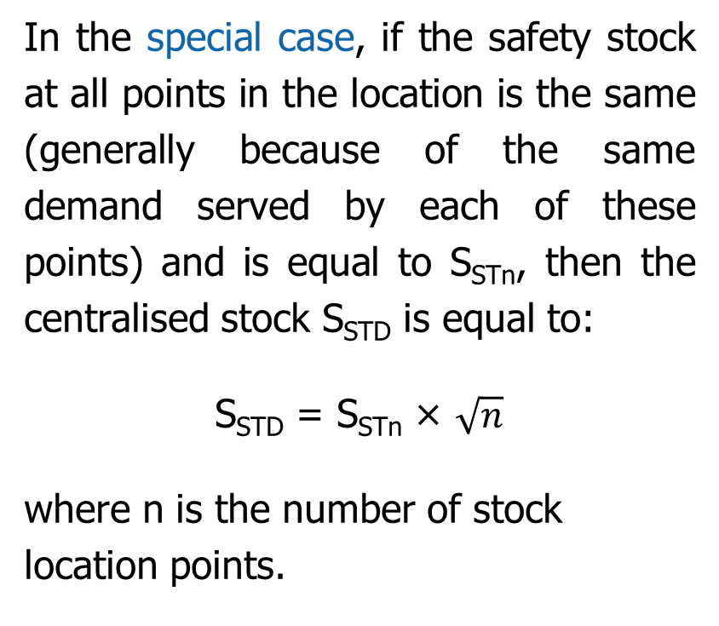
Safety stock calculation
In the special case, if the safety stock at all points in the location is the same (generally because of the same demand served by each of these points) and is equal to S_{STn}, then the centralised stock S_{STD} is equal to:
S_{STD} = S_{STn} × $\sqrt{n}$
where n is the number of stock location points.
Formula in Excel:
SST = [safety factor]*[standard deviation of the sum of demands at points D1-Dn in the replenishment cycle] =
= [safety factor]* SQRT[(STDEV.P([cell range for D1])^2) + (STDEV.P([cell range for D2])^2) + … + (STDEV.P([cell range for Dn])^2)]
Source: Cyplik & Hadaś, 2012; Babaï & Dallery, 2005; Mascle & Gosse, 2014

Slide 19
Warehouse space
In the case of dispersed stock, customers are served directly from stock located in regional warehouses (RW), where the safety stock is maintained.
Supplier
Central warehouse
Regional warehouse 1
Regional warehouse 2
Regional warehouse 3
Regional warehouse 4
Regional warehouse n
Client
Client
Client
Client
Client
Source: Krzyżaniak, 2006
Figure 5: Distributed inventory case illustration

Slide 20
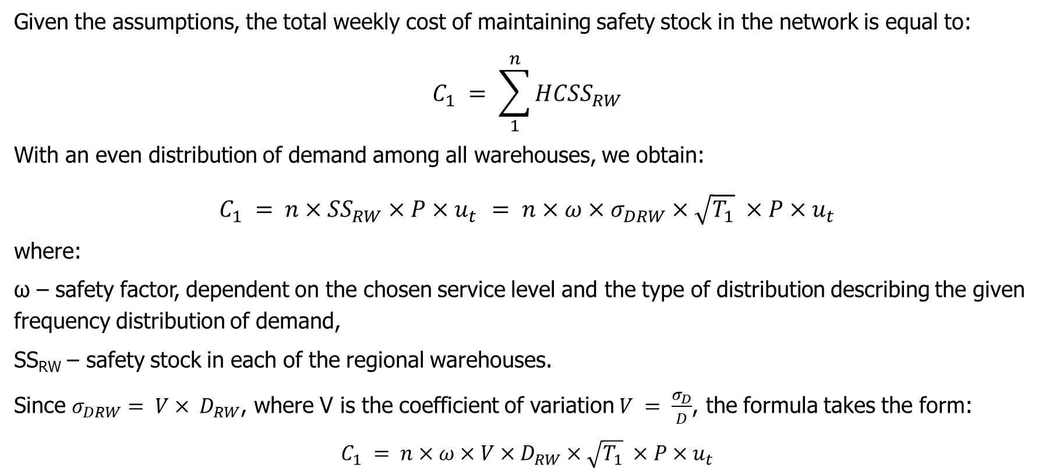
Cost of maintaining safety stock
Given the assumptions, the total weekly cost of maintaining safety stock in the network is equal to:
$$C_{1} = \sum_{1}^{n}{{HCSS}_{RW}}$$
With an even distribution of demand among all warehouses, we obtain:
$$C_{1} = n×{SS}_{RW}×P×u_{t }= n×ω×σ_{DRW}×\sqrt{T_{1}} ×P×u_{t}$$
where:
ω – safety factor, dependent on the chosen service level and the type of distribution describing the given frequency distribution of demand,
SS_{RW} – safety stock in each of the regional warehouses.
Since $σ_{DRW}= V× D_{RW}$, where V is the coefficient of variation $V = \frac{σ_{D}}{D}$, the formula takes the form:
$$C_{1} = n×ω×{V×D}_{RW}×\sqrt{T_{1}} ×P×u_{t}$$
Source: own elaboration

Slide 21
Warehouse space
For centralised stock, customers are served from the central warehouse (CW) with direct deliveries, such as courier shipments.
Client
Supplier
Central warehouse
Regional warehouse 1
Regional warehouse 2
Regional warehouse 3
Regional warehouse 4
Regional warehouse n
Figure 6: Centralised inventory case illustration
Source: Krzyżaniak, 2006

Slide 22
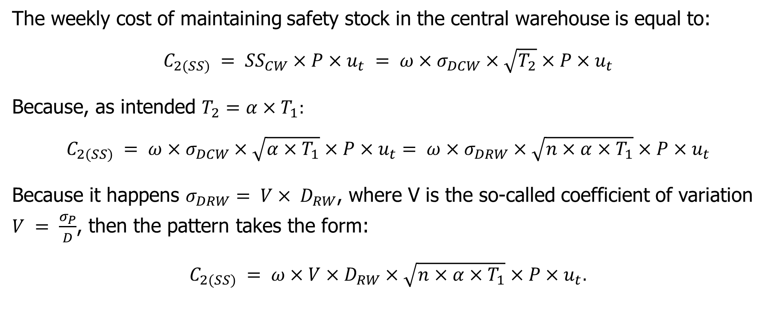
Cost of maintaining safety stock
The weekly cost of maintaining safety stock in the central warehouse is equal to:
$$C_{2(SS)} = {SS}_{CW}×P×u_{t} = ω×σ_{DCW}×\sqrt{T_{2}}×P×u_{t}$$
Because, as intended $T_{2}=α×T_{1}:$
$$C_{2(SS)} = ω×σ_{DCW}×\sqrt{α×T_{1}}×P×u_{t}= ω×σ_{DRW}×\sqrt{n×α×T_{1}}×P×u_{t}$$
Because it happens $σ_{DRW}= V× D_{RW}$, where V is the so-called coefficient of variation $V = \frac{σ_{P}}{D}$, then the pattern takes the form:
$C_{2(SS)} = ω×V×D_{RW}×\sqrt{n×α×T_{1}}×P×u_{t}$.
Source: own elaboration

Slide 23


Strengths and weaknesses of the classic inventory management concept
simplicity and clarity – they are easy to understand and implement;
help in minimising the total costs of inventory management by balancing the costs of ordering and holding inventory, aiming for economic order quantity;
clear and defined decision-making processes that help manage orders and inventory based on calculations and predefined rules.
the need for an assumption of constant and predictable demand, which does not always correspond to the dynamic and variable market realities;
not accounting for demand variability and risk in the supply chain (e.g., delivery delays, market changes);
lack of flexibility in responding to rapid changes in the market or supply chain, as they are based on fixed parameters and do not anticipate dynamic adaptation to new conditions.
Source: own elaboration

Slide 24
Distribution Requirements Planning
DRP (Distribution Requirements Planning) – coordinates demand with inventory levels in various locations;
The purpose of using the distribution demand planning method is to reduce inventories in the distribution network;
The DRP system allows for estimating delivery schedules for each stock keeping unit (SKU) to sales points. It requires having the following information:
  the structure of the distribution channel through which the SKU flows;
  forecast of demand for individual SKUs at the point of sale level;
  the current stock level (on-hand stock) of a given SKU;
  target level of safety stock;
  recommended replenishment amount;
  replenishment delivery time.
Source: Nugroho, 2019; Mukhsin & Sobirin, 2022

Slide 25
DRP Algorithm
Projected on Hand (t) = (On Hand (t-1) + Scheduled Receipt (t) + Planned Order Receipt(t) – Gross Requirement (t))
Net Requirement can be calculated using formulation below:
Net Requirement (t) = (Gross Requirement (t) + Safety Stock) – (Scheduled Receipt (t) + Projected on Hand (t-1))
1. Netting – projected on-hand is an on-hand inventory
2. Lotting is the process to find the order or production lot size in every network distribution
3. Offsetting is an order quantity that is planned to be ordered in the planned time period
4. Explosion – total inventory and distribution cost
Total Inventory and Distribution Cost = Ordering Cost + Holding Cost + Delivery Cost
Source: Ngatilah et al., 2020

Slide 26
Strengths and weaknesses of DRP
improved coordination in the supply chain through better information and goods flow from the producer to the consumer, leading to more efficient distribution;
increased forecasting accuracy, as it considers actual order data and inventory levels throughout the chain, which helps optimise inventory levels and reduce costs;
improved product availability by ensuring that stocks are placed where they are most needed, thereby minimising the risk of shortages and production downtime.
complexity of implementation, especially in large organisations with extensive supply chains, which requires precise planning and coordination;
high initial costs related to purchasing software, hardware, and employee training;
dependency on the accuracy and timeliness of input data, inaccuracies in the data can lead to forecasting and planning errors, which ultimately may cause excessive or insufficient inventories.
Source: own elaboration

Slide 27
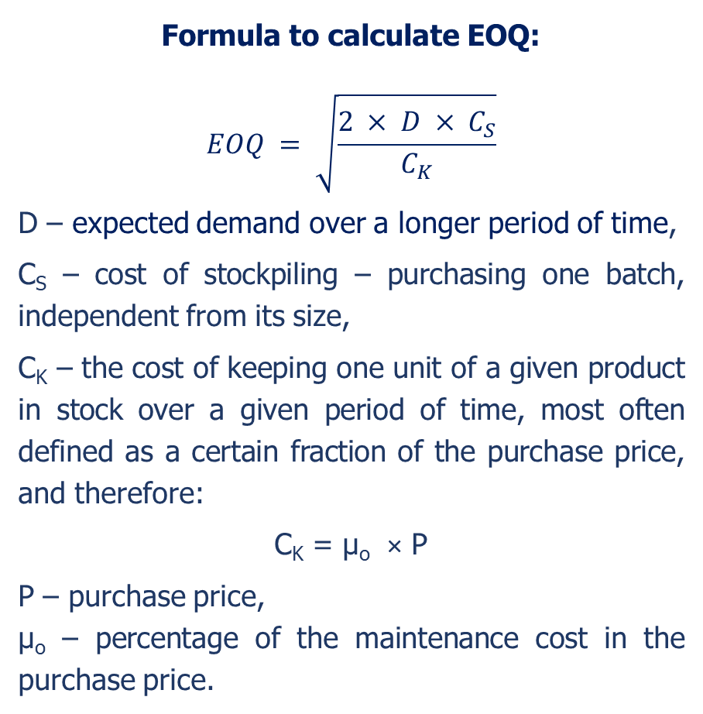
Economic Order Quantity
Formula to calculate EOQ:
$$EOQ = \sqrt{\frac{2 × D × C_{S}}{C_{K}}}$$
D – expected demand over a longer period of time,
C_{S} – cost of stockpiling – purchasing one batch, independent from its size,
C_{K} – the cost of keeping one unit of a given product in stock over a given period of time, most often defined as a certain fraction of the purchase price, and therefore:
C_{K} = µ_{o} × P
P – purchase price,
µ_{o} – percentage of the maintenance cost in the purchase price.
EOQ (Economic Order Quantity) is a mathematical model used to determine the optimal order quantity that minimises the total costs associated with ordering and holding inventory;
This method is ideal for products with stable and predictable demand.
Formula in Excel:
EOQ = SQRT((2*[expected demand]*[cost of stockpiling])/[the cost of keeping one unit])
Source: Davis et. al., 1984; Krzyżaniak, 2005; Muckstadt, 2010

Slide 28
Economic Order Quantity
minimisation of total costs;
increased operational efficiency;
simplification of the decision-making process in inventory management.
the need for a constant demand assumption;
the need for an assumption of fixed ordering and holding costs;
lack of flexibility in responding to changes.
Source: own elaboration

Slide 29
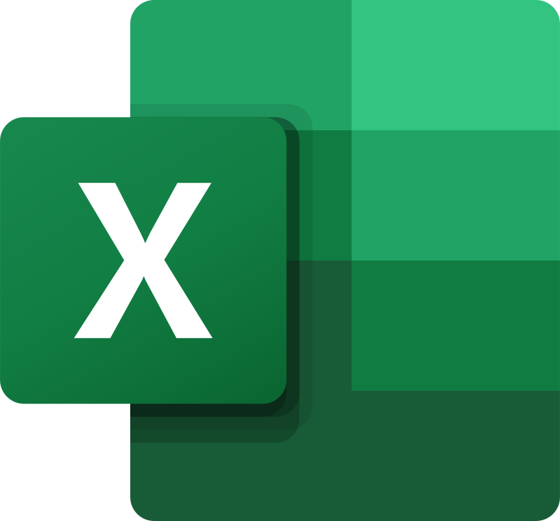
Solver tool in solving Optimisation problems
Solver is an add-in for Microsoft Excel used for advanced analysis and solving Optimisation problems;
It allows users to define multiple decision variables, constraints, and objectives, and then employs various mathematical methods to find optimal solutions;
  The Optimisation model consists of three elements:
    objective cells (objective function);
    variable cells (decision variables);
    constraint cells.
Source: Bomba & Kwiecień, 2012, Mason, 2013; MacDonald, 1995; Mason, 2012; Baj-Rogowska, 2013

Slide 30
Solver tool in solving Optimisation problems
Solver allows the user to select the appropriate method depending on the characteristics of the problem to be solved. The main methods include:
  Simplex Method (Simplex LP);
  GRG Method (Generalised Reduced Gradient);
  Evolutionary Method;
  Integer Constraints.
Co-funded by the European Union
Views and opinions expressed are however those of the author(s) only and do not necessarily reflect those of the European Union or the National Agency (NA). Neither the European Union nor NA can be held responsible for them.
Source: Baj-Rogowska, 2013; Delgado-Aguilar et al., 2018; Węgrzyn, 2013

Slide 31
Optimising the use of warehouse space – an example of using the Solver tool
The Alfa company has a warehouse with a total area of 10,000 m², which must accommodate three types of products: A, B and C. Each of these products has different requirements for warehouse space, has its own specific safety stock and generates different profits per product unit:
  product A: requires 14 m² per unit, safety stock is 40 pcs., generates a profit of 30 Euro;
  product B: requires 12 m² per unit, safety stock is 60 pcs., generates a profit of 32 Euro;
  product C: requires 18 m² per unit, safety stock is 90 pcs., generates a profit of 23 Euro.
Source: own elaboration

Slide 32
Optimizing the use of warehouse space – an example of using the Solver tool
Products A, B and C go to markets X, Y and Z. The total demand for all products in the markets is:
  market X: 220 pcs.
  market Y: 230 pcs.
  market X: 332 pcs.
How many units of each product should be held in the warehouse to maximise the total profit from the warehouse space used without exceeding the total warehouse space available, assuming that Alfa meets all demand?
Source: own elaboration

Slide 33
Optimising the use of warehouse space – an example of using the Solver tool
Solution:
  Objective function: maximising the total profit from products.
  Constraint: size of warehouse space, storage space for a unit of product, volume of market demand.
Put data in MS Excel Sheet and use Solver tool to calculate How many units of each product should be held in the warehouse
Source: own elaboration

Slide 34
Summary
Optimisation in logistics is the process of finding the most effective way of organising the flow of goods, information, and resources throughout the entire supply chain;
In the context of the supply chain, the warehouse have an extremely important role;
Inventory management in the supply chain is a key element that ensures operational fluidity, cost minimisation, and customer satisfaction;
DRP – coordinates demand with inventory levels in various locations;
EOQ is a mathematical model used to determine the optimal order quantity that minimises the total costs associated with ordering and holding inventory;
Solver allows users to define multiple decision variables, constraints, and objectives, and then employs various mathematical methods to find optimal solutions.
Co-funded by the European Union
Views and opinions expressed are however those of the author(s) only and do not necessarily reflect those of the European Union or the National Agency (NA). Neither the European Union nor NA can be held responsible for them.

Slide 35
Authors:
Katarzyna Grzybowska
Katarzyna Ragin-Skorecka
Katarzyna Siemieniak
Piotr Cyplik
Michał Adamczak
Jędrzej Jankowski-Guzy
Adrianna Toboła-Walaszczyk
Final version: June 2025

Slide 36
Thank you for your attention

