Slide 1



Advanced using of spreadsheet to analyse logistics data
Introduction to spreadsheet analysis
Lecture
BAS4SC
Business Analytics Skills
for the Future-proof Supply Chains
Co-funded by the European Union
Views and opinions expressed are however those of the author(s) only and do not necessarily reflect those of the European Union or the National Agency (NA). Neither the European Union nor NA can be held responsible for them.
Project number – 2022-1-PL01-KA220-HED-000088856

Slide 2
Agenda
basic information;
the importance of data for logistics;
data analysis;
spreadsheet and its application.

Slide 3
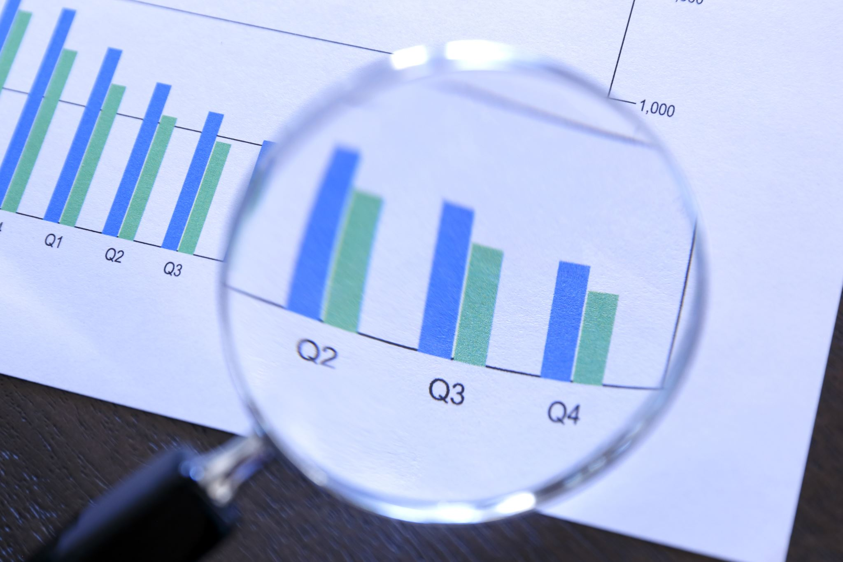
Basic information
Data management:
  Data is a resource that is treated as an enterprise's asset, which is not only of operational or tactical importance, allowing for the efficient handling of its current activities, but increasingly strategic, enabling development and keeping up with the ever-growing competition on the market.
Source: Szymonik, 2010

Slide 4
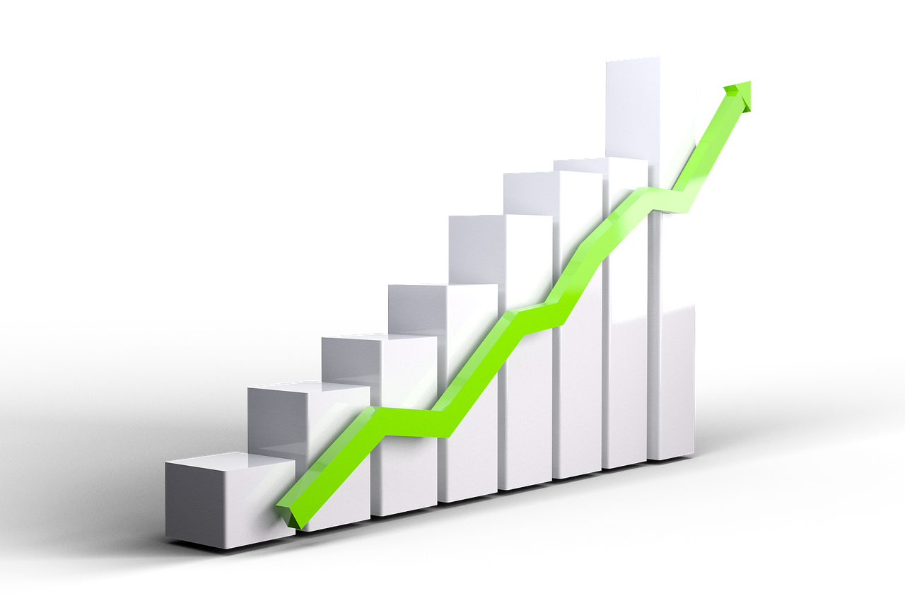
Basic information
Data management:
  Modern organisations (enterprises, institutions) operate in an increasingly complex information environment with a dynamic development of the information services sector;
  The number of sources of obtaining useful information is increasing.
Source: Szymonik, 2010

Slide 5

Basic information
Data management:
  Establishing and strengthening the special character of information as a production factor. Data is a special resource due to its specific general properties, i.e., intangible nature, susceptibility to distortion, etc., diversity of functions and great diversity.
Source: Szymonik, 2010

Slide 6

Basic information
Data management:
  Dynamic development of information technologies and their applications in the practical implementation of information processes;
  The use of modern information technologies in the implementation of information processes gives rise to specific areas and problems of data management and analysis for specific technologies and adopted detailed IT solutions.
Source: Szymonik, 2010

Slide 7
Data analysis and management
Data analysis and management include the following activities:
  constituting the information function of the enterprise, i.e. acquiring, storing, processing, sharing and using information;
  within the planes (technological, organizational, human resources) influencing the implementation of this function.
Source: Szymonik, 2010

Slide 8
Qualitative information characteristics
Qualitative information characteristics include:
  relativity – information meets the needs and is important for the recipient;
  accuracy – information is adequate to the level of knowledge represented by the recipient, precisely and exactly reflects and defines the topic;
  up-to-date – the update cycle is consistent with the content and the pace of change;
  completeness – information contains an optimal and sufficient amount of data to transform the information into specific knowledge, and its level of detail depends on the needs of the recipient;
Source: Szymonik, 2010

Slide 9
Qualitative information characteristics
Qualitative information characteristics include:
  consistency – individual data harmonises with each other, the form corresponds to the content, data updating is consistent with the goals;
  appropriateness – appropriate presentation of information and description for presentation, enabling correct interpretation;
  availability – information is available from anywhere and at any time,
  credibility – the information confirms the truthfulness of the data and contains elements ensuring the reliability of the message;
  congruence – information is consistent with other information, interpreted in the appropriate context, functioning in a familiar communication system.
Source: Szymonik, 2010

Slide 10
The importance of data for logistics
In theory, the term logistics is not clearly defined (there is some duality). There is no single definition of logistics accepted so far;
The Association of American Logisticians - Council of Logistics Management proposed a definition that is widely used in the USA:
  ”Logistics is the process of planning, implementing and controlling the efficient and effective economic flow of raw materials, production materials, finished goods and services and relevant information from the point of origin to the point of consumption in order to meet customer requirements”.
Source: Szymonik, 2015

Slide 11

The importance of data for logistics
The European Logistics Association has adopted the following definition:
  ”Logistics is a concept covering the organisation, planning, control and implementation of the flow of goods from the places of their production (purchase) through the sphere of production and distribution to the final recipient, the aim of which is to meet the needs of the market, with minimum costs and minimum capital involvement”.
Source: Szymonik, 2015

Slide 12
Logistics definition
Logistics is the process of physical flow of goods/services and information accompanying these processes;
Logistics is a concept of integrated management of the system of flow of goods/services and information;
Logistics is an interdisciplinary field of knowledge, the subject of which is the study of regularities and phenomena occurring during the flow of goods and information along the entire supply chain.
Source: Szymonik, 2015

Slide 13
The importance of data for logistics
The essence of logistics is the flow of material goods and services from their place of origin to the final recipient (consumer);
In a traditionally managed company, data analyses and reports are carried out by many departments based on various types of systems and IT tools;
One of the areas of logistics in which managed information makes operations efficient and effective is the supply chain;
Modern logistics needs not only data and information, but also knowledge.
Source: Szymonik, 2010; Szymonik, 2015

Slide 14
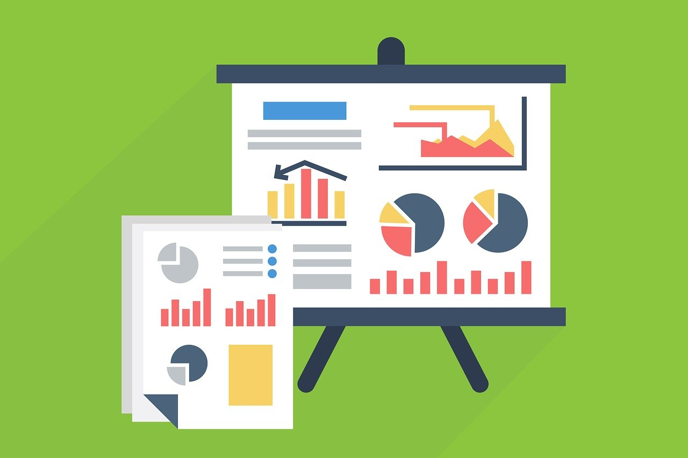
Data definiton
Data are sets of values collected from various sources such as databases, text files, spreadsheets, websites, opinion polls, which convey information describing quantity, quality, fact, statistics, other meanings or sequences of symbols that can be further interpreted and processed.
Source: Dembowska, 1979; Strefakursów, 2023

Slide 15
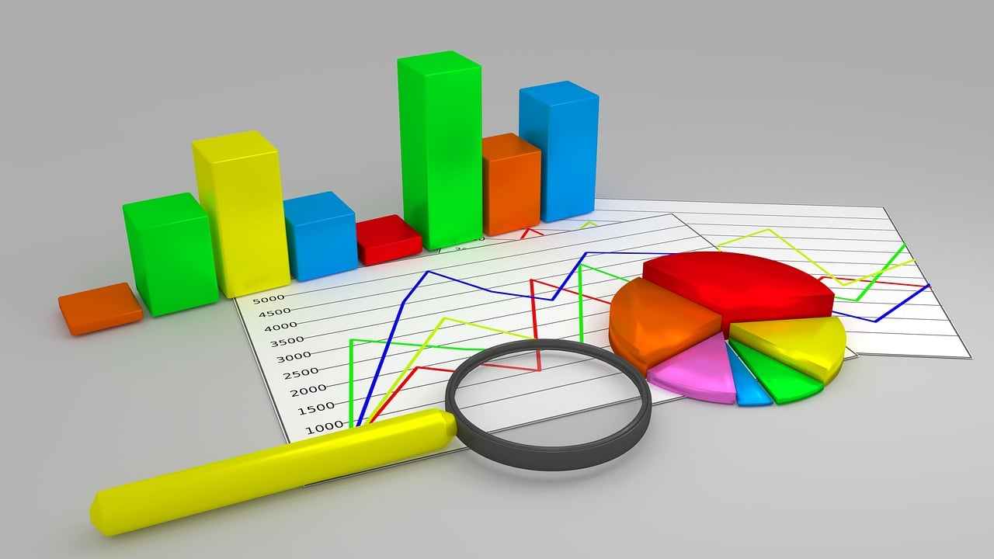
Data analysis
Data analysis is the process of examining, interpreting and presenting information collected from various sources;
Using a variety of techniques and tools, data scientists turn raw data into actionable information that helps enterprises make decisions, identify trends, and solve problems.
Source: Strefakursów, 2023

Slide 16
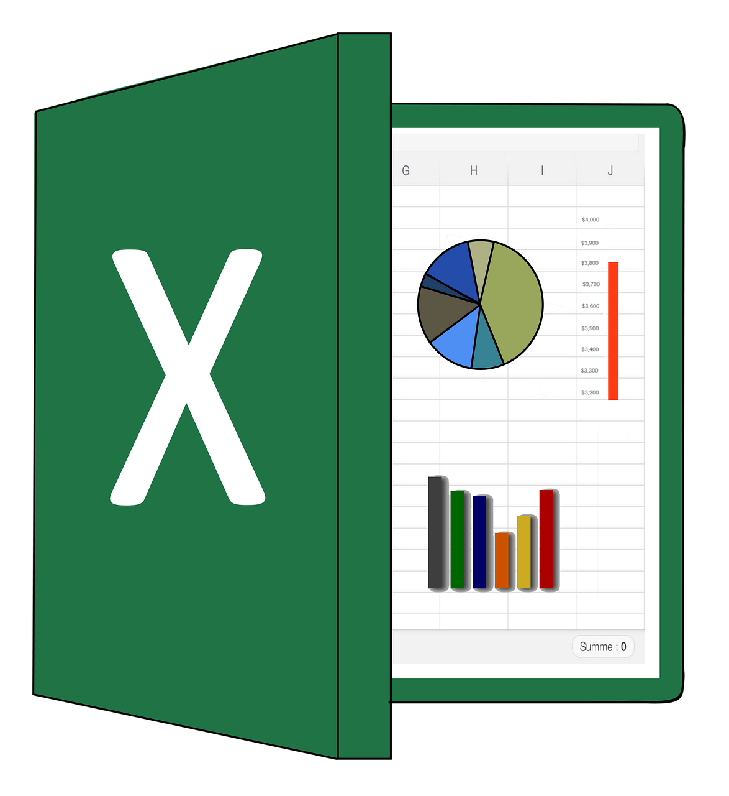
Spreadsheet and its functions
A spreadsheet is a computer program used to perform various types of calculations, often very complex ones;
Spreadsheets are used to present data, mainly numerical, in the form of a set of tables that allow automatic processing of this data, its analysis and presentation in various ways, e.g., in the form of various types of charts, ranging from simple line charts, through pie charts and bar charts, to eye-catching bubble charts;
Source: XBlue.pl, 2023

Slide 17
The most important capabilities of spreadsheets
creating charts
data analysis
performing calculations
preparing offers
presentation of results
creating reports and summaries
Source: XBlue.pl, 2023

Slide 18
The most important tools provided by spreadsheets
Microsoft Excel files are called workbooks;
A workbook consists of one or more worksheets;
The sheet is divided into columns, located vertically, and rows, arranged horizontally;
The basic element of a spreadsheet is a cell, which is a small rectangular area whose unique address, called a reference, is created as a result of the combination of the column header letter and the number being the row number at the intersection of which it is located.
Source: XBlue.pl, 2023

Slide 19
The most important tools provided by spreadsheets
You can enter numerical or text data into each cell, or a formula (e.g., =A8+C11 or =(F14‐E10)*12, etc.) in the worksheet, which allows you to calculate a given value based on the contents of the cells;
It may contain the addresses of these cells, mathematical symbols and more advanced operations such as functions;
A spreadsheet function, in turn, is an algorithm specially designed by the program's creators, as well as ready-to-use formulas that allow you to perform specialised calculations or search for specific values.
Source: XBlue.pl, 2023

Slide 20
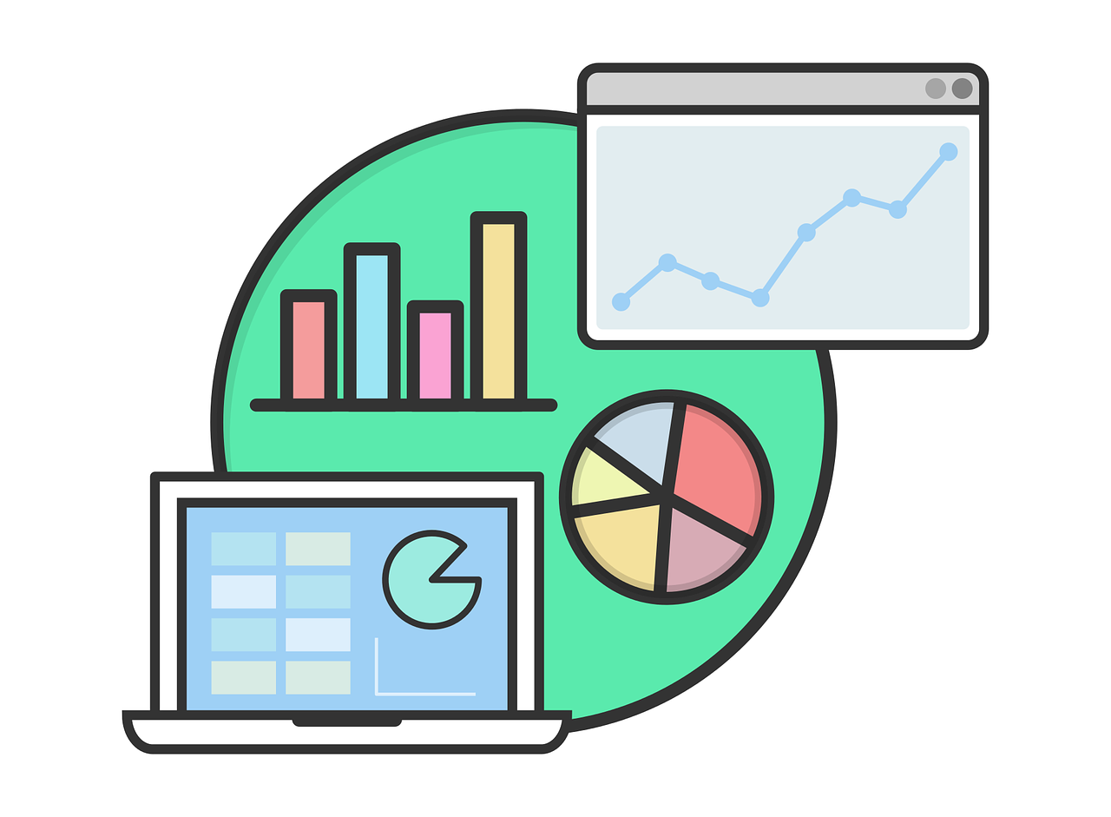
The most important tools provided by spreadsheets
Spreadsheet software can present the collected data or calculation results using charts;
Advanced spreadsheet programs are able to generate many different types of charts, which can be used for statistical purposes, optimisation of a given process or visualisation of changes planned to be implemented in the organisation.
Source: XBlue.pl, 2023

Slide 21
The most important tools provided by spreadsheets
Such a large selection of tools from this category allows for the most readable imaging of many different types of data;
Another way to clearly visualise numbers in a spreadsheet is through pivot tables - an analytical tool in which can freely rearrange the information contained in them;
Thanks to the use of a pivot table, it is possible to freely reconstruct rows and columns so that the resulting table form is more clear or more clearly indicates specific data that the user wants to highlight;
Knowledge of this spreadsheet function is essential when creating summaries and reports.
Source: XBlue.pl, 2023

Slide 22



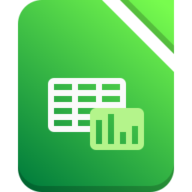




The most frequently used spreadsheets
Most popular spreadsheet applications:
  MS Excel;
  Google Sheets;
  Zoho Sheet;
  LibreOffice Calc;
  CryptPad Sheet;
  Smartsheet;
  Quip;
  Airtable.
Source: https://zapier.com

Slide 23
The most frequently used spreadsheets
The most popular and most frequently used spreadsheet by enterprises and educational institutions is Excel, which is part of the Microsoft Office package;
It offers a very extensive range of tools and is constantly updated and improved;
Since it is a paid tool, the Libre Office spreadsheet Calc is also often used as an alternative to Excel;
This program is very similar to a Microsoft Office product, but it lacks some more advanced functionalities, which makes it more likely to be used for personal purposes and by students.
Source: XBlue.pl, 2023

Slide 24
Summary
Logistics is the process of physical flow of goods/services and information accompanying these processes;
A spreadsheet is a computer program used to perform various types of calculations, often very complex ones;
Spreadsheets are used to present data, mainly numerical using table and charts that can be really useful in data management of logistics and supply chain processes;
There are many simple data analysis tools spreadsheets that can be used for logistics data management;
One of the most frequently used spreadsheets is MS Excel.

Slide 25
Authors:
Katarzyna Grzybowska
Katarzyna Ragin-Skorecka
Katarzyna Siemieniak
Piotr Cyplik
Michał Adamczak
Jędrzej Jankowski-Guzy
Adrianna Toboła-Walaszczyk
Final version: June 2025

Slide 26
Thank you for your attention

